Slide 1

Notes:
Welcome, we’re waiting for folks to come on in. You will need to manually connect to audio and video. If you’re having trouble hearing, call in.

Slide 2

North Carolina Council for women & youth involvement
www.councilforwomen.nc.gov

Slide 3
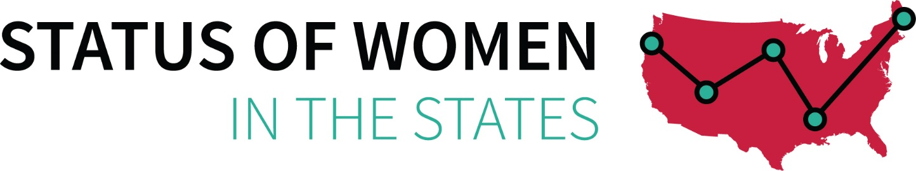


North Carolina
www.iwpr.org | www.statusofwomendata.org |@IWPResearch
Notes:
I’ll start by sharing a little bit about the Institute for Women’s Policy Research, or IWPR. Founded 30 years ago by economist Dr. Heidi Hartmann, IWPR is a D.C. think tank focusing on the analysis of public policy through a gendered lens. We work with policymakers, scholars, and advocacy groups to conduct research on economic and social policy issues affecting women and families and we strive to build a network of individuals and organizations that conduct and use women-oriented policy research.

Slide 4
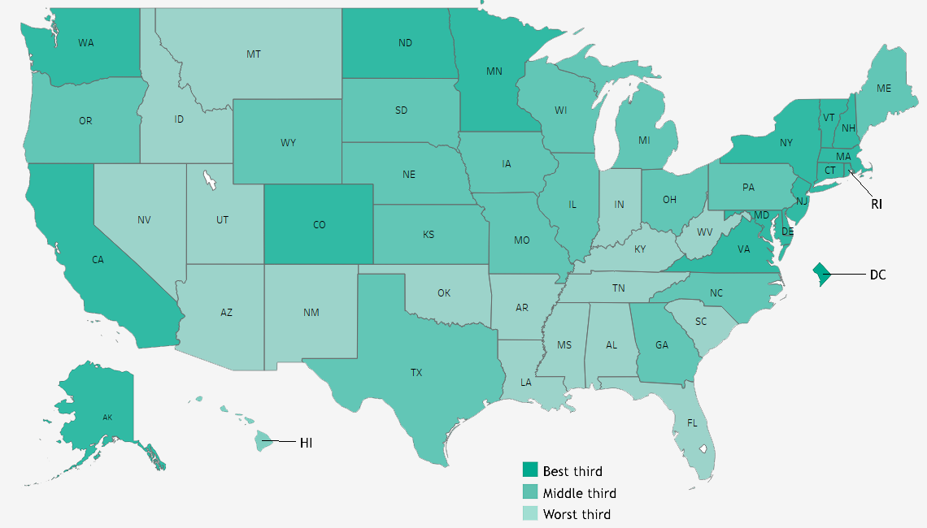
How the States Measure Up: Employment & Earnings Composite Index
Source: Institute for Women’s Policy Research
Notes:
Let’s talk about the status of women.
North Carolina is in the middle-third of the country when it comes to women’s employment and earnings overall. Think about what letter grade this might mean our home state would receive on its Employment & Earnings Report Card.

Slide 5


North Carolina’s Employment & Earnings
Report Card
National
Rank
Women’s Median Annual Earnings $36,400 32
Earnings Ratio Between Women and Men 80.9% 18
Share of Women in the Labor Force 57.3% 36
Women in Managerial or Professional Occs 41.6% 23
EMPLOYMENT & EARNINGS COMPOSITE C 31
Notes:
If you guessed “C”, you’re right.
To grade each state on the status of women in the area of employment and earnings, we look at four factors: median annual earnings for women who work full-time, year-round; the earnings ratio between women and men employed full-time, year-round; the percent of women in the labor force; and the percent of employed women who work in managerial or professional occupations.
As you can see from the national rankings, North Carolina ranks in the middle third for three out of four of these indicators, and in the bottom third for the share of women in the labor force. Overall, North Carolina earns a C in the area of Employment & Earnings, a big improvement from the D that the state received more than ten years ago; during that time, the state’s ranking rose from 37th to 31st.
So I’ll touch on each of these areas in a bit more detail:

Slide 6
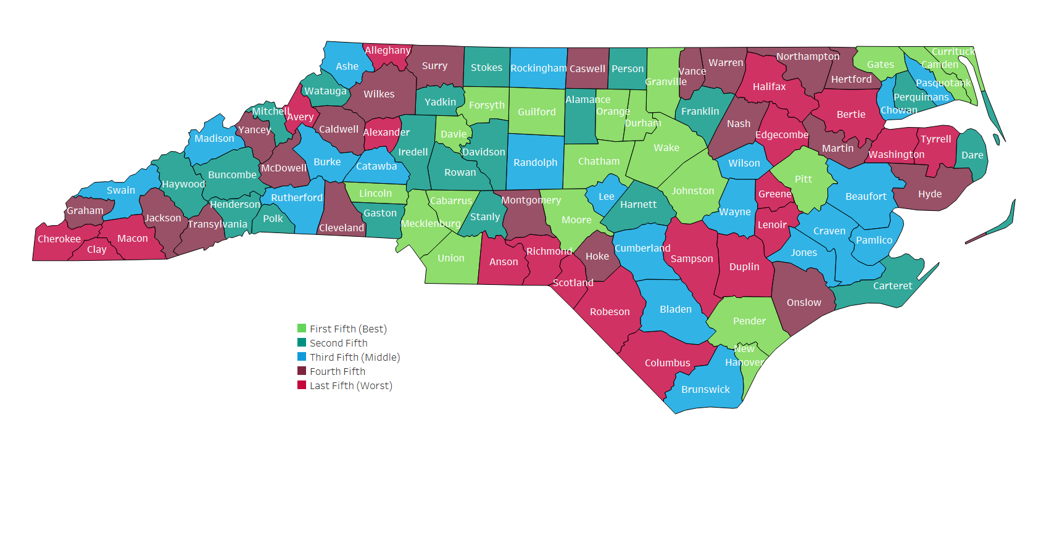
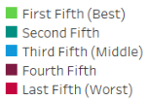
Women’s Earnings Are Rising…
Women’s Highest Earnings
Orange $47,555
Wake $45,293
Durham $44,248
Camden $42,409
Chatham $41,972
Women’s Lowest Earnings
Sampson $28,540
Robeson $28,049
Alleghany $26,905
Clay $26,329
Washington $24,976
Note: Median earnings in the past 12 months for those aged 16 and older who worked full-time, year-round.
Source: IWPR analysis of data from the U.S. Census Bureau, 2012-2016 American Community Survey 5-year Estimates, accessed through American Fact Finder.
Notes:
Comparing North Carolina counties, on one end of the spectrum there is one county, Washington, where women earn less than $25,000, and on the other end there are eight counties, where women earn more than $40,000 annually, with the highest earnings, over $47,000, in Orange County.
The state has nine counties where women who work full-time, year-round earn less than 75 percent of what men earn.

Slide 7
…But progress on closing the wage gap is slow
North Carolina Women Will Not See Equal Pay Until…
2019 2020 2021 2022 2023 2024 2025 2026 2027 2028
2029 2030 2031 2032 2033 2034 2035 2036 2037 2038
2039 2040 2041 2042 2043 2044 2045 2046 2047 2048
2049 2050 2051 2052 2053 2054 2055 2056 2057 2058
2059
2060
Notes:
In addition to women’s rising wages, some other good news is that the wage gap in the state is narrowing. In 2002, the wage gap between women and men working full-time, year-round was 26 percent, but by 2016 it had narrowed to 19 percent, meaning women earned about 81 cents for every dollar earned by men [MAE for FTYR men in 2016, $45,000].
But, despite the improvement, if earnings trends continue at the same rate as they have since 1959, women in North Carolina will not have pay equal with men till 2060.

Slide 8

I’ll be a 64 year old by 2060!!

Slide 9
If Women Were Paid the Same as Comparable Men, It Would Equal nearly $16 Billion
If working women in North Carolina were paid the same as comparable men, women’s average earnings would increase by
$6,628
Added up across all working women in North Carolina,
this would amount to an earnings increase of
$15,600,000,000
Notes:
If working women in North Carolina aged 18 and older were paid the same as men of their same age, level of education, number of work hours, and urban or rural residency, women’s average earnings would increase by about $6,600, a raise of over 19 percent. Added up across all working women in the state, this would amount to an earnings increase of $15.6 billion, which is equivalent to 3.0 percent of the state’s gross domestic product in 2016.

Slide 10
Hispanic women make less than half of White men’s earnings
  Women’s Median Annual Earnings by Race/Ethnicity & the Earnings Ratio
Ratio with 81.5% 80.7% 65.1% 62.1% 62.1% 48.9%
White Men
Notes: For full-time, year-round workers aged 16 and older. Racial groups are non-Hispanic.
Source: IWPR analysis of 2014-2016 American Community Survey microdata (IPUMS, Version 6.0).
Notes:
Up to this point we’ve been talking about earnings for women overall. But women’s earnings vary widely by race and ethnicity.
Asian/Pacific Islander and White women in the state have the highest median earnings, over $40,000 annually. Black and American Indian women, as well as women who are multiracial or of another race earn, about $31,000 or $32,000, while Hispanic women earn substantially less—about $24,000 a year.
When we compare the earnings of women with White men’s earnings, there is a much larger wage gap for Hispanic women, who earn less than half of what White men earn.

Slide 11
Women need more education than men to secure good-paying jobs
  Median Annual Earnings and the Gender Earnings Ratio by Education
Notes: Full-time, year-round workers aged 25 and older.
Source: IWPR analysis of 2016 American Community Survey microdata (Integrated Public Use Microdata Series, Version 6.0).
Notes:
For both women and men, higher education leads to higher earnings. If we just look at the green bars for women, we can see a steady increase in earnings with each step in education, and a similar pattern for men.
But the $74,000 for men with a bachelor’s degree or higher, which is such a big increase, clues us into something else going on. Higher education does not erase the wage gap.
When you compare women and men with the same level of higher education, the wage gap is actually largest for those with a bachelor’s or advanced degree—women with this level of education earn about 68 percent of what men earn.
In fact, women who complete high school earn less than men who do not, and women who attend some college or receive an associate’s degree earn less than men whose highest level of education is high school. These data indicate that women in North Carolina need more educational qualifications than men to secure good-paying jobs.

Slide 12
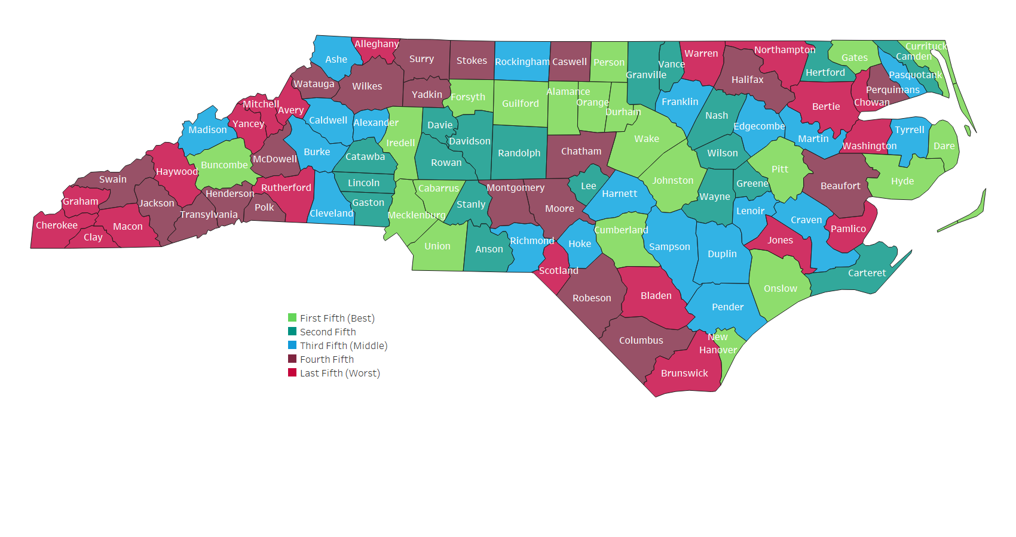
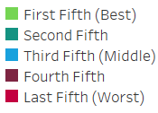
Women’s Labor Force Participation Rate In North Carolina is in the Bottom Third
Women’s Highest LFP Rate
Mecklenburg 65.9%
Durham 65.7%
Dare 65.3%
Wake 64.8%
Orange 62.9%
Women’s Lowest LFP Rate
Washington 45.1%
Mitchell 45.0%
Clay 43.8%
Cherokee 42.0%
Graham 40.3%
Note: Aged 16 and older.
Source: IWPR analysis of data from the U.S. Census Bureau, 2012-2016 American Community Survey 5-year Estimates, accessed through American Fact Finder.
Notes:
The labor force participation rate for women in North Carolina is 57 percent, earning the state a ranking of 36th in the country, and the percent of women in the labor force has dropped since 2002, when it was 60 percent.
There is pretty wide variation in women’s labor force participation across the state. In 31 counties, less than half of women aged 16 and older are in the labor force, with the lowest rate of 40 percent in Graham County. At the other end, there are nine counties with more than 60 percent of women in the labor force—Mecklenburg has the highest rate of 66 percent.
It’s also interesting to note when you look at the boxes with the highest and lowest counties that three of the counties with high labor force participation—Orange, Wake, Durham—also had the highest earnings for women. Clay is one of the counties with the lowest percent of women in the labor force, and it had some of the lowest earnings.

Slide 13
Women’s Labor Force Participation Varies by Race and Ethnicity
  Labor Force Participation Rate By Gender And Race/Ethnicity
Notes: Aged 16 and older. Racial groups are non-Hispanic.
Source: IWPR analysis of 2014-2016 American Community Survey microdata (IPUMS, Version 6.0).
Notes:
For every racial and ethnic group except Black women and men, men are more likely to be in the labor force than their female counterparts. Among North Carolina women, Black women are the most likely to be in the labor force, at about 63 percent, followed closely by women of another race or two or more races, at 61 percent. American Indian and White women have the lowest labor force participation rates.
[Part of the explanation for the disparity between Black women and men may be that Black men are the only racial or ethnic group with a higher unemployment rate in North Carolina than women of the same race or ethnicity.]

Slide 14

Women of Color in North Carolina
Among women, Black women have the highest labor force participation rate at 62.5% yet make on average $8,205 less than white women
Of Black women employed, 33.2% are in managerial or professional occupations; for Hispanic women, 20.7% are in these positions
What does this mean?
Less likely to have paid time off and health benefits
More likely to spend money on short term investments (e.g., childcare) than long term investments (i.e., child’s supplementary education including test prep and tutoring)
Source: Institute for Women’s Policy Research

Slide 15
2 in 3 mothers of young kids are in the labor force
  Labor Force Participation of Parents
Notes: For parents aged 16 and older. Children under age 18 include children under age 5.
Source: IWPR analysis of 2016 American Community Survey microdata (IPUMS, Version 6.0).
Notes:
In North Carolina, while fathers of children under age five are slightly more likely to be in the labor force than those with children under age 18, the reverse is true for mothers. Only two-thirds of mothers with children under five are in the labor force, while nearly three-quarters of mothers with children under 18 are employed.

Slide 16
More than Two in Five Employed Women Are In Managerial Or Professional Occupations
  Share in Managerial/Professional Occupations By Gender And Race/Ethnicity
Note: Aged 16 and older. Calculated using three years of data (2014-2016). Racial groups are non-Hispanic..
Source: IWPR analysis of data from the U.S. Census Bureau, 2010-2014 American Community Survey 5-year Estimates, accessed through American Fact Finder.
Notes:
Nearly 42 percent of employed women in North Carolina work in managerial or professional occupations, which include a range of jobs, such as managers, lawyers, doctors, nurses, teachers, accountants, engineers, and software developers, that typically require at least a four-year degree and that generally have high earnings and are likely to provide employment benefits.
A larger share of employed women are in these positions than employed men, and the share of employed women in professional or managerial roles has been increasing.
Although Asian/Pacific Islander and White women in North Carolina have lower labor force participation rates than women from most other racial or ethnic groups, they are more likely to be employed in managerial or professional occupations. Similarly to the disparities in earnings for Hispanic women, we can see that they are much less likely to be in managerial or professional roles than other women.

Slide 17
What Can Be Done –
Policy Recommendations
Enforce existing fair labor standards and strengthen protections for those who discuss their pay.
Bar employers from considering salary history in determining starting wages.
Require employers to formalize and make available criteria for hiring, compensation, and promotion.
Increase the minimum wage, and extend labor protections to domestic workers.
Encourage employers to conduct audits of employee salaries and address disparities.
Pass paid sick and safe days, paid family and medical leave, and predictable schedules legislation.
Expand publicly-funded child care and early education, and raise the threshold for child care subsidy eligibility.
Support women business owners.
Actively reach out to and support women pursuing careers in technical and nontraditional fields.
Discuss earnings and growth potential of different fields of study and occupations when advising girls and women on careers.
Notes:
Now that I’ve quickly touched on the employment and earning picture for women in North Carolina, I want to talk about several policies and strategies that lawmakers, employers, funders, and advocates could implement to reduce barriers and continue to improve economic equity and stability for North Carolina’s women.
Several steps could narrow the gender wage gap, especially the very large gap experienced by some women of color:
Proactively enforce existing legislation regarding fair labor standards and strengthen protections against retaliation for those who discuss their pay. The fact is that many people have no idea if they are being underpaid relative to comparable employees, and they should not face backlash for inquiring.
Pass legislation that bars employers from requiring potential employees to submit previous salary history, which can perpetuate wage inequality. The issue is that if a person is underpaid in a job, but their pay at subsequent jobs is using that underpayment as a baseline, that can follow a person throughout their career, resulting in significant earnings loss. The ban shifts the onus on the employer to determine what the position is worth to them, regardless of the characteristics of the person who fills the job. This kind of ban is gaining momentum and a recent court case ruled that companies cannot justify lower pay for an employee based on previous salary.
In a similar vein, employers should be transparent about the criteria they use for hiring, setting wages, and promotion, to make sure that bias or discrimination are not influencing decisions.
Increase the minimum wage in North Carolina to improve economic security for women, who are disproportionately represented among low-wage workers, and include domestic workers in labor protections like overtime pay and minimum wage.
Encourage employers to do an audit of employee salaries. I think we’ve all heard examples of large corporations who were quite sure that they did not have a gender wage gap, but when they looked at the data, found that they did. It seems better to do that internal investigation preemptively, rather than in reaction to some a public accusation.
Like the vast majority of states, North Carolina has not passed paid leave legislation. Few low-wage workers in the state receive work-life supports such as paid sick and safe days, paid family and medical leave, and predictable schedules. Because women are more likely than men to have unpaid caregiving responsibilities, these benefits are vitally important to help women remain and advance in the workforce.
To support parents who are working, going to school, or in training, the state should expand publicly-funded child care and early education and raise the threshold for child care subsidy for child care eligibility.
Support women business owners through public and private sector investment in women-owned and minority-women-owned businesses and by providing technical assistance to women to help them to identify opportunities and financing to start or to grow their business. Compared with businesses owned by men, businesses owned by women are far more likely to have no start-up or expansion capital and, among those that do, most use their own personal or family savings. Addressing the lack of access to financing options could mitigate some of the risk of business ownership and encourage women, especially low-income women, to pursue business ownership as a path to financial stability.
Occupational segregation, where certain occupations are male-dominated and tend to be higher-paying, while others are female-dominated and lower-paying, is the single largest contributor to the gender wage gap. To tackle occupational segregation and get more women into higher-paying jobs, employers and stakeholders in workforce development should increase active outreach and support for women pursuing careers in technical and nontraditional fields.
At the same time, educators and counsellors should ensure that career advice for women and girls explicitly addresses the earnings and growth potential of different fields of study and occupations.
In many ways, North Carolina is making progress. The benefits of increasing the share of women in the labor force, continuing to close the gender wage gap, and increasing women’s representation in a wider range of occupations would allow more women and families to achieve economic security, reduce the number of people in poverty, and grow the state economy.

Slide 18


The Council for Women & Youth Involvement board recommends the following policies:
Expand publicly funded child care and early education.
Create policies to support work-life balance.
Support women business owners.
Advocate for employers to promote paid internships, training, apprenticeships, and recruitment for women in high-growth occupations with low female
participation.
Notes:
After reviewing policy recommendations:
Now we will be discussing what steps you can take to seek out and promote jobs for women in high-growth fields. Today, we’ll be hearing from Treka Spraggins and Terry Wall of the American Association for University Women, Carrie Bartek of Wake Technical Community College, and Candace Dudley of the Council for Women and Youth Involvement.

Slide 19
Treka Spraggins &
Terry Wall
What can you do to seek out high growth fields?
AAUW Raleigh-Wake County Branch President
AAUW Raleigh-Wake County Membership Chair

Slide 20
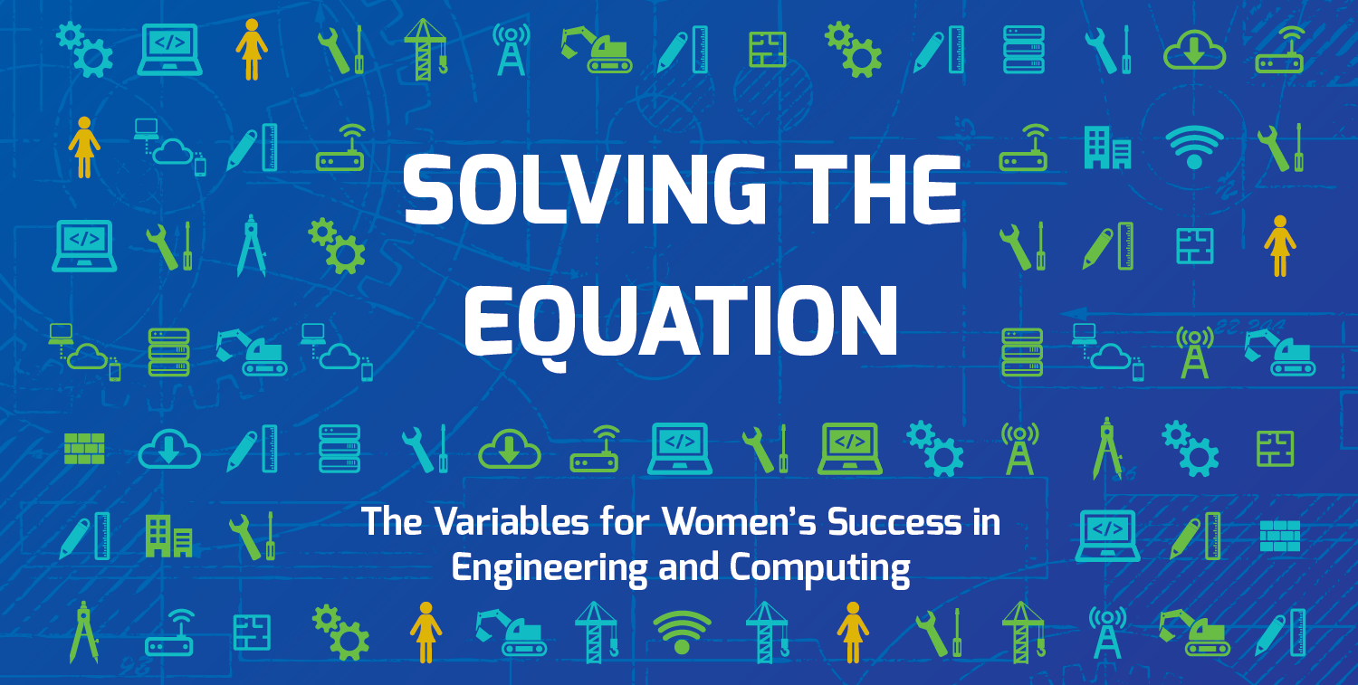
Solving the Equation
The Variables for Women’s Success in Engineering and Computing
Notes:
In this presentation, I will share with you key findings from AAUW’s latest research report, Solving the Equation: The Variables for Women’s Success in Engineering and Computing.
In less than 10 years, the United States will need more than 1.7 million additional engineers and computing professionals to fulfill demand.
Women are needed in these expanding fields. In addition to expanding the talent pool, women’s experiences — along with men’s experiences — should inform and guide the direction of engineering and technical innovation.

Slide 21
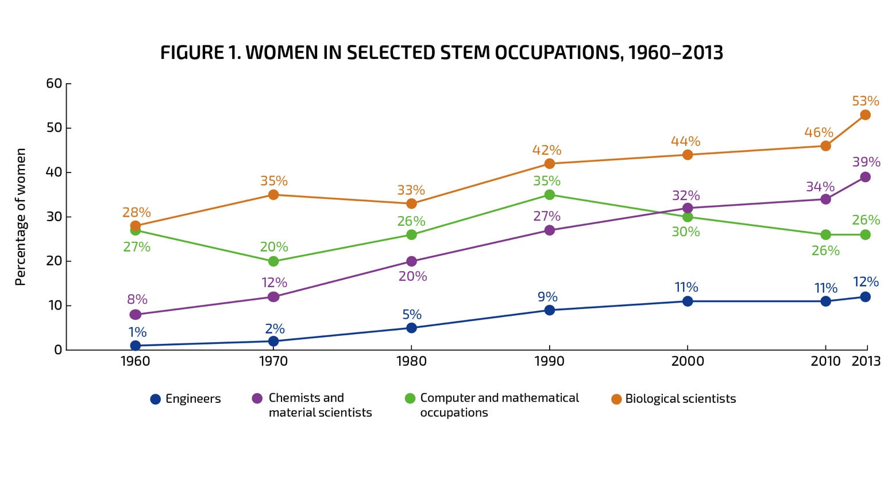
Notes:
Why focus on engineering and computing?
Engineering and computing occupations require less investment of time and money in education compared with many other STEM occupations.
At the same time, engineering and computing jobs tend to pay better than other STEM jobs — and other jobs overall. The average starting salary for individuals with a bachelor’s degree in engineering or computing was approximately $62,000 in 2014, tens of thousands of dollars higher than annual salaries among other recent college graduates.
Finally, engineering and computing offer better prospects than jobs in other STEM fields. Computing jobs in particular are predicted to grow dramatically over the next decade.
When women are not well-represented in these fields, they lose out on these high-quality job opportunities.
Engineering and computing have not kept pace with other historically male fields such as chemistry and biology. This chart shows the percentage of women in STEM professions between 1960 and 2013. The top orange line represents biological scientists; the purple line represents chemists and material scientists; the green line represents mathematical and computer scientists; and the blue line represents engineers.
In 1960, women made up 28 percent of working biological scientists, 27 percent of mathematical and computer scientists, 8 percent of chemists, and only 1 percent of engineers in the workforce.
Just over 50 years later in 2013, women made up just over half of working biologists and 39 percent of chemists but only 26 percent of working mathematical and computer scientists, a much smaller percentage than in 1990, when women made up 35% of working computer and mathematical professionals, and around the same percentage as in 1960. Finally, in 2013, women made up just 12 percent of engineers.
Figure 1 notes: Postsecondary teachers are not included. For biological scientists in the 1980 and 1990 censuses, data include life scientists as well as biological scientists. For chemical and material scientists in the 1960 and 1970 censuses, the category was titled “chemists”; in the 1980 and 1990 censuses, the category was titled “chemists except biochemists.” For computer and mathematical occupations in the 1960 census, no category for computer scientists was included; in the 1970 census, the category was titled “mathematicians and computer specialists”; and in the 1980, 1990, and 2000 censuses, the category was titled “mathematical and computer scientists.”
Figure 1 sources: AAUW analysis of data from U.S. Census Bureau (1960, 1970, 1980, 1990, 2000); L. M. Frehill analysis of data from U.S. Department of Labor, Bureau of Labor Statistics (2011, 2014b).

Slide 22
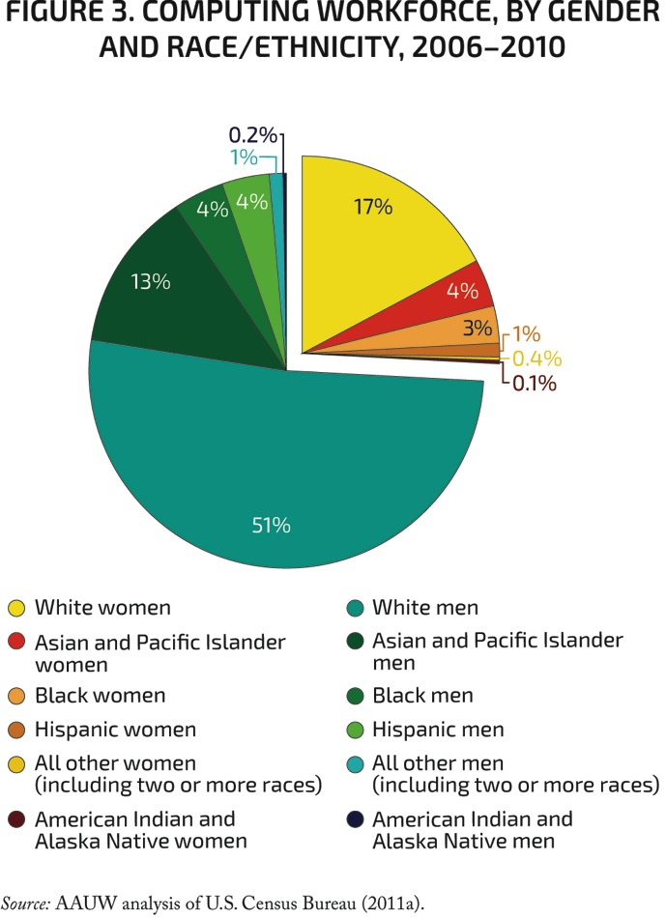
Women make up 26% of the computing workforce.
Notes:
Women overall are underrepresented in computing, and black and Hispanic women are particularly underrepresented.
The yellow, orange, and red sections of this chart represent women and the various shades of green sections represent men. Black women make up just 3 percent of computing professionals, and Hispanic women make up just 1 percent.
Figure 3 source: AAUW analysis of U.S. Census Bureau (2011a).

Slide 23
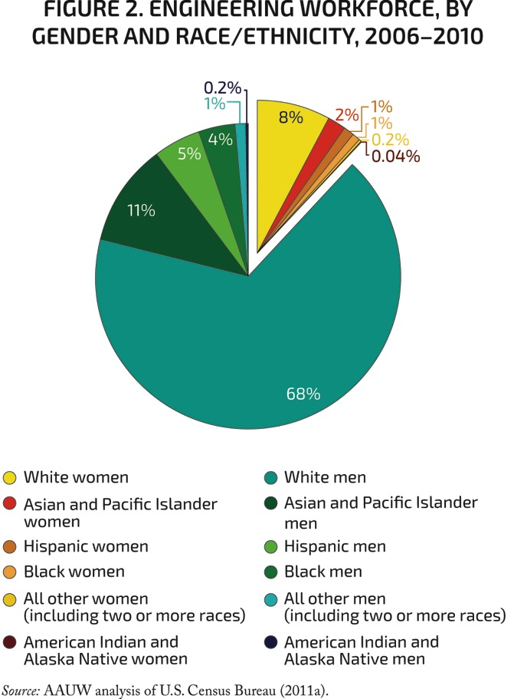
Women make up 12% of the engineering workforce.
Notes:
The story is similar in engineering, where women are even less well-represented than in computing, making up just 12 percent of working engineers.
Again, the yellow, orange, and red sections of this chart represent women, and the green sections represent men.
Black and Hispanic women each make up just 1 percent of the engineering workforce.
Figure 2 source: AAUW analysis of U.S. Census Bureau (2011a).

Slide 24
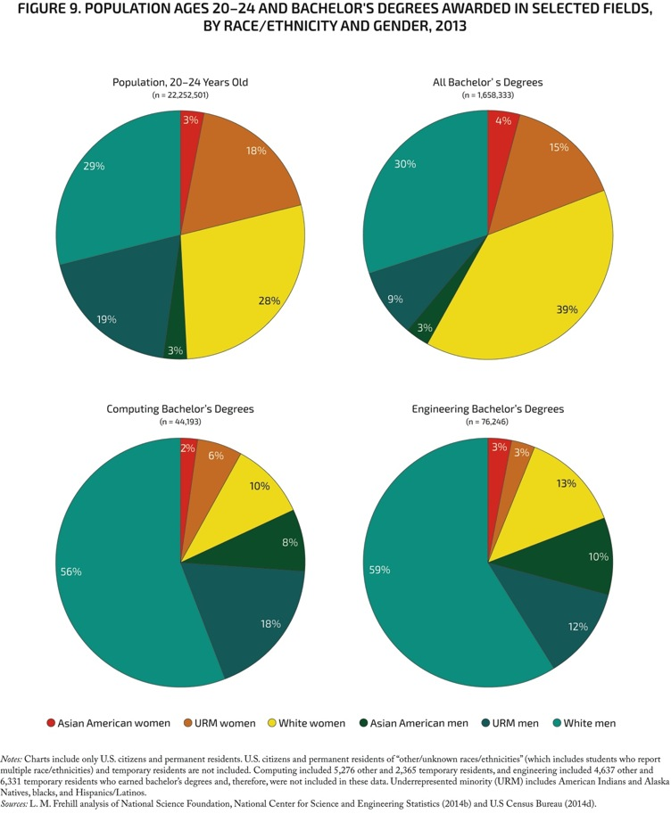
Many women of color are particularly underrepresented.
Notes:
Another way of looking at the issue of representation is in terms of bachelor’s degrees awarded compared with the overall population.
In the chart shown above, again, women are shown in yellow, orange, and red, and men are shown in green. Different racial/ethnic groups are shown in different shades.
White women made up 28 percent of the population ages 20 to 24 in 2013, but were awarded just 13 percent of bachelor’s degrees in engineering and 10 percent of bachelor’s degrees in computing that year.
The disparity is greater for many women of color. Although black, Hispanic, American Indian, and Alaska Native women together made up 18 percent of the population ages 20 to 24 in 2013, they were awarded just 6 percent of computing and 3 percent of engineering bachelor’s degrees conferred that year.
In contrast, men from these demographic groups made up 19 percent of the population ages 20 to 24 and were awarded 18 percent of computing bachelor’s degrees and 12 percent of engineering bachelor’s degrees.
Although men of some races and ethnicities are still underrepresented among those awarded degrees in these fields — and even more so in the engineering and computing workforce — men of every race and ethnicity are typically much closer to proportional representation than their female counterparts.
Figure 9 notes: Charts include only U.S. citizens and permanent residents. U.S. citizens and permanent residents of “other/unknown races/ethnicities” (which includes students who report multiple race/ethnicities) and temporary residents are not included. Computing included 5,276 other and 2,365 temporary residents, and engineering included 4,637 other and 6,331 temporary residents who earned bachelor’s degrees and, therefore, were not included in these data. Underrepresented minority (URM) includes American Indians and Alaska Natives, blacks, and Hispanics/Latinos.
Figure 9 sources: L. M. Frehill analysis of National Science Foundation, National Center for Science and Engineering Statistics (2014b), and U.S Census Bureau (2014d).

Slide 25
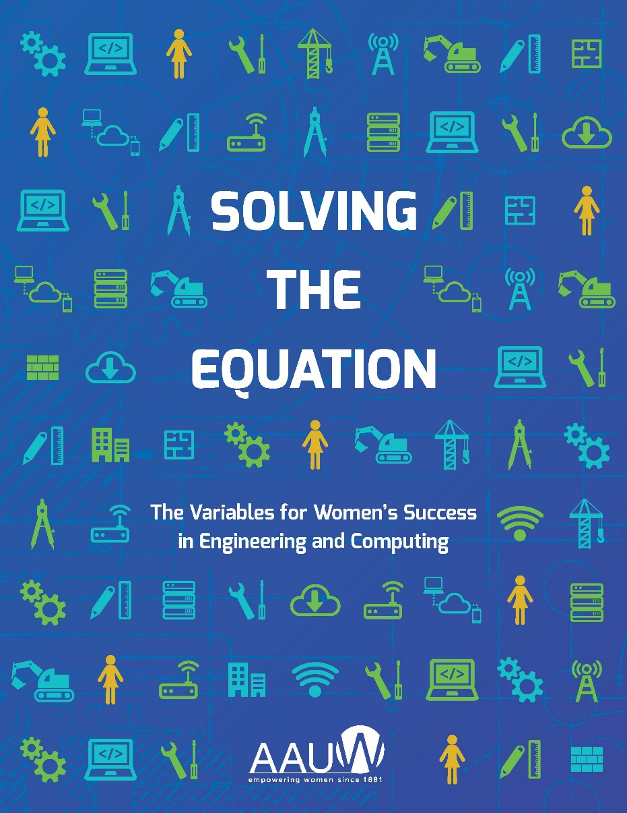
Notes:
What is it about engineering and computing that make them such male-dominated fields?
Drawing on a large and diverse body of research as well as interviews with top researchers, Solving the Equation highlights recent research that explores the factors behind the underrepresentation of women in engineering and computing in the United States. Each of the findings demonstrates that social and environmental factors contribute to the underrepresentation of women in engineering and computing and has practical applications.
The rest of this presentation will describe some of these research findings and provide recommendations for change.
25

Slide 26
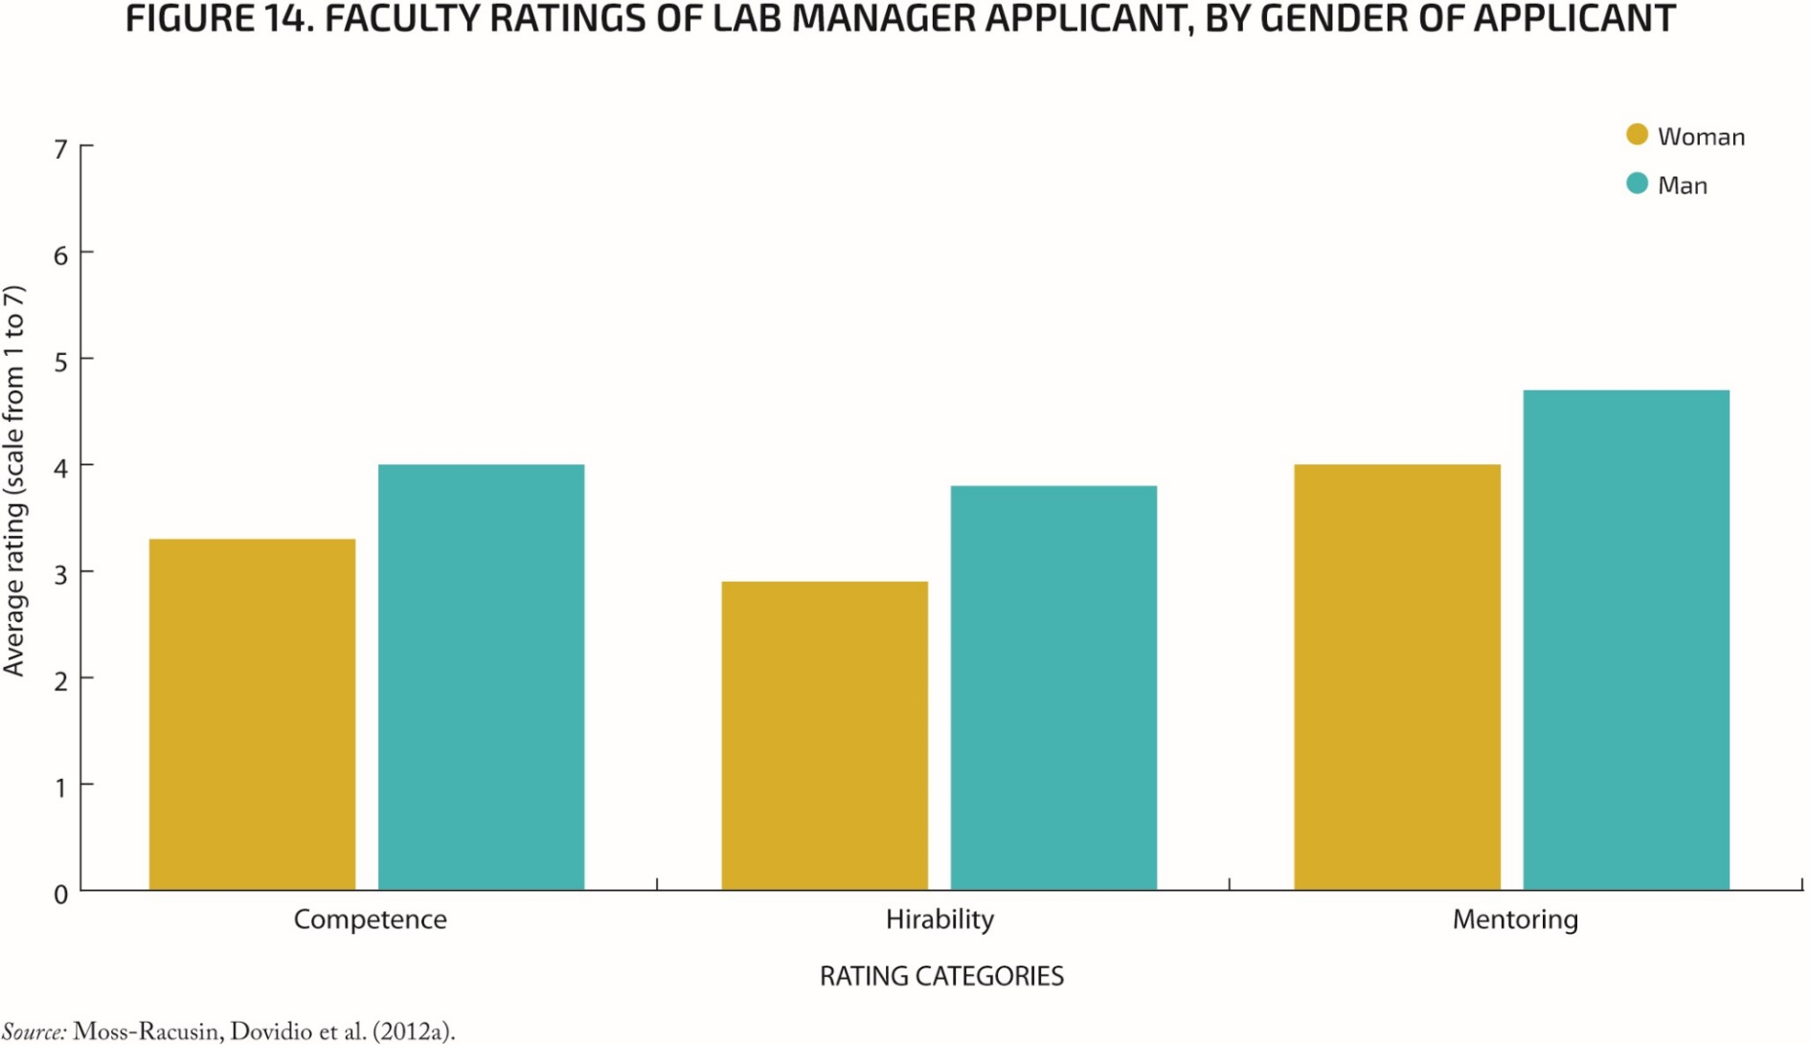
Notes:
Stereotypes and gender bias are the subject of several of the studies showcased in the report.
Dr. Corinne Moss-Racusin and her colleagues at Yale University asked faculty members in biology, chemistry, and physics departments at research universities across the country to provide feedback on an application for a student science-laboratory manager position.
Half of the science professors reviewed an application from a student named “Jennifer,” while the other half reviewed an identical application from a student named “John.”
The results were striking, as you can see in this chart. Ratings of male applicants are shown in blue and ratings of female applicants are shown in yellow.
Scientists — both women and men — viewed the female applicant as less competent and less hirable than the identical male applicant and were less willing to mentor the female candidate than the male candidate. Faculty members also indicated that they would offer less money to the woman than the man.
Looking further into the responses, the researchers found that scientists were less likely to hire a woman than an identical man because they viewed the woman as less competent, not because of some other potential reason such as workplace commitment
From hiring decisions to project assignments to promotions, the findings from this study reveal that female engineers and computing professionals are likely to be evaluated as less competent, less hirable, and less valuable than identically qualified male counterparts.
Figure 14 source: Moss-Racusin, Dovidio et al. (2012a).

Slide 27
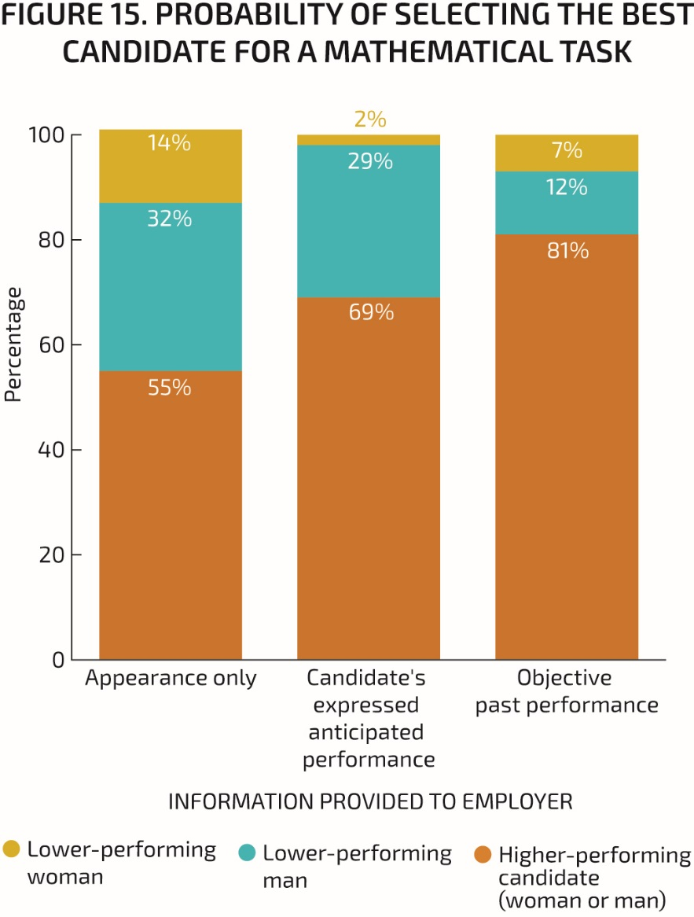
Notes:
A second finding related to gender bias comes from the research of Dr. Ernesto Reuben, a Columbia business school professor, and his colleagues, who conducted an interesting study providing evidence that in hiring situations, women are judged as less competent than men for mathematical tasks.
In a laboratory experiment, individuals performed a math task on a computer, summing as many sets of four two-digit numbers as possible during a four-minute period, and were given their score.
The participants were then told that they would perform the same task a second time and were asked to estimate how many questions they would answer correctly.
Before the second task began, two participants were chosen randomly to act as job candidates. They walked to the front of the room carrying “Candidate A” and “Candidate B” signs, while the remaining participants acted as employers, tasked with hiring one of the two candidates to perform the second math task. If employers chose correctly — that is, actually chose the candidate who performed better than the other candidate on the second math task — they received increased compensation for the study.
After the employers made their hiring decision, the experiment was repeated a number of times with other randomly chosen job candidates. Employers chose candidates from pairs representing any combination of women and men including same-sex pairs to avoid making gender overly obvious as a factor in employers’ decisions; however, the researchers analyzed data only from the instances in which the two candidates in the pair were of different genders.
In phase one, employers were asked to choose between the two candidates based only on the applicants’ appearance. As might be expected, when basing a hiring decision purely on appearance, employers frequently made bad hiring decisions, selecting the higher-performing candidate only about half (55 percent) of the time.
The bad hiring decisions were not gender neutral. Employers were more than twice as likely to choose the man as they were the woman when they made a bad hiring decision, choosing the lower-performing man 32 percent of the time and the lower-performing woman 14 percent of the time.
These results are shown on the left column of this chart. The orange portion shows the percentage of times “employers” chose the higher-performing candidate, the blue portion shows the percentage of time they chose the lower-performing man, and the yellow portion shows the percentage of times they chose the lower-performing woman.
In phase two (shown in the middle column of the chart) employers were shown the candidates’ estimates of their performance on the second math task. This phase simulated a real-life interview situation in which employers ask — and often have to take a candidate’s word for — how candidates would expect to perform in a given job. With this additional information, the employers in the study did a better job, choosing the top performer 69 percent of the time. Yet in this scenario, when employers knew the candidates’ estimated future performance, employers still chose a lower-performing man (over a higher-performing woman) 29 percent of the time — nearly as often as when employers made their decision based solely on appearance. In contrast, employers chose a lower-performing woman only 2 percent of the time. In other words, employers made fewer mistakes overall when they knew candidates’ estimates of their future performance, but when employers did make a bad hiring decision, they nearly always erred in favor of the lower-performing man and almost never in favor of the lower-performing woman.
In phase three, employers were told the actual performance of each candidate on the first task. In this case, employers did an even better job, choosing the top performer 81 percent of the time. When employers hired the lower-performing candidate, they were still nearly twice as likely to hire the lower-performing man (12 percent) rather than the higher-performing woman (7 percent), but the gender discrepancy was not as great as when employers based their decisions on candidates’ appearance or candidates’ future anticipated performance.
The researchers also asked all participants to complete a math/science-gender Implicit Association Test, which tests how rapidly participants associate math and science with male and math and science with female. The test results were clear: Participants with stronger implicit gender biases — that is, those who more quickly associated science and math with men — were more likely to discriminate against women in their hiring practices. The study found a strong correlation between implicit bias and bad hiring decisions favoring men. Employers with stronger math/science-male biases were more likely than others to choose a man rather than a woman in each phase of the study.
This study presents a discouraging scenario for women in typically male fields such as engineering and computing. No matter what type of information employers had about applicants, employers’ bad hiring decisions usually favored a low-performing male candidate over a high-performing female candidate.
And in both the first and second phases of the study, nearly one in three times the higher-performing woman did not get hired (the blue portion on the chart shows the times that the higher-performing woman was not hired). The odds of higher-performing men getting hired were much better in every scenario, especially when employers based their decisions on candidates’ predictions of their future performance.
Figure 15 notes: The percentage of times that a lower-performing man was chosen in each condition was calculated from information provided in figure 1 in the source. The authors multiplied the percentage of times the lower-performing candidate was chosen by the percentage of times the lower-performing chosen candidate was a man.
Figure 15 source: Reuben et al. (2014a).

Slide 28
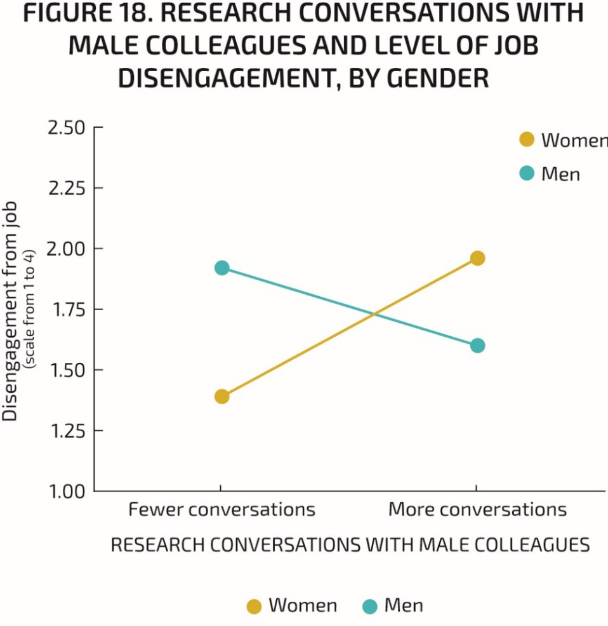
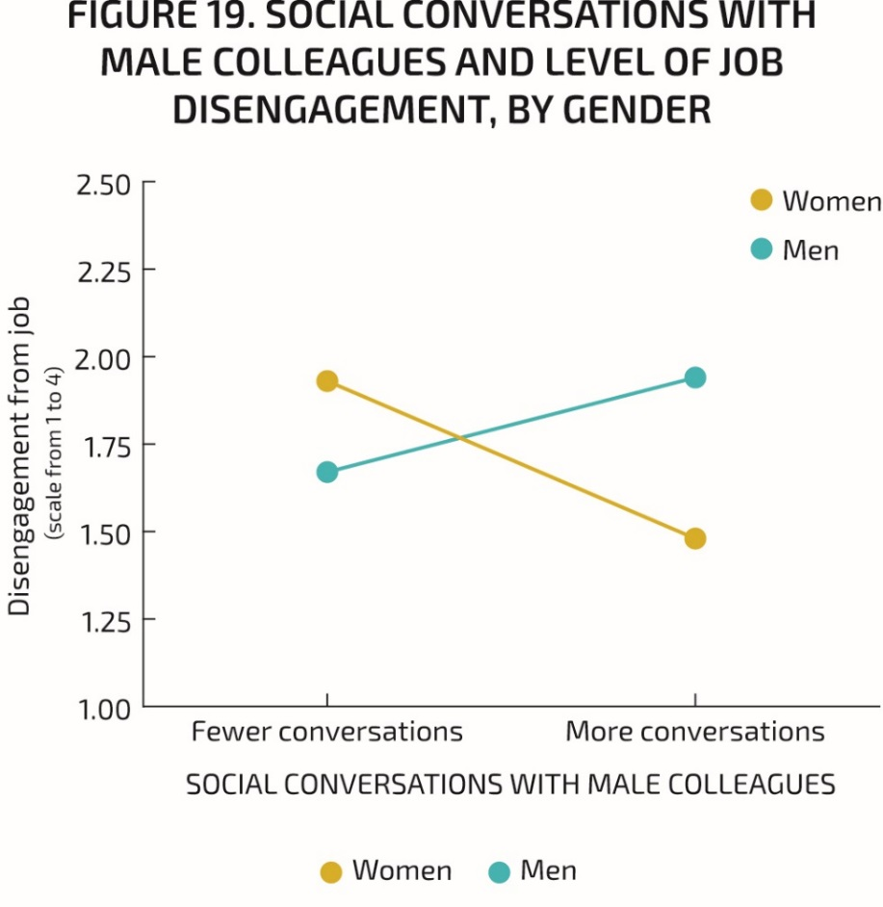
Notes:
Stereotypes and biases pose an additional challenge to women through a phenomenon known as “stereotype threat,” which can occur when an individual fears confirming a negative stereotype about a group to which she or he belongs.
Many studies have shown that stereotype threat affects academic performance.
When negative stereotypes about women’s mathematical abilities are brought to test-takers’ attention, women’s performance is worse than that of women who are told that there are no gender differences in math performance.
Stereotype threat is proposed not only to influence women’s mathematical performance but also to contribute to disengagement from fields in which women are negatively stereotyped, such as engineering and computing. We know that stereotypes can undermine girls and women in school, but researchers are only beginning to examine how stereotype threat affects women in the workplace.
One study in this area conducted by Dr. Toni Schmader, a psychologist at the University of British Columbia, and her colleagues found that the more often that female STEM faculty discussed research with their male colleagues, the less engaged they felt in their work.
You can see this result in the chart on the left.
The yellow line represents female STEM faculty, and the blue line represents male STEM faculty. As you move to the right, faculty had more research conversations with their male colleagues. You can see that the more research conversations female faculty had with their male colleagues, the more disengaged they reported being with their work. For male STEM faculty, on the other hand, the more research conversations they had with their male colleagues, the more engaged they reported being with their work.
The second figure, on the right, shows the second finding from this study, which was that the more social conversations female STEM faculty had with their male colleagues, the more engaged they reported being with their work.
Again, the yellow line represents female STEM faculty, and the blue line represents male STEM faculty. The more social conversations female STEM faculty had with their male colleagues, the more engaged they were with their work. (Male STEM faculty, on the other hand, reported being less engaged with their work as they had more social conversations with their male colleagues — which is what one might expect, since more time socializing at work means less time working.)
Schmader and her colleagues hypothesize that research-related conversations with male colleagues may generate stereotype threat for female scientists. Social conversations with male colleagues, on the other hand, may lessen the threat by increasing a feeling of belonging in their work environment.
Figure 18 notes: On average, study participants’ conversations with their male colleagues were about research 47 percent of the time. The “fewer” value represents 19 percent, in other words, study participants who talked about research 19 percent of the time when they spoke with their male colleagues. The “more” value represents 77 percent, in other words, women and men who talked about research 77 percent of the time they conversed with their male colleagues. Nineteen percent is one standard deviation lower than the average value, and 77 percent is one standard deviation higher than the average value (AAUW communication with Toni Schmader).
Figure 18 source: Holleran et al. (2011).
Figure 19 notes: On average, study participants’ conversations with their male colleagues were about social topics 23 percent of the time. The “fewer” value represents 5.5 percent, in other words, study participants who talked about social topics 5.5 percent of the time when they spoke with their male colleagues. The “more” value of social conversations with male colleagues represents 40.5 percent, in other words, study participants who talked about social topics 40.5 percent of the time when they conversed with their male colleagues. Five and one-half percent is one standard deviation lower than the average value, and 40.5 percent is one standard deviation higher than the average value (AAUW communication with Toni Schmader).
Figure 19 source: Holleran et al. (2011).

Slide 29
What can we do?
Acknowledge that we are all influenced by gender biases
Base hiring decisions on objective information
Remove gender information from evaluation scenarios
Notes:
A first step toward addressing biases in hiring is acknowledging the reality that we are all influenced by gender biases, whether or not we consciously endorse them.
Second, Dr. Ernesto Reuben and his colleagues found that employers made better and less-biased hiring decisions when they were provided with objective information about past performance. Employers should base hiring decisions on objective past performance information as much as possible.
Another way to reduce the influence of biases on our evaluations of others is to remove information about an individual’s age, race, or gender from decision-making contexts.

Slide 30
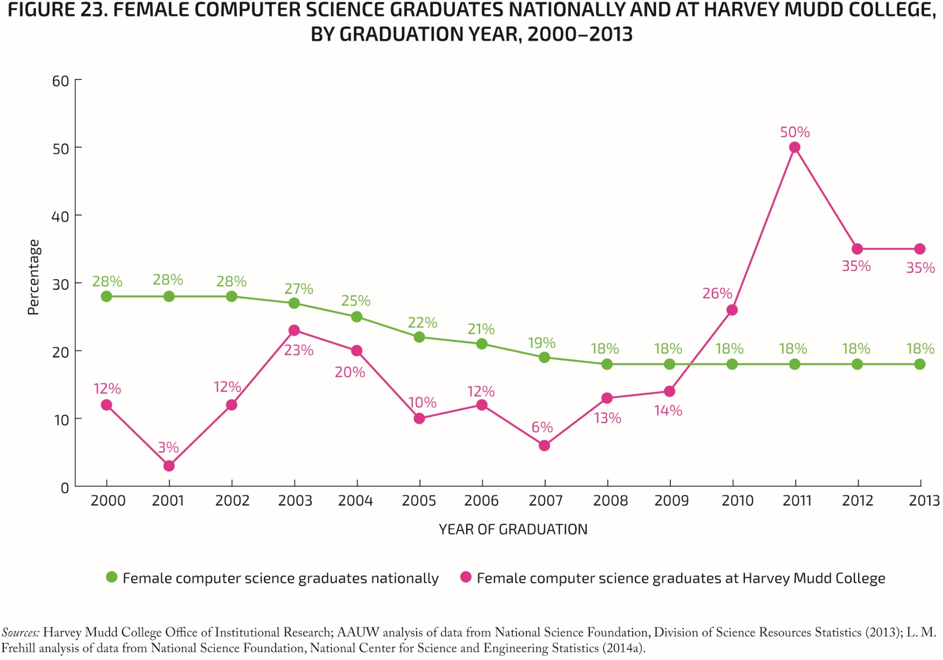
Notes:
Harvey Mudd College is a prime example of how changing structures and environments can result in a dramatic increase in women’s representation in computing.
With leadership from the college president and college-wide support for the initiative, Harvey Mudd increased the percentage of women graduating from its computing program from a historical average of 12 percent to approximately 40 percent in five years.
This chart shows the percentage of graduating computer science majors who were women, nationally (in green) and at Harvey Mudd College (in pink), from 2000 to 2014. You can see that starting in 2010, the percentage of women in Harvey Mudd’s graduating class of computer science majors has surpassed the national average.
Figure 23 source: Harvey Mudd College Office of Institutional Research; AAUW analysis of data from National Science Foundation, Division of Science Resources Statistics (2013); L. M. Frehill analysis of data from National Science Foundation, National Center for Science and Engineering Statistics (2014a).

Slide 31
What can colleges do?
Revise their introductory computer science course and split it into two levels divided by experience
Provide research opportunities for undergraduates after their first year in college
Take female students to the Grace Hopper Celebration of Women in Computing or similar conferences
Notes:
Harvey Mudd College achieved this dramatic increase through three major changes:
HMC revised its required introductory computer science course to present the breadth of the computer science field — and emphasize the social relevance of the field — in addition to the basics of programming. The school also split the class into two levels divided by experience, providing students with less experience in computer science the time and environment they need to build their skills and interest.
HMC provided research opportunities for women immediately after their first year of college, to expose them to real computer science problems as early as possible.
HMC gave first-year female students opportunities to attend the annual Grace Hopper Celebration of Women in Computing, hosted by the Anita Borg Institute for Women and Technology, to give them a sense of identity with people in the field and share their excitement for it. Taking even a few students to the Grace Hopper Celebration or similar conferences can change their mindset and have an important effect on a school’s program.
These changes can be modified and applied at other colleges and universities. Taken together, they provide a roadmap for reversing the downward trend in women’s representation among bachelor’s degree recipients in computing.
And the first step, according to Dr. Christine Alvarado, who helped lead these changes, is for a college or university to make an institution-wide commitment to addressing women’s underrepresentation.

Slide 32
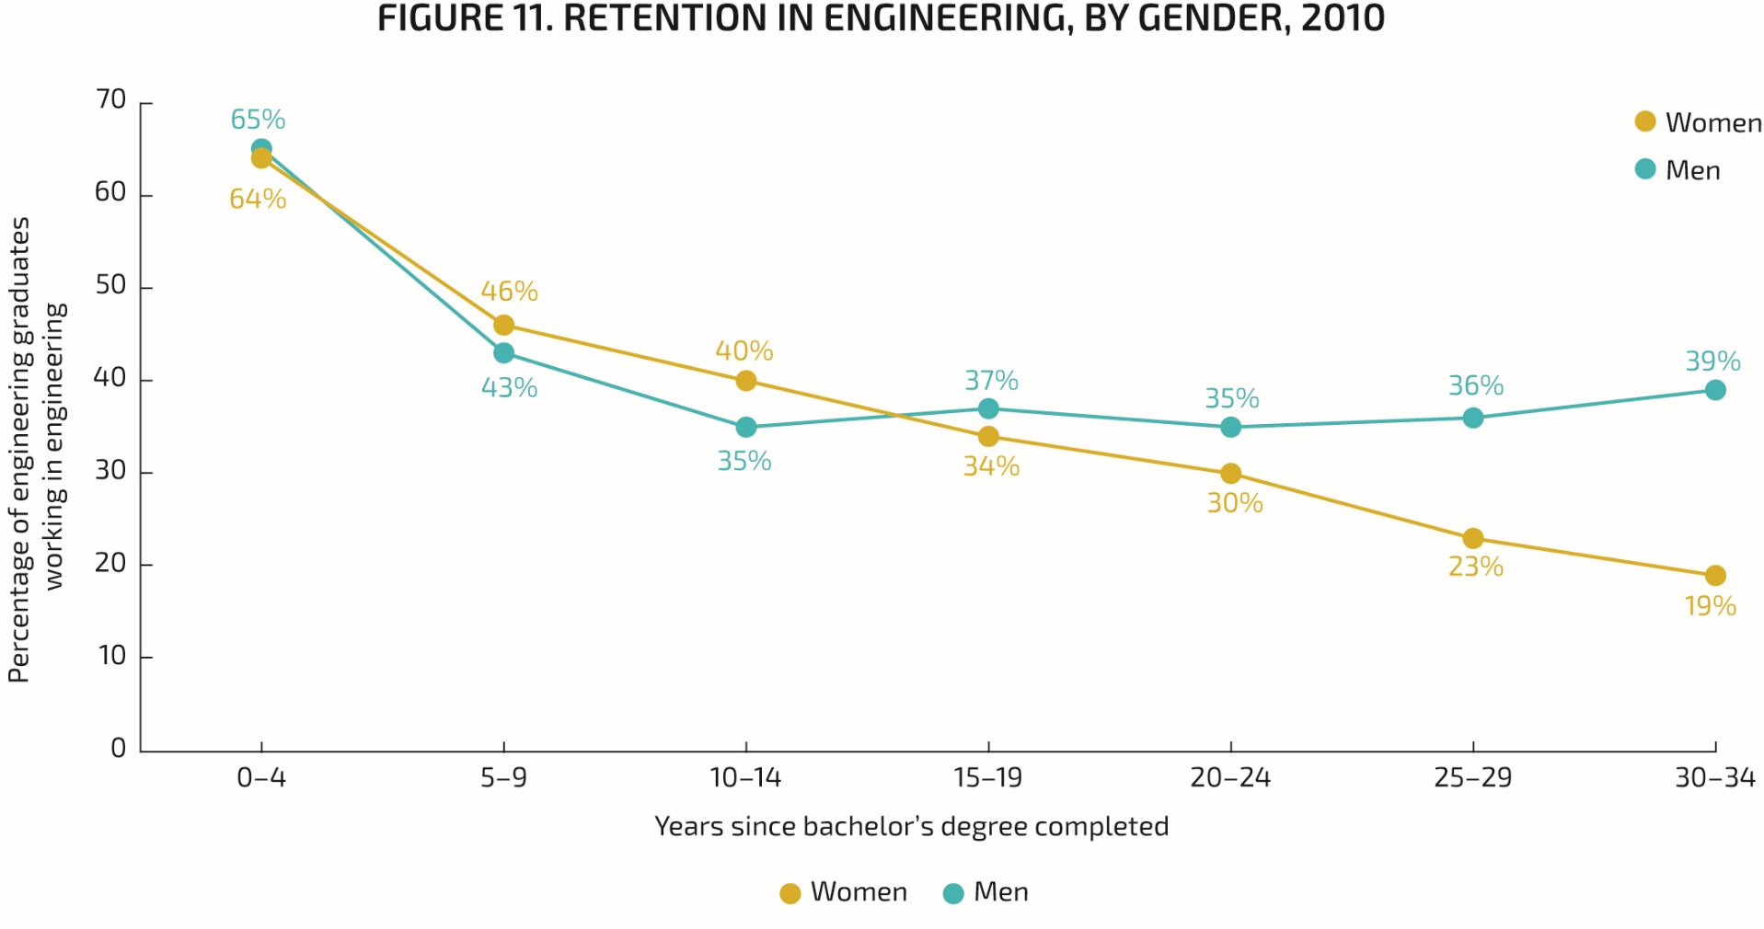
Notes:
Retention is as critical as recruitment in achieving gender diversity in engineering and computing. AAUW’s analysis of National Science Foundation data finds that while most (about 65 percent) women and men who graduate with bachelor’s degrees in engineering initially take engineering jobs, by 10 years into their careers, only about 40 percent of graduates, both women and men, remain in engineering.
While men’s retention rate levels off at around 40 percent for the next 25 years, the retention rate for women continues to decline. Thirty years into their careers (by the time women and men are in their 50s), women are half as likely as men to report that they are still working as engineers.
In this chart, men are shown in blue, and women are shown in yellow.
A recent research study by professors Nadya Fouad and Romila Singh at the University of Wisconsin, Milwaukee, along with their colleagues, uncovered factors that lead women to stay in engineering.
Drawing from the population of women who had graduated with an undergraduate degree in engineering at any time in the past, the survey compared women currently working as engineers with women who had left the field. Participants included women who earned engineering degrees as far back as 1947 and as recently as 2010.
The researchers found that women who leave engineering are very similar to women who stay in engineering. The two groups had similar undergraduate majors, were equally likely to be married and have children, were of similar racial/ethnic backgrounds, and were of similar age. The two groups of women were also psychologically similar. They were equally interested in engineering and equally confident in their engineering abilities, their ability to navigate the political environment in their workplace, and their ability to manage multiple work-life role demands.
The differences that researchers found were not in the women themselves but in their workplace environments.
Women who left engineering were less likely to have opportunities for training and development, support from co-workers or supervisors, and support for balancing work and non-work roles than were women who stayed in the profession.
Figure 11 notes: Includes only individuals who reported a bachelor’s degree in engineering and no additional educational credential as of 2010. Includes women and men who reported earning a bachelor’s degree in engineering as well as working in an engineering occupation in either the National Survey of College Graduates or the National Survey of Recent College Graduates administered in October 2010.
Figure 11 source: L. M. Frehill analysis of National Science Foundation, National Center for Science and Engineering Statistics (2010a, 2010b).

Slide 33
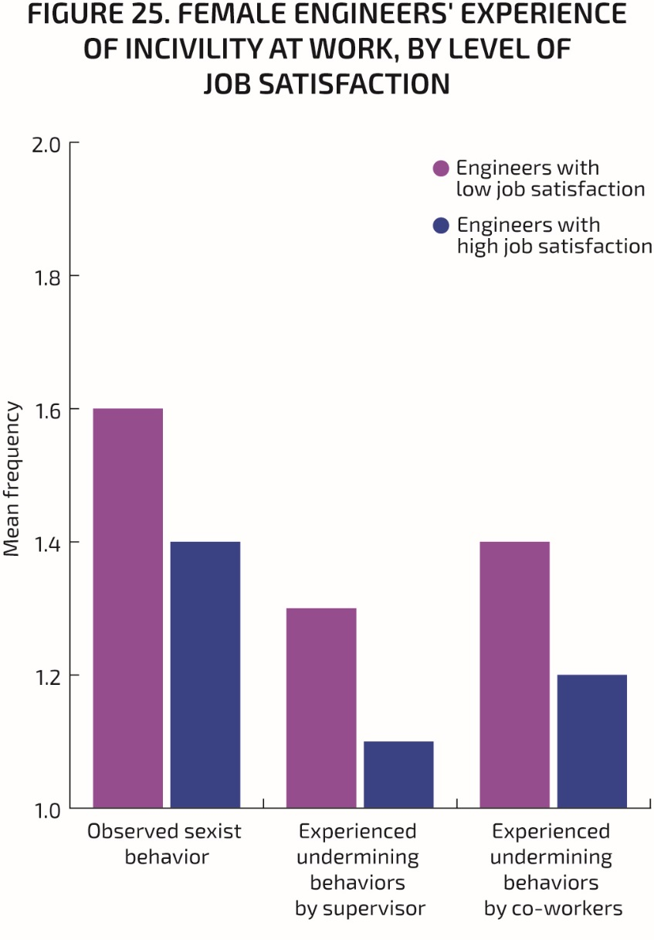
Notes:
In addition, this chart shows that, on average, engineers who reported less satisfaction with their job also reported observing more sexist behavior at work in the last year and experiencing more undermining behaviors by both co-workers and supervisors in the last month.
The engineers with low job satisfaction are shown in purple and those with high job satisfaction are shown in blue.
Female engineers who were most satisfied with their jobs, in contrast, worked for organizations that provided clear paths for advancement; gave employees challenging assignments that helped develop and strengthen new skills; and valued, recognized, and acknowledged employees’ contributions.
Figure 25 note: Scale from 1 (never) to 6 (every day). Participants estimated the frequency with which they experienced undermining behaviors in the past month and the frequency with which they observed sexist behavior in the past year.
Figure 25 sources: Fouad et al. (2012); AAUW communications with Romila Singh.

Slide 34
What can employers do?
Clearly define employees’ roles and responsibilities
Provide opportunities for training and development
Acknowledge employees’ contributions
Root out uncivil behaviors
Notes:
Organizations can put a number of practices in place to improve the retention of women in engineering and computing.
First, they can ensure that employee roles and responsibilities are clearly defined and that employees are provided with the resources they need to fulfill those responsibilities. Ensuring that employees do not have excessive workloads is also part of this step.
Second, organizations can provide opportunities for employees to acquire new skills through both formal and informal training and development opportunities.
Third, organizations can increase satisfaction among their employees — and therefore increase the likelihood that they will stay — by acknowledging and rewarding employee contributions.
And fourth, organizations should take an intentional and purposeful approach to creating a civil and supportive work environment. Dr. Singh points out that sexist, uncivil, and undermining behaviors are all learned behaviors and can be stamped out by organizational leadership that refuses to tolerate these kinds of behaviors.
None of these recommendations are necessarily novel or foreign. In fact, they have been put in place already by many organizations included in lists of “great places to work.” This research suggests that engineering and technical companies can increase the retention of technical women — and likely technical men as well — in their organizations by putting in place these practices.
Doctors Fouad and Singh looked only at women in engineering in this study. They are currently conducting a similar study of men in engineering, so we will soon know if these factors affect the satisfaction and turnover rates of men and women in engineering differently.

Slide 35




www.aauw.org/research/solving-the-equation
Notes:
If you’re interested in learning more, please visit AAUW’s website to download an electronic version of the report at the web address above.
Solving the Equation is made possible by these generous supporters: the National Science Foundation, Research on Gender in Science and Engineering award 1420214; AT&T; and the Mooneen Lecce Giving Circle.
35

Slide 37
Carrie Bartek
What are companies and schools doing to help women succeed in high growth fields?
Dean of College Initiatives and Assessment
Wake technical community college

Slide 38
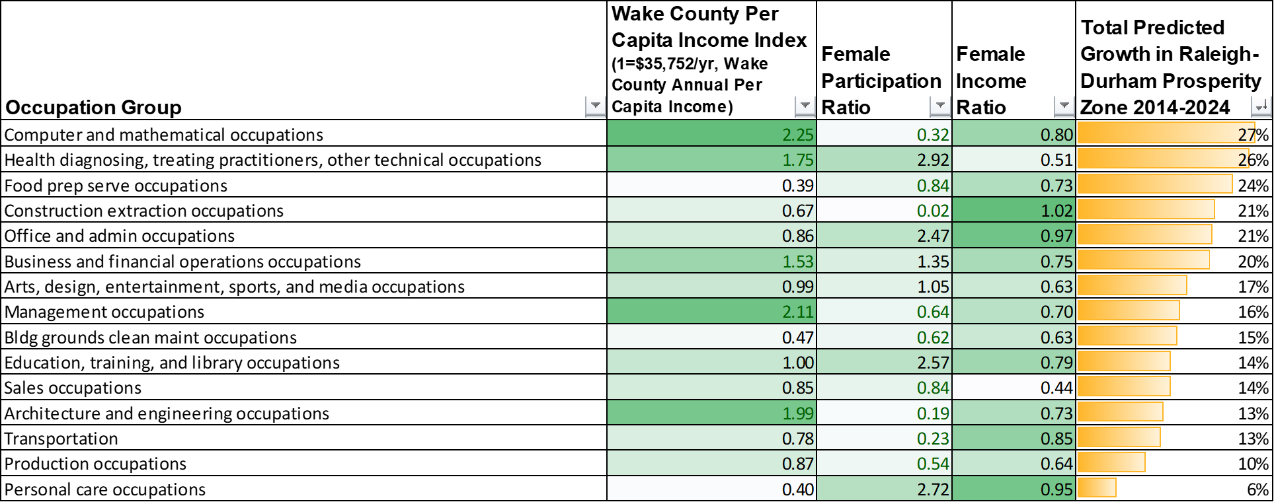
Wake County female to male participation and income ratios in TOP 15 Growth Occupations with Employment Numbers >10,000
Source: U.S. Department of Labor Market Statistics for Wake County, 2014
Notes:
Carrie

Slide 39
Wake Invests in Women Guiding Principles
Passion for Impact: we are passionate about empowering women to advance in their careers and to achieve greater pay equity
Data-Driven: our decisions are informed by qualitative/quantitative research on needs and what has worked elsewhere to address the gender wage gap
Program and System-Focused: we will seek out both programmatic and systemic solutions that will address inequities in the gender wage gap
Collaborative: we are committed to working with strategic partners to identify lasting solutions
Equity Lens: we are committed to bringing an equity lens to this work (e.g., disaggregating data by race, ethnicity, and socioeconomic status to understand needs and targeted solutions)
Application and Replication: we are focused initially on the gender gap in STEM-related fields, and we believe in the potential application and replication of lessons to other occupational groups

Slide 40
Wake Invests in Women working theory of change
Research-based Solutions
Aim: Close the Gender Wage Gap in Wake County
Outcome Measures:
  1. Increase the proportion of women in higher-wage,
  high-growth occupations
  2. Increase movement and retention of women through the career pipeline to ensure greater upward mobility
  3. Increase pay equity (by race, ethnicity, and socioeconomic status) between women who move into higher wage, higher-growth positions and their male counterparts who are in equivalent positions
Primary Drivers
Secondary Drivers Change Ideas
Education and training
Equal proportion of women in higher-wage, high-growth occupations
Cultural norms and beliefs
Mentoring, internships and
support
networks
Agency and empowerment
Equal proportion of women in higher-wage, high-growth positions within occupations
Educational norms and practices
Workplace support and access to leaders
Employer norms and policies
Equitable pay for women moving into higher-wage, high-growth positions
Employer policies and practices
Hiring and promotion practices
Employer culture training

Slide 41
Candace dudley
What policies can you implement in your community? How?
Internship coordinator
NC council for women and youth involvement

Slide 42
Q & A

Slide 43

Jennifer Clark
Director of Communications
clark@iwpr.org
Institute for Women’s Policy Research
Mary Williams Stover
Executive Director
maryw.stover@doa.nc.gov
www.councilforwomen.nc.gov
Notes:
I’ll be happy to answer your questions now if we have any time on the agenda, or feel free to reach out if you have any follow-up questions after.

