Slide 1

37th Annual
State Construction
Conference
March 29th, 2018
Inspection Discoveries

Slide 2
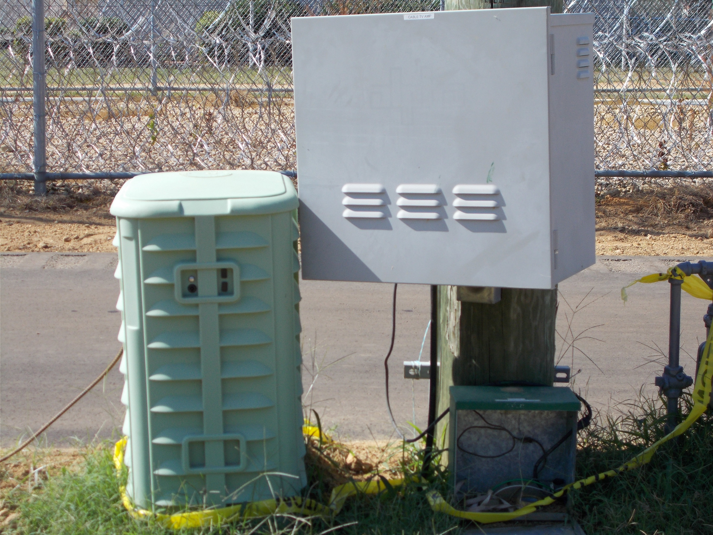
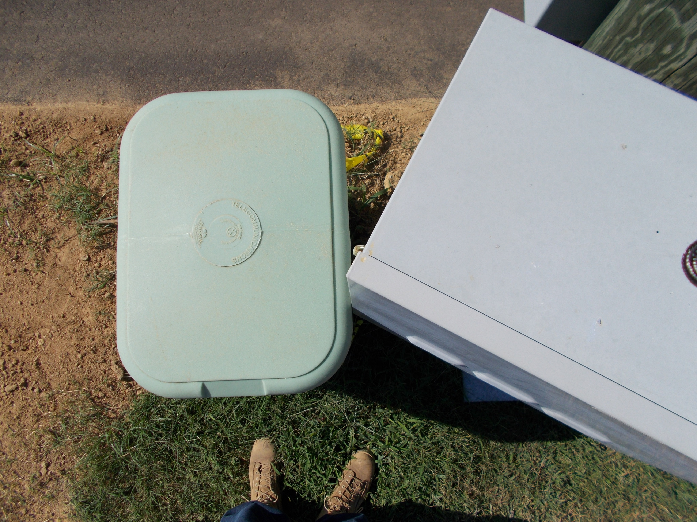
Door hinges debacle

Slide 3
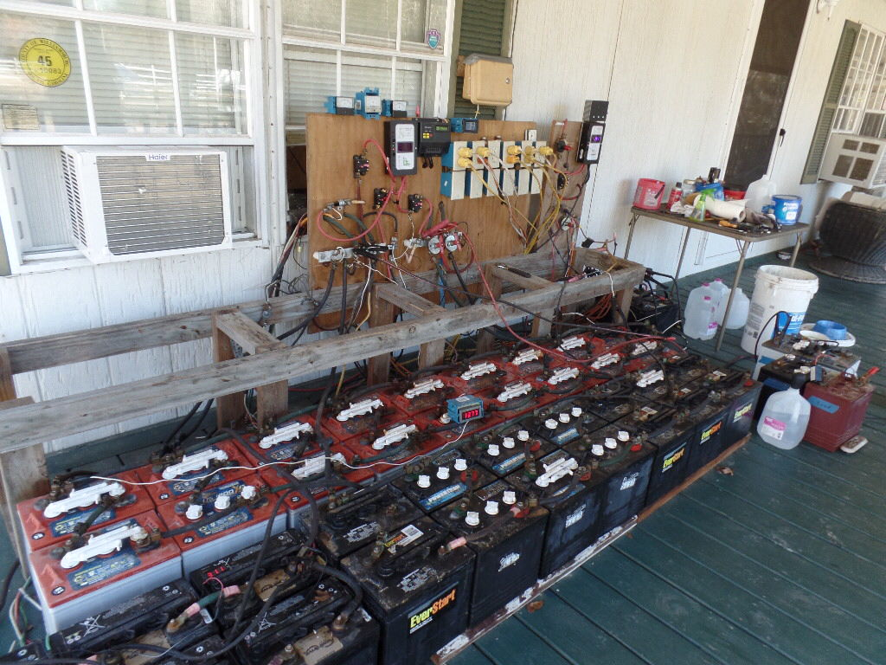
Ventilation – checked
Floor deck design - checked

Slide 4
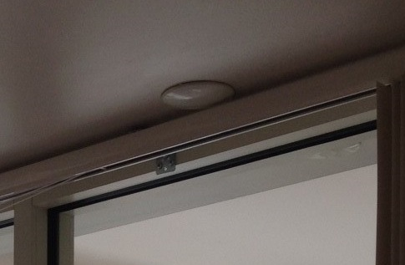
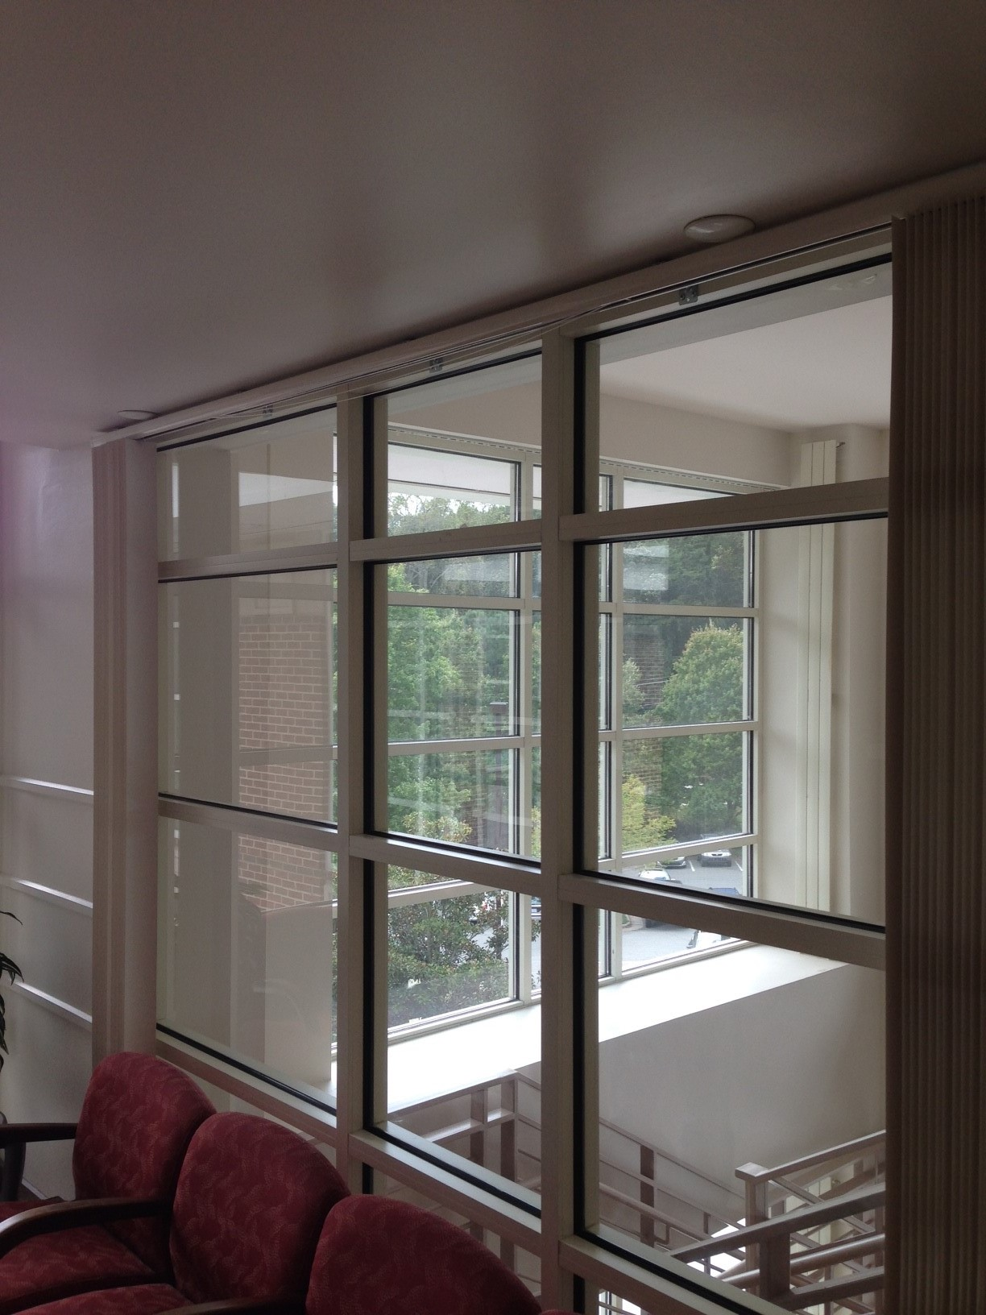
Wall wash compromised

Slide 5
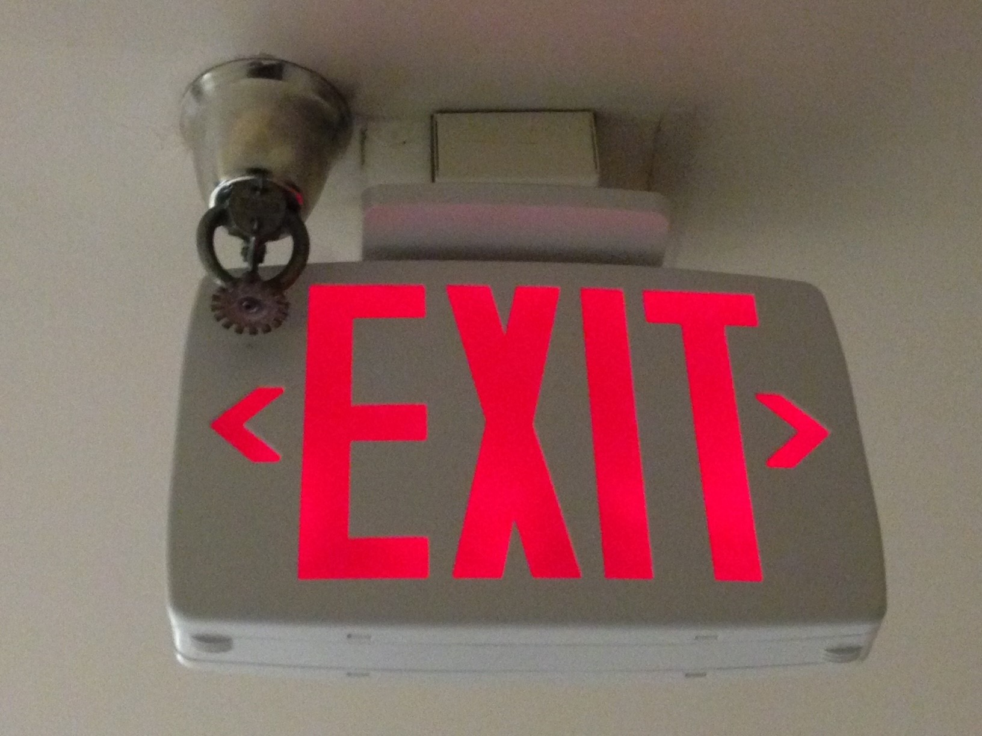
Exit is protected

Slide 6
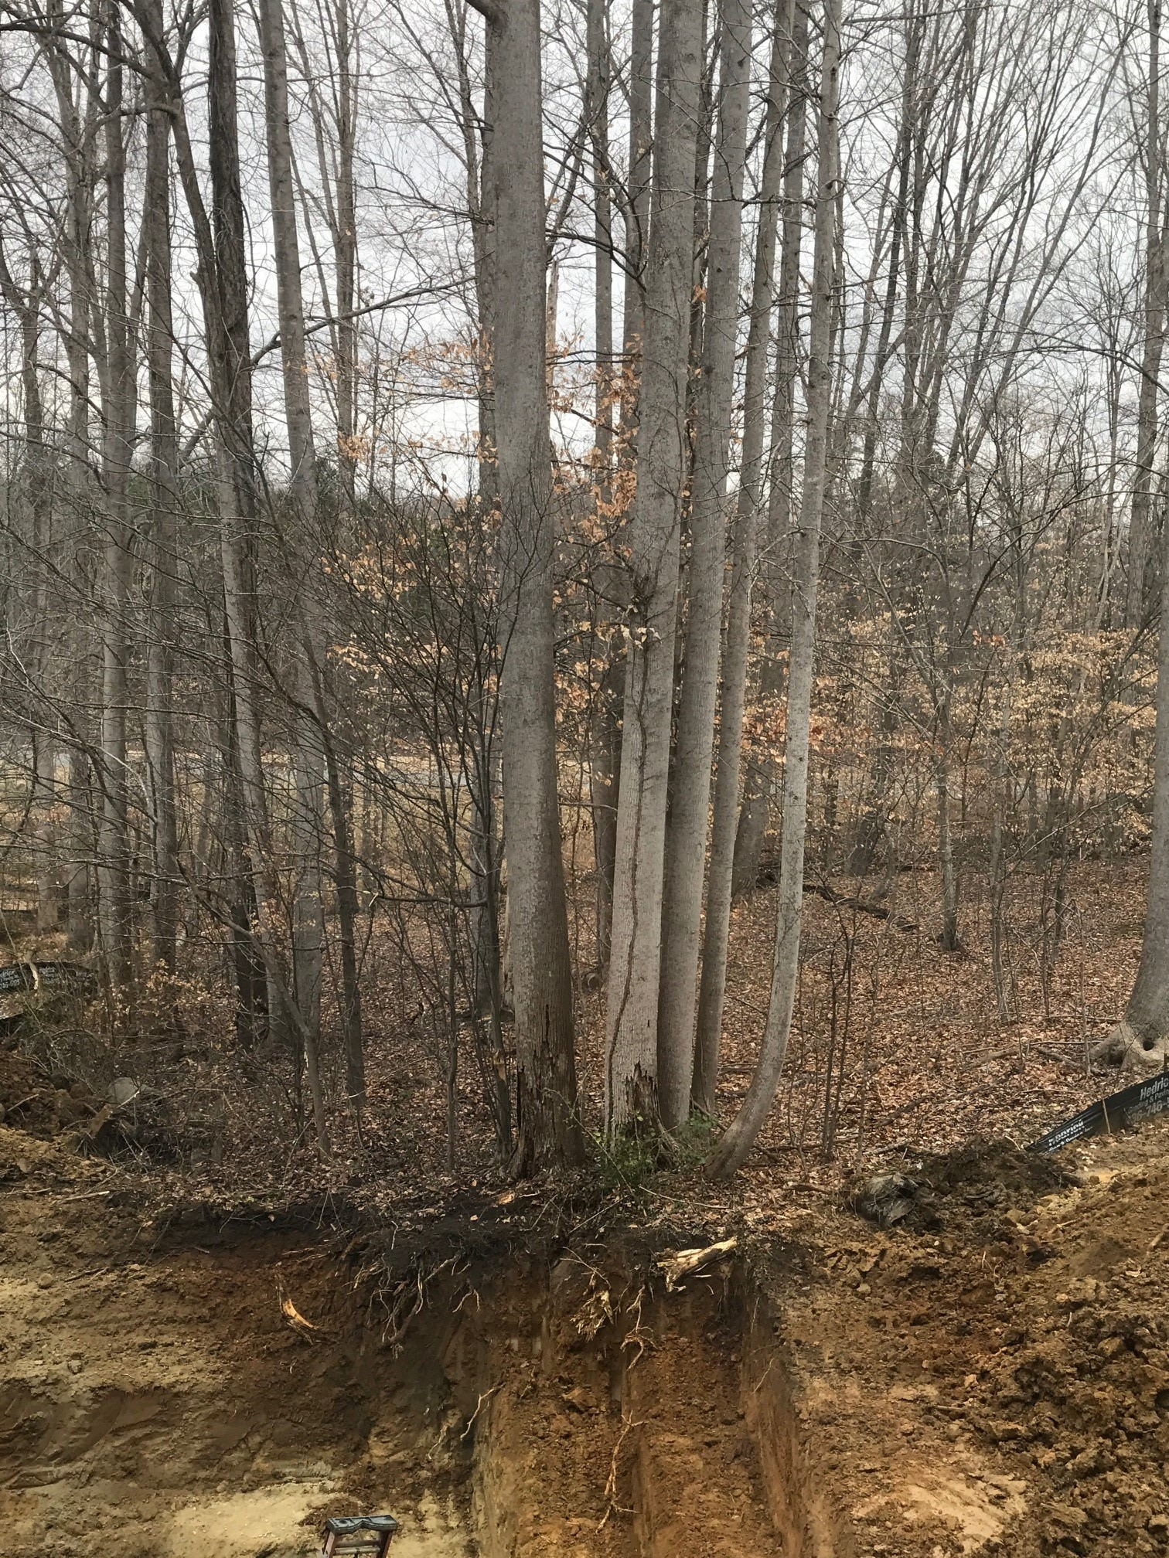
Are those trees to remain?

Slide 7
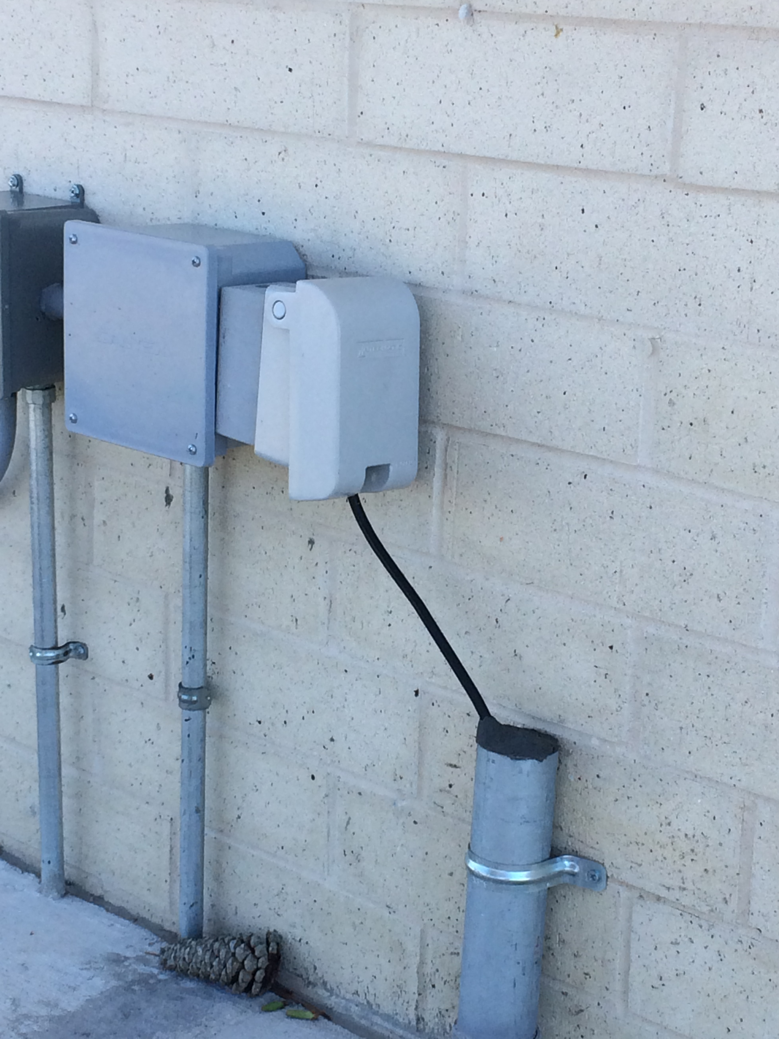
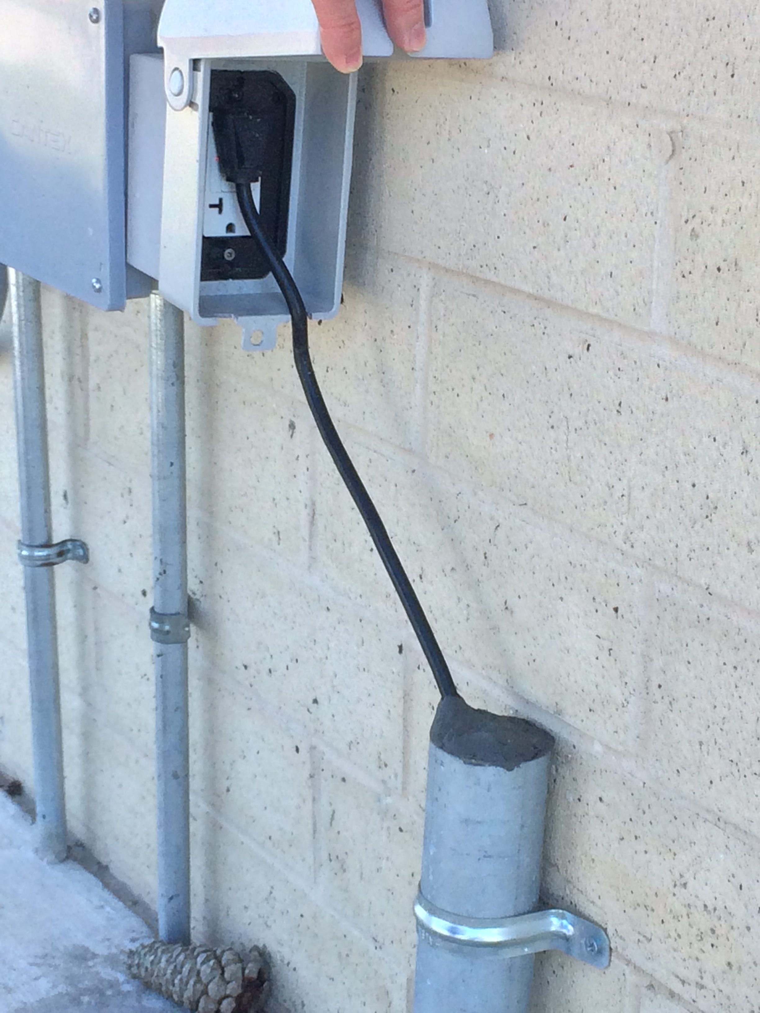
There is a reason why appliances cords are 6 feet long

Slide 8
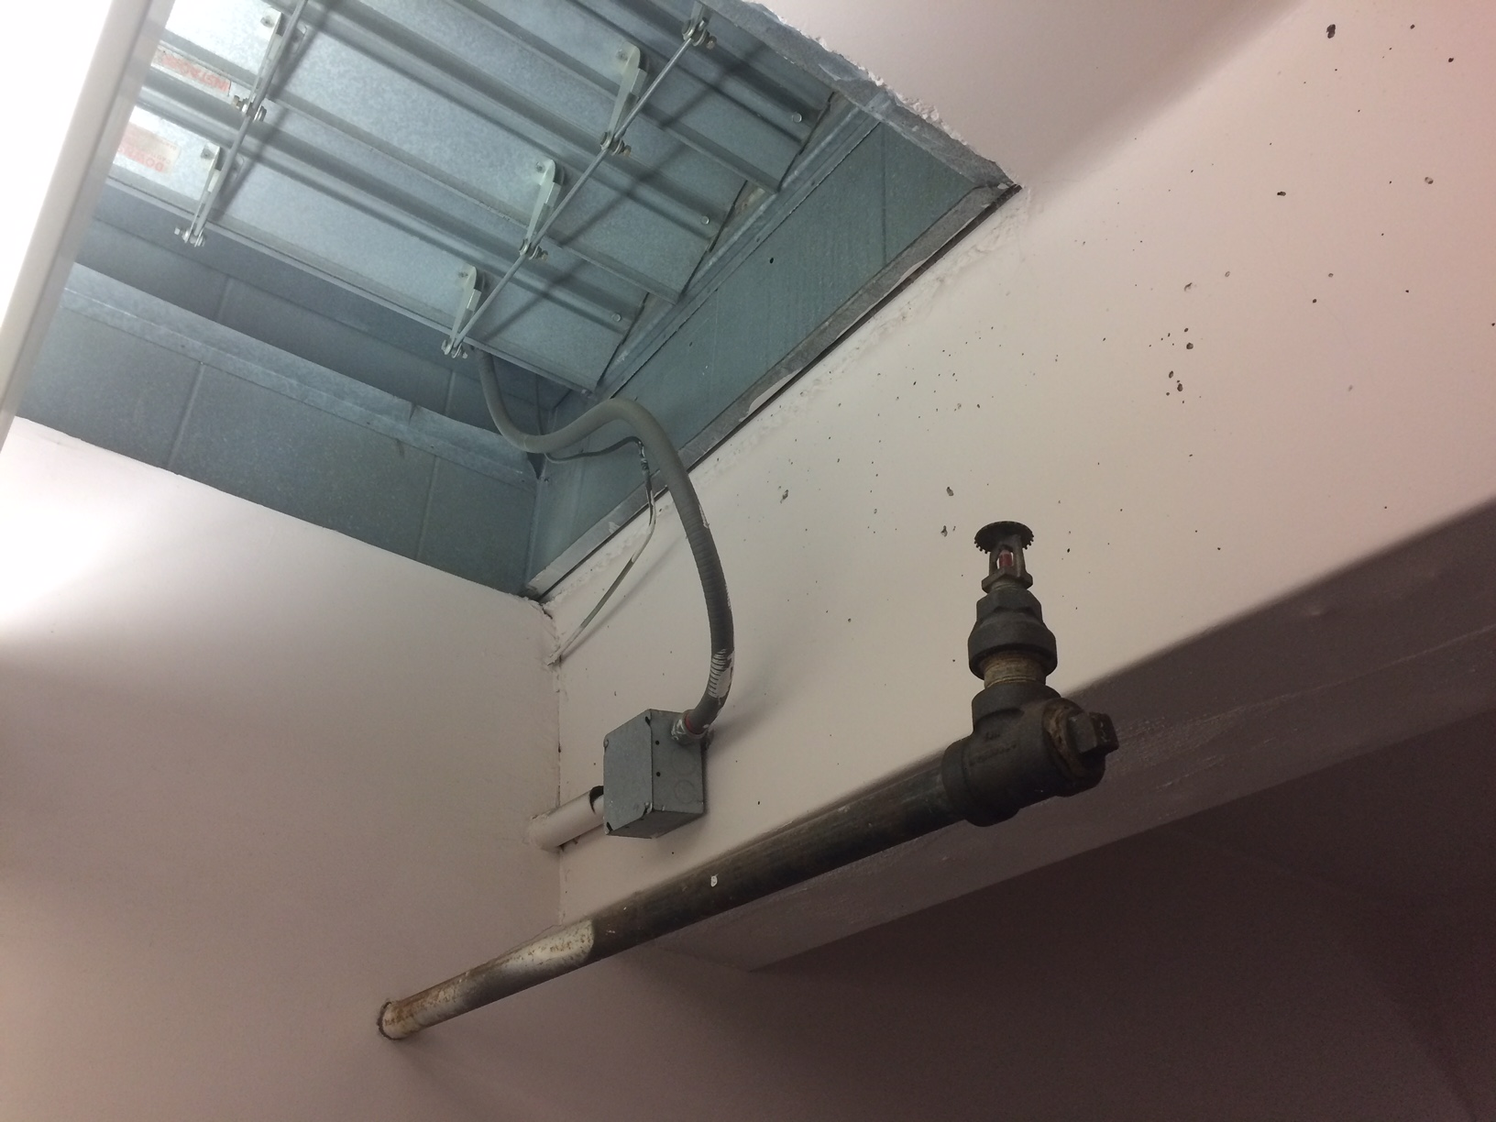
Better than having another roof penetration

Slide 9
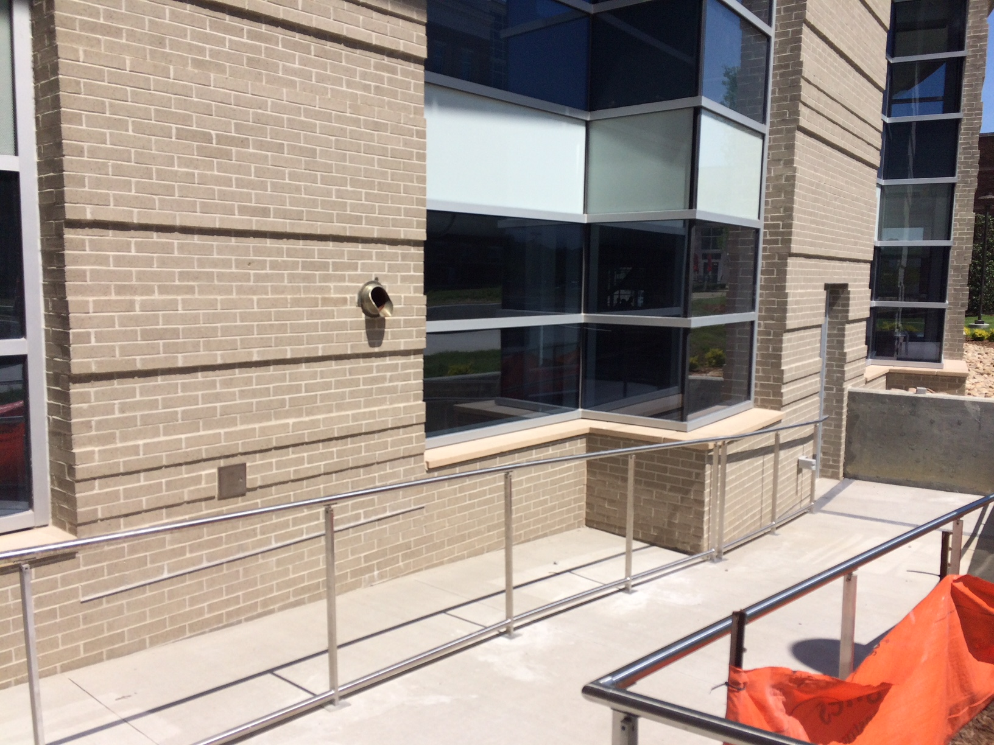
How high should it be? 6 feet?

Slide 10
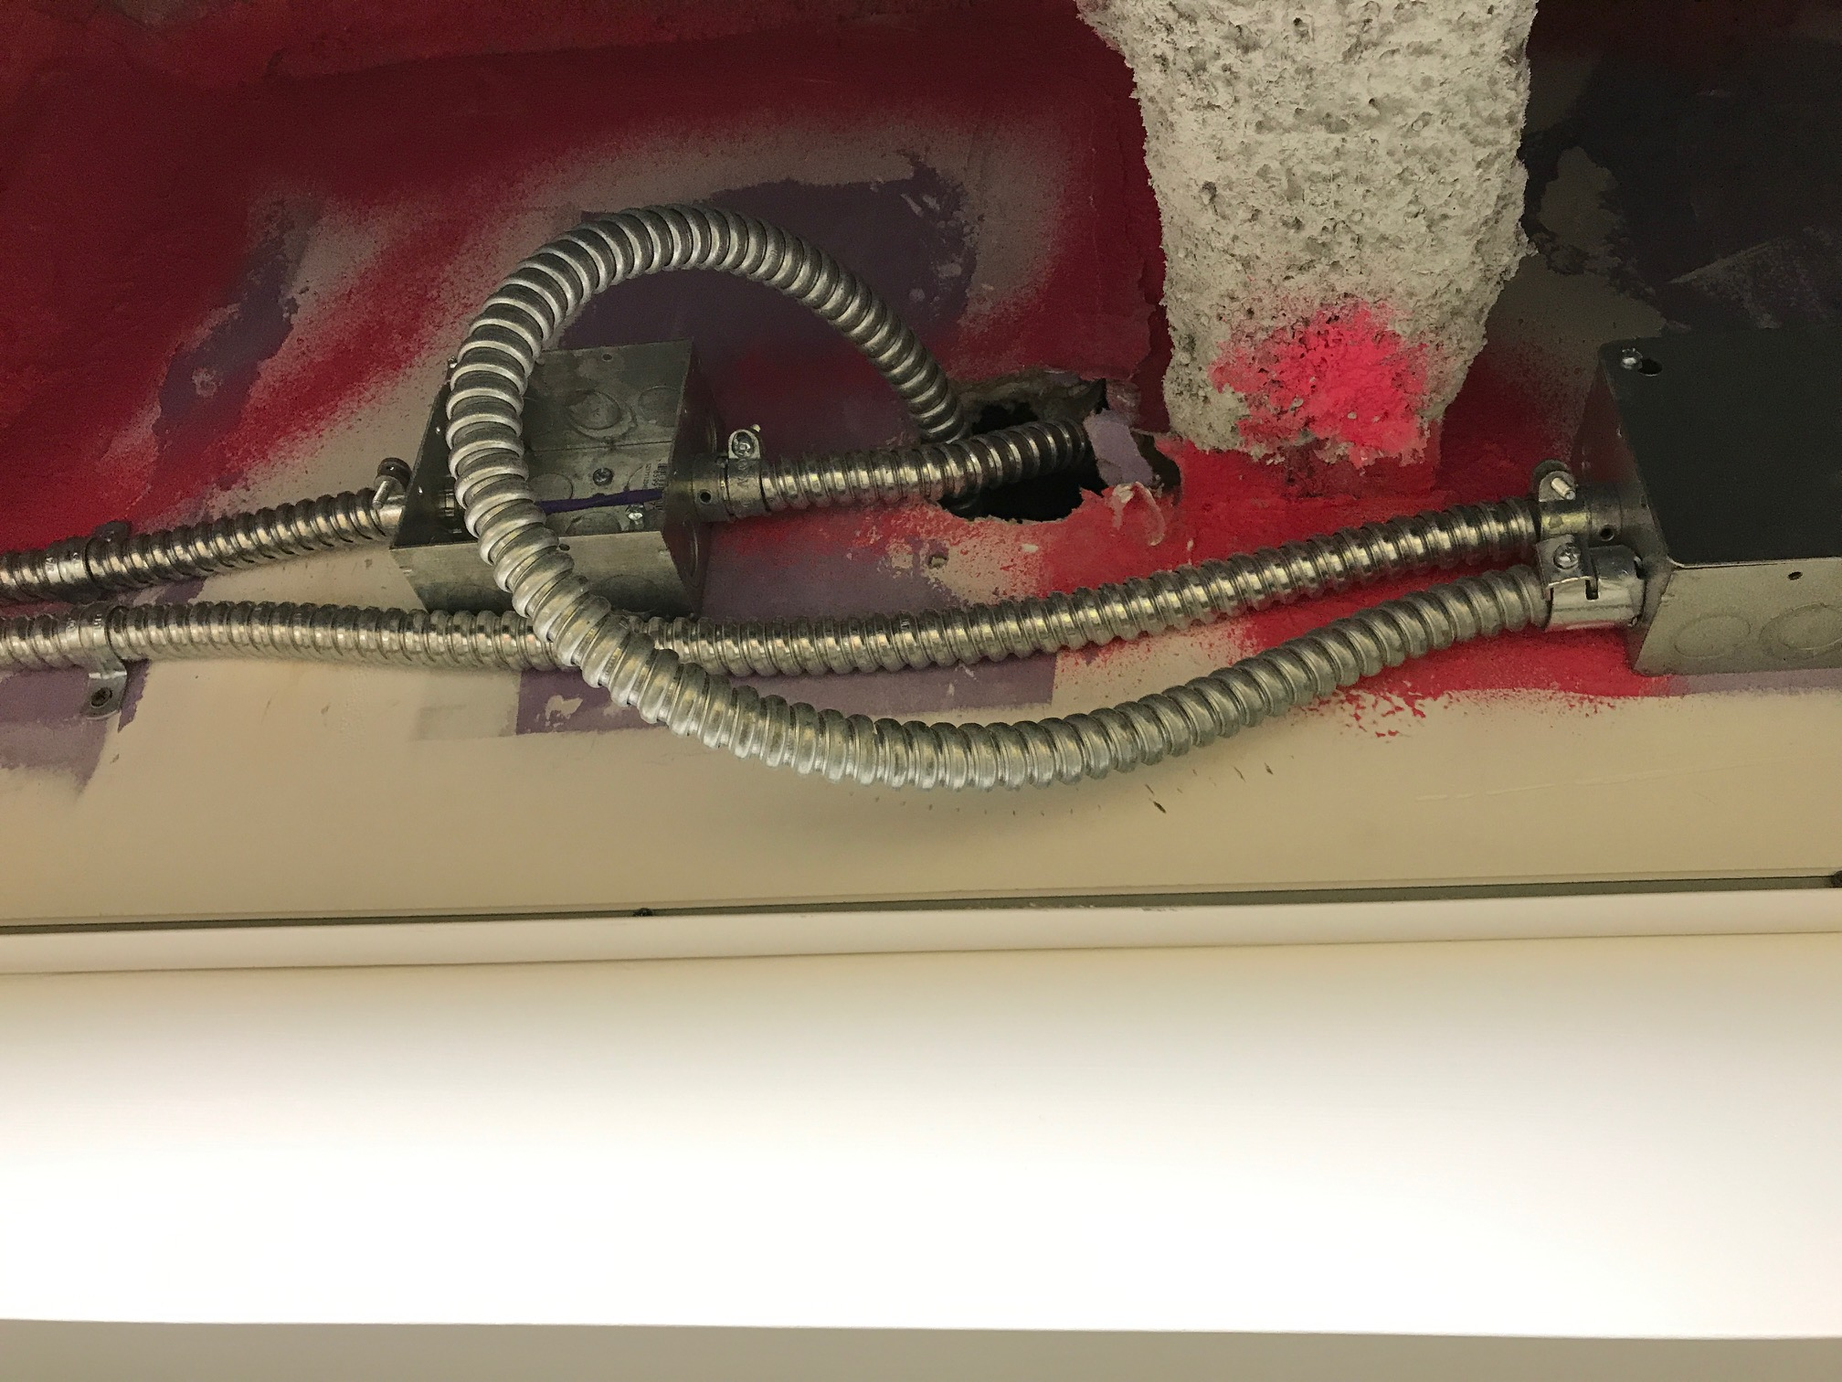
One of the reasons MC cables should not used

Slide 11
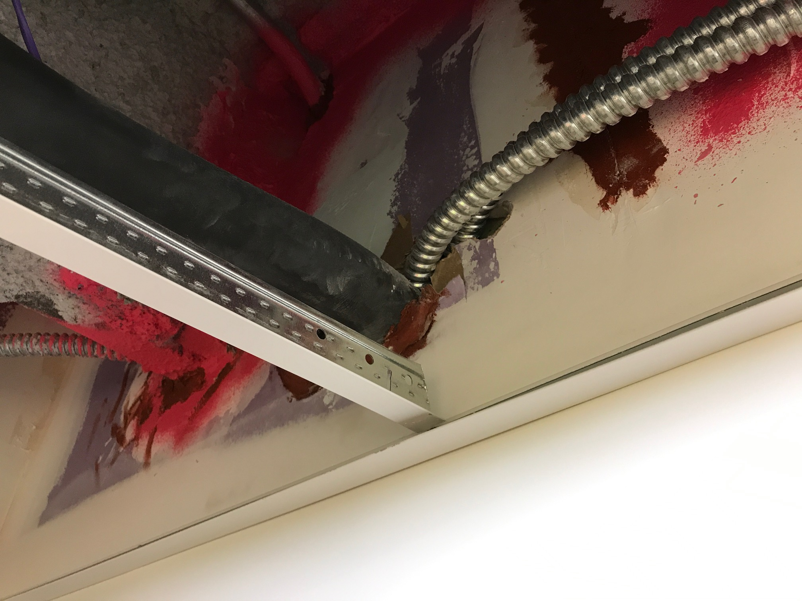
are MC cables exempt?

Slide 12
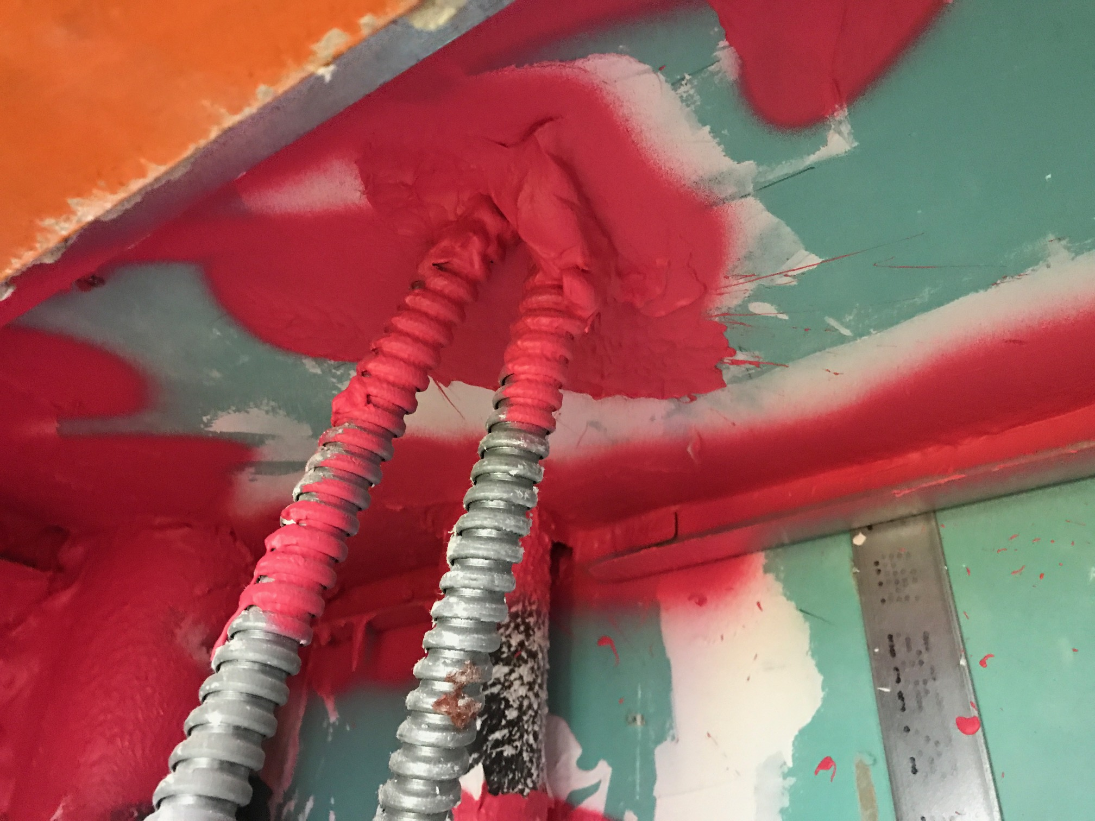
Not exempt, but no UL detail to follow

Slide 13
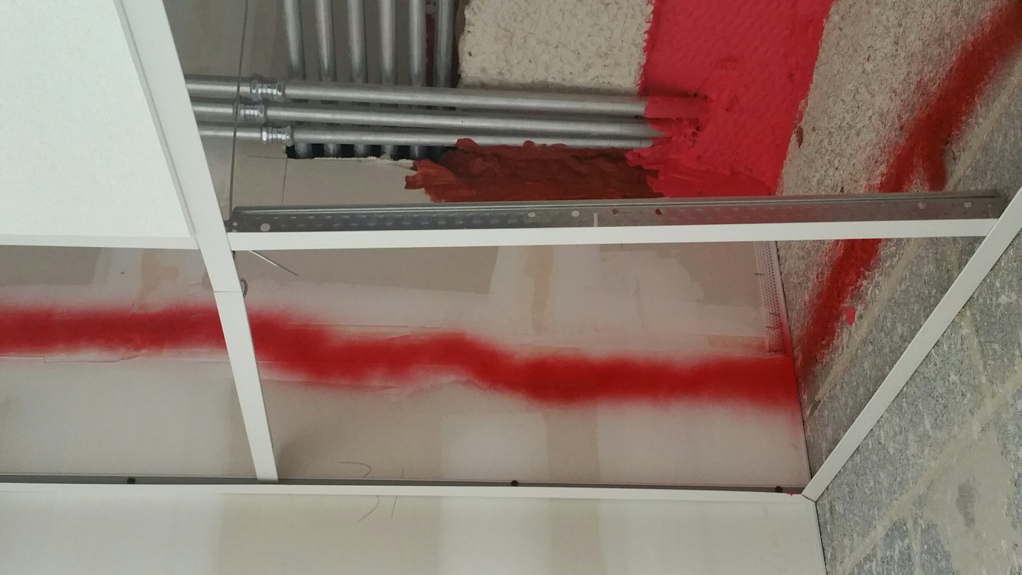
EMT is not exempt either

Slide 14
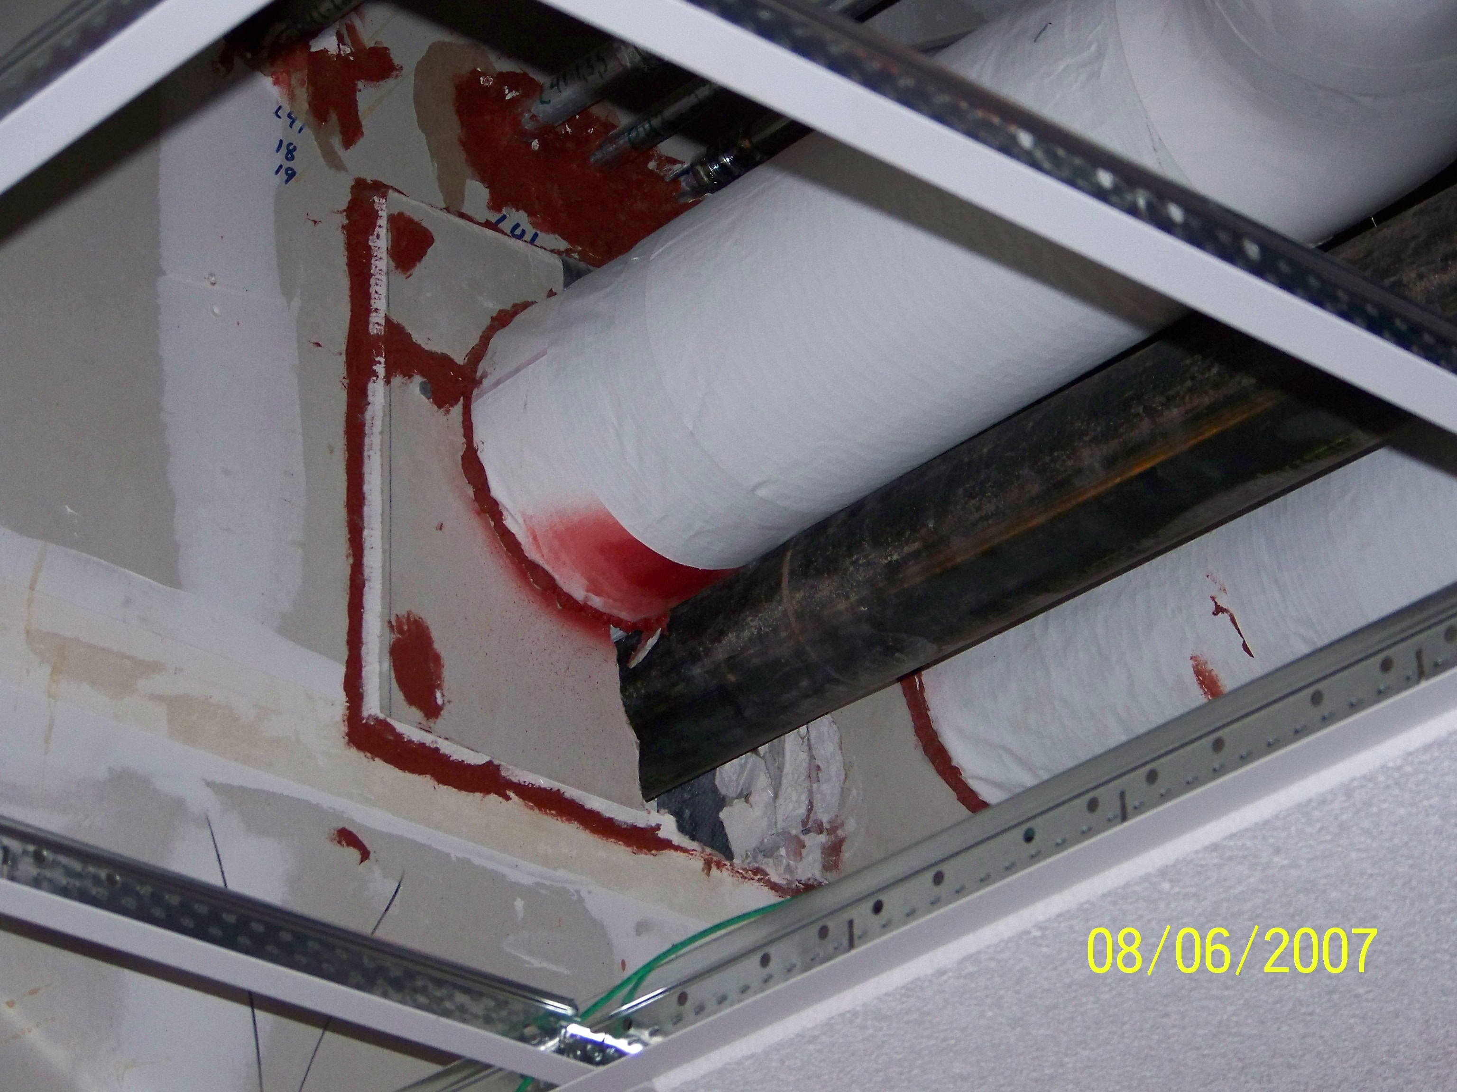
who is going to pay for the damages?

Slide 15
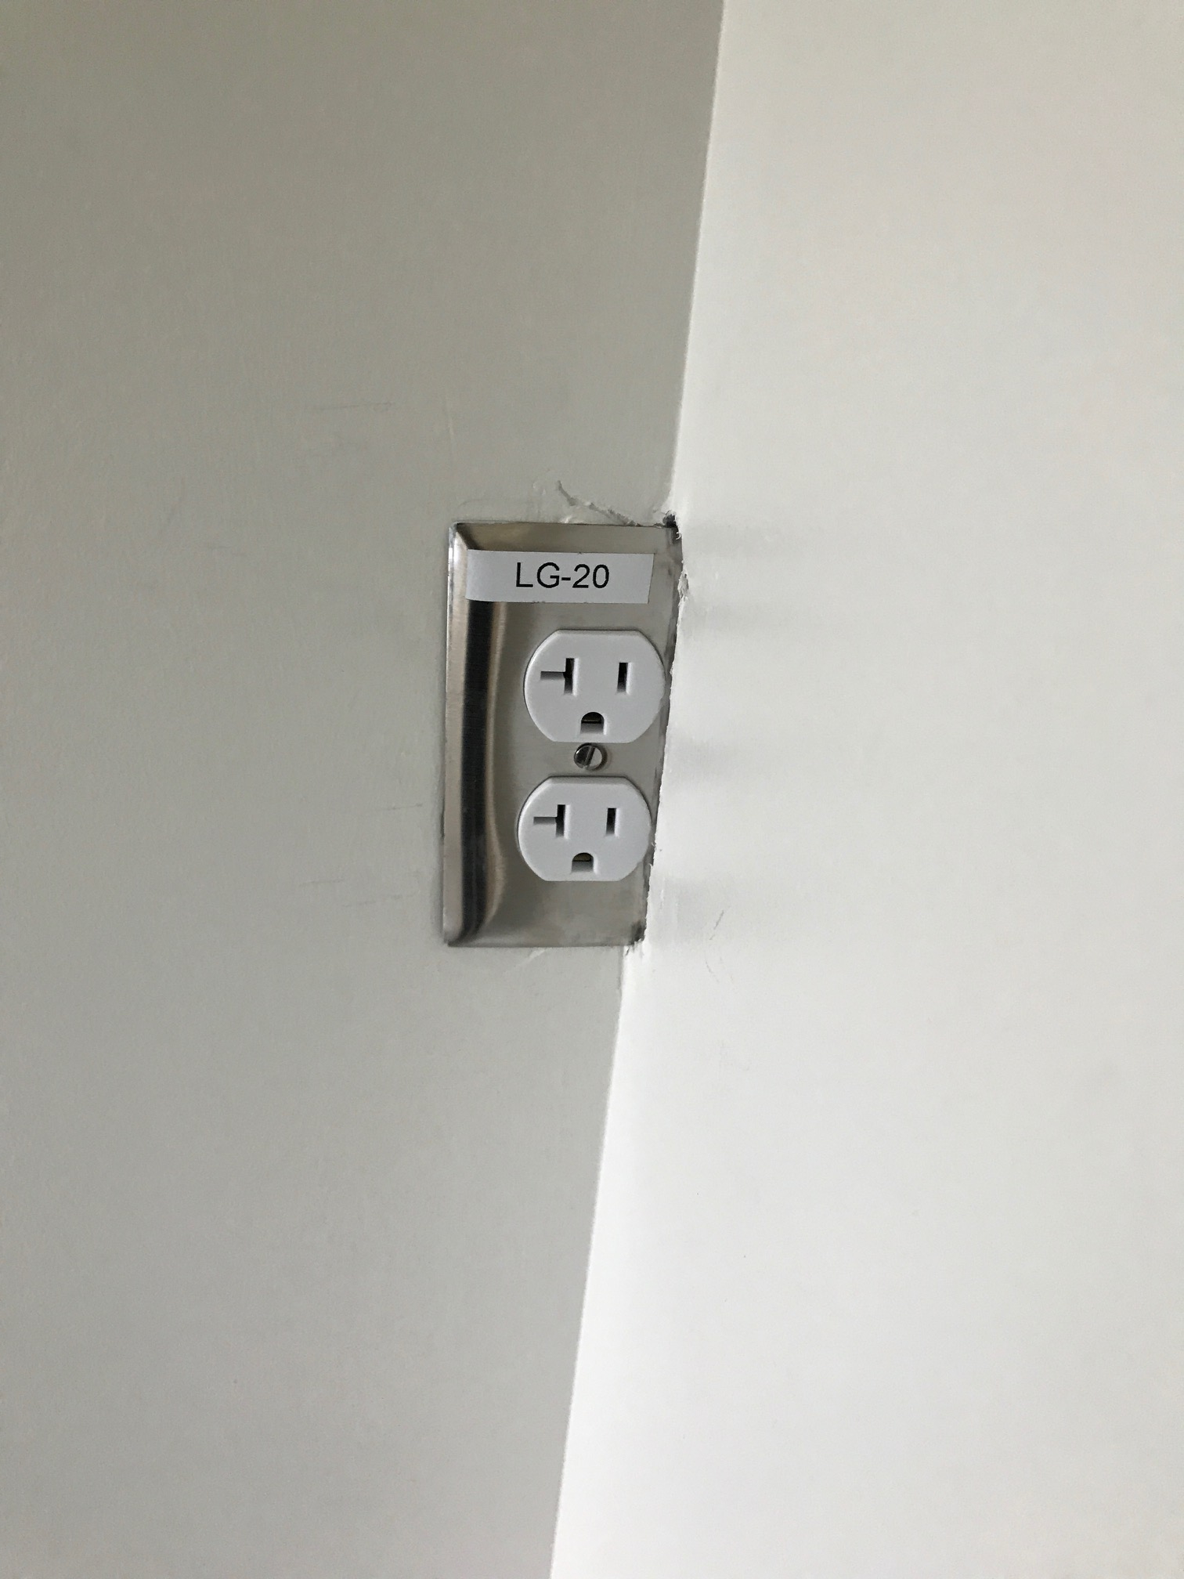
Nice trimming job

Slide 16
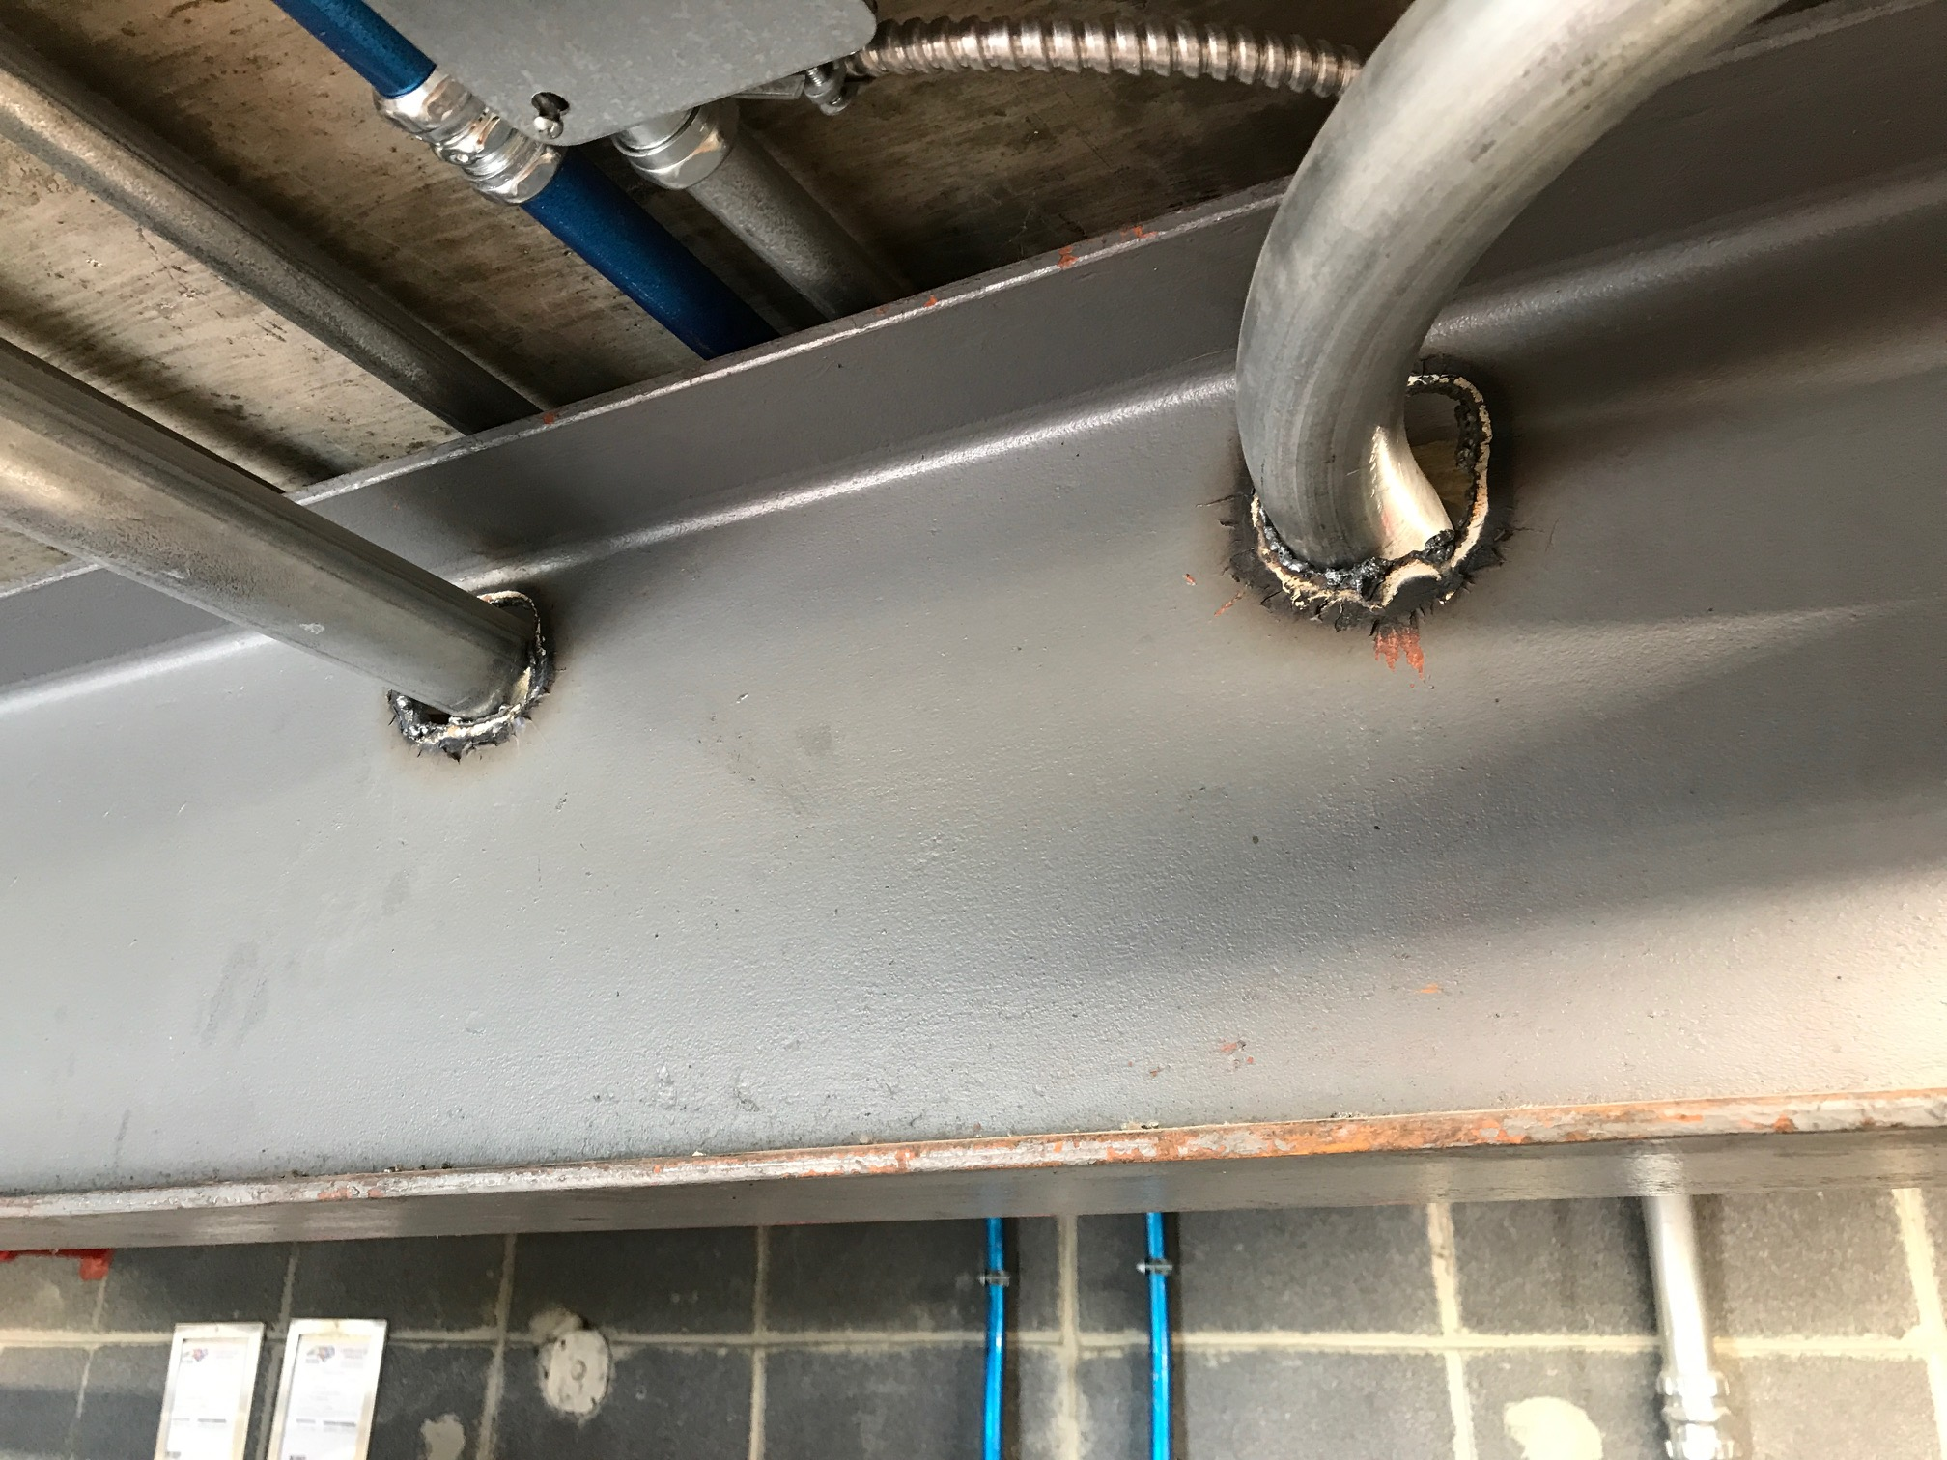
Structural engineer said it’s fine?

Slide 17
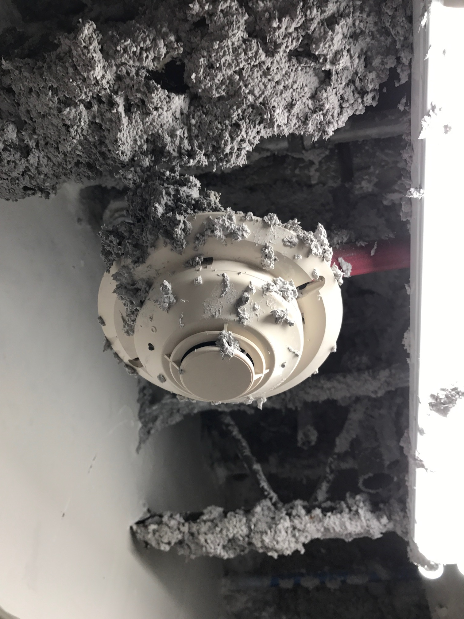
Fire proofed smoke head!

Slide 18
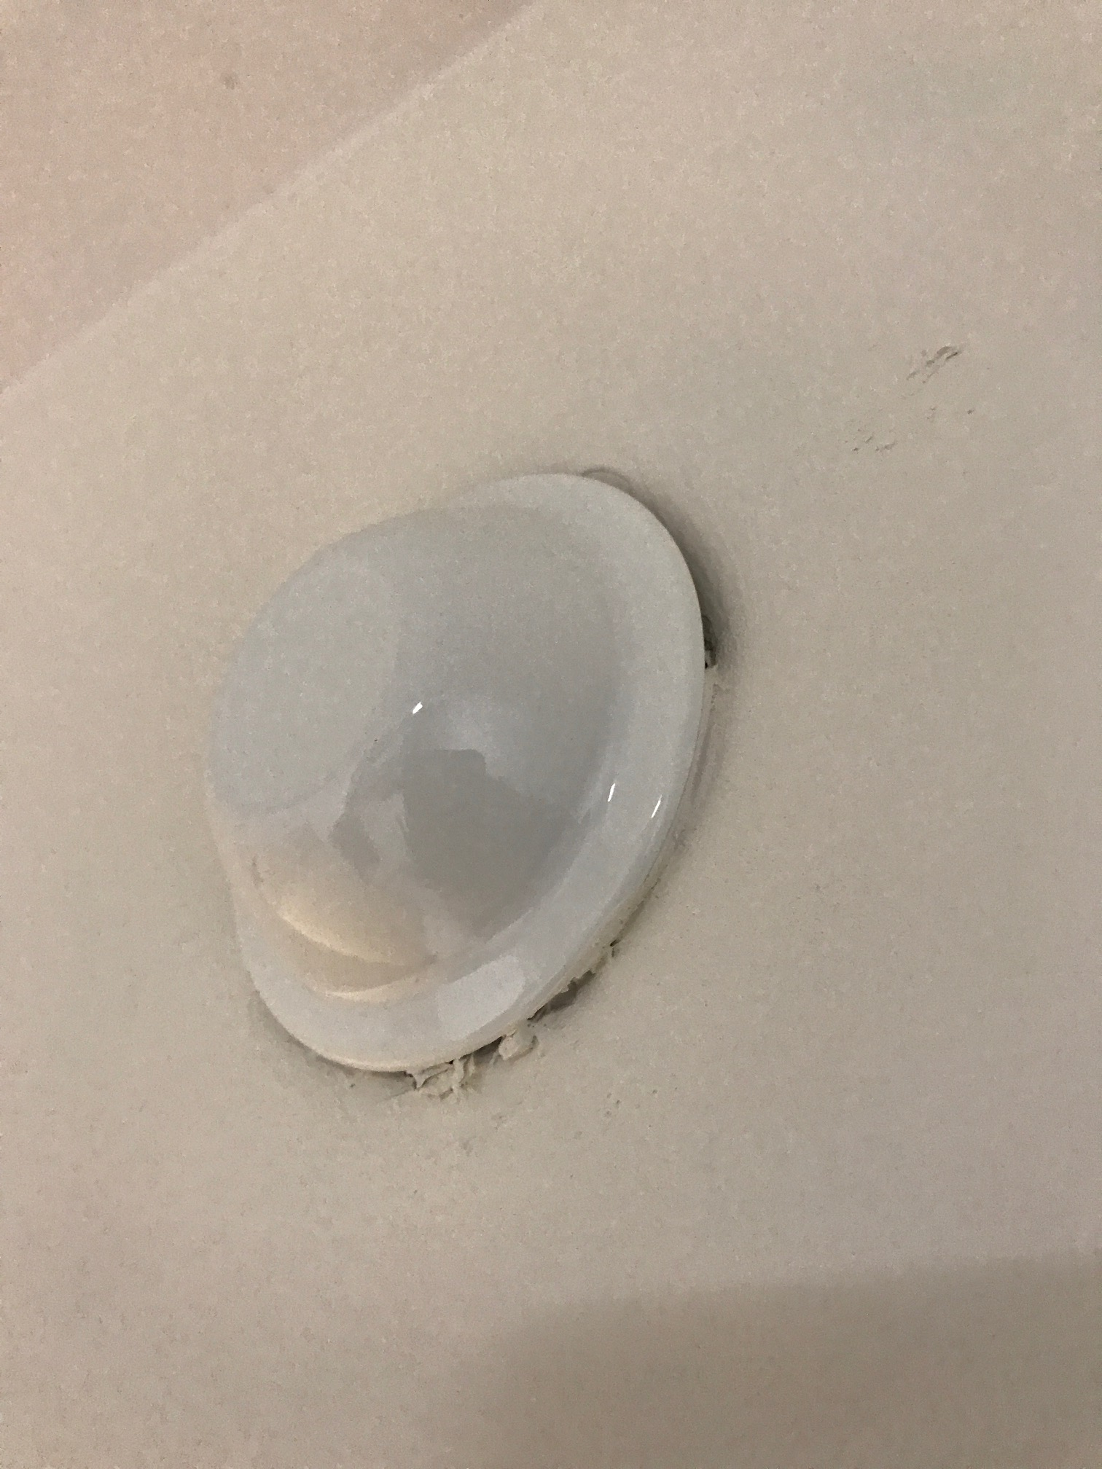
Sprinkler head protected permanently

Slide 19
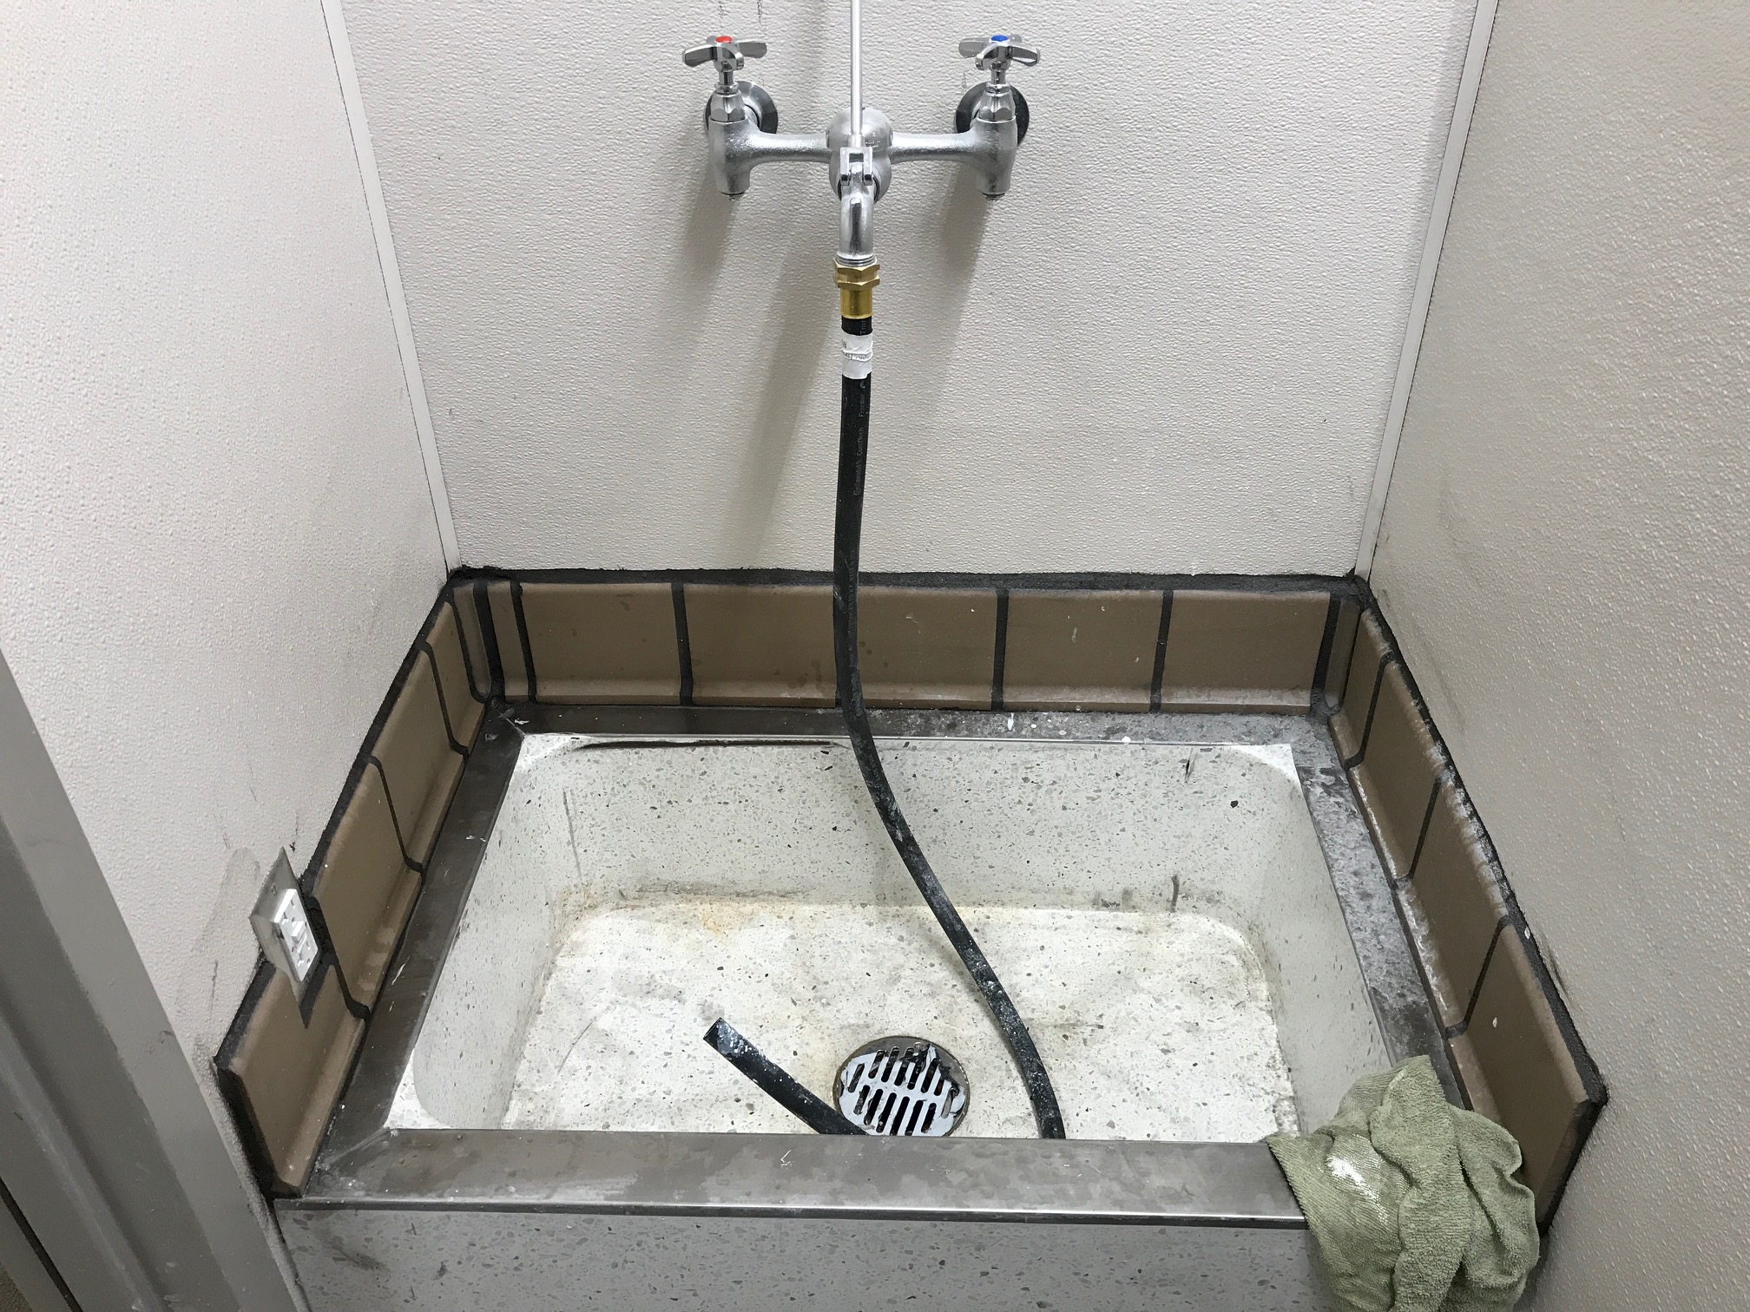
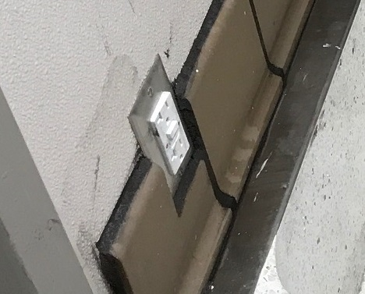
What will the janitor think?

Slide 20
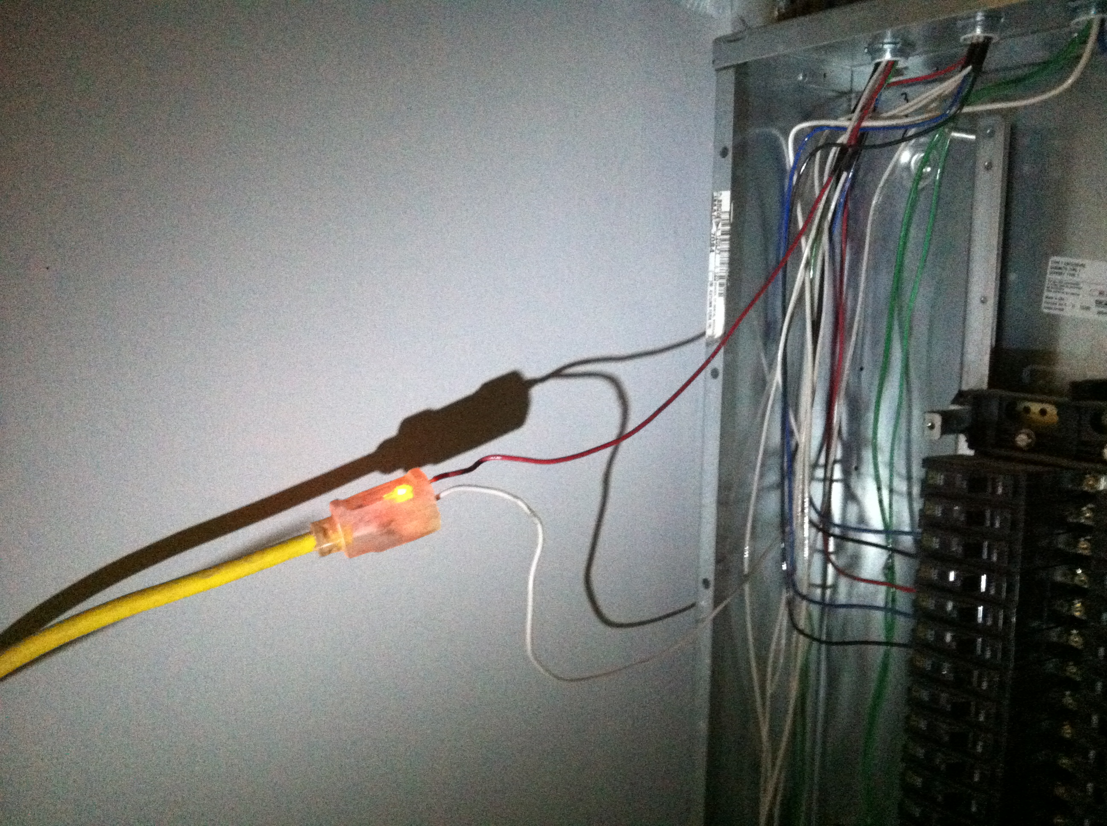
It’s OK, just temporary

Slide 21
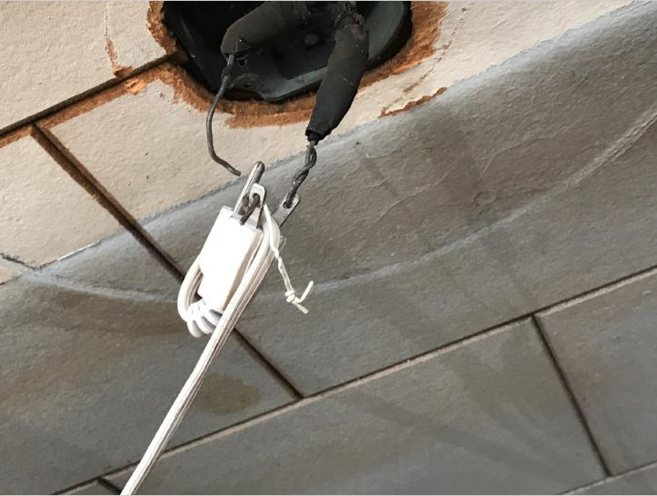
Quick fix, This is just wrong

Slide 22
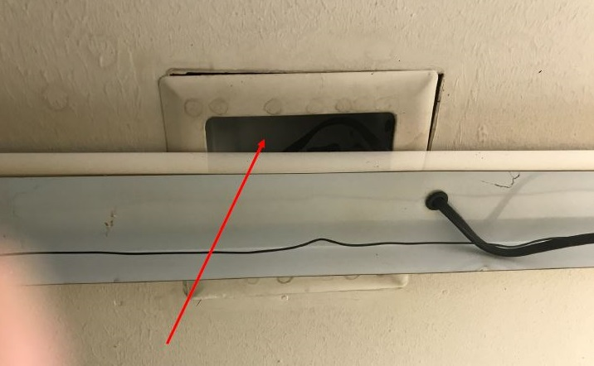
Can you Find the recessed light?

Slide 23
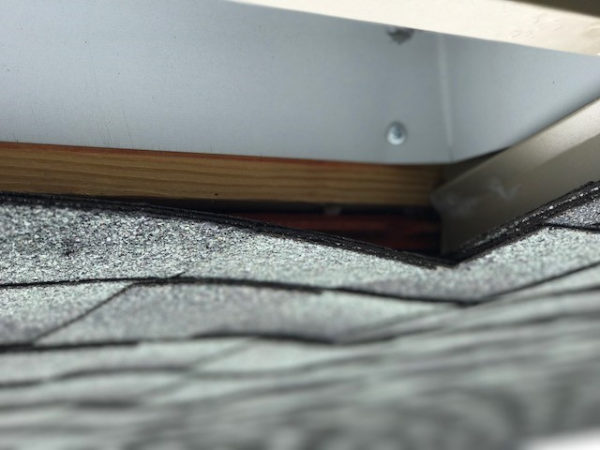
So the roof can breath

Slide 24
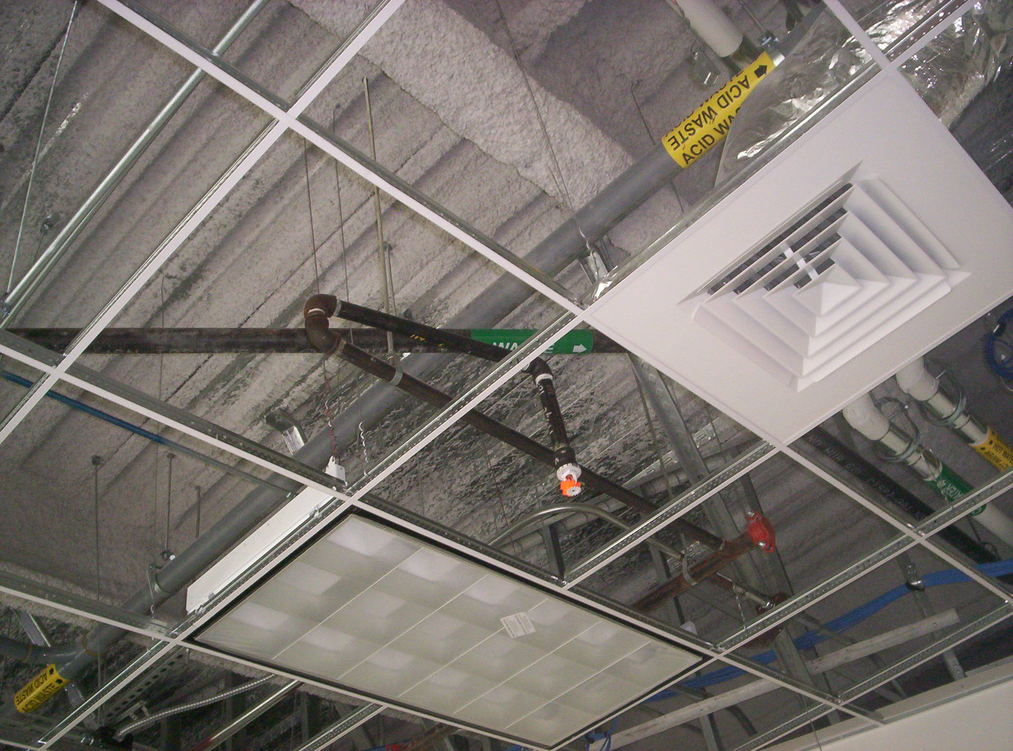
Going around your elbow(s)

Slide 25
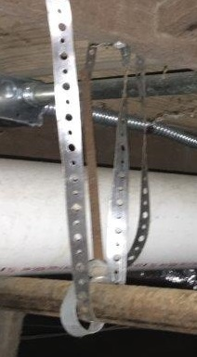
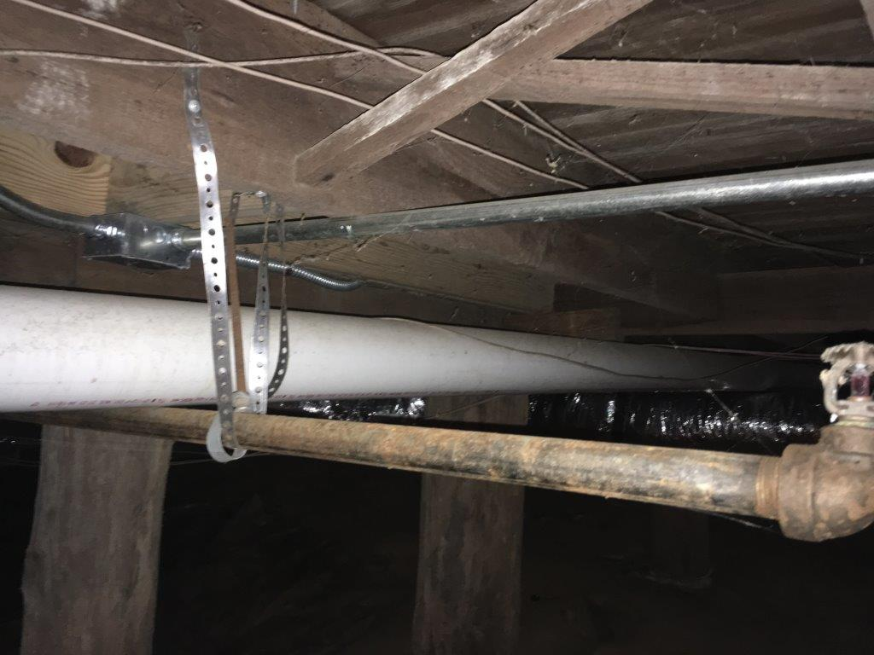
Shortcut, but it works

Slide 26
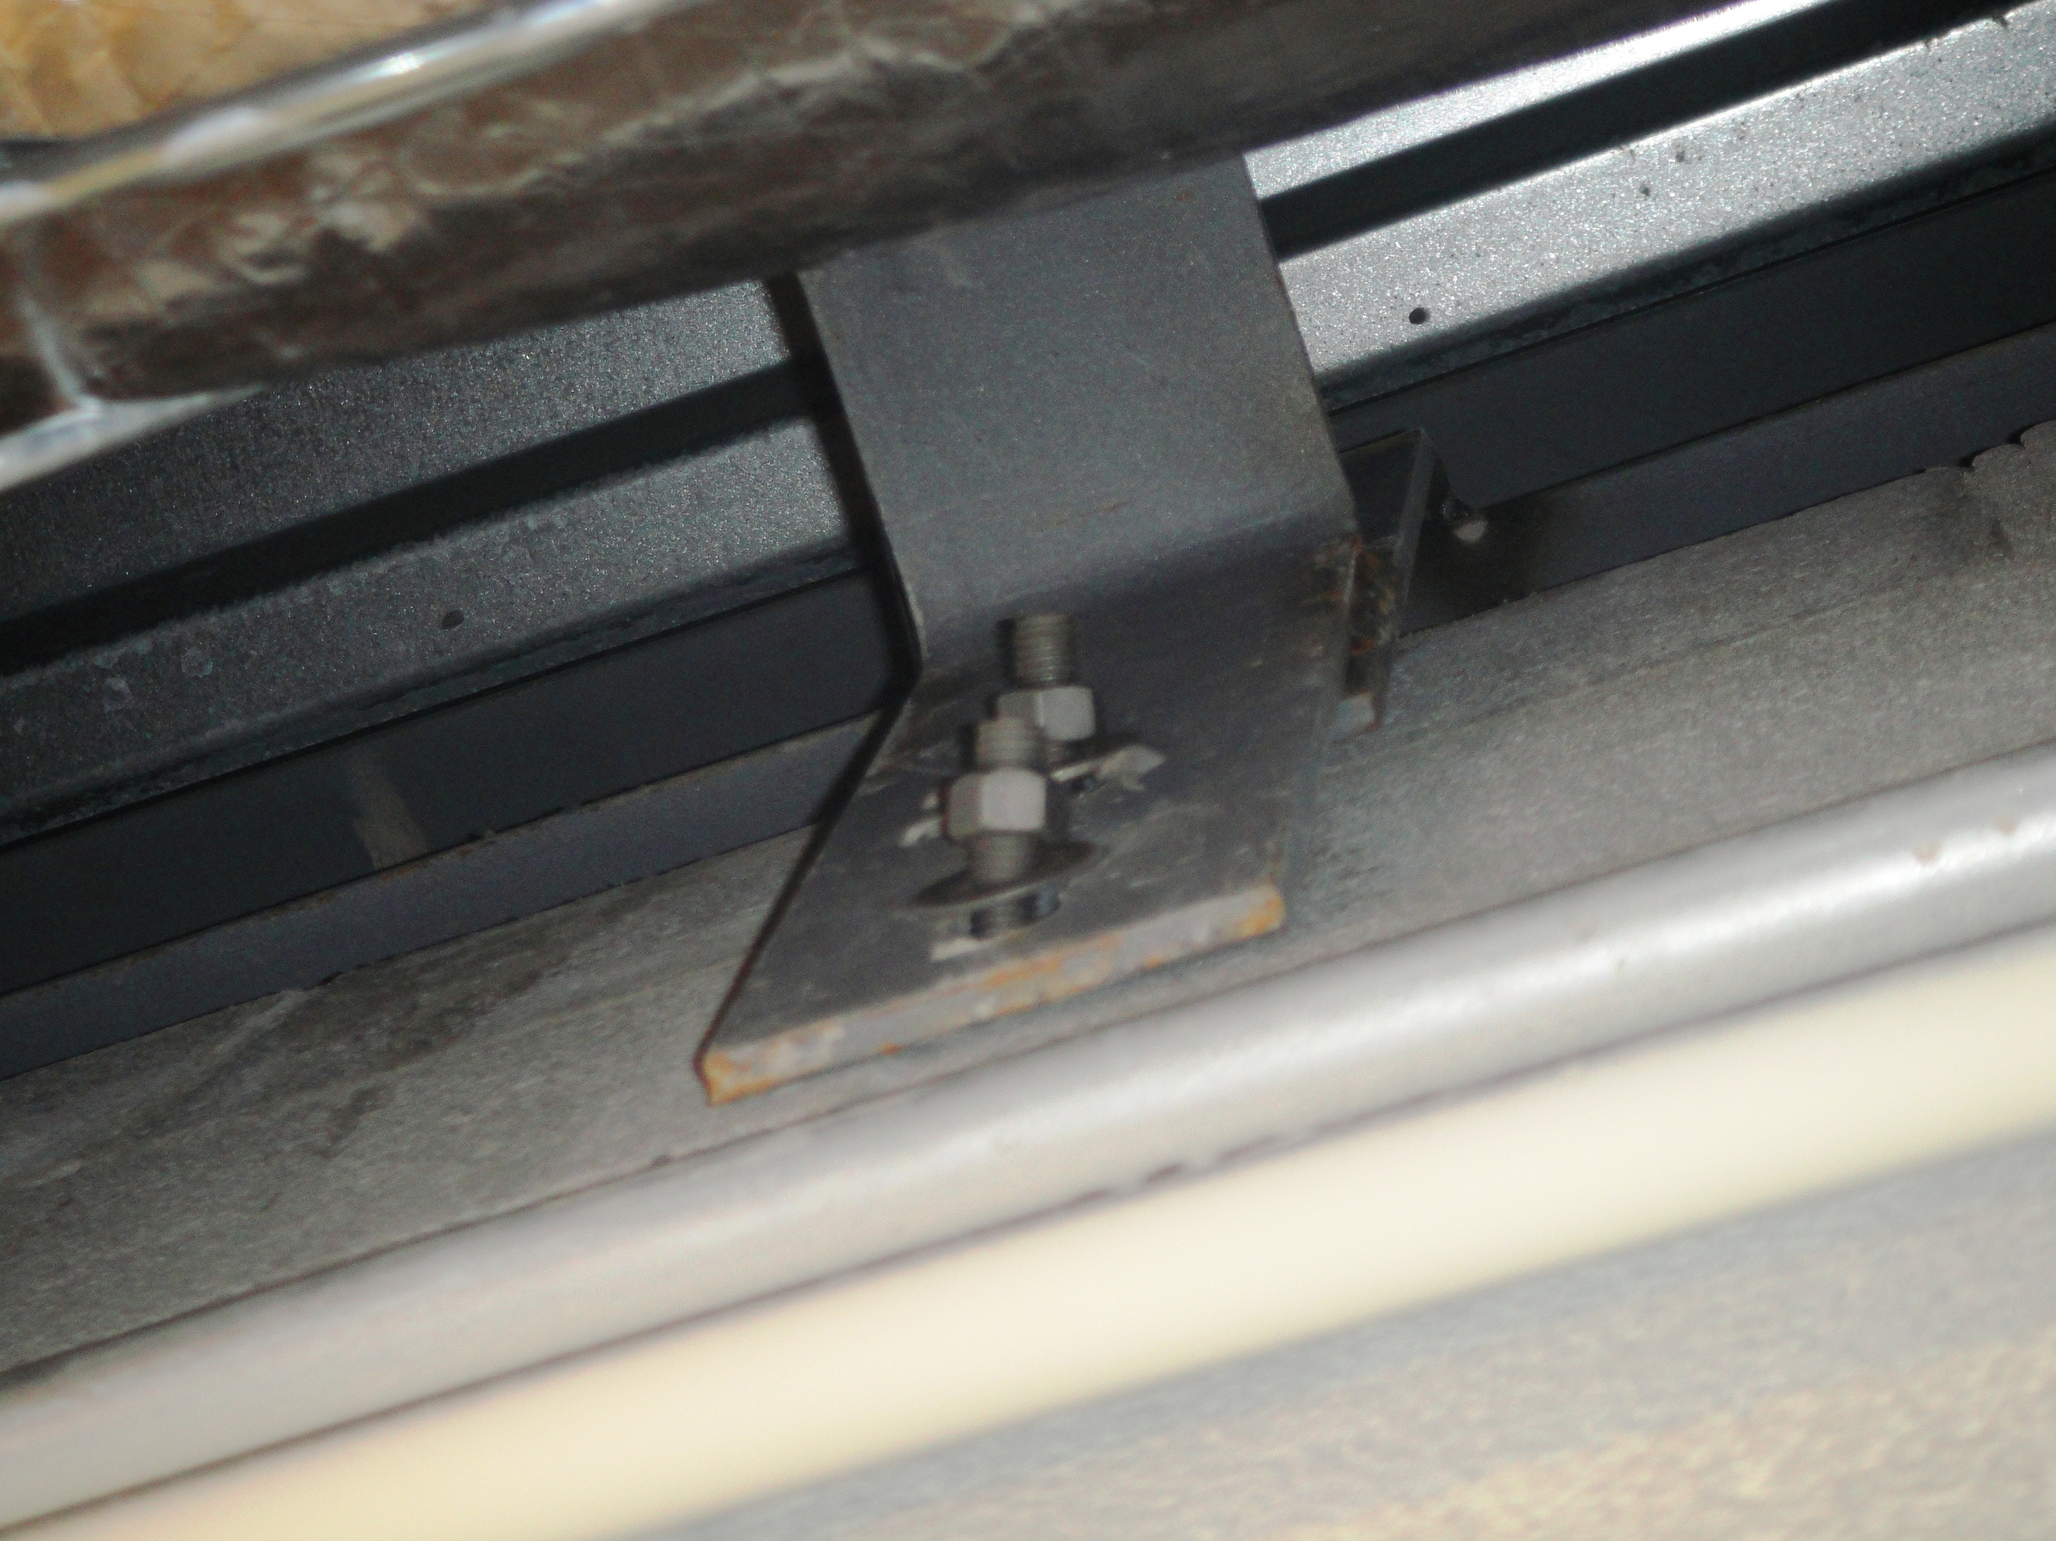
Inspections are important

Slide 27
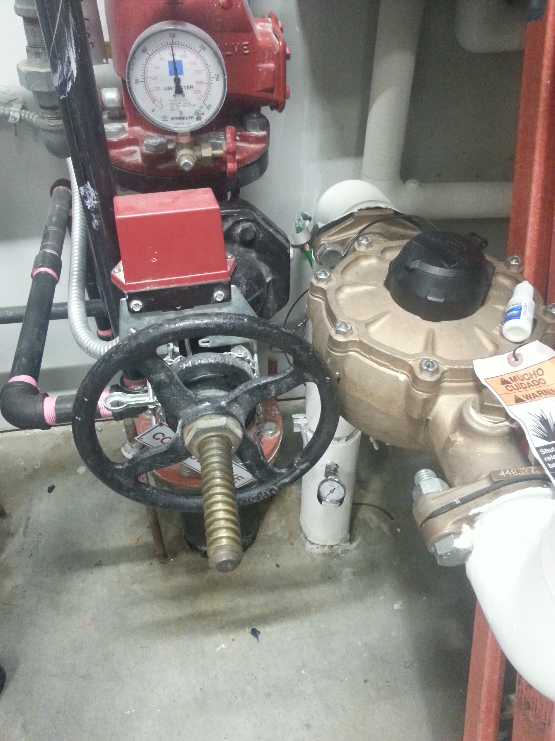
Knuckle buster

Slide 28
If it’s clear to the reviewer it will be clear to the contractor
APPROVED

Slide 29
37th Annual
State Construction
Conference
March 29th, 2018
Thank you
Questions? Send email to
Latif.kaid@doa.nc.gov

