Slide 1
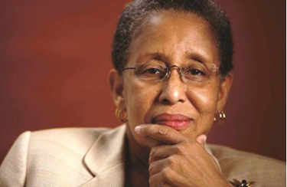
In Honor of Ms. Andrea Harris

Slide 2
Ms. Harris demonstrated relentless leadership by continuing to champion and drive change for leveling the playing field of opportunities for HUB vendors. She was a “Legacy Maker.”
Ms. Harris demonstrated relentless leadership by continuing to champion and drive change for leveling the playing field of opportunities for HUB vendors. She was a “Legacy Maker.”

Slide 3
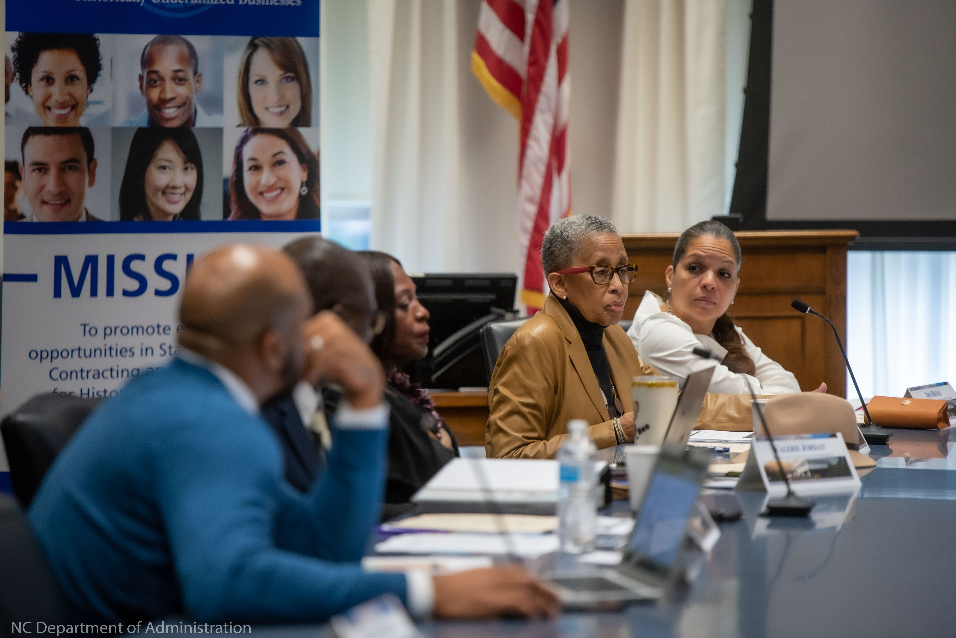
“Andrea Harris was a trailblazer who never stopped fighting for social and racial equity in our state. When doors were intentionally shut, she broke through for women and minority-owned businesses to succeed, modeled excellence in advocacy and mentored scores of freedom fighters.”
- Gov. Roy Cooper
“Andrea Harris was a trailblazer who never stopped fighting for social and racial equity in our state. When doors were intentionally shut, she broke through for women and minority-owned businesses to succeed, modeled excellence in advocacy and mentored scores of freedom fighters.”
- Gov. Roy Cooper

Slide 4
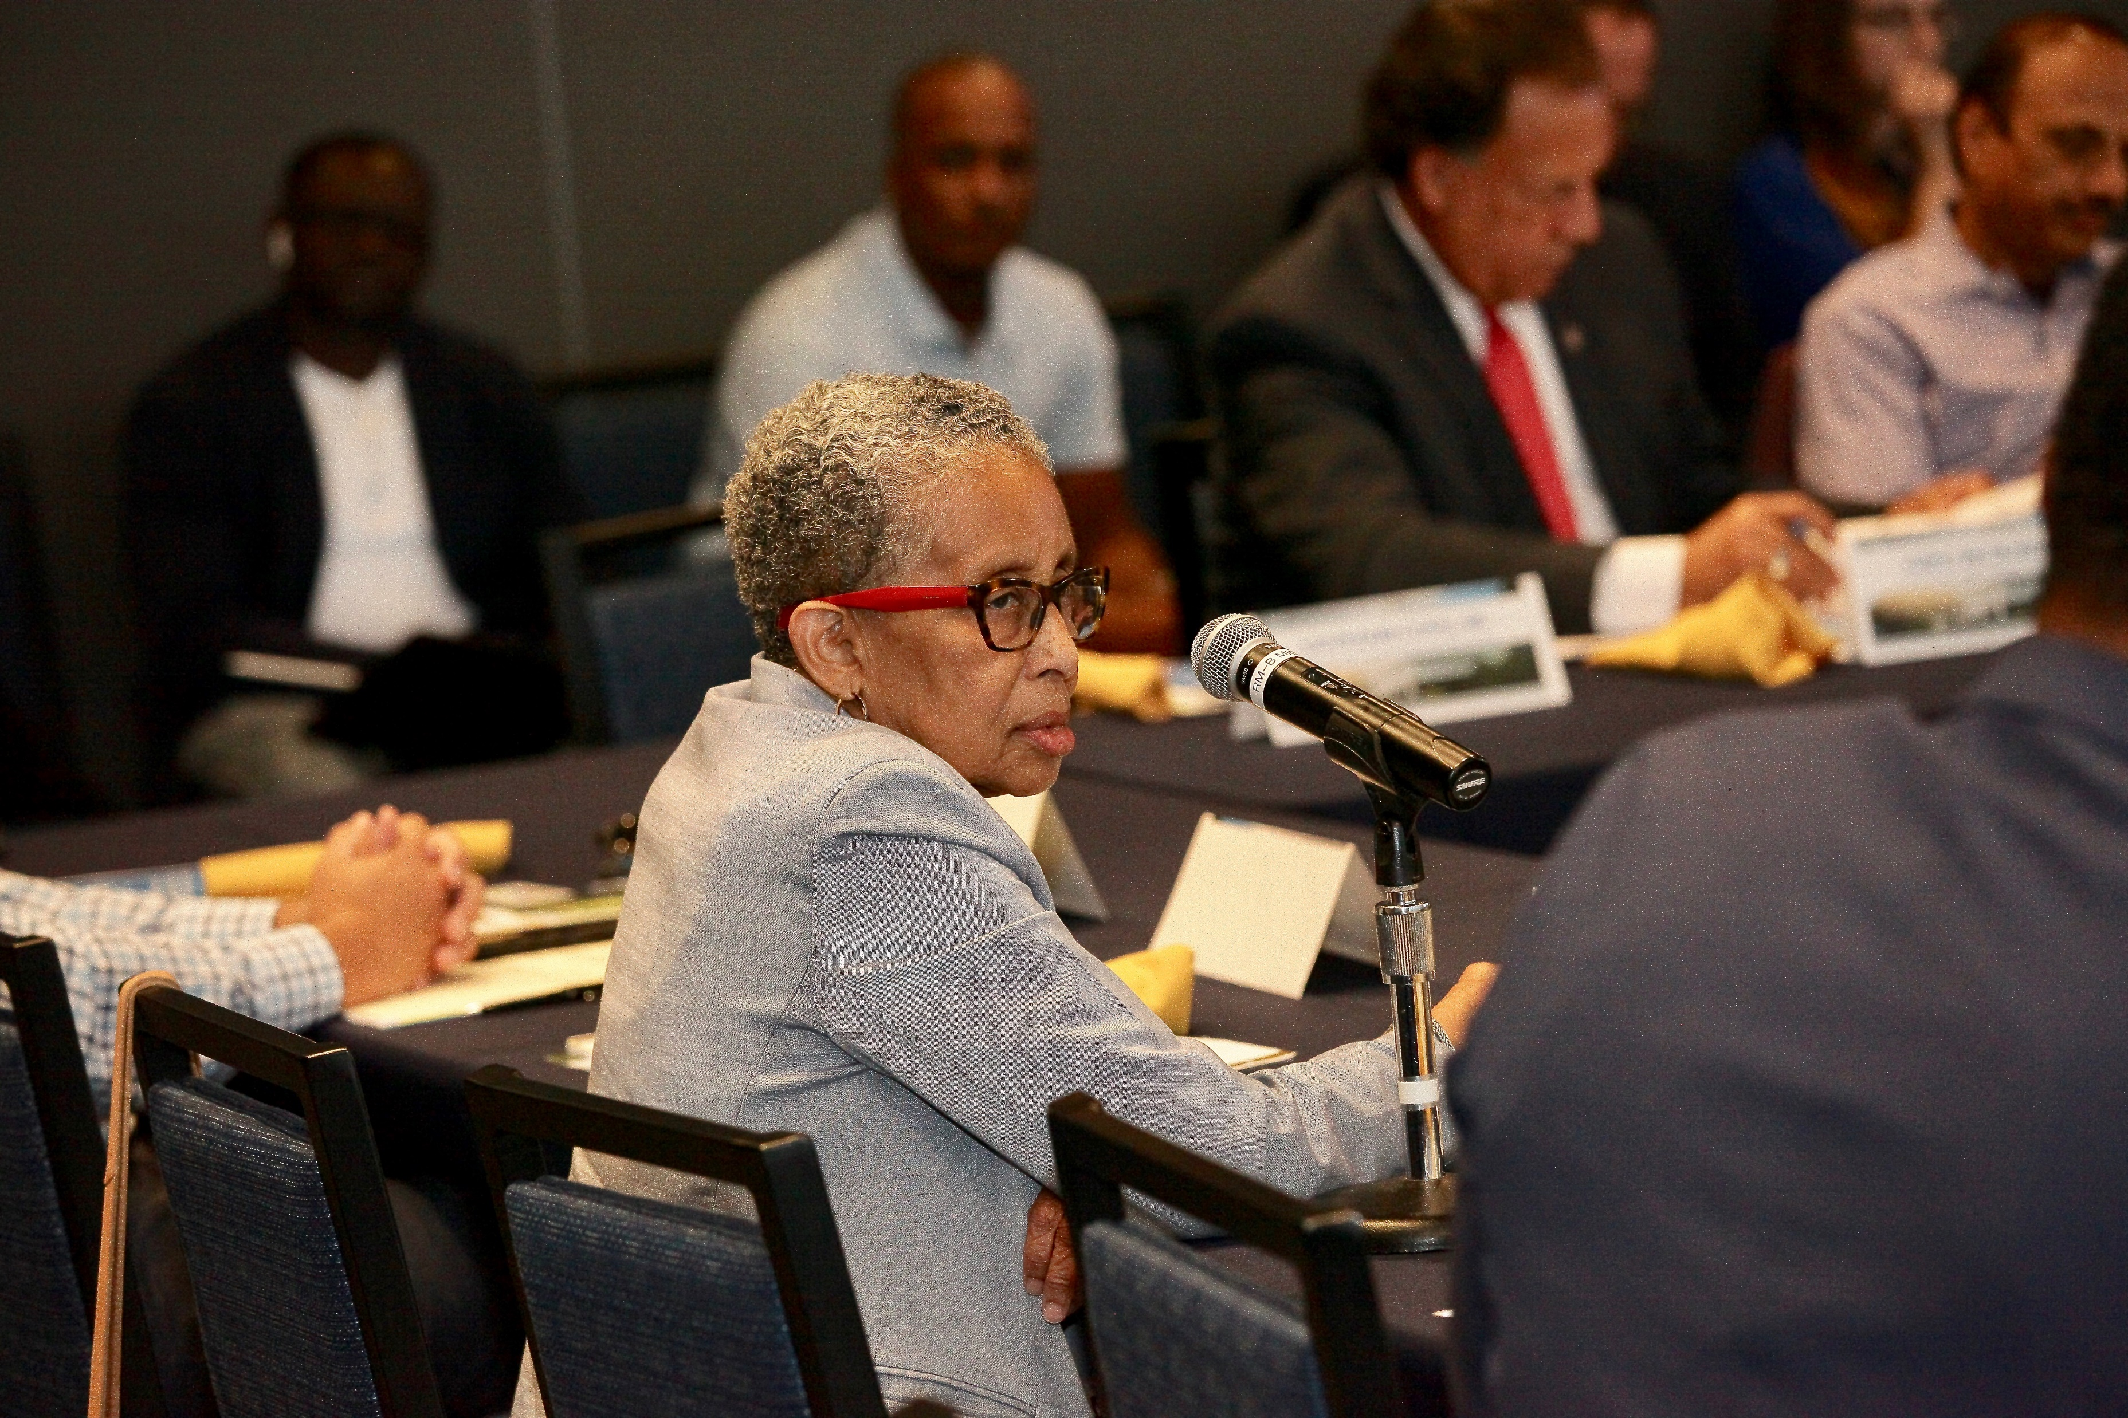
The HUB Office stands with many, remembering the fierce warrior and passionate leader who left footprints everywhere she went. She was small in stature, but a giant in the eyes of all she encountered.

Slide 5
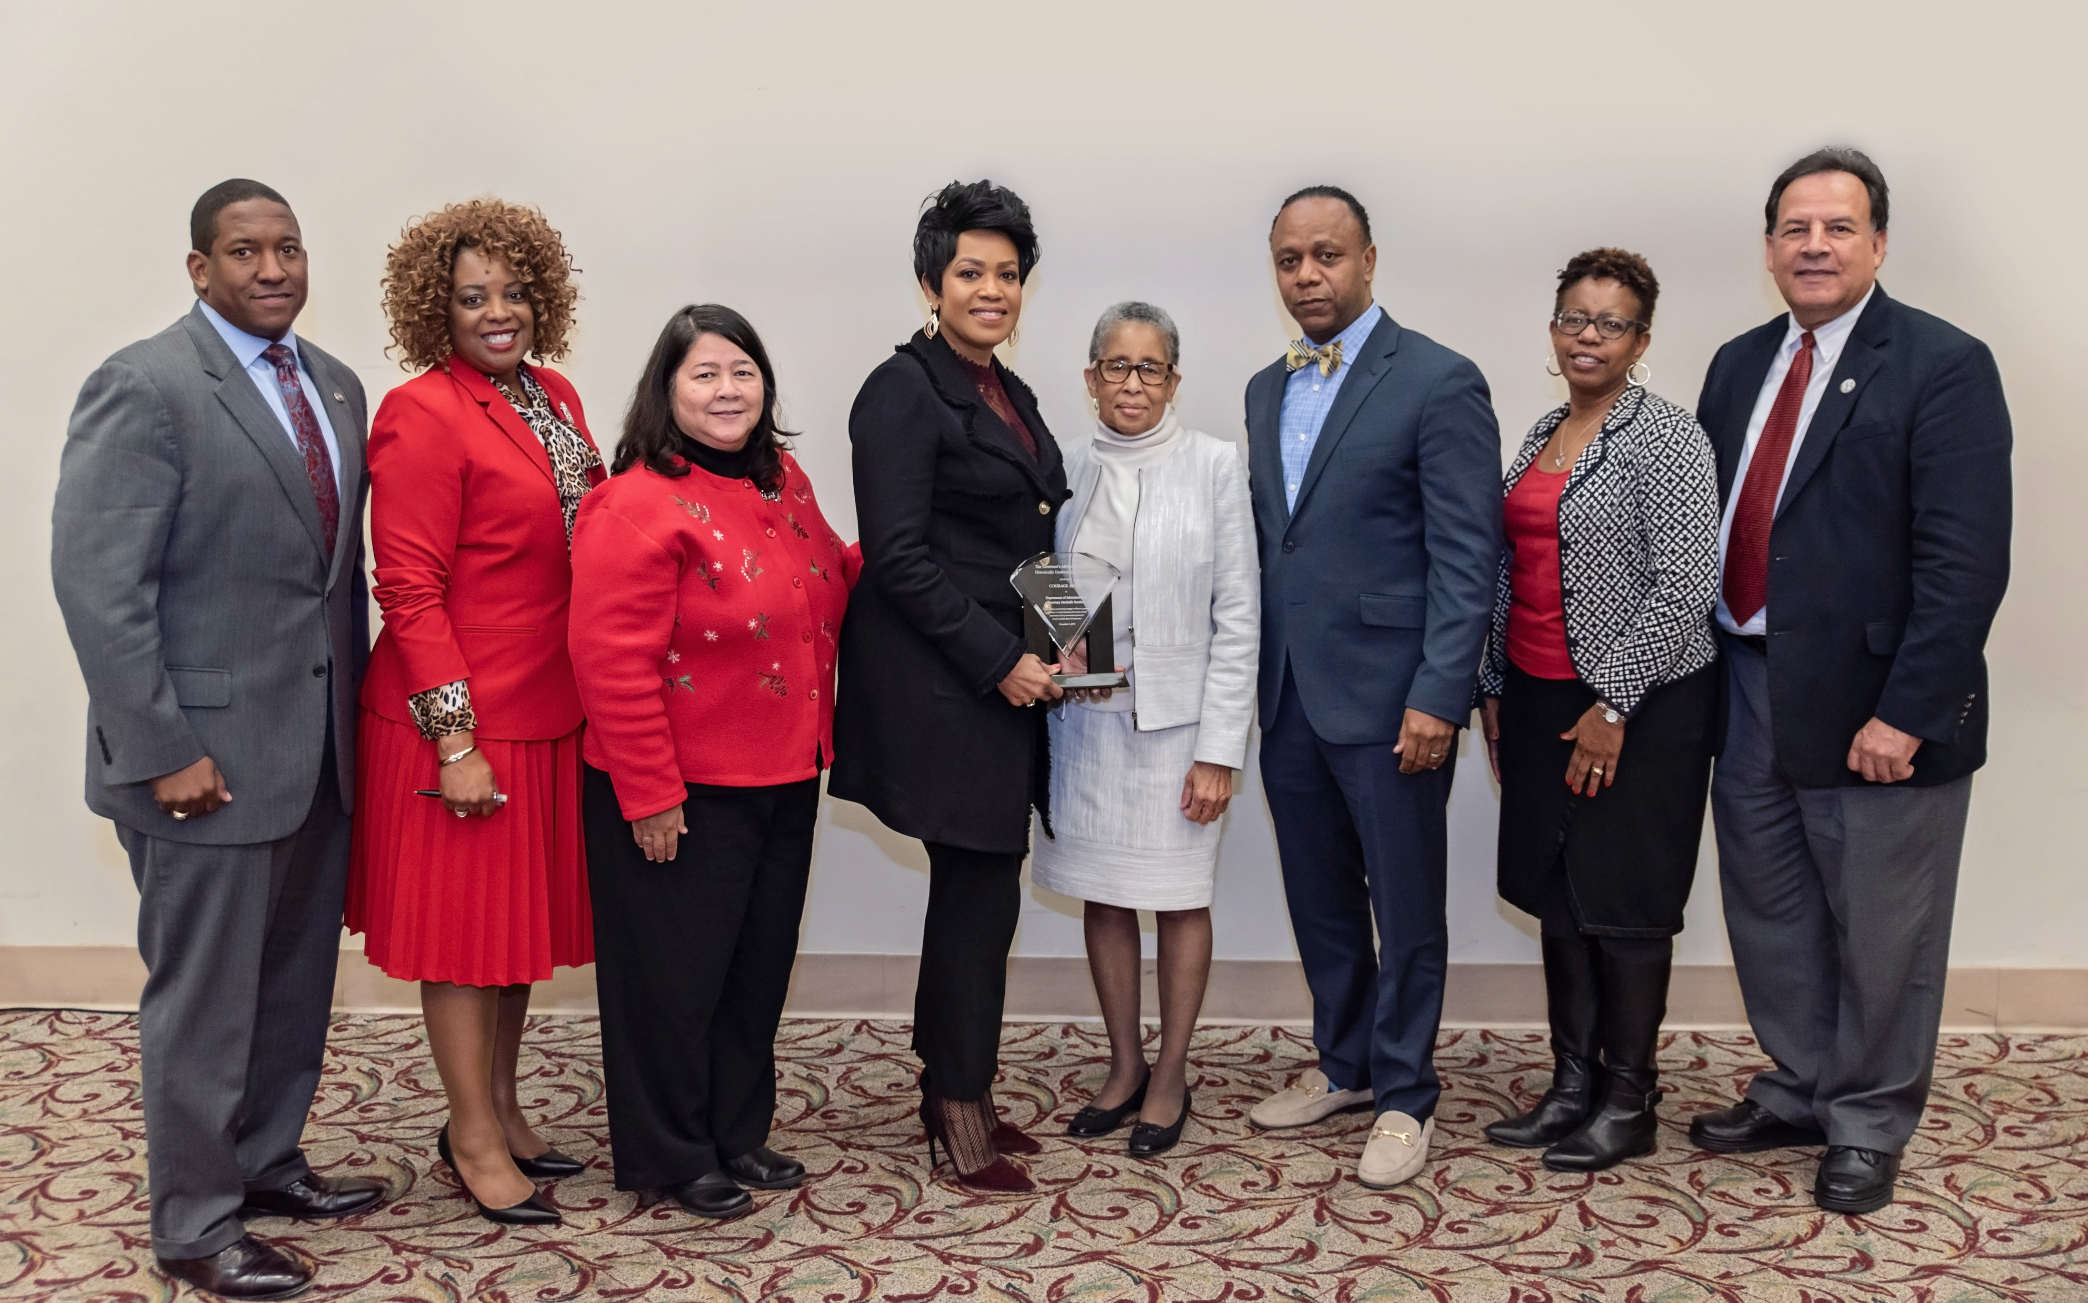
.
A true servant leader, whose passion to fight against poverty and oppression led her to co-found the NC Institute of Minority Economic Development in 1986 and appointed to the Governor’s Advisory Council for HUB in 2017. Her actions helped thousands overcome economic barriers.

Slide 6
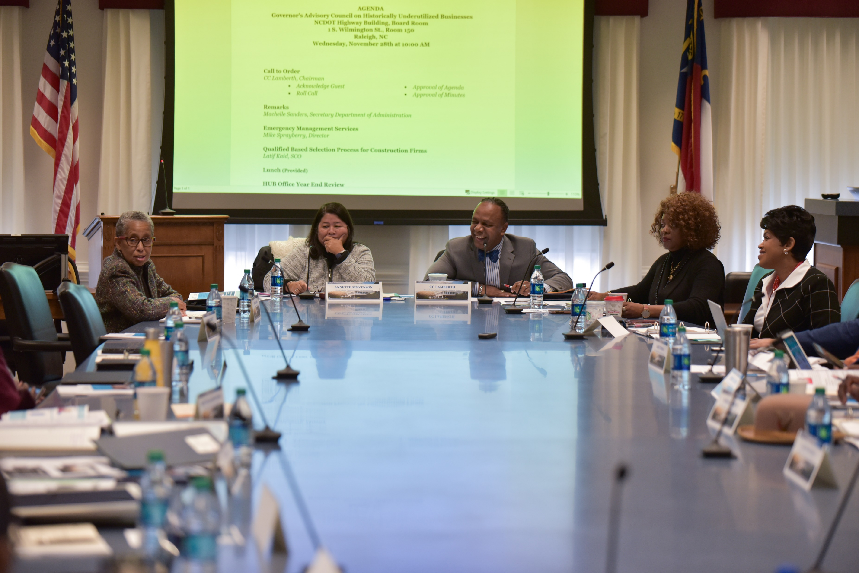
“She left an indelible impact on North Carolina’s business and African American communities, and she will be missed.”
- Gov. Roy Cooper
“She left an indelible impact on North Carolina’s business and African American communities, and she will be missed.”
- Gov. Roy Cooper

Slide 7
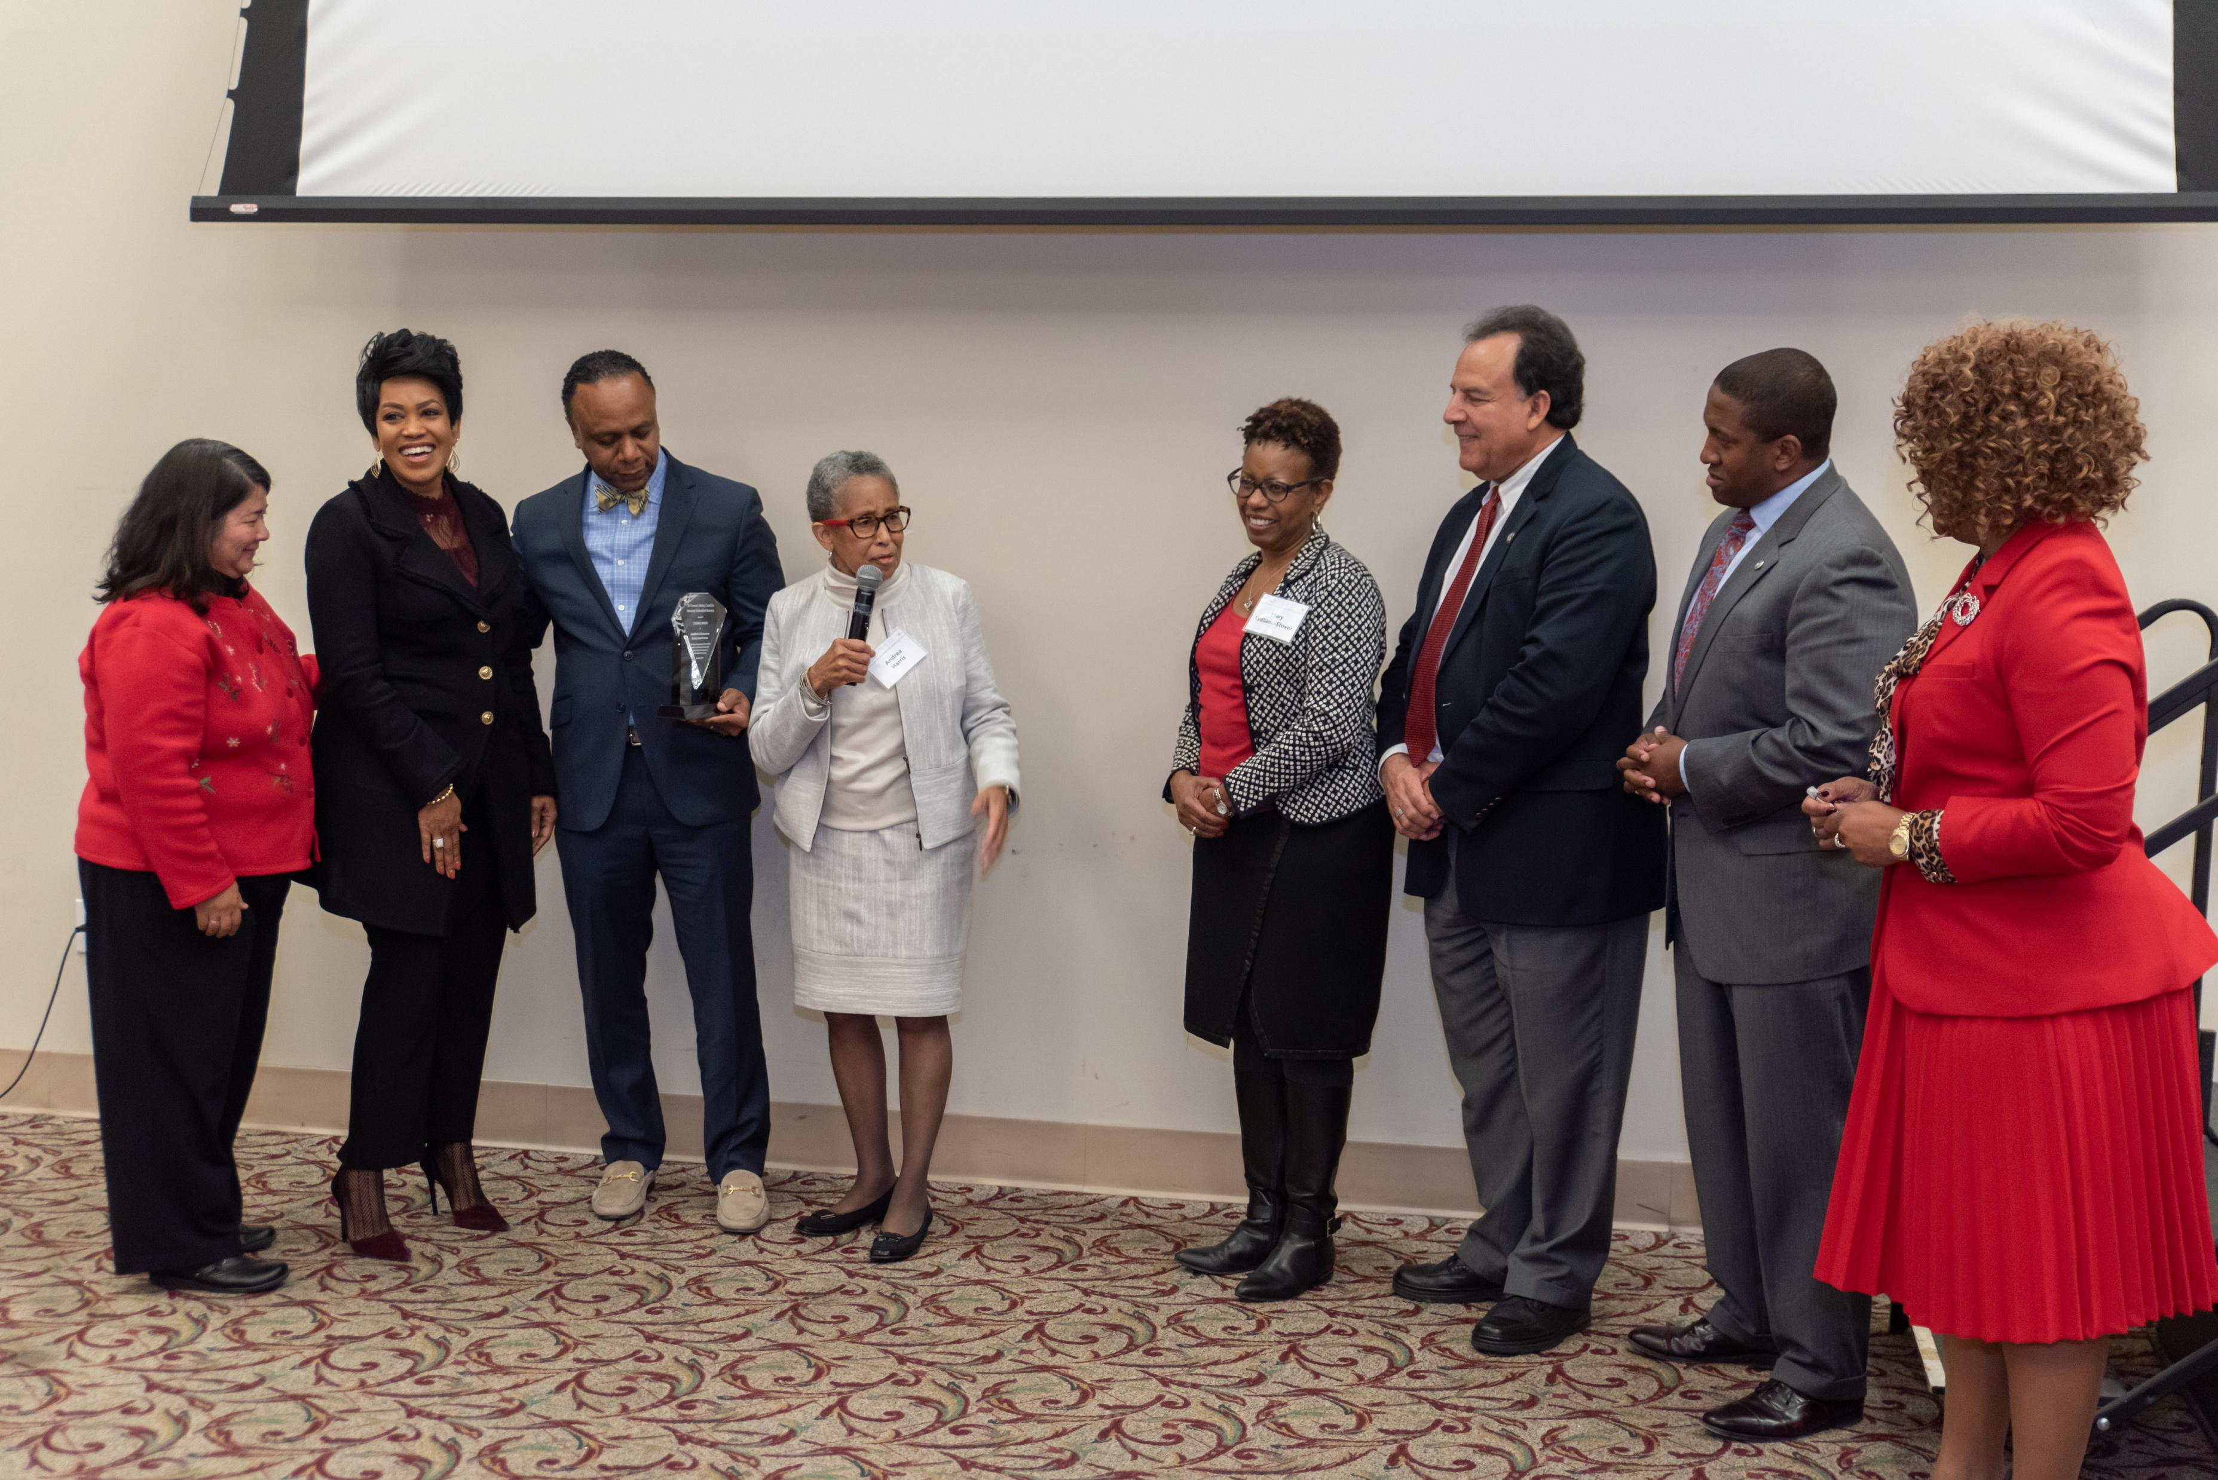
“The greatest legacy Andrea left us is a compounded legacy,” “What I mean by that are the dividends that will be paid generations from now.”
Kevin J. Price
President of NCIMED

Slide 8
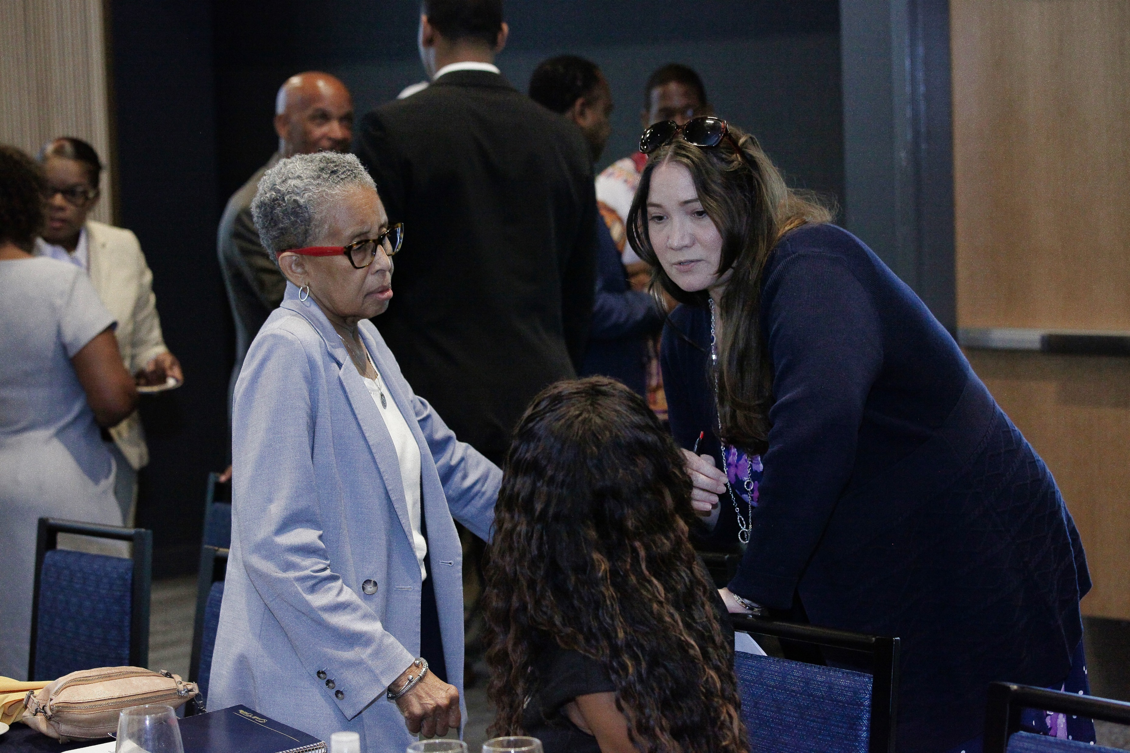
“I decided to be a part of saving the world,”
- Andrea Harris, 2015
“I decided to be a part of saving the world,”
- Andrea Harris, 2015

Slide 9
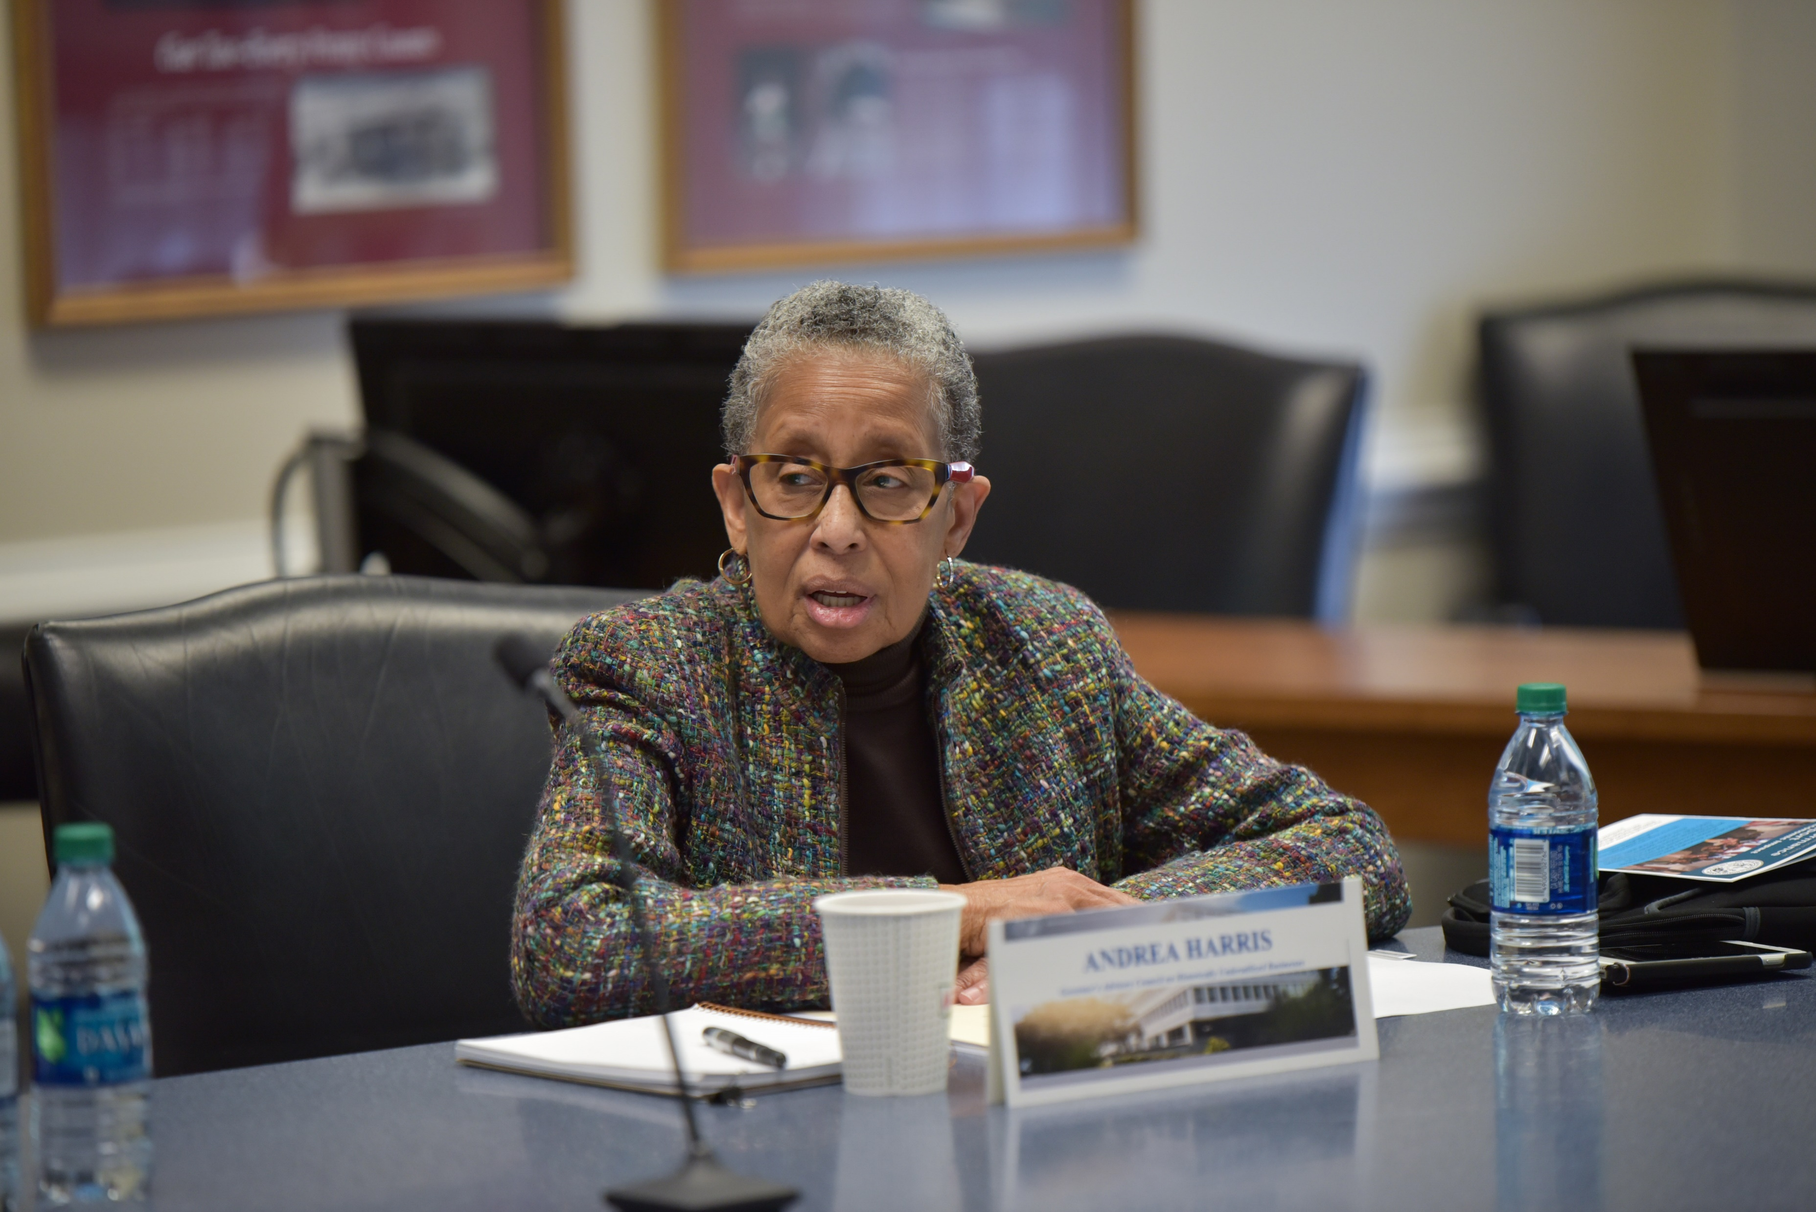
“Being the first to do this or that means you have the responsibility to work in the interest of a second, a seventh, a nine hundredth to follow where you pioneered.”
- Johnetta Cole
“Being the first to do this or that means you have the responsibility to work in the interest of a second, a seventh, a nine hundredth to follow where you pioneered.”
- Johnetta Cole

Slide 10
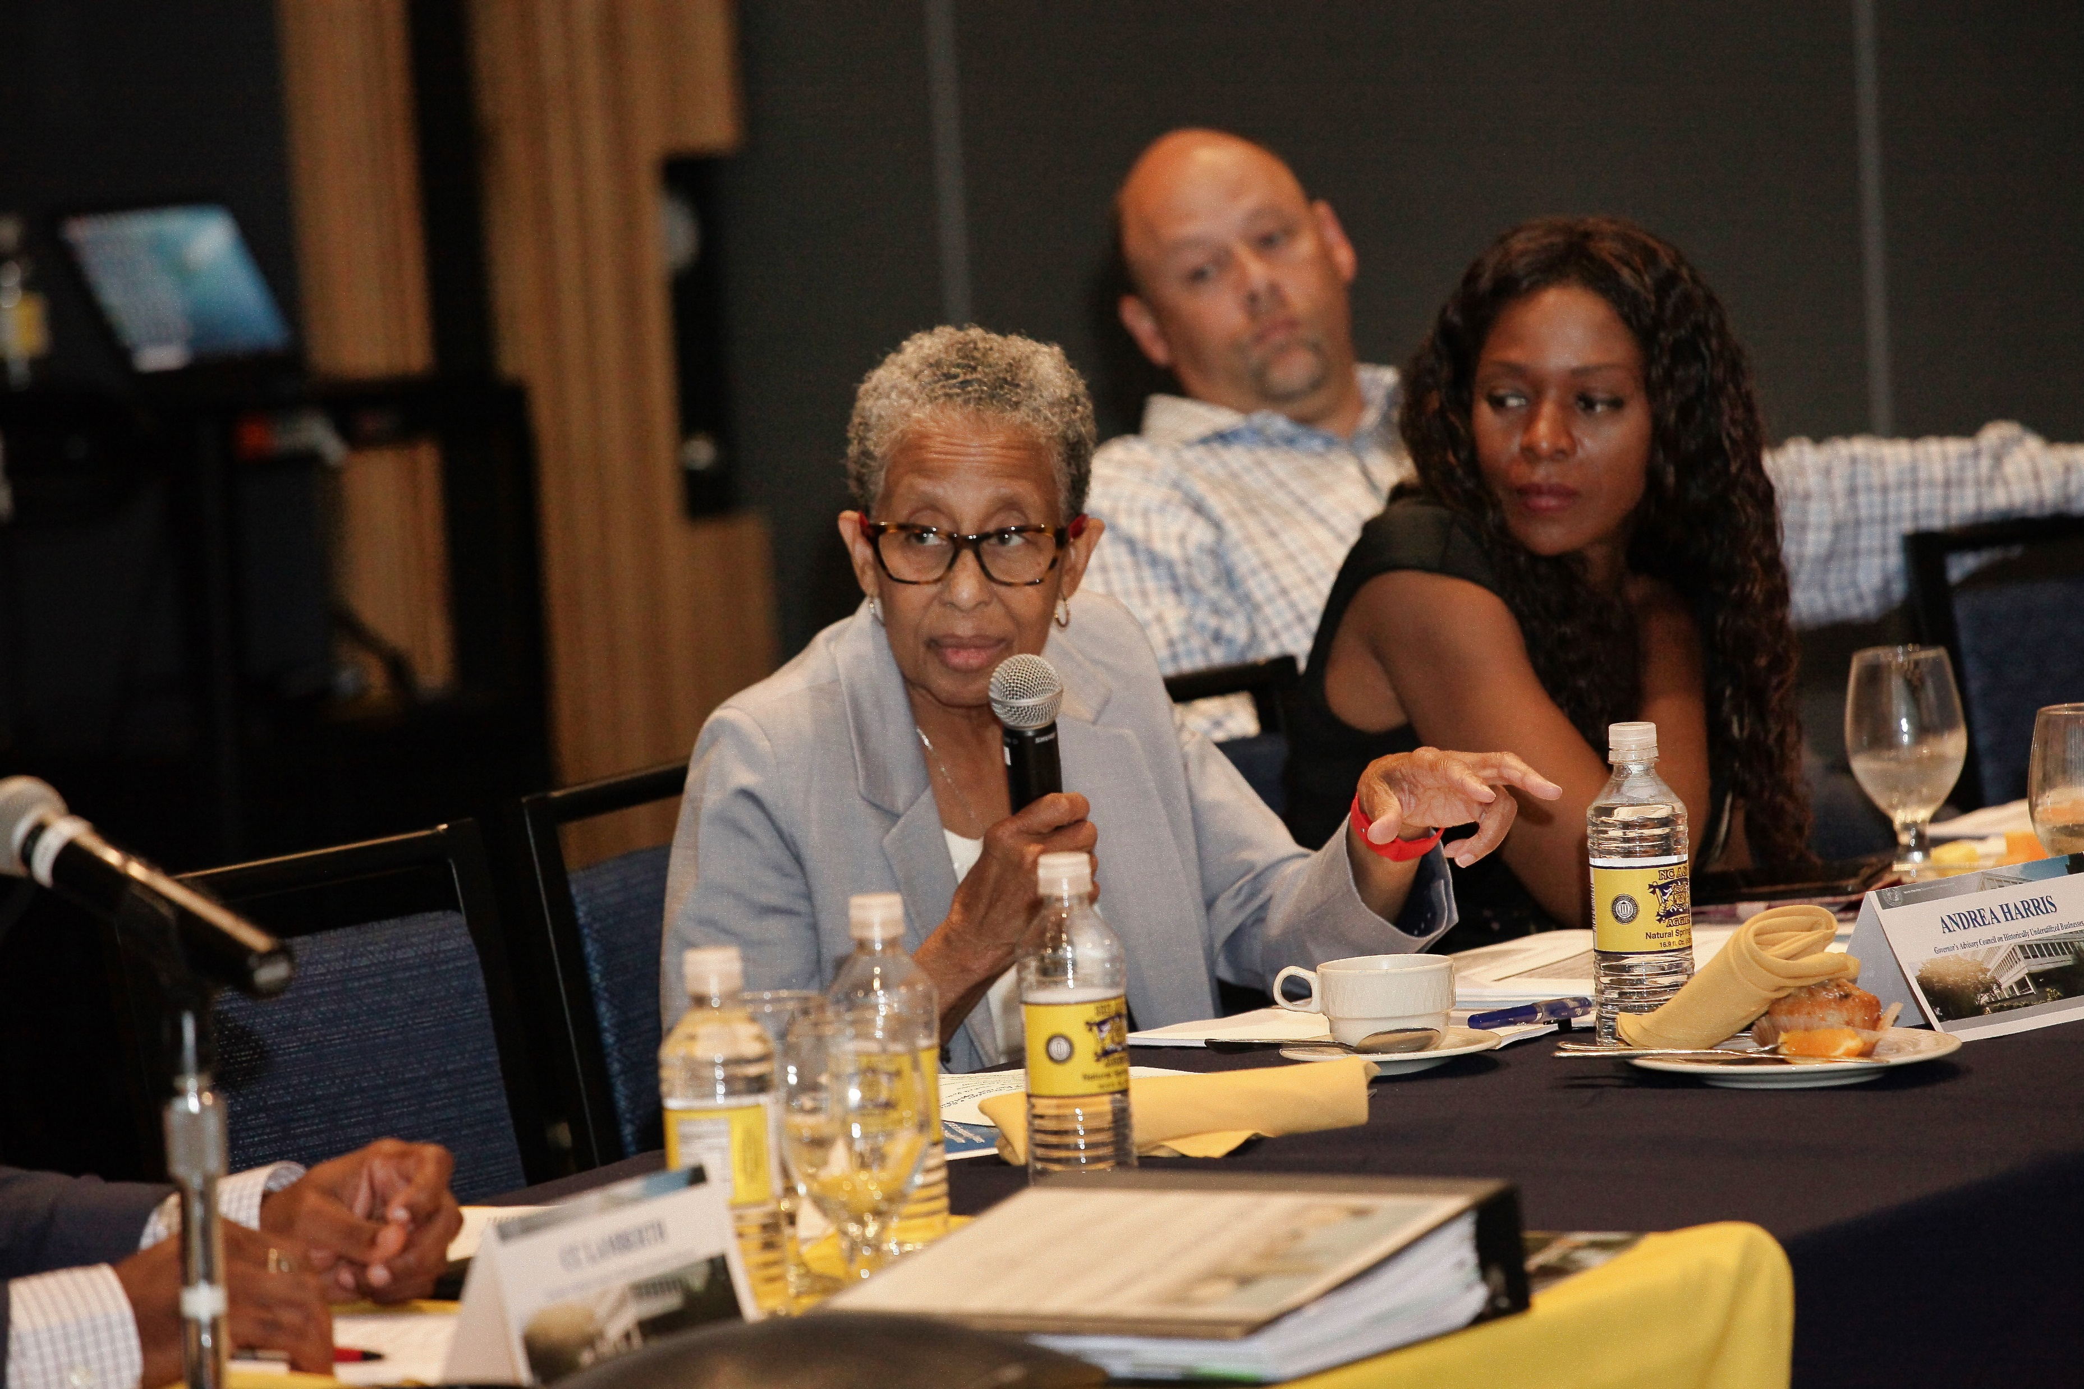
“We need to make sure we always have people at the table who are most affected.”
- Andrea Harris, 2019
“We need to make sure we always have people at the table who are most affected.”
- Andrea Harris, 2019

Slide 11
From the HUB Staff
“A legend that has left a blueprint for “All” to follow” – Alicia Lyon
After numerous conversations with Ms. Harris, she would always say, "Ok, Thank you! I got it from here". Well Ms. Harris, you left a legacy and great instructions, so I am taking a page from your book, "We got it from here". - Traci Herrod
“Because I must look beyond me, I strive for Thee” This quote embodies the person of Andrea Harris. She was a Champion at rescuing people and building a stronger more inclusive North Carolina. Her fingerprints leave a rich indelible stain, telling the story of North Carolina’s struggles and historical achievements. And God said, Well Done, My Good and Faithful Servant. I am better because She lived, - Nicole Gye’Nyame
Phenomenally, Phenomenal – Andrea Harris, Icon.

Slide 12
From the HUB Staff
Although I am still processing like others, I am truly confident that each life touched is better today than we were before our introduction to this brilliant lady. Always most calm but intentional. The wisdom shared with me will forever be cherished. Our conversations were never elongated, but the result was always the same, “yes ma’am I will take care of it…. yes ma’am I’m on it….yes ma’am I understand the charge and …..yes ma’am I got it.”
Ms. Harris was extremely proud of the work that all of us are doing. Our biggest cheerleader in our face and behind our back. WE have no choice but to take all that has been learned and put it into immediate action.
I am committed to continuing to fight for equality and access to opportunities for all….it is my hope that you will join me. ~ Tammie Hall
Phenomenally, Phenomenal – Andrea Harris, shero

Slide 13
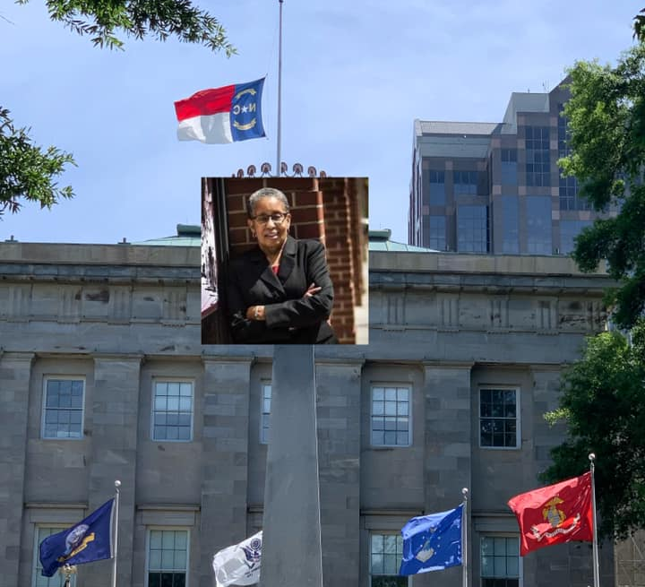
Rest in Love
(Flags lowered at half-staff for 4 days)

Slide 14
GOVERNOR’S ADVISORY COUNCIL
for
HISTORICALLY UNDERUTILIZED
BUSINESSES
LEAD ON

