Slide 1
WEX Updates
State of NC Motor Fleet May 14, 2019

Slide 2
Agenda
Introductions and WEX Resources
Roles and responsibilities for Michaela and Denise
Current Project underway with Motor Fleet
WEX Systems Overview:
WEXonline
Clearview and Clearview Snap
WEX Connect
High level demo of Clearview – what are the differences in the tools (WEXOnline vs. Clearview)
Coming soon single sign on and Clearview Snap
Provide access to Clearview for agency owned vehicles

Slide 3
WEX Contacts
Michaela Franco
Account Manager
Phone: 207-523-7754
Michaela.franco@wexinc.com
Denise Baumgart
Strategic Relationship Manager
Phone: 913-393-3208
Denise.baumgart@wexinc.com
Day to day contact
Liaison between Motor Fleet and all of WEX
WEXOnline Training
Any general questions
Responsible for overall relationship between WEX and the State of North Carolina
Contract Management
Sharing best practices

Slide 4
Motor Fleet Hierarchy Project
Goal of the project: To provide visibility for each agency to access WEX resources to manage fuel related costs
Timing of the Project: Currently underway in preparation for upcoming card renewal
WEX working with Motor Fleet to segment vehicles to their respective agencies / division by creating reporting accounts (Subset Example)
Motor Fleet (Reporting and Invoicing)
Dept of Agriculture (Reporting)
Food and Drug
Forest Services
Meat and Poultry
Dept of Public Safety
Community Corrections
Correction Enterprises
Crime Control
Also appending driver information to the card records

Slide 5
WEX Systems
WEXOnline
System of Record
Card Maintenance (ordering, transferring and terminating cards)
Manage Authorization Profiles
Clearview
Analytics Tool (Demo)
Coming soon – single sign on with WEXOnline!
Clearview Snap
Initial roll out
WEX Connect
Mobile Access to identify low cost stations
Use in emergency situations to find open stations
Free – download now in app store!

Slide 6
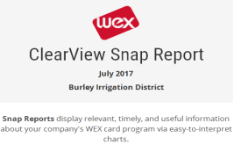
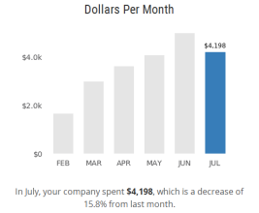
ClearView Snap
Visual Dashboard
Monthly and/or weekly delivery of key fuel information via email
Viewable at a glance – no clicks, no system login
Simple, clean visuals display prior period actuals, month over month comparisons and trends over time
Alexa Skill (beta)
Instant voice command access and accompanying visuals using Amazon Alexa platform
Alexa offers a new delivery channel, daily updates, and transaction-level information
Alexa, Ask ClearView Snap . . .
Notes:
Snap is a new analytics product in the ClearView product suite.
Launched on WEX Direct existing customers - 7-80 vehicles – 7,200 customers loaded between June and December on WEX direct.
Easy access to information about fueling patterns either using visuals or voice
WEX Direct program, GTM Opt Out: Charged $4.99 per month. 11% opt out rate. 37% open rate. 42% of users found it very helpful.

Slide 7
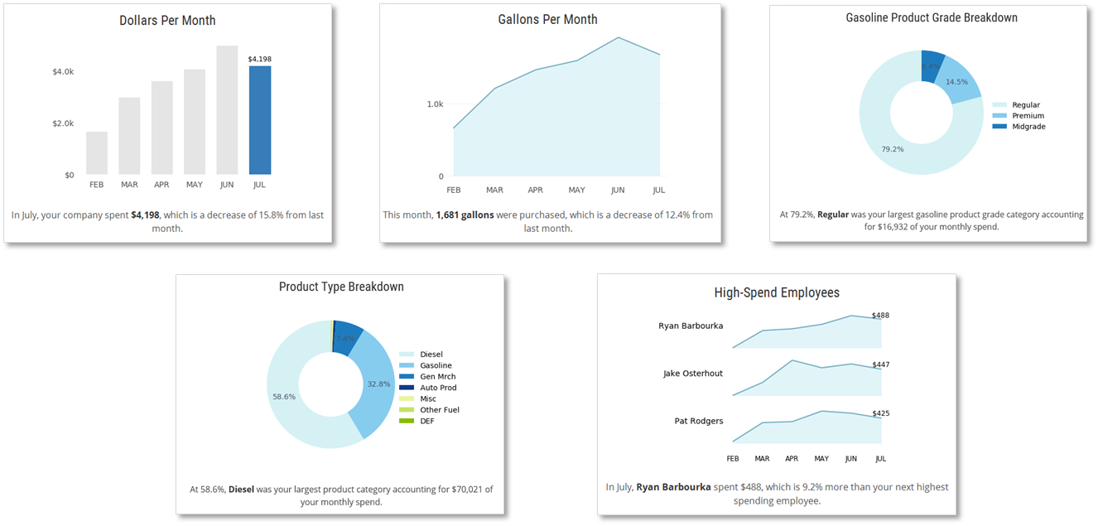
Snap Dashboards: Insight into Fueling Patterns at a Glance
Notes:
Monthly and weekly charts
User can customize dashboards to best meet their needs
DEMO Dashboard

Slide 8
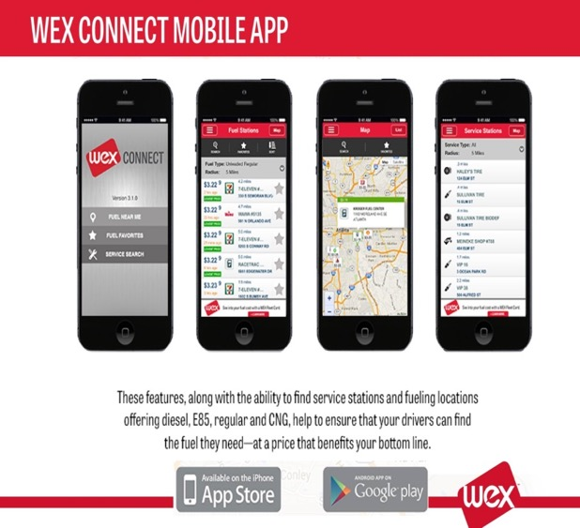
WEX Connect
Our WEX Connect mobile app allows you to instantly find fuel stations with the most up-to-date fuel prices. Its FREE to download.
FIND SERVICE STATIONS based on brand, location and service type
REAL-TIME INFORMATION ensures open fuel stations are noted in times of natural disasters
FREE FOR CUSTOMERS and non-customers alike – download it today

Slide 9
Clearview Demo
https://www.wexclearview.com

