Slide 1

Motor Fleet Management
Department of Administration
Telematics
Mike Gwyn, Data Manager
Compliance Specialist
(919) 857-4026

Slide 2
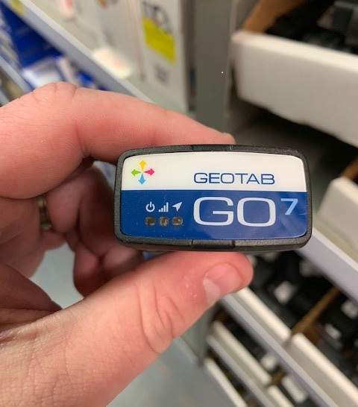
The GEOTAB Telematics
Device
Contract administered by AT&T

Slide 3
Telematics measure:
Telematics is a method of monitoring a vehicle. By combining a GPS system with on-board diagnostics it's possible to record – and map – exactly where a car is and how fast it's traveling, and cross reference that with how a Vehicle is behaving internally.
Vehicle Locations
Distance Traveled
Aggressive Driving Habits
  Harsh Braking
Speeding Violations

Slide 4
How does Telematics Work?
A vast amount of data can be collected via the telematics device and other connected hardware or sensors, such as position, speed, trip distance/time, idling, harsh braking and driving, seat belt, fuel consumption, vehicle faults, battery voltage, and other engine data.
In the case of Geotab, this information is stored in the cloud and brought into a fleet management software system, accessible from a desktop computer or a mobile device like a smartphone or tablet. Using the software, users are able to view and export reports and gain business intelligence such as the top 10 drivers with the highest number of speeding incidents or vehicles that are due for scheduled maintenance.
The Benefits:
  Increase Efficiency
  Improve Safety
  Increase Job Satisfaction
  Reduce Operating Costs
How to Modernize Fleet Management
  Monitor Safety Habits
  Optimize Vehicle Performance
  Schedule Alert for Repair Centers
  Streamline Compliance
Located underneath the driver-side dashboard and inserted into the On-Board Diagnostics (OBD) Reader Port.

Slide 5
Types of Reporting
Vehicle Report
  Provides a list of vehicles with a device installed as vehicle information including the settings
Trips History Report
  Historic tracking to examine trip information for a previous date.
  Also provides detailed rate of speed committed by driver in a designated speed area.
Trips History Summary Report
  Shows the summary trip information of your fleet.
Device Install History Report
Congregation Report
  Determine when more than one vehicle/driver is close proximity to others. ** Used to measure productivity of fleet.

Slide 6
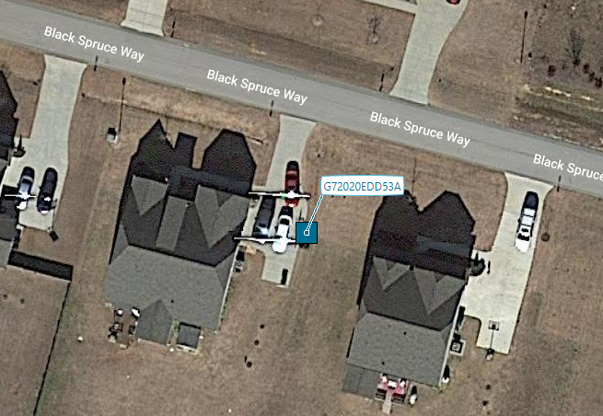
Examples

Slide 7
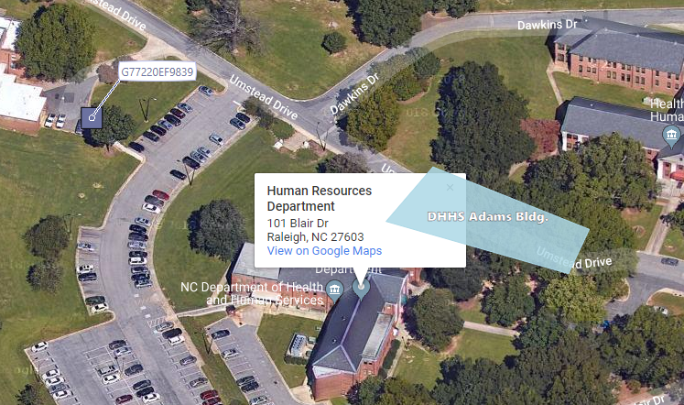
Example

Slide 8
Contact:
Mike Gwyn
Data Manager
Compliance Specialist
Motor Fleet Management
1915 Blue Ridge Road
Raleigh, North Carolina
(919) 857-4026
michael.gwyn@doa.nc.gov

