Slide 1
Accounting
Mileage Entry Instructions

Slide 2
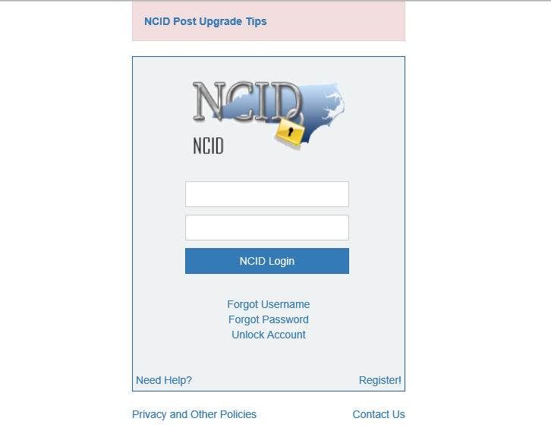
Log into the Motor Fleet Management System at: https://www.ncmotorfleetsys.com/MotorFleet/

Slide 3
Under the “Mileage Logs” Drop-down Menu, Select “Report Monthly Mileage”

Slide 4
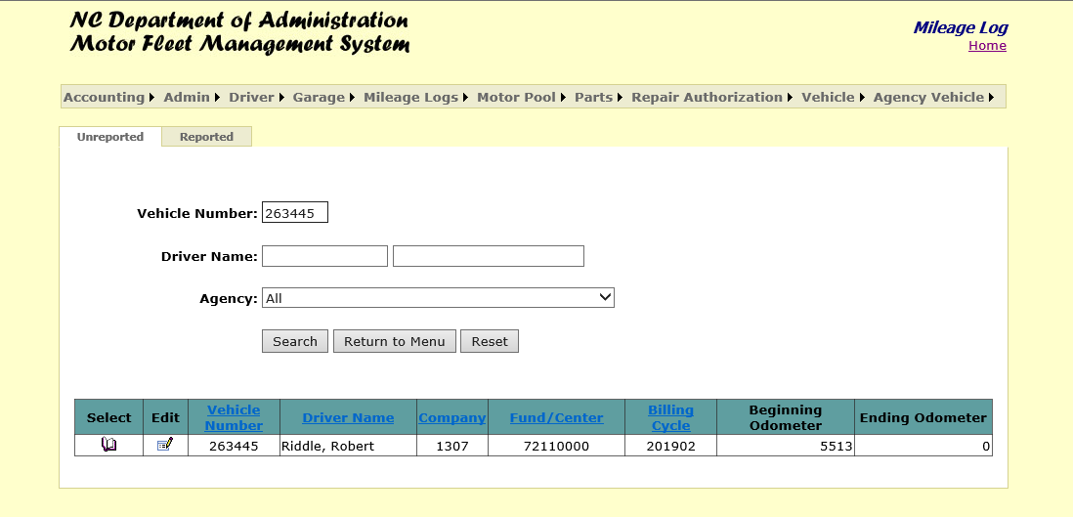
Entering your Vehicle Number will display the Unreported Mileage and the associated Billing Cycle.
Click the book under the “Select” column to continue to the mileage entry screen.

Slide 5
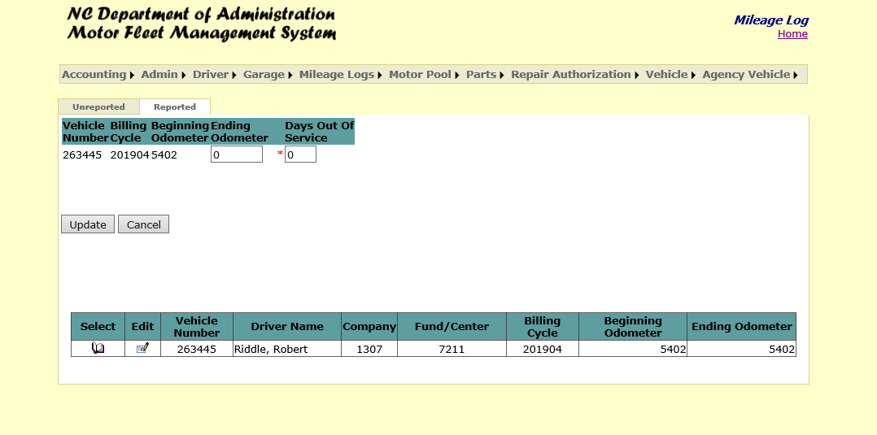
Enter the ending odometer for the vehicle and click “Update”.
Vehicle coordinators are permitted to enter up to 9 Days Out of Service. In the event your vehicle is out of service for more than 9 days, you will enter the maximum amount of 9 days and contact Motor Fleet to add additional days.

Slide 6
To review mileage you have already entered, you can select the “Reported” tab. Changes may be made if billing has not occurred (Billing is done around the 20th of each month.)
Select the table under the “Edit” column to proceed.

Slide 7
Enter the Ending Odometer for the vehicle and click “Submit.”
You may also edit agency budget information on this screen.

Slide 8
Questions & Answers

