Slide 1

State Construction Conference
March 2, 2017
State Construction Office
Interscope + System

Slide 2



AS A COURTESY TO OTHERS,
AND MOBILE DEVICES

Slide 3
Today’s Panel
LeaAnne Hahnel
Interscope Business Systems Analyst
State Construction Office
NC Department of Administration
Miriam Tripp
Special Projects Officer
UNC-General Administration
Dorrine Fokes
Associate Director, Facility Services
Business Finance and Operations
NC Community Colleges
Latif Kaid, P.E.
Assistant Director
State Construction Office
NC Department of Administration
Notes:
Ask the room to introduce themselves

Slide 4
Today’s Session
Why Interscope+ was created
How State Government uses Interscope+
Overview of how the system functions
Question and Answer Forum
IPS
&
eVP

Slide 5

eVP Electronic Vendor Portal

Slide 6
eVP Electronic Vendor Portal
Where vendors register to do business with the State of North Carolina
Consolidation of IPS and E-Procurement

Slide 7
What is IPS
IPS
Interactive Purchasing System
Must be registered in IPS to be in Interscope
Free email notifications for bidding opportunities
IPS advertises solicitations from
all state agencies
Community colleges
Universities
Public schools
Some local governments
Notes:
IPS-provides free email notifications of bidding opportunities to registered Vendors. This is where all solicitations from state agencies, community colleges, universities, public schools and some local governments will be found.
You must be registered in IPS to have an account in Interscope.

Slide 8
What is E-Procurement
NC E-Procurement
Enterprise-wide purchasing system
Cost saving and efficient method of purchasing
Allows over 150 government entities to aggregate purchases
Provides purchasing power

Slide 9
Who Participates in E-Procurement
State agencies
K-12 schools
Community Colleges
Local Governments
Counties
Municipalities
Notes:
Local governments can participate

Slide 10
E-Procurement Vendor Benefits and Fees
Benefits
Increased accuracy
Single point of access to markets
Cost savings
Fees
1.75% transaction fee on purchase orders (goods only)

Slide 11
What else is in eVP
eQuote
HUB

Slide 12
Contact Information
eVP
888-211-7440 option 2
vendor@nc.gov
IPS
919-807-4500
HUB
919-807-2330
Huboffice.doa@doa.nc.gov
doa.pchelpdesk@doa.nc.gov
INTERSCOPE
919-807-4109
interscope@doa.nc.gov

Slide 13
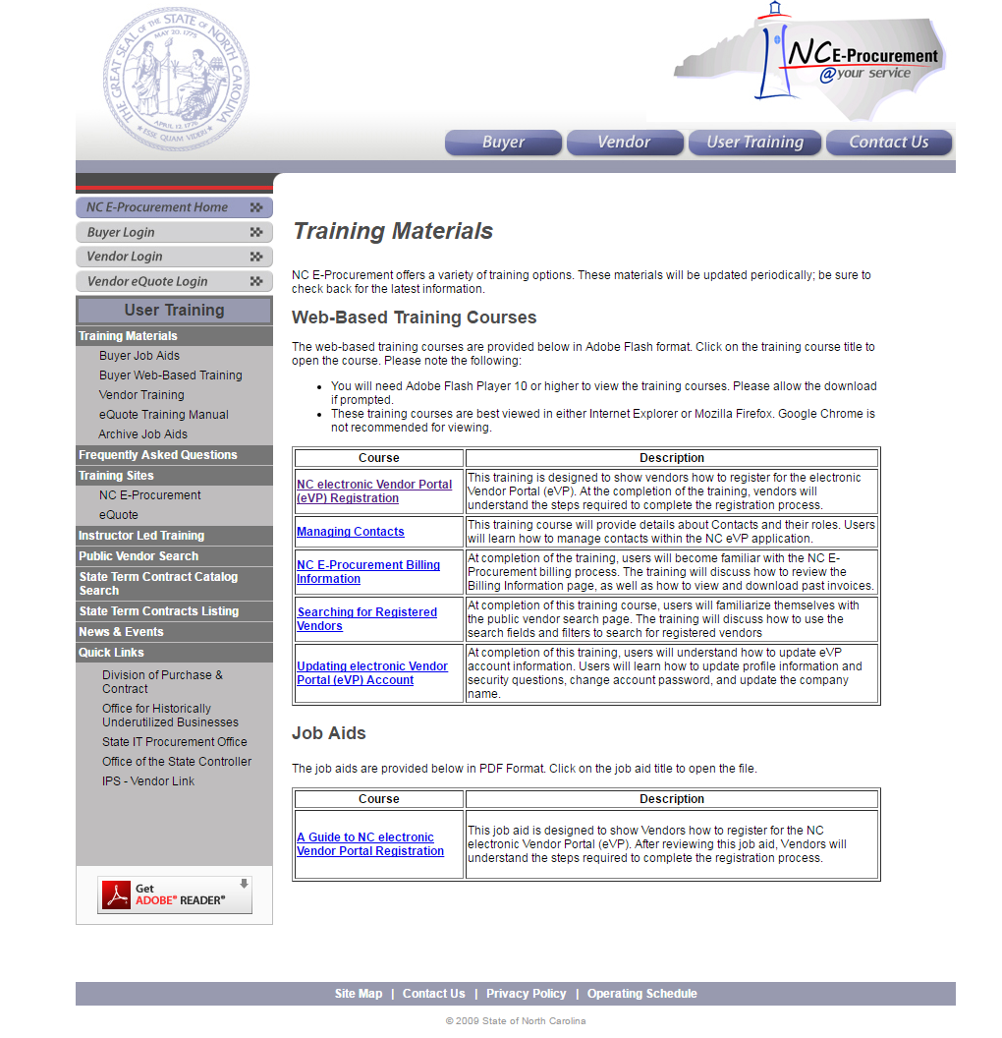
eVP Resources
http://eprocurement.nc.gov/Training/Vendor_Training.html

Slide 14
What is IPS
IPS
Interactive Purchasing System
Must be registered in IPS to be in Interscope
Free email notifications for bidding opportunities
IPS advertises solicitations from
all state agencies
Community colleges
Universities
Public schools
Some local governments
Notes:
IPS-provides free email notifications of bidding opportunities to registered Vendors. This is where all solicitations from state agencies, community colleges, universities, public schools and some local governments will be found.
You must be registered in IPS to have an account in Interscope.

Slide 15
Why Interscope+ was created
Interscope was originally created in 1999 for the State Construction Office to internally track Capital Projects

Slide 16
Why Interscope+ was created
In 2012, the decision was made to create a state-wide Capital Project System that would be used by the
Community College System, the University System, and all State Agencies.

Slide 17
Why Interscope+ was created
Interscope
Capstat
HUBSCO
Interscope+

Slide 18
How we use Interscope+
Track the life cycle of Capital Projects
From Authorization
Until closed out
Tracks funding sources
Tracks HUB data

Slide 19
How we use Interscope+
It is not intended to be an accounting system.
BUT- Has these features
Budgets
Code and Item Numbers
P6 Milestones linking
HUB Information
Optional detailed expenditure tracking is available.
Contracts
*But not linked to NCAS.

Slide 20
What can Interscope+ do?
Provides a single Capital Projects Management System for the
State Construction Office
Universities
Community Colleges
State Agencies
Provides MBE (HUB) data integration.

Slide 21
What can Interscope+ do?
Track funding sources and budgets
Track commitments
Reduce conflicting data
Provide consistent reporting
Replace HUBSCO for reporting HUB data
Integrates Primavera P6 schedule data

Slide 22
How the System Functions
Typical Capital Project Flow
Authorization
Allocate Funds
Program
Assign Funds
Project
Commit Funds
Design Contract
Interscope Package

Slide 23
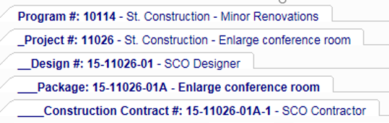

How the System Functions Typical Capital Project
Authorization
Program
Project
Design Contract
Package
Construction Contract
It may help to think of each Interscope+ tab as a nested file folder

Slide 24
Interscope “SCO” ID Number
The “full” ID number is gradually created
16
Project Year
Calendar year project was created
02222
Project “Sequence” Number
Unique number assigned by Interscope
02
Design Contract Number
Project’s may have multiple contracts
A
Package ID
Process container for Design and Construction

Slide 25
Interscope “SCO” ID Number
# 16-02222-02-A
Project Year
Package ID
Design
Contract
Number
Project “Sequence” Number
Project Year is the calendar year that the project was created
Project “Sequence” Number is assigned by Interscope and is a unique number for the project
Design Contract Number designates which design contract is selected. A project may have multiple design contracts
Package ID is the indicator letter for the selected Interscope package, the process container for Design and Construction as well as the State
Construction Office. *Only one milestone schedule is available per package

Slide 26
Interscope “SCO” ID Number
Please be sure you include the full SCO ID Number on your all of your documents.
For example: submittals, plans, correspondence and any documents

Slide 27
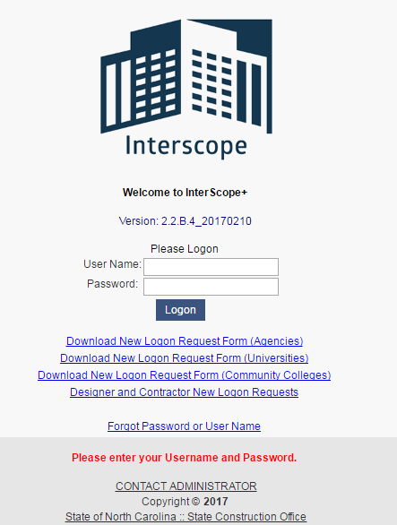
Interscope Logon’s
Download logon request for Agencies
Download logon request for Universities
Download logon request for Community Colleges
Designer and Contractor logon requests
Forgot user name or password

Slide 28
Question and Answer Forum
Questions
and
Answers

Slide 29
State Construction Conference
March 2, 2017
State Construction Office
Interscope + System

