Slide 1

Department of Administration
State Construction Conference
Tammie Hall, Asst. to the Secretary for HUB Outreach

Slide 2
HUB Office
The Office for Historically Underutilized Businesses promotes diversity and inclusion in state government procurement and contracting.
HUB Certification
Encourages use of Historically Underutilized Businesses
Business Development with HUB vendors
Compliance Reports - construction and goods/services purchases

Slide 3
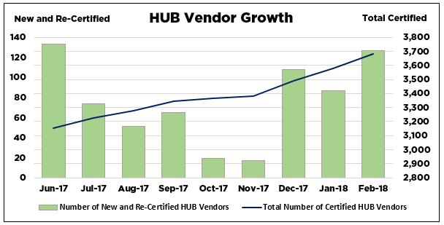
HUB Certifications

Slide 4
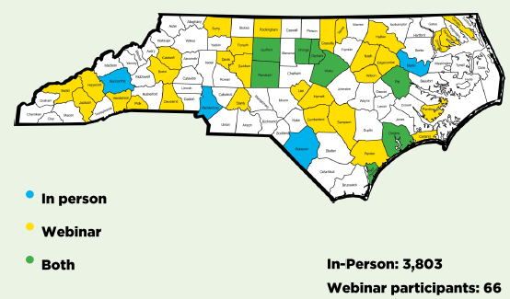
Community Engagement and Training
FY18 Q1 & Q2

Slide 5
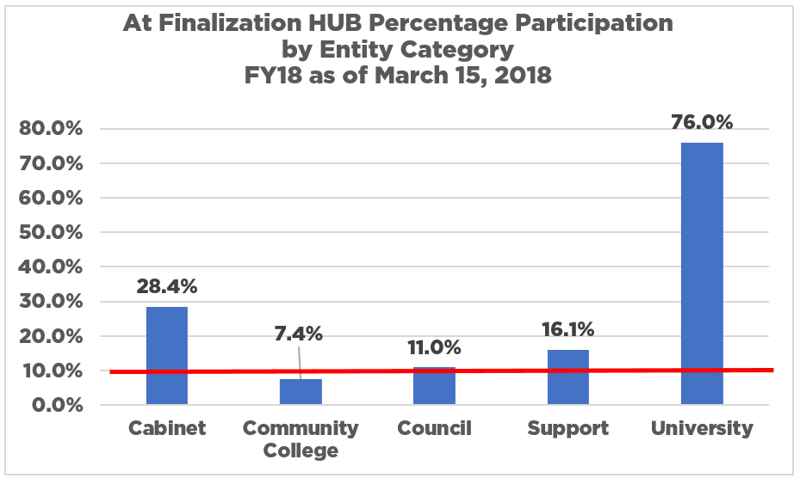
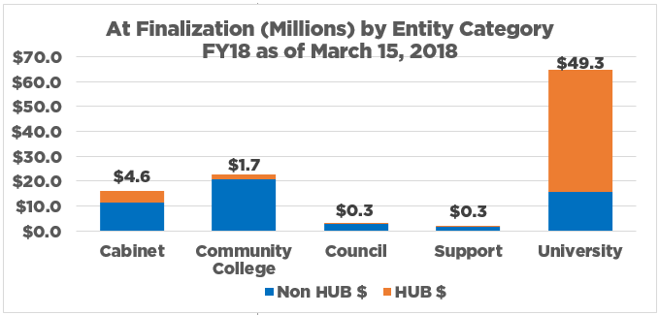
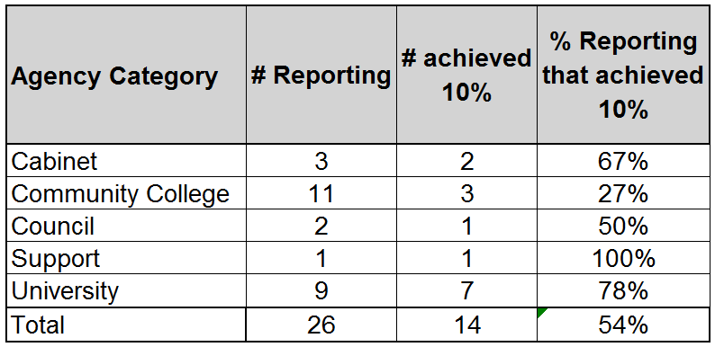
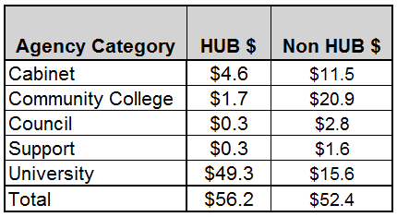
Completed Building Project Spending

Slide 6
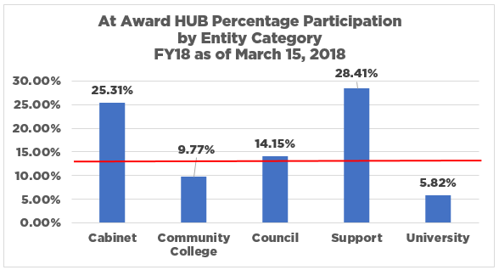
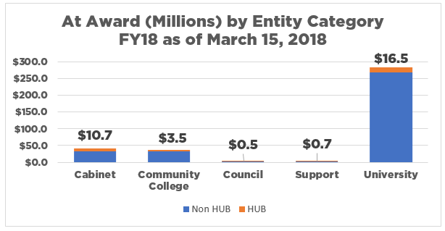
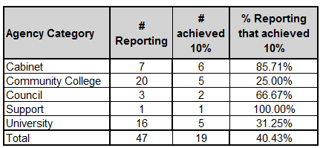
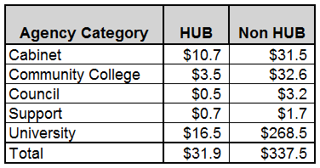
Building Projects At Award

Slide 7

Executive Order 25
Governor’s Advisory Council on Historically Underutilized Businesses
HUB Liaisons
HUB Plan Development

Slide 8
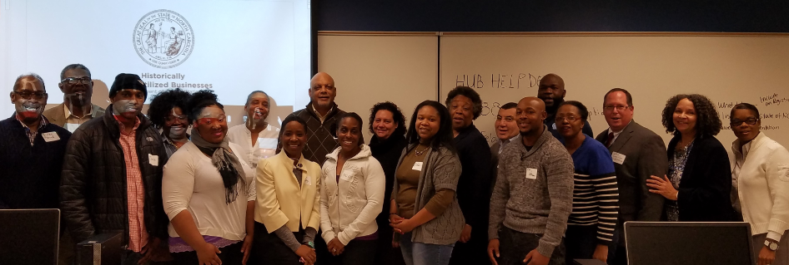
New HUB Office Initiatives
Certification Reciprocity
  NC DOT Disadvantaged Business Enterprises (DBEs)
  National Certifications in GA, NC, SC, TN, VA
    WEBENC
    NMSDC/CVMSDC
    U.S. Small Business Administration (8A and Women Owned)
    U.S. Department of Veteran Affairs (Service Disabled Veterans)
Certification Trainings
  Conducted at Robeson, Edgecombe, Wake
  Plans for Asheville, Fayetteville, and Elizabeth City

Slide 9


JOIN US
The ABC’s of Bonding
37th Annual State Construction Conference
Joanne S. Brooks, Esq.
Vice President and Counsel
The Surety and Fidelity Association of America
March 29, 2018

Slide 10

Contact Information
HUB Office
  Website: http://www.doa.nc.gov/hub/
  Main Office Phone: 919-807-2330
  Email: HUBOffice.DOA@doa.nc.gov
Tammie Hall, Director
  919-807-2330
  Tammie.Hall@doa.nc.gov
Teamwork makes the Dream Work

