Slide 1


The ABC’s of Bonding
37th Annual State Construction Conference
Joanne S. Brooks, Esq.
Vice President and Counsel
March 29, 2018

Slide 2
Why does surety exist?
Proverbs 11:14-16
1894-Heard Act
1935-Miller Act
  Current Law
  $150,000 threshold
  Little Miller Acts
Private entities understand bonding assures performance and payment protection
Prequalification
  Capital
  Capacity
  Character
Claim Services
  Performance-protecting taxpayer and owner dollars
  Payment-protecting subcontractors/suppliers

Slide 3
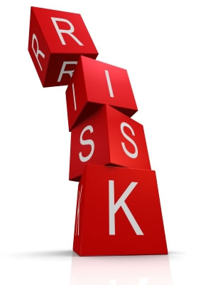
Construction
is still
Risky Business

Slide 4

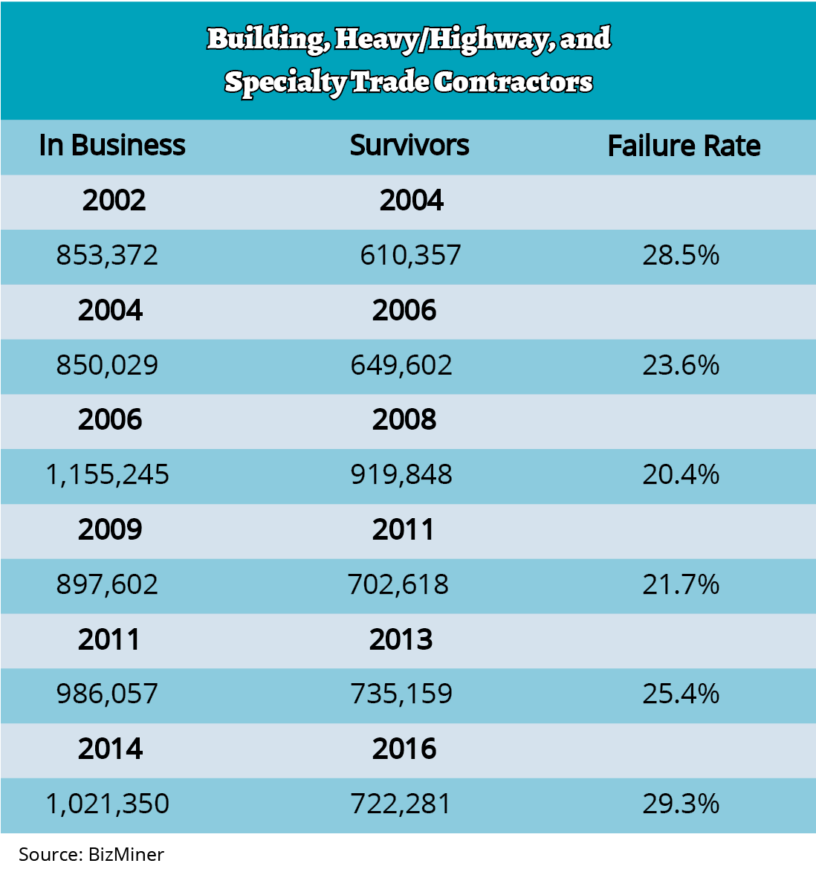
Notes:
In 2002, many large general contractor defaults hit the industry, followed by the failure of many subcontractors. According to BizMiner, of 853,372 building, heavy/highway and specialty trade contractors operating in 2002, only 610,357 were still in business by 2004 – a 28.5% failure rate. Of the 850,029 companies in business in 2004, 649,602 were still in business in January 2006, an improved 23.6% failure rate. Of the 1,155,245 companies operating in 2006, 919,848 were still in business in 2008 – a 20.4% failure rate. And of the 897,602 companies operating in 2009, 702,618 still were in business in 2011, 25.4% failure rate.
The recession had a negative impact on many contractors, forcing some to close their doors. Overall, surety capacity will remain strong because construction firms have become more sophisticated as a result of the economic downturn and are better able to manage risk.
The latest figures from Bizminer show that construction indeed is a risky business. Of the 986,057 companies operating in 2011, only 735,159 still were in business in December 2013—a 25.4% failure rate. The failure rate for startups was even higher—35.0%.
Rev. 9/2014

Slide 5
Large Contractors Do Fail
Morrison Knudsen (1905-1995)
Guy F. Atkinson (1926-1997)
J.A. Jones (1890’s-2003)
Modern Continental (1967-2008)
Ballenger (1937-2012)
Truland Systems (1909-2014)

Slide 6
Sureties Pay Claims
In 2016 alone, sureties paid losses in excess of $1.4 billion
Over the last 16 years, sureties have paid in excess of $12 billion in losses, not including expenses and out of pocket money used to finance troubled contractor, and hire experts to perform consulting services.

Slide 7
WHAT SURETY COMPANIES LOOK FOR
WHAT IT TAKES TO RUN A SUCCESSFUL BUSINESS
Sustainability
Profitability
Continuity
Proven track record
  Pay subs timely
  Responsible
Reference
Sustainability
Profitability
Continuity
Proven track record
  Pay subs timely
  Responsible
Reference

Slide 8
Certification
Does Not Equal
Qualification

Slide 9
Surety as part of the solution
Economic Empowerment
Job Creation
Sustainability
Legacy Wealth
Surety = Empowerment

Slide 10
Common Misconceptions
False
True
Bonding isn’t available for small contractors
Bonding is expensive
Bonding keeps small contractors from winning work
Bonding companies are discriminatory
There are many programs including fast-track and SBA, and our education programs
No cost assessment
If you are a sustainable contractor sureties will fight for your account
The industry makes money issuing bonds to strong contractors not by denying access
The color is green! Sureties support contractors who are successful and well managed!

Slide 11
Even more truths….
Construction is an industry filled with risk
Running a business requires a whole different set of skills than those necessary to do construction work
Contractors thrive when they build relationships, focus on their business and provide excellence in performance and quality

Slide 12
Surety Industry Commitment
SBA-Surety Bond Guarantee Program
MCDP-education and partnering-the industry is supporting this-knowledge is power
Partnership with US DOT OSDBU to bring the Bond Education Program (BEP)-started in 2010 over 100 classes held, 2 have been in Spanish, 1on1 key, tying knowledge to opportunity over $650 million in bonding.

Slide 13
Steps for Success
Relationships
Know your value
An amazing surety bond agent
An accountant
A banker
An insurance agent
Advisors
What makes you the best choice?
How do you differentiate yourself from others?
What do you do best?
Are you being honest in your assessment of your business?

Slide 14
It’s all about being strategic…
Plan your work and work your plan
Stay in your lane and focus on your goals
Be excellent in your service
Reinvest in your business
This is a marathon and not a sprint
Keep the money in your business

Slide 15
Types of Bonds
Bid
Performance
Payment
Maintenance
License and Permit

Slide 16
Thank you!!!
The Surety and Fidelity Association of America
Joanne Brooks, Esq.
Vice President & Counsel
jbrooks@surety.org

