Slide 1

37th Annual State Construction Conference
Bluebeam and InterScope Plus
Notes:
Creativity is thinking up new things. Innovation is doing new things.-Theodore Levitt professor at Harvard Business School and editor of the Harvard Business Review
We are not only thinking up new things at State Construction –We are doing new things.
I want to take you through a Then, now and future look at what we have done with Interscope and the new things we will do with InterscopePlus.

Slide 2
Why Do We Have Interscope
Notes:
Interscope is an acronym for:

Slide 3
INTERSCOPE
Internet
State
Construction
Office
Project
Environment

Slide 4

Capstat
HUBSCO
Interscope Plus
Notes:
Interscope was originally created in 1999 for the State Construction Office to internally track Capital Projects
In 2012, the decision was made to create a state-wide Capital Project System that would be used by the Community College System, the University System, and all State Agencies.

Slide 5
Track the life cycle of Capital Projects
From
Authorization
Until closed out
Tracks funding sources
Tracks HUB data

Slide 6
Interscope Then
Notes:
I'm not big on reach backs, but, it is important for us to understand where we were so we can understand where we are and where we area going

Slide 7
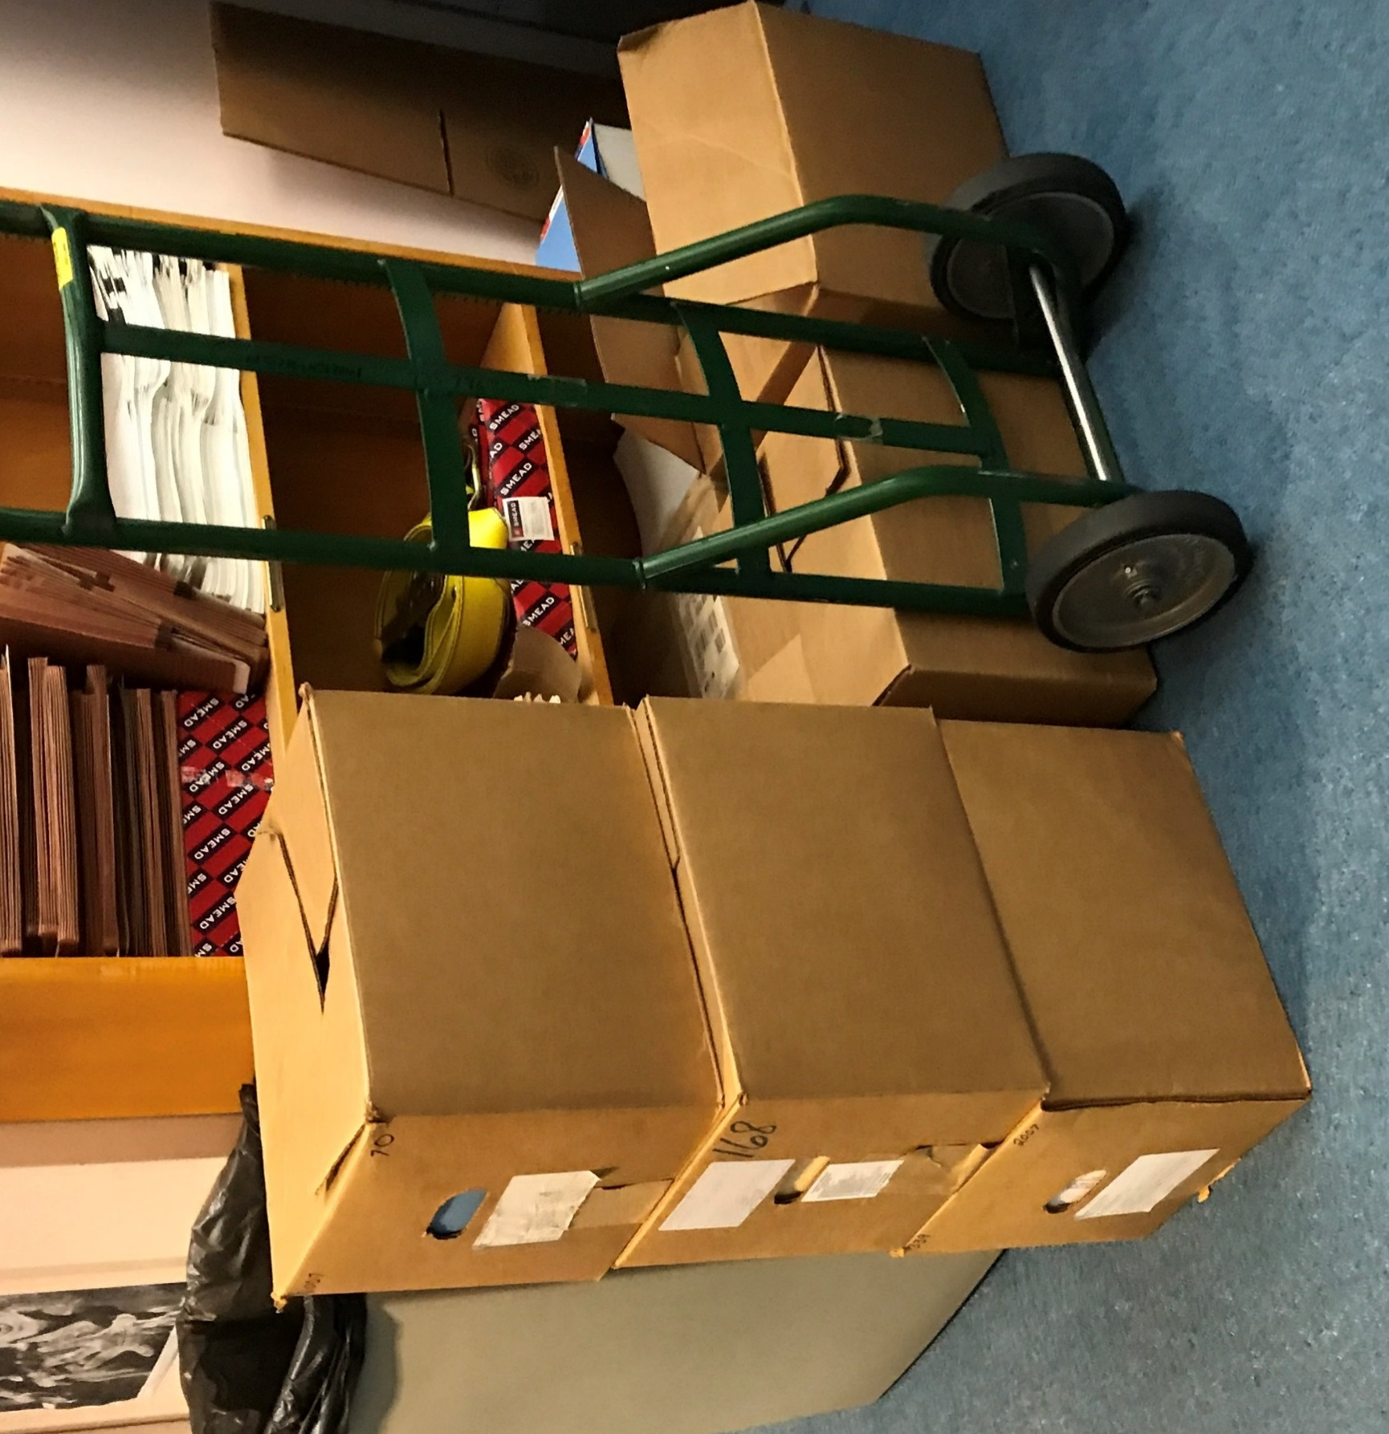
Prior to 2010 Change Orders and forms were a manual process
Notes:
These are boxes of mail going out for one change order

Slide 8
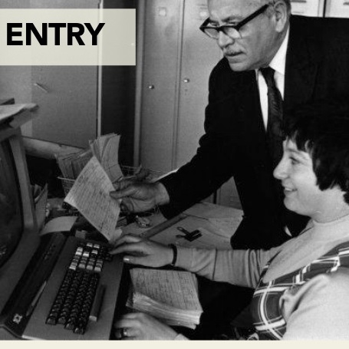
Notes:
Prior to InterscopePlus weekly Inspections
and monthly progress reports were
a manual process

Slide 9
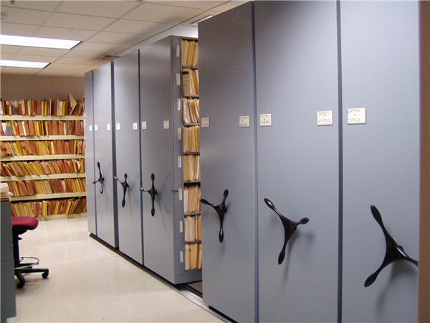
Data was manually
entered
into a “Mainframe”
Notes:
with a limited number of characters available
The person keying the data sometimes had to decide what was most important to record. If there were questions or more information needed the paper file had to located.

Slide 10
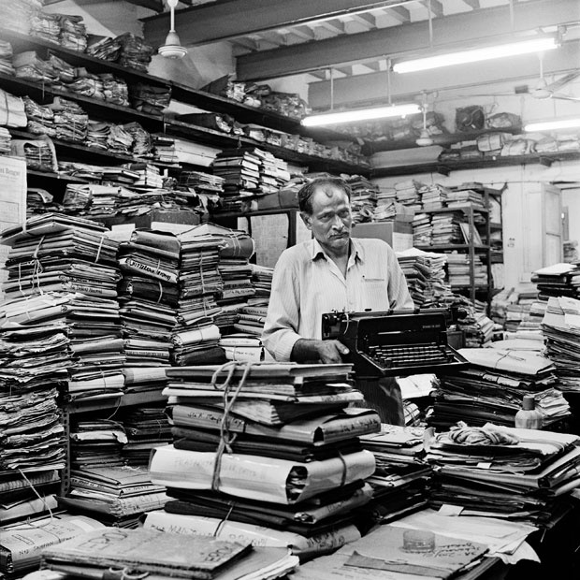

Slide 11
Interscope Now
Notes:
Prior to electronic change orders
It could take weeks for a change order to be approved
Now with electronic change orders
Change orders can be processed in a matter of minutes

Slide 12
Reduced Cost
=
SAVINGS
$5,254,667
in SAVINGS to date for the State of North Carolina
Notes:
Average of 125 change orders per month
Average cost to process a manual change order $500
Electronic Change Orders have been in production nearly 7 years

Slide 13
InterscopePlus
Electronic Change Orders
Electronic Weekly and Monthly Reports
Electronic Closeout
HUB Data
Notes:
Project Closeout and final reporting is now electronic function and is a huge time saver for designers and SCO

Slide 14
Interscope
of the
Future

Slide 15
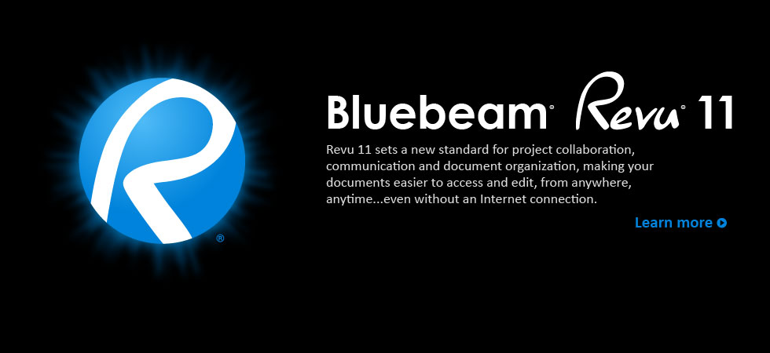
Notes:
We see Interscope and Bluebeam exchanging data like Interscope and Premavera 6 exchange data today.
The biggest change I think we will see in the office will be the physical change

Slide 16
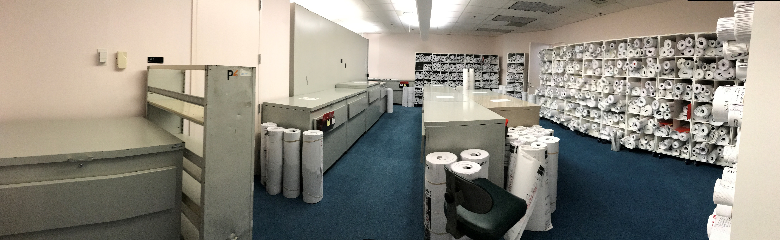
Notes:
Just think of the 100’s of pounds of paper we will save
We can use this space for more cubicles or workstations

Slide 17
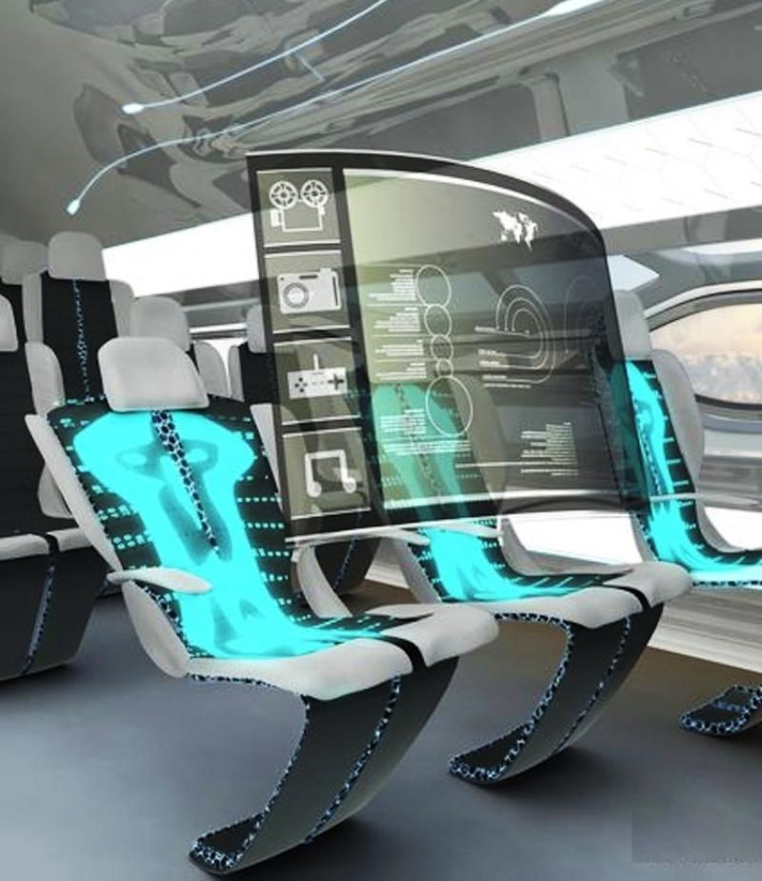
Notes:
This is what I envision for Electronic Plan Review

Slide 18
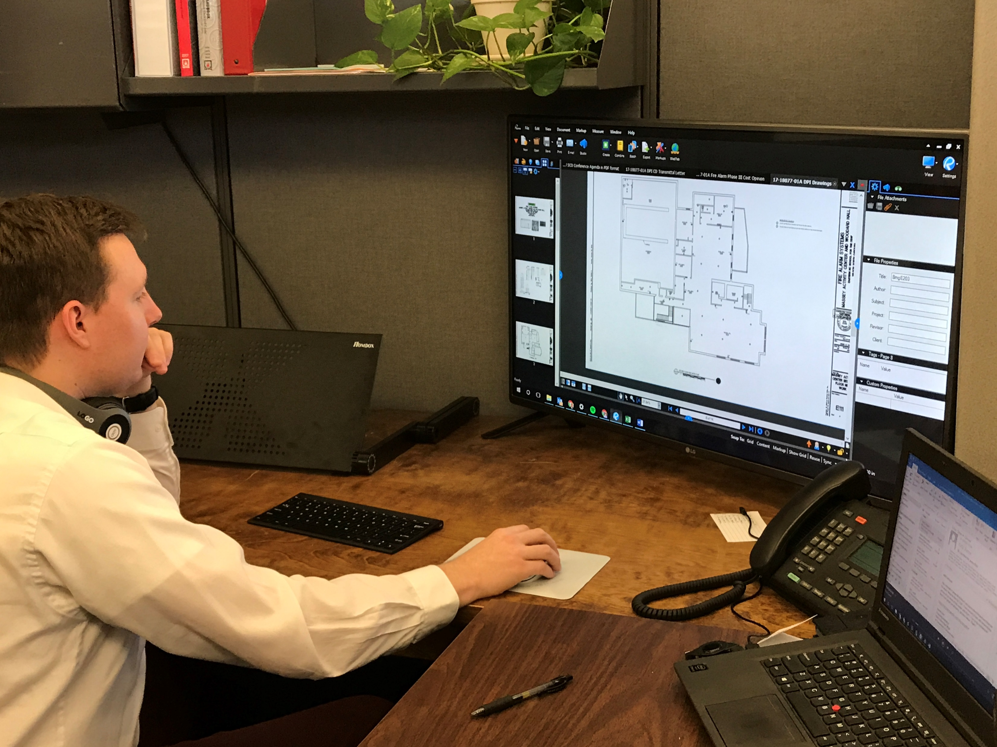
Electronic Plan Review
Notes:
This will be more of the reality though

Slide 19

Collaborate Anytime Anywhere
Manage Projects Digitally
Unlimited Number Of PDF’s
Notes:
1-regardless of your internet connection
2-start to finish
3-Data is stored in the cloud
4-colloaborate in real time
5-In the future-our field staff will have the ability to inspect and monitor with the plans on their iPads and collaborate real time with designers, contractors and the State Construction Office

Slide 20
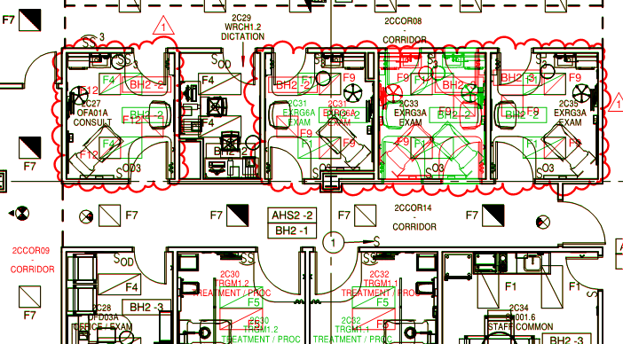
Notes:
Each discipline will have its own color to use in markup
And you can overlay disciplines for further collaboration
As reviewers are creating these markups, they can also make notations that will show up in the review summary report
Reviewers will also have a “library” of common comments to choose from
Saving the reviewer lots of time by not having to create that written document at the end of the plan review process
Some reviewers have stated this part of the process can take as long as the actual plan review itself.

Slide 21
No License for Bluebeam?
Blue Beam Vu
Does not require a license
You still have full markup ability
Notes:
I know some of you are thinking- I don’t’ have bluebeam, how am I going to fit into this process.
You can download a copy of Bluebeam Vu today. It is free and can be used with full markup ability

Slide 22

Notes:
We are deep in the weeds right now working out the logistics of implementation
Processes Procedures Document Management, Implementation
Pilot Projects- We are working through some pilot projects now with a few designers and project owners
We anticipate having a good foundation in place in about six months.
So stay tuned
Here’s what we do know:
All files uploaded into Bluebeam must be PDF’s
CAD and/or Rivet files will need to be converted to PDF prior to upload
Bluebeam does NOT have files size limits
Plans that are being uploaded should be:
Created, Stamped, and Signed Electronically

Slide 23
Review Times
Currently
8 weeks
With Bluebeam
5 weeks
Notes:
These are average review times
Disciplines will have the ability to review simultaneously
The largest time saver we see here will be the reviewer not having to re write comments & generate word doc at the end of reviewing
This task will happen simultaneously as the plan review occurs. Bluebeam will capture the reviewers notes and compile them in the a summary document

Slide 24
Cost Avoidance
$780,000 annually
Or
$3,900,000 collectively over a 5 year period
Notes:
Based on the current work load SCO will not need to hire 10 additional staff in design review BECAUSE of the implementation of Bluebeam
With that said, we have cost avoidance

Slide 25
50 % Increase in Productivity
Saving 5,880 man hours annually
29,400 man hours over a 5 year period collectively
Notes:
By having Bluebeam we will save 5880 man hours annually or 29,400 hours over a 5 yr period collectively
This is a 50% increase in productivity

Slide 26
$636,919 in salaries annually
Or
$3,184,594 over a 5 year period collectively
Notes:
What will those man hours look like in dollars?
636 K in salaries annually
Or almost 3.2 mil in salaries over a 5 yr period collectively

Slide 27
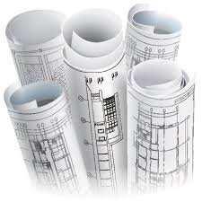

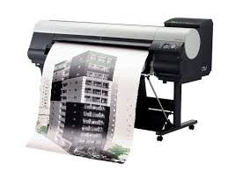
Notes:
We cannot even quantify the savings we and you will realize with electronic review
Paper
Printing
Courier/mail
I these stats will make a great slide in a few years

Slide 28

Notes:
We went from this to this

Slide 29
Design Build Contracts
AiM
ERP
HUB Reporting
Inspections Module
Mechanical
Plumbing
Life Safety
Electrical
Notes:
We are also working on a few other initiatives in Interscope
Design build contracts are coming and we are working on a solution in Interscope, as we speak, to accommodate these new contract types
We are working with the university system to streamline some data entry in (AIM) and Interscope
We have the same initiative with the Community College system office using the ERP-Enterprise Resource Planning- system which is the early development phase now.
We continue to develop the HUB reporting within Interscope
As well as an inspections module to adhere to the the legislative mandated inspections for trades

Slide 30
Training Dates

Slide 31
Introduction to Interscope+
Audience:
Agencies, Community Colleges and Universities
April
12 & 13, 2018
July
19 & 20, 2018
October 11 & 12, 2018
November
8 & 9, 2018
(by request)
Notes:
For Interscope

Slide 32
Interscope + Change Orders, HUB data and Closeout
Audience: Community College
Location: Caswell Building
June 7 & 8, 2018
September 13 & 14, 2018

Slide 33
Interscope Change Orders, HUB data and Closeout
Audience: University
Locations: Various
ECU
April 25, 2018
WSSU
September 27, 2018

Slide 34
Capital Projects Coordinator (CPC)
Audience: Agencies
Location: New Education Building (SCO)
May 24, 2018
Audience: Community Colleges
Location: Caswell Building (System Office)
July 24, 2018
Audience: Universities
Location: TBD
October 23, 2018

Slide 35
Interscope for Contractors and Designers
iCenter-Unite Room 1107
April 17, 2018
Pitt Community College-Russell Bldg.
May 10, 2018
UNC-Charlotte
June 26, 2018

Slide 36
Training Resources
Website
Training Materials Library
Training Dates
Interscope
Help Tab
User Manual
User Training Tutorials

Slide 37
Additional Resources
Connect NC Bond Mapping Project
Found on State Construction Website Landing Page
Notes:
If we have not already mentioned it,
The QR code on the back of your name tag is a link to all of today’s presentations.
Within my presentation, you have links to the registration forms for all of the training classes offered and training resources. As well as this connect NC bond mapping project.
Thank you and enjoy the rest of the conference.

Slide 38
2018 State Construction Conference
Bluebeam and InterScope PLus
Notes:
Ole and Sven are out hunting in Minnesota and they shoot a deer. They begin dragging the deer back to the truck by the tail, but they keep slipping and losing both their grip and their balance.
A farmer comes along and asks them, “What are you boys doing?”
They reply, “We’re dragging the deer back to the truck.”
The farmer tells them, “You are not supposed to drag a deer by the tail. You’re supposed to drag the deer by the handles. They’re called antlers. You’re supposed to drag a deer by the antlers.”
Ole an Sven say, “Thank you very much for the idea.”
They begin pulling the deer by the antlers. After about five minutes, they are making rapid progress. Ole says to Sven, “Sven, the farmer was right. It goes a lot easier by the antlers.”
Sven replies, “Yeah, but we’re getting farther and farther from the truck.”
“The majority of people in life are pulling the easy way, but they are getting further and further from the ‘truck’ or their real goals and objectives.”

