Slide 1
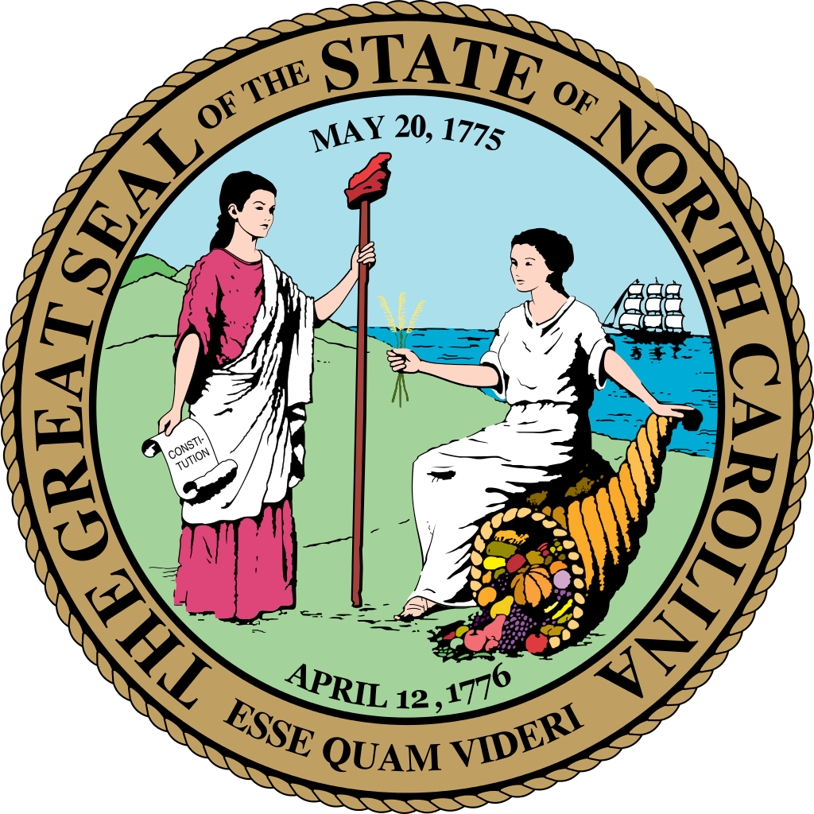
Connect NC Bond Update
State Construction Conference
Mark Bondo
Office of State Budget and Management
March 29, 2018

Slide 2
General Information
The Connect NC Bond Act was passed by the General Assembly in 2015 and approved by the Voters in March 2016
The Connect NC Bond is a $2 Billion General Obligation bond program supporting University, Community College, Public Safety, State and Local Parks, NC Zoo, and Agriculture

Slide 3
Total Allocation
Agriculture includes only the Department of Agriculture and Consumer Services Project. The Plant Sciences Building is included in the University Total

Slide 4
First Issuance
The First Issuance of the Connect NC Bond was sold in August 2016 at an interest rate of 2.079%
The First Connect NC Bond sale was for $200 Million
The State issues debt based on the cash flow needs of the projects being financed.

Slide 5
Current Total Expenditures
Agriculture includes only the Department of Agriculture and Consumer Services Project. The Plant Sciences Building is included in the University Total

Slide 6
Current Expenditures: Cumulative

Slide 7
Projected Issuance Schedule

Slide 8
Forecast Recipients
Agriculture includes only the Department of Agriculture and Consumer Services Project. The Plant Sciences Building is included in the University Total

Slide 9
Forecast Expenditures: Cumulative

Slide 10
Contact Information
Mark Bondo
Office of State Budget and Management
Mark.bondo@osbm.nc.gov
919-807-4786

