Slide 1

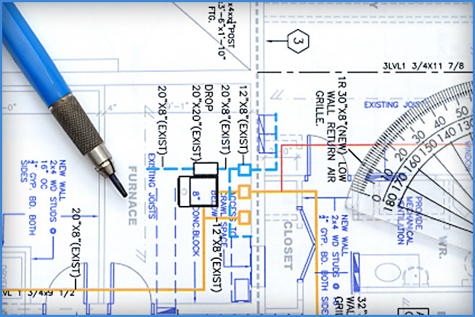

Prevention Thru Design
Notes:
This presentation is not a substitute for any of the provisions of the Occupational Safety and Health Act of 1970 or for any standards issued by the U.S. Department of Labor, nor does mention of trade names, commercial products, or organizations imply endorsement by the U.S. Department of Labor.

Slide 2
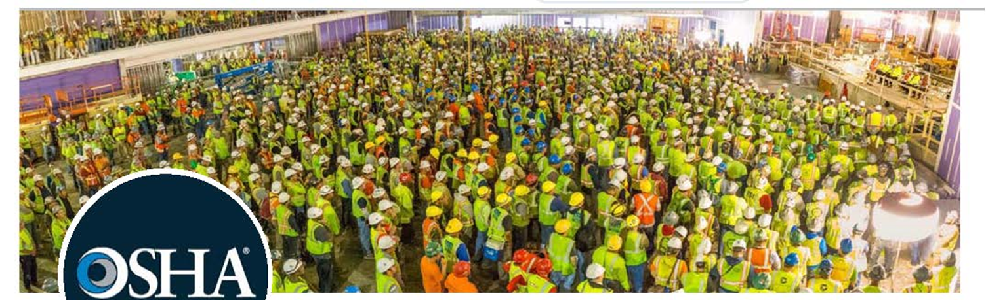
Morning Safety Briefing

Slide 3

Session Goals
The goal of this session is to provide Contractors, Owners, Design/Build Firms, Engineers, Architects with information on how to recognize and anticipate construction hazards and how to reduce or even eliminate them with well thought out permanent design features.

Slide 4
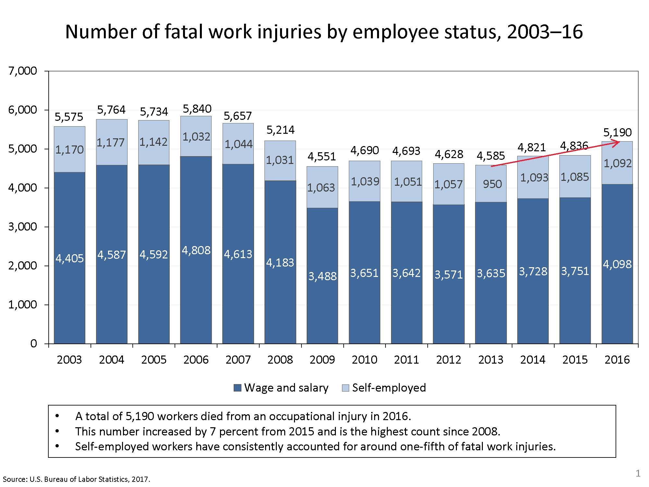

Slide 5
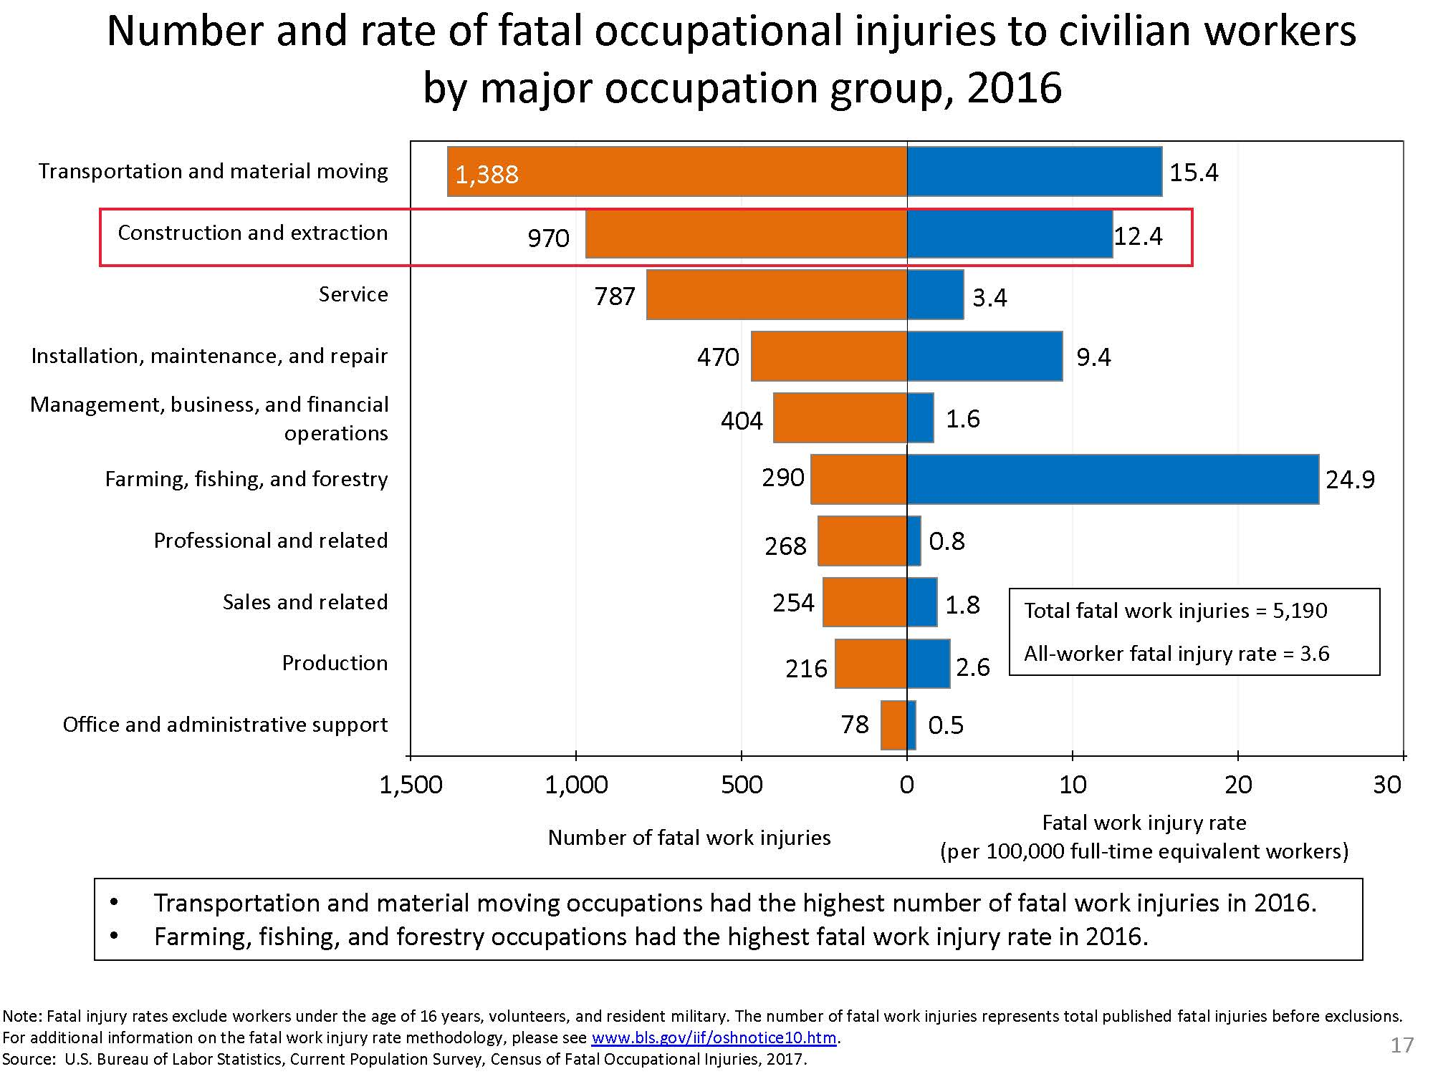

Slide 6
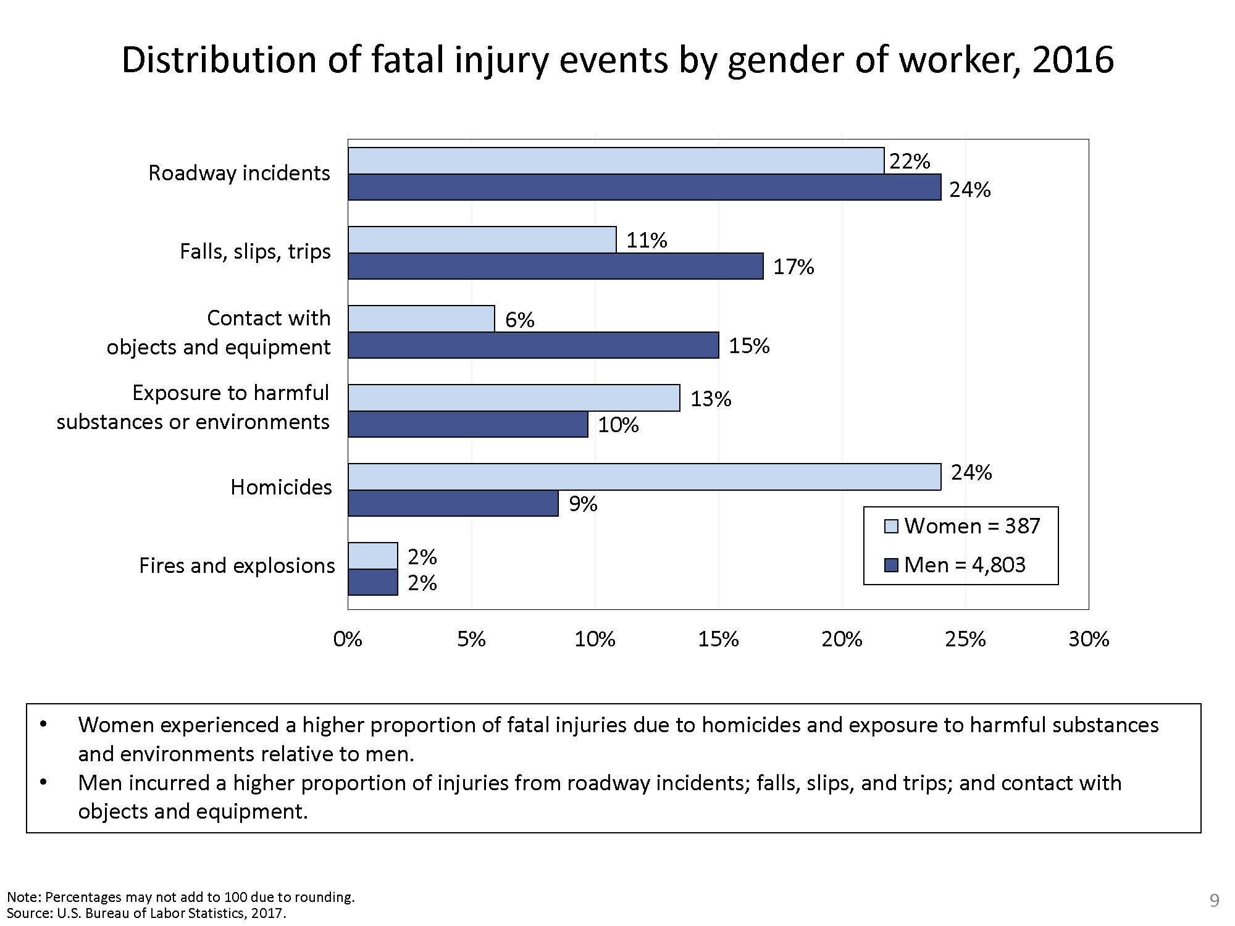


Slide 7
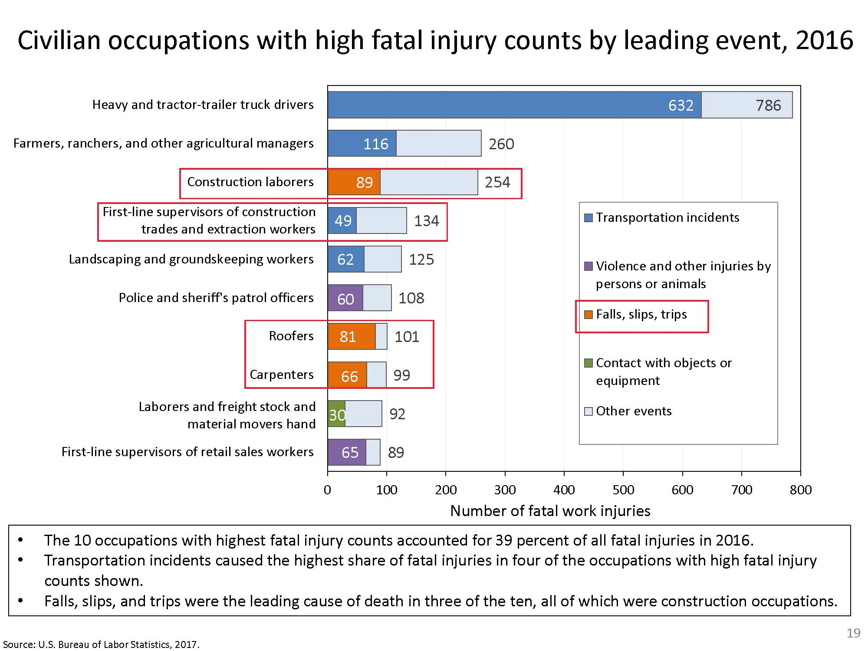

Slide 8
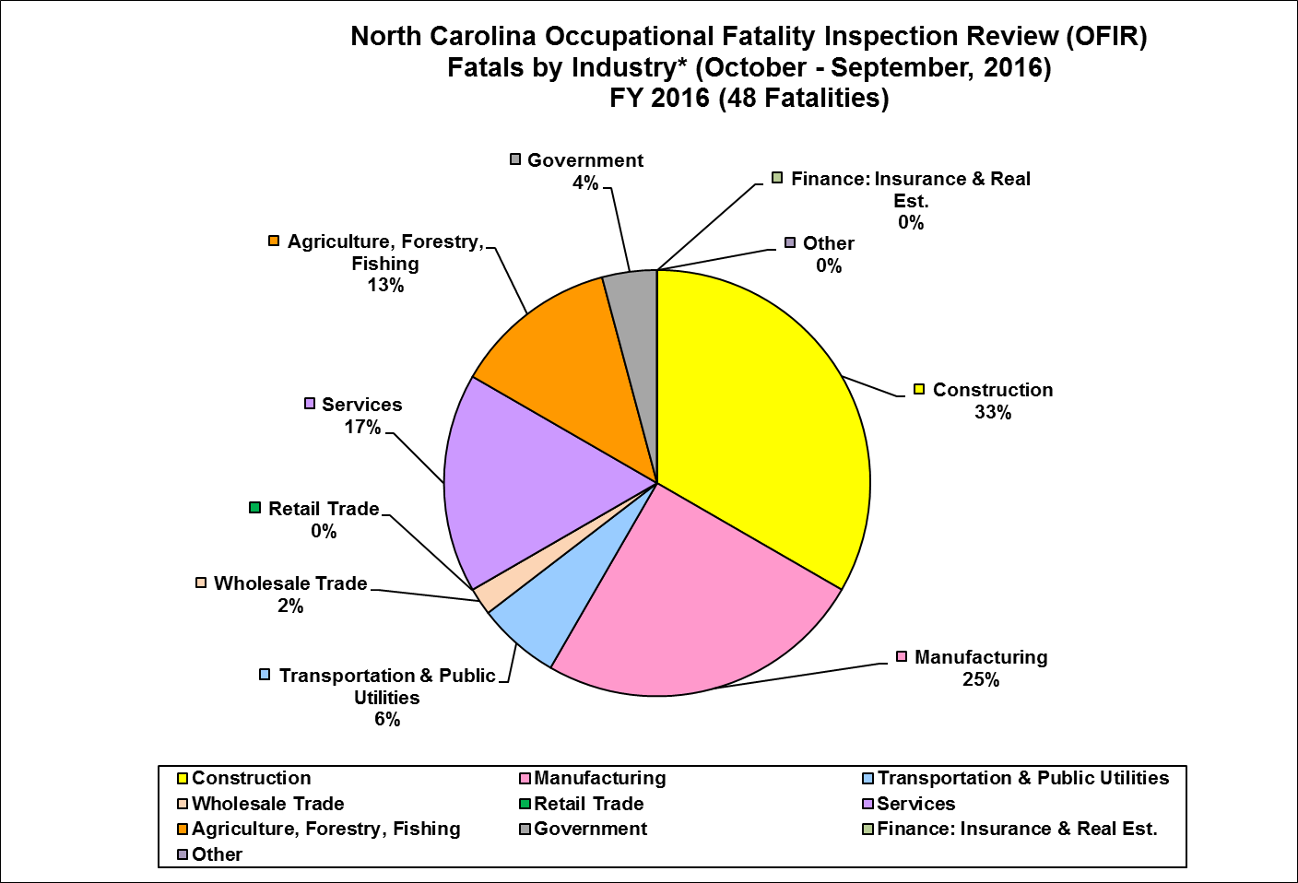

Slide 9
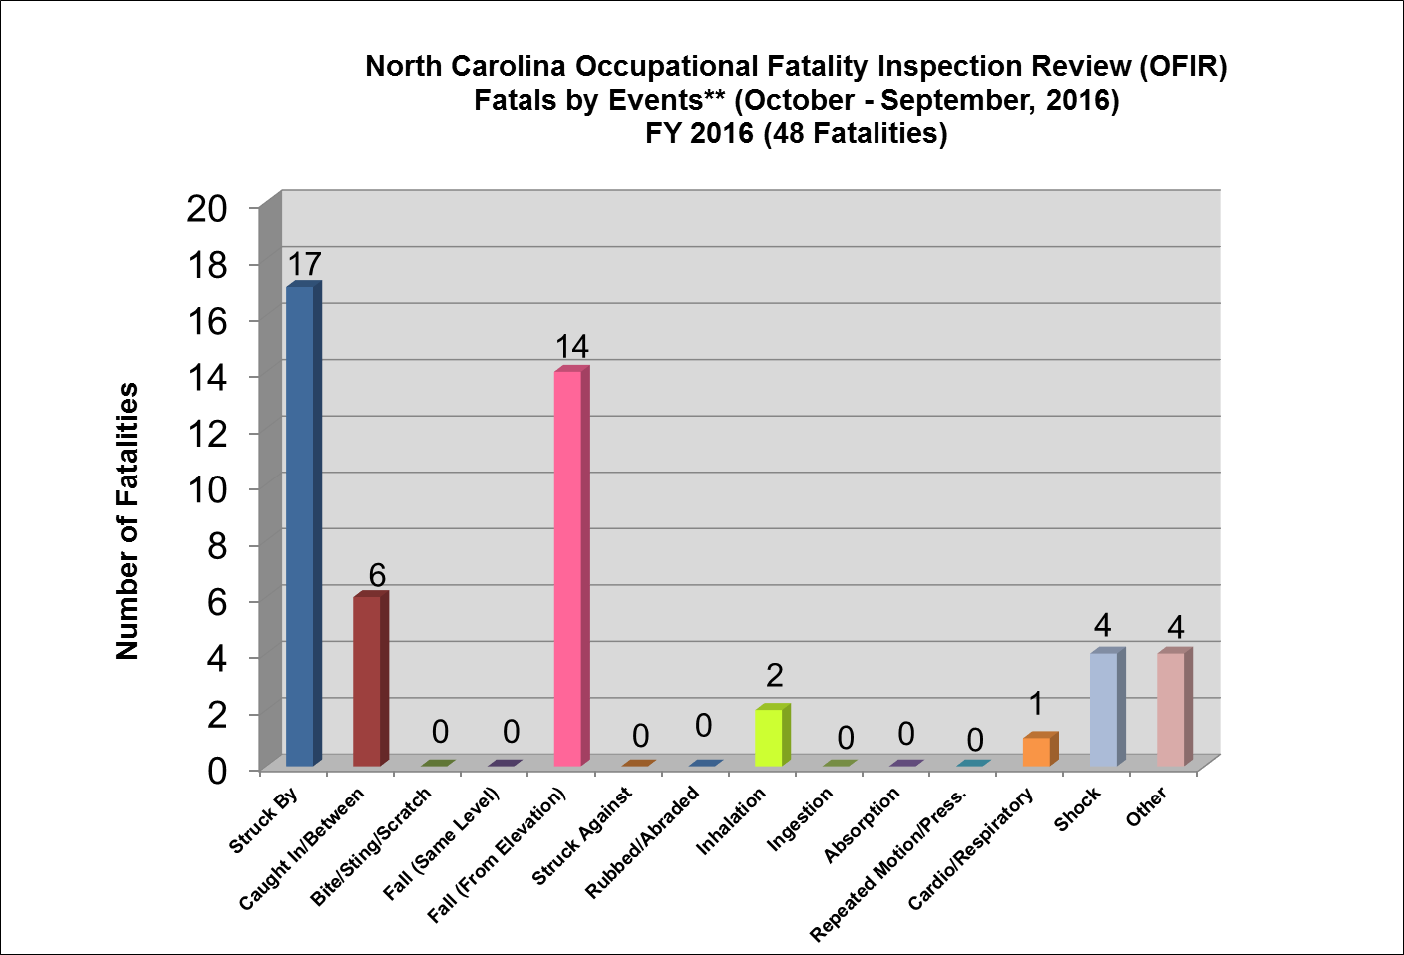

Slide 10

Prevention Thru Design(PtD)
What PtD is….
  Permanent design features eliminating hazards or reducing risk (i.e., eliminate need for fall protection)
What PtD is not…
  How to use safety protective devices or procedures (i.e., how to use fall protection)

Slide 11

Why Is PtD Necessary?
IBC Chapter 33 Safeguards During Construction
- Pedestrian Safety, Required Exits, Demolition
But, there are no requirements for construction safety in IBC Codes
“The International Building Code (IBC) is the foundation of the complete Family of International Codes®. It is an essential tool to preserve public health and safety that provides safeguards from hazards associated with the built environment.
It addresses design and installation of innovative materials that meet or exceed public health and safety goals.”

Slide 12

Prevention Thru Design(PtD)
  The process of addressing construction site safety and health, and planning for future maintenance in the design phase of a project.

Slide 13
Considering Safety During Design Offers the Most Payoff¹
High
Conceptual Design
Detailed Engineering
Ability to Influence Safety
Procurement
Construction
Start-up
Low
Project Schedule
¹ R. Szymberski, “Construction Project Safety Planning” TAPPI Journal, 1997.

Slide 14
Top Ten 1926 OSHA Violations
1) Subpart M .501(b)(13) – Fall Protection – Residential Construction
2) Subpart X .1053(b)(1) – Portable ladders not extended 3 feet above landing
3) Subpart M .501(b)(1) – Fall Protection – Unprotected Sides & Edges
4) Subpart M .503(a)(1) – Fall Protection – Training
5) Subpart E .102(a)(1) – Eye and Face Protection
6) Subpart E .100(a) – Head Protection
7) Subpart L .451(g)(1) – Scaffolds – Fall Protection
8) Subpart L .453(b)(2)(v) – Aerial lifts – Fall Protection
9) Subpart L .451(e)(1) – Safe Access
10) Subpart M .501(b)(10) – Fall Protection – Low-sloped Roofs

Slide 15
Federal Civil Penalties
Inflation Adjustment Improvements Act of 2015
Maximum allowable penalties for OSHA citations:
  Prior to 2016
  Other Than Serious $1,000
  Willful $70,000
2018
$12,934*
$129,336*
Failure to abate assessed per day beyond the abatement date
* OSHA penalties now indexed (CPI) for inflation
Notes:
President Barack Obama signed into law the Bipartisan Budget Act of 2015. This act sets a budget for the US government for two years and raises the debt limit to prevent a government shutdown. Passage of the Act has a clause buried inside which means means OSHA penalties will go up to keep up with inflation.
As any employer who has paid an OSHA penalty knows, OSHA does not receive those penalties directly. OSHA penalties are paid into the general fund. OSHA does not receive any of the OSHA fines and their budget is controlled by Congress.
The maximum monetary penalties OSHA can levy for citations are set by Congress, and the limits have not changed since 1990.

Slide 16
Fall Protection
Engineering Controls
1) Consider Parapets
2) Specify Window Sills at 42 inches
3) Specify Skylights with Guards or Screens
4) Permanent Roof Anchors
5) Protect Stairway and Roof Openings
6) Reduce Work at Elevations
7) Design gantry systems to maintain atriums and skylights
8) Permanent ladders or stairs to access building system components (eliminate need for scaffolding for future maintenance)
9) Position equipment at least 15 feet from roof edge

Slide 17
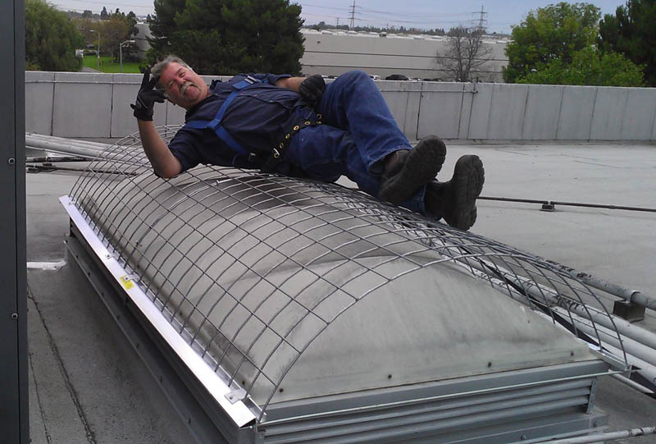
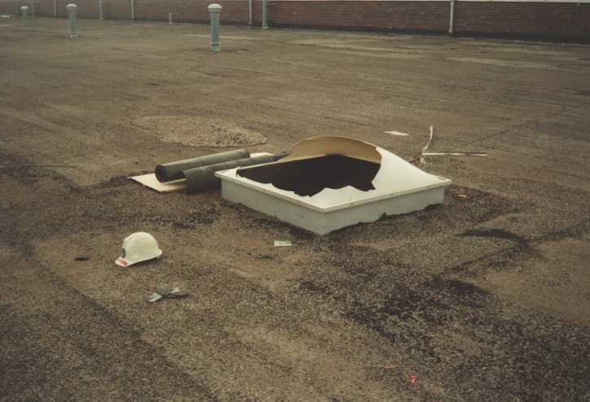
Skylights
Specify skylights that can
withstand human impact loads.
So that this does not happen!

Slide 18
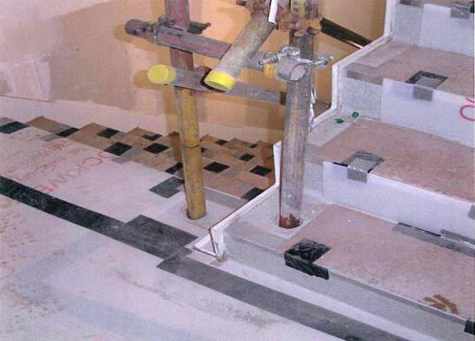
Stairways and Floor Openings
Cast-in sockets can be specified around floor openings and stairways.
The sockets make it easy for contractors to install temporary guardrails during the construction phase.
The sockets can then be used for permanent railings or filled in.

Slide 19
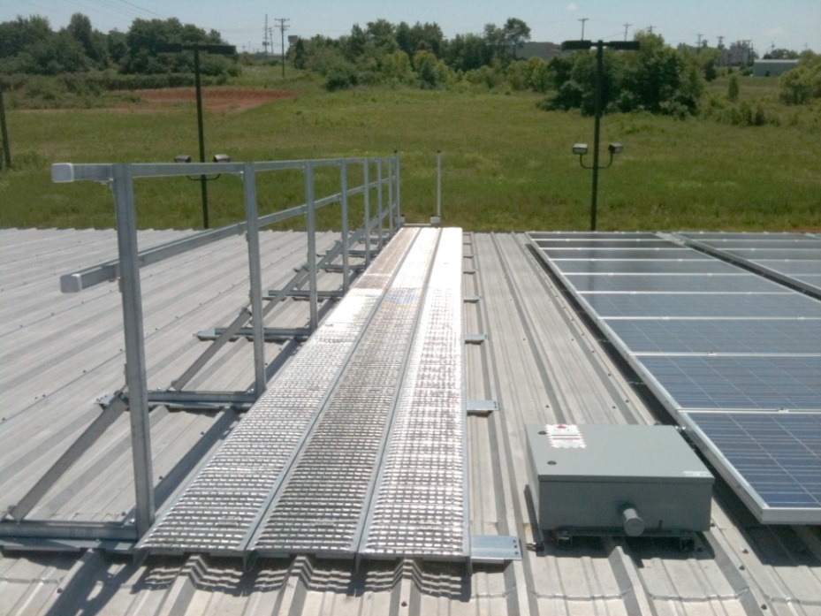
Falls Through Roof Surface
Add a safe catwalk to your plans so that workers and future maintenance personnel with have a structurally sound and
safe surface to walk upon when accessing the roof.

Slide 20
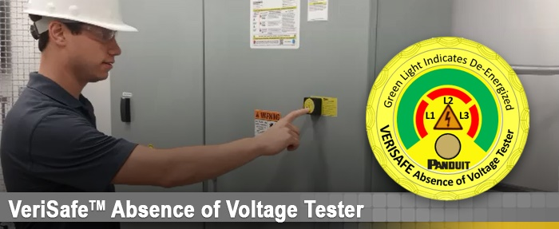
29 CFR 1910 Subpart S – Electrical
1910.333(b)(2)(iv)(B) Energized Equipment
Electrical maintenance personnel must assume all electrical equipment is energized prior to beginning any maintenance action
  Simply turning off a breaker supplying electrical equipment shall not permit maintenance personnel to assume residual voltage is absent
  Mandates manual 6-step portable voltmeter test (while wearing appropriate PPE) to confirm no voltage remains

Slide 21
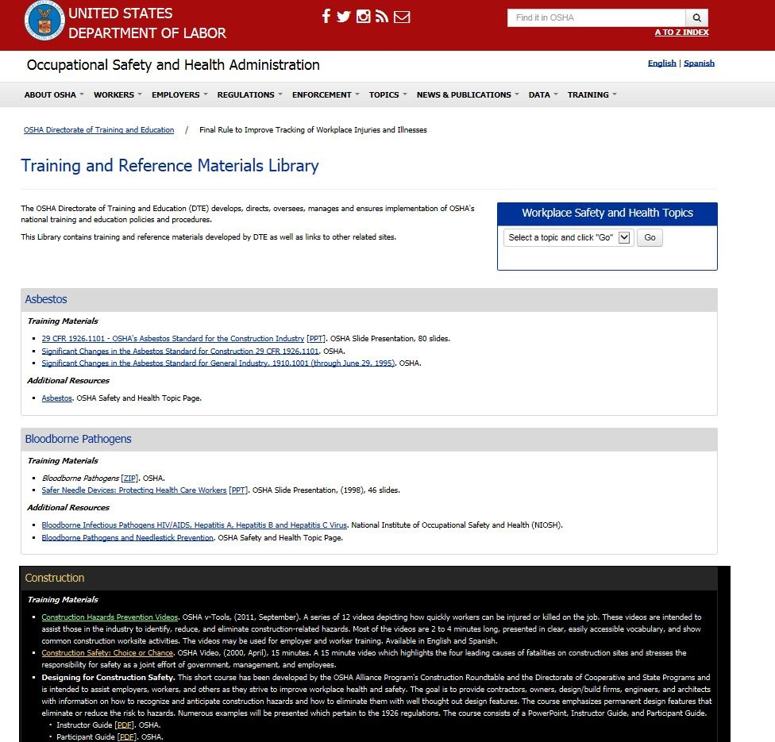
https://www.osha.gov/dte/library/materials_library.html

Slide 22
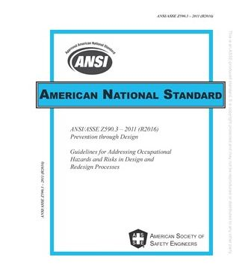

ANSI/ASSE Z590.3 Prevention through Design http://www.asse.org/publications/standards
Guidelines for Addressing Occupational Risks in Design and Redesign Processes

Slide 23

https://www.cdc.gov/niosh/topics/ptd
4 Education Modules:
Architectural Design
Reinforced Concrete Design
Structural Steel Design
Mechanical and Electrical Systems
100+ PtD Journal Articles
PtD In Motion Newsletter
Notes:
The Prevention through Design Program is pleased to announce the release of four education modules, consisting of an Instructor’s Manual and a slide deck. Each module outlines the motivations for PtD, encourages inclusion of worker health and safety considerations early in the design process, and identifies hazards associated with the topic.
The Architectural Design and Construction Education Module covers site planning and excavation, specific building elements such as skylights, solar panels and green roofs, general safety considerations, and hazards associated with decommissioning a building.
The Reinforced Concrete Design Education Module covers concrete design, detailing, fabrication and erection processes. Examples are provided to enable structural engineers and detailers to incorporate PtD into their reinforced concrete designs.
Topics in the Structural Steel Design Education Module include the steel design, detailing, fabrication and erection processes. Examples are provided to enable structural engineers and detailers to incorporate PtD into their steel designs.
The Mechanical-Electrical Systems Education Module covers electrical hazards and presents NORA goals for working with electricity. A wind farm case study demonstrates effective PtD solutions for fall protection. The research facility case study identifies PtD concepts applied to mechanical-electrical systems safety. This module contains five short videos in the PowerPoint version. In the Adobe version, links are provided to access captioned videos through the internet.

Slide 24

Contacts
NCDOL OSH Consultative Services Bureau
  Kevin O’Barr – Bureau Chief
  (919) 807-2899
  kevin.obarr@labor.nc.gov
NCDOA Safety Program Director
  Angelo Owens
  (919) 807-2492
  angelo.owens@doa.nc.gov
State Construction Office
  Matthew Marbois
  (919) 807-4099
  matthew.marbois@doa.nc.gov

Slide 25
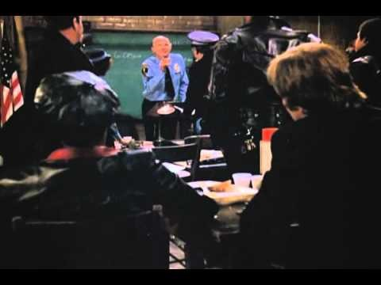
“Remember!
Let’s Be Careful Out There!”
Morning Roll Call - Sergeant Phil Esterhaus, Hill Street Blues
(Michael Conrad b1925-d1983)

