Slide 1

37th Annual
State Construction
Conference
March 29th, 2018
WELCOME

Slide 2

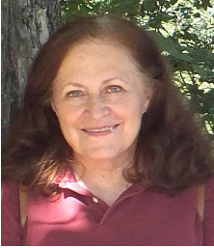

Howard Beasley
Jane Johnson
Jim Yancey

Slide 3
NC Building Code 2018 Transition
For SCO Plan Approval
Approded DD or CD to continue w/ 2012

Slide 4
Electronic submittals
For Plan review
University Download Projects( <$2M)
Informal Projects (<$1/2M)
Projects requiring code only reviews
Addendums
VE Packages
Change Order Proposals
Engineering Shop Drawings when required

Slide 5
37th Annual
State Construction
Conference
March 29th, 2018
State Building Commission Update

