Slide 1

38th Annual
State construction Conference
March 28, 2019
SCO Conference 2019

Slide 2
Bid “entanglements” explained
Why so important?
Expenditure of Public Funds
General Statutes ….. and
NC Administrative Code apply
SCO Conference 2019

Slide 3
Top 10 Questions:
Advertising
Bid evaluation
Award selection
SCO Conference 2019

Slide 4

“our survey says…..”
SCO Conference 2019

Slide 5
10
Are Industry Certifications required …..
….. from certain bidders?
Yes, AISC certification is required for both erection and fabrication of steel.
If Special Inspections are required by Code, any structural steel fabrication on these structures will require the AISC Certification.
SCO Conference 2019

Slide 6
9
Potential bidder wishes to make a $ donation to the Project in their bid!
Answer:
Don’t go there!!!
SCO Conference 2019

Slide 7
8
Why does the person signing the contract have to be registered on the Secretary of State website?
Only those persons registered with the Secretary of State can legally bind the “entity” to a contract.
SCO Conference 2019

Slide 8
8
Why does the person signing the contract have to be registered on the Secretary of State website?
Only those persons registered with the Secretary of State can legally bind the “entity” to a contract.
Corporation, LLC, Partnership, registered JV
SCO Conference 2019

Slide 9
8
Remember the “old days” of two-party checks issued by the State?
Bank would not honor the deposit to the second party – if the first party signing was not listed as a registered agent FOR THAT COMPANY with the North Carolina Secretary State.
SCO Conference 2019

Slide 10
7
Do the Performance and Payment Bonds need to be executed the same day as the contract?
No, the execution date must be on the contract date or after the contract date.
Under no circumstances may the Bond execution date precede contract date.
SCO Conference 2019

Slide 11
7
Under no circumstances may the Bond execution date precede contract date.
Why?
The terms of the bond cannot be established prior to the final terms of the Construction Contract.
SCO Conference 2019

Slide 12
6
Why can’t the Prime Contractor list themselves on Affidavit C or D ??
Both Affidavit’s state that the minority businesses will be employed as construction subcontractors, vendors, suppliers, or providers of professional services.
SCO Conference 2019

Slide 13
6
Both Affidavit’s state that the minority businesses will be employed as construction subcontractors, vendors, suppliers, or providers of professional services.
Why?
SCO Conference 2019

Slide 14
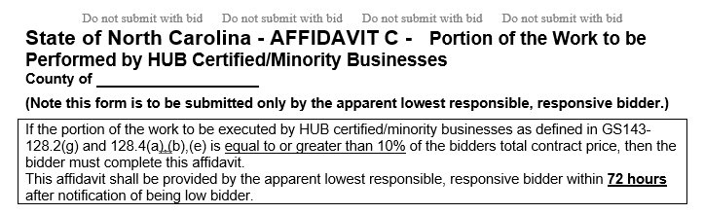
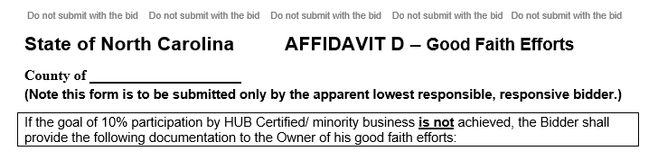
6
Including material suppliers
Including material suppliers
SCO Conference 2019

Slide 15
6
The Statute applies equally……
…………. to all apparent low bidders.
“All are held to the good faith effort”
SCO Conference 2019

Slide 16
Who is required to post all CONSTRUCTION advertisements on the State of NC IPS Website?
5
Universities and State Agencies - REQUIRED
Community Colleges by policy
Agencies post to IPS through email to SCO
Universities do not post through SCO
SCO Conference 2019

Slide 17
5
Universities do not post through SCO
Universities post to NC IPS through…
…. the UNC System Office
An SCO ID # is required to post ANYTHING
On NC IPS
SCO Conference 2019

Slide 18
4
Must a bid be rejected if the price for a single alternate was left blank?
INSTRUCTIONS TO BIDDERS Item 1 – Page 1
For a proposal to be considered it must be in accordance with the following instructions:
Proposals must be made in strict accordance with the Form of Proposal provided therefor, and all blank spaces for bids, alternates, and unit prices applicable to bidder’s work shall be properly filled in.
SCO Conference 2019

Slide 19
4
Must a bid be rejected if the price for a single alternate was left blank?
Can’t the State assume my bid is $ zero?
Absolutely not.
SCO Conference 2019

Slide 20
Can a GC change a subcontractor – shown on the bid form - after bid and award??
3
Public Contracts
§ 143-128(d)
No, with three (3) specific exceptions
SCO Conference 2019

Slide 21
A contractor whose bid is accepted shall not substitute any person as subcontractor in the place of the subcontractor listed in the original bid, except:
3
If the listed subcontractor's bid is later determined by the contractor to be non-responsible or non-responsive,
or, the listed subcontractor refuses to enter into a contract for the complete performance of the bid work,
or with the approval of the awarding authority for good cause shown by the contractor.
SCO Conference 2019

Slide 22
Low bidder accidentally used the “wrong form” for bid bond. “Surely the State will not turn down the low bidder just for using the wrong form for a bond?”
2
First of all, stop calling me Shirley!!
SCO Conference 2019

Slide 23
Low bidder accidentally used the “wrong form” for bid bond. “Surely the State will not turn down the low bidder just for using the wrong form for a bond?”
2
It’s not about the wrong form. It’s the language stated on the form.
SCO Conference 2019

Slide 24
2
§ 143-129(b)
No proposal for construction or repair work may be considered or accepted by said board or
governing body unless at the time of its filing the same shall be accompanied (cash, certified check or bid bond) in an amount equal to not less than five percent (5%) of the proposal.
SCO Conference 2019

Slide 25
It’s not about the wrong form. It’s the language stated on the form.
2
This is unacceptable language:
…. pays to the Owner the difference, not to exceed the amount of this Bond, between the amount specified in said bid and such larger amount for which the Owner may in good faith contract with another party to perform the work covered by said bid …..
SCO Conference 2019

Slide 26
2
OK, I get it. I made a mistake.
Can’t I just send you a correct form?
Absolutely not – Prohibited by Statute
SCO Conference 2019

Slide 27
2
Can’t I just send you a correct form?
§ 143-129(b)
No proposal for construction or repair work may be considered or accepted by said board or
governing body unless at the time of its filing the same shall be accompanied (cash, certified check or bid bond) in an amount equal to not less than five percent (5%) of the proposal.
SCO Conference 2019

Slide 28
2
So, the Agency, University, Community College:
Likely re-bid and ultimately award the contract
Calculate the difference between the original bid not honored and the amount eventually contracted for.
SCO Conference 2019

Slide 29
“our survey says…..”
SCO Conference 2019

Slide 30
1
If SCO can give me Approval to Award in just a few days, why does it take weeks for the fully executed construction contract?
Answer: Improper endorsements of bonds and insurance forms:
SCO Conference 2019

Slide 31
1
For Construction Contracts ….
Bonds and Insurance
Required Cancellation Provision
SCO Conference 2019

Slide 32
1
This clause (or it’s full intent) must be included in the Endorsement Form:
Not withstanding the preprinted cancellation provisions on this form, coverages afforded under these policies will not be cancelled, reduced in amount nor will any coverages be eliminated until at least thirty (30) days after mailing written notice, by certified mail return receipt requested, to the insured and the State of North Carolina Owner (at the address of the Certificate Holder), of such alteration or cancellation.
SCO Conference 2019

Slide 33
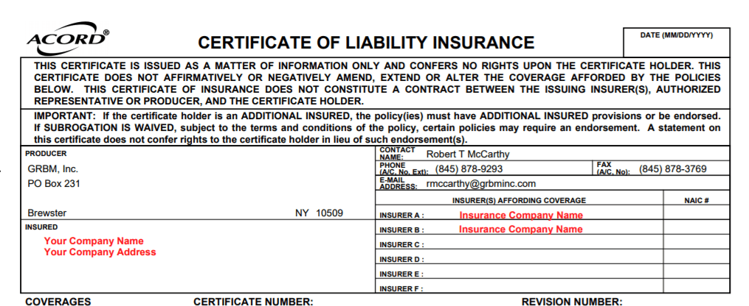
1
Not the Acord certificate
SCO Conference 2019

Slide 34
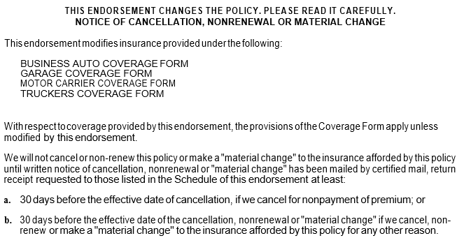
SCO Conference 2019

Slide 35
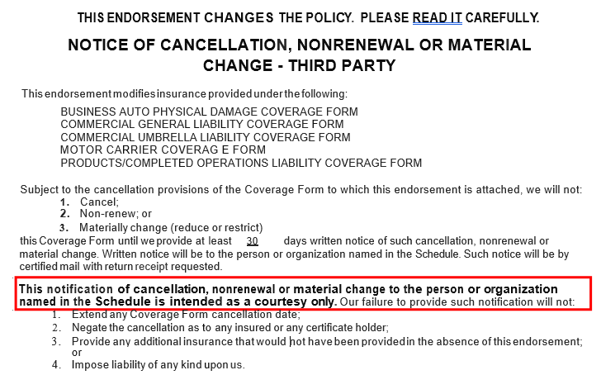
SCO Conference 2019

Slide 36
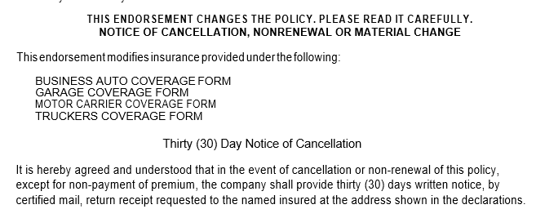
SCO Conference 2019

Slide 37
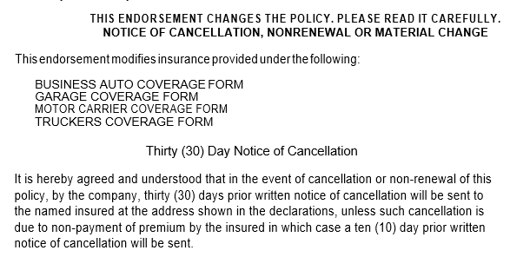
Also missing:
Certified Mail
Return Receipt
SCO Conference 2019

Slide 38
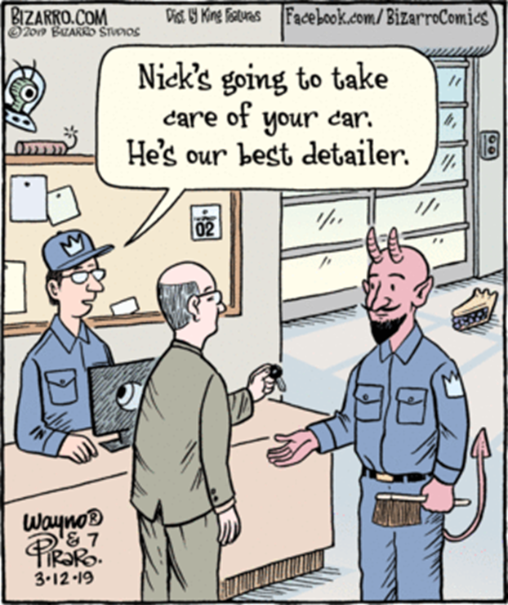
SCO Conference 2019

Slide 39
The
devil
is
in
the
details
SCO Conference 2019

Slide 40
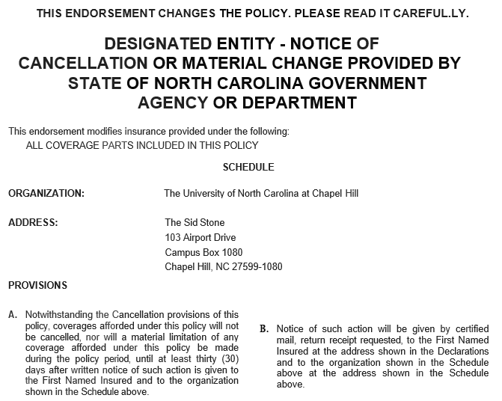
SCO Conference 2019

Slide 41
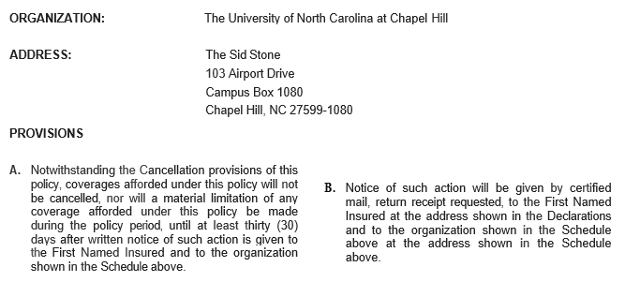

SCO Conference 2019

Slide 42
38th Annual
State construction Conference
March 28, 2019
SCO Conference 2019

