Slide 1


Welcome
Energy Outlook – Executive Order 80
Panel Discussion
Notes:
WELCOME TO THE EXECUTIVE ORDER 80 BREAKOUT SESSION, WHICH WE WILL ALSO REPEAT AT 3:00 PM TODAY. PLEASE TAKE YOUR SEATS AND IF YOU CAN MOVE TOWARD THE AISLE TO ACCOMMODATE THOSE WHO ARE STANDING, THAT WOULD BE GREAT.
AGAIN, WELCOME TO THE EXECUTIVE ORDER 80 BREAKOUT SESSION.
WE HAVE A LOT OF GROUND TO COVER, SO WE’LL GO AHEAD AND GET STARTED.

Slide 2
Energy Outlook
Executive Order 80
Panel Discussion
AGENDA
INTRODUCTION OF PANELISTS
EXECUTIVE ORDER 80 OVERVIEW
DPS ENERGY PROGRAMS
PRIVATE SECTOR ROLE IN EXECUTIVE ORDER 80
DOA ENERGY PROGRAMS
QUESTIONS AND DISCUSSION
SCO Conference 2019
Notes:
WE’D LIKE TO FIRST REVIEW THE AGENDA FOR TODAY’S SESSION.
I’LL INTRODUCE THE PANELISTS, SUSHMA MASEMORE WILL PROVIDE AN OVERVIEW OF EXECUTIVE ORDER 80, PAUL BRAESE WILL REVIEW ENERGY PROGRAMS AT THE DEPARTMENT OF PUBLIC SAFETY, ROGER WOODS WILL DISCUSS THE PRIVATE SECTOR IN STATE ENERGY PROGRAMS, AND I WILL REVIEW DEPARTMENT OF ADMINISTRATION ENERGY PROGRAMS.
WE’D LIKE TO REQUEST THAT QUESTIONS BE HELD UNTIL AFTER THE PRESENTATIONS IF YOU WOULD.

Slide 3
INTRODUCTION OF PANELISTS
SUSHMA MASEMORE, PE – DEPUTY ASSISTANT SECRETARY FOR ENVIRONMENT AND STATE ENERGY DIRECTOR
PAUL BRAESE, PE – ENERGY MANAGER, NORTH CAROLINA DEPARTMENT OF PUBLIC SAFETY
ROGER WOODS, PE – PARTNER, IBI GROUP OF NORTH CAROLINA
JOSEPH BADEN, PE – BUILDING SYSTEMS ENGINEER, STATE CONSTRUCTION OFFICE
SCO Conference 2019
Notes:
READ THE BIOS FROM THE SEPARATE SHEET.
AFTER INTRODUCING THE PANELISTS, INVITE SUSHMA MASEMORE TO PRESENT AN OVERVIEW OF EXECUTIVE ORDER 80.

Slide 4
Sushma Masemore, P.E.
Overview of Governor Cooper’s Executive Order No. 80:
NC’s Commitment to Address Climate Change and Transition to a Clean Energy Economy
State Construction Conference
March 28, 2019 - Raleigh
SCO Conference 2019

Slide 5

Topics Covered
Overview of Exec Order No. 80
Cabinet Agency Directives
Clean Energy Plan Process
State Buildings Energy Performance Preview
SCO Conference 2019

Slide 6

Executive Order No. 80
North Carolina’s Commitment to Address Climate Change and Transition to a Clean Energy Economy
Recognizes that climate change is affecting the health and welfare of our residents, economy, environment and our natural and built infrastructure.
Recognizes that we must take an active role in combatting climate change and make our state more resilient to its impacts.
Calls for clean energy technology innovations, workforce development, and a modern, smart electric grid to grow the state’s economy while making North Carolina a national leader in clean energy solutions.
Recognizes that we can protect our communities, grow our economy, and ensure a healthy environment at the same time.
https://governor.nc.gov/documents/executive-order-no-80-north-carolinas-commitment-address-climate-change-and-transition
SCO Conference 2019

Slide 7
State Goals
The State of North Carolina will strive to accomplish the following by 2025:
  Reduce statewide greenhouse gas emissions to 40% below 2005 levels
  Increase the number of registered, zero-emission vehicles (ZEVs) to at least 80,000
  Reduce energy consumption per square foot in state-owned buildings by at least 40% from fiscal year 2002-2003 levels
SCO Conference 2019

Slide 8
N.C. Climate Change Interagency Council
Composition: The secretary or designee of each cabinet agency and a representative of the Governor’s Office
Council Chair: Secretary Regan, N.C. Department of Environmental Quality
Council Duties:
    Recommend new and updated goals and actions to meaningfully address climate change
    Develop and implement programs and activities that support climate mitigation and adaptation
    Consider stakeholder input when developing recommendations, programs, and activities
    Schedule, monitor, and provide input on the preparation and development of the plans and assessments required by EO 80
    Review and submit to the Governor EO 80 plans and assessments
Status Update on Implementation: To Governor by Oct. 15, 2019.
https://deq.nc.gov/energy-climate/climate-change/nc-climate-change-interagency-council
SCO Conference 2019

Slide 9
Specific Directives
Department of Environmental Quality
  N.C. Clean Energy Plan - encourage the increased utilization of clean energy technologies in the public and private sectors. Due Oct. 1, 2019
  Comprehensive Energy, Water, and Utility Use Conservation Program – update best practices and guidance to achieve 40% state buildings efficiency goal. Due Feb. 1, 2019 and Dec. 1, 2019
  N.C. Climate Risk Assessment and Resiliency Plan - provide a scientific assessment of current and projected climate impacts on North Carolina and prioritize effective resiliency strategies. Due Mar. 1, 2020
  Greenhouse Gas Inventory – prepare estimates of North Carolina’s statewide net GHG footprint.
Department of Transportation
  N.C. Zero-Emission Vehicle Plan – develop a strategy to achieve the ZEV target and address topics such as ZEV corridors and ZEV infrastructure. Due Oct. 1, 2019
SCO Conference 2019
Notes:
ZEV = ZERO EMISSION VEHICLE

Slide 10
Specific Directives
Department of Commerce
  Clean energy and clean transportation workforce assessments - evaluate current and future workforce needs, assess the skills and education required for employment, and recommend actions to help North Carolinians develop such skills and education. Due Oct 1, 2019
Department of Administration
  N.C. Motor Fleet Zero-Emission Vehicle Plan - identify feasible trips for a ZEV, recommend needed infrastructure, address ZEV procurement options, and include other key strategies for increasing ZEV use. Due Oct. 1, 2019
  Report accounting of each agency’s number of ZEVs and miles driven by vehicle type. Due Oct. 1, 2019
SCO Conference 2019

Slide 11
General Directives to All Cabinet Agencies
Assess and Address Climate Change
  Evaluate the impacts of climate change on agency programs and operations
  Integrate climate change mitigation and adaptation practices into agency programs and operations
  Support communities and sectors vulnerable to climate change impacts
Support Clean Energy Businesses
  Take actions that support the expansion of clean energy businesses and service providers, clean technology investment, and companies committed to procuring renewable energy.
Procure and Use Zero-Emission Vehicles
  Prioritize ZEVs in the purchase or lease of new vehicles and use ZEVs for agency business travel when feasible. When ZEV use is not feasible, prioritize cost-effective, low emission alternatives.
Improve State Building Energy Consumption
  Comprehensive Program for State Buildings (next slide!)
SCO Conference 2019

Slide 12



State Buildings Comprehensive Program
Utility Savings Initiative (USI) - EO80 Section 8
General Description of Approach
  Build on agency success pursuant to G.S. 143-64.12 (a) to further reduce energy usage
  Promote best practices for state government buildings energy efficiency
  Provide training to energy managers and staff
  Adopt a standard methodology for calculations and reporting
Actions
  Comprehensive Program Report drafted and provided to Climate Council for review
  Energy Managers identified for each cabinet agency
  DEQ meetings with each cabinet agency to discuss FY18 data and accomplishing EO80 goals
  Energy Managers meeting Feb. 21 to collaborate, share best practices and address questions
EO80 Deliverables Schedule
  January 15, 2019, Identify energy managers
  February 1, 2019, update and amend Comprehensive Energy, Water, and Utility Use Conservation Program
  March 1, 2019, collect cabinet agency utility management plans and assess the adequacy of the plans with EO80
  Evaluate Utility Management Plans- in process
SCO Conference 2019

Slide 13
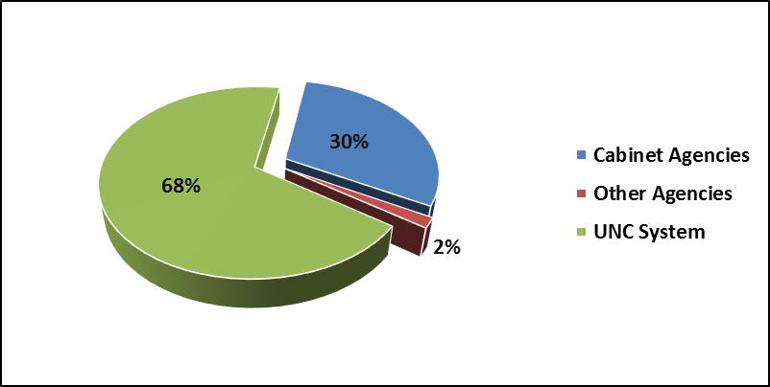
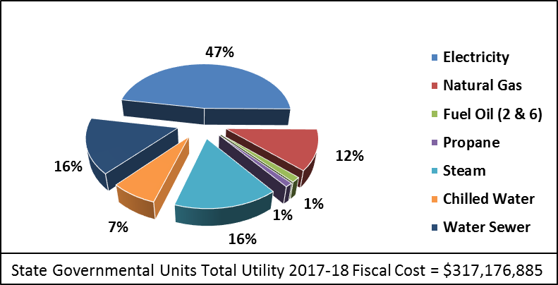

2018 Comprehensive Program Report Conclusions – Fuel and Cost
State Governmental Units occupied about 135 million square feet of space. State Governmental Units spent over $317 million in utility costs.
Electricity costs represent almost 50% of the total utility costs.
Since 2003, State Governmental Units have decreased energy consumption by 28% and avoided $1.2 billion dollars in utility costs by implementing energy efficiency retrofits or upgrades.
To reach a 40% energy intensity goal by 2025, the SEO estimates achieving about $200 million in avoided utility costs with $792 million dollars in investment.
https://deq.nc.gov/conservation/energy-efficiency-resources/utility-savings-initiative
SCO Conference 2019
Notes:
THE 135 MILLION SQUARE FEET OF OCCUPIED SPACE NOTED ABOVE INCLUDES LEASED SPACE, NOT OWNED BY THE STATE OF NORTH CAROLINA.

Slide 14
Comprehensive Program Report Conclusions
Agency Trends and Emissions Summary
Agency Changes in Electricity Use and Building Area
Agency and University Avoided GHG Emissions (FY03-FY18)
1,000,000
60
900,000
Building Area
Building Gross Area - million sq. ft.
Fuel Source | All State Government Units (MTCO2e)
Electricity Usage | 1,723,750
Nat Gas Usage | -204,969
Fuel Oil Usage | 1,556,109
Propane Usage | 91,154
Total | 3,166,044
37% increase
from FY 2003
50
800,000
Electricity Use - MWh
700,000
40
600,000
500,000
Electricity
30
13% use increase
from FY 2003
400,000
300,000
200,000
20
10
100,000
0
0
2003
2005
2007
2009
2011
2013
2015
2017
SCO Conference 2019

Slide 15
NC GHG Emissions from the Residential, Commercial, Industrial Sector (MMT CO2e)
 | 2005 | 2017 | Changes from 2005-2017
Industrial Total Energy Use | 36.34 | 20.14 | -45%
Fuel Combustion | 17.72 | 9.93 | -44%
Electricity Use | 18.62 | 10.21 | -45%
Commercial Total Energy Use | 32.37 | 25.07 | -23%
Fuel Combustion | 5.06 | 5.72 | 13%
Electricity Use | 27.31 | 19.36 | -29%
Residential Total Energy Use | 40.19 | 28.31 | -30%
Fuel Combustion | 6.75 | 5.28 | -22%
Electricity Use | 33.44 | 23.03 | -31%
SCO Conference 2019
SCO Conference 2019

Slide 16
DEQ Directive: Clean Energy Plan
EO80 Section 4
Develop a North Carolina Clean Energy Plan that fosters and encourages:
  Utilization of clean energy resources and innovative technologies, and
  Integration of these resources to facilitate the development of a modern and resilient electric grid.
Collaborate with stakeholders to increase the utilization of clean energy technologies, energy efficiency measures, and clean transportation solutions.
Submit the plan to the Governor by October 1, 2019.
SCO Conference 2019

Slide 17
Clean Energy Plan Development Process
EO80 Section 4
General Description of Approach
  Vision building and assessing current landscape
    What is NC’s vision of a clean energy future?
    How different is it from the current direction?
    How well do current policies, regulatory and business practices help achieve that vision?
  Evolving and changing landscape
    What policy and technology trends are influencing how we foster clean energy use?
  Develop recommendations
SCO Conference 2019

Slide 18
Clean Energy Plan Stakeholders
Distributed energy resource/renewable energy system providers and integrators
Investor owned utilities, municipalities, and electric cooperatives
Local governments, council of governments and other supporting entities
Elected officials
Large corporate, business and finance groups
Manufacturing and industrial organizations and trade associations
Healthcare and commercial buildings sector
Higher education institutions
Environmental justice, under-served communities and faith-based organizations
Affordable housing and community development organizations
Consumer advocates
Youth and students
Environmental organizations
Energy efficiency system and service providers
Others (to be defined per suggestions)
SCO Conference 2019

Slide 19

Clean Energy Plan Development Process
Public Engagement Methods:
Method 1. Six Facilitated Workshops, Raleigh
Method 2. Regional Listening Sessions
Method 3. Combined with Other Statewide Events
Method 4. Online Input
Regional Listening Sessions
Statewide outreach events organized in metropolitan and rural areas to collect information and provide input on this effort.
Attendees will be shown pre-recorded segments of the facilitated workshops and asked specific questions to obtain feedback.
All stakeholders are welcome to attend.
Sessions scheduled from March –May in:
Charlotte | Asheville
Rocky Mount | Wilmington
Hickory | Fayetteville
Elizabeth City | Wilmington
Dates and locations posted at https://deq.nc.gov/energy-climate/climate-change/nc-climate-change-interagency-council/climate-change-clean-energy-2
SCO Conference 2019

Slide 20
THANK YOU
Sushma Masemore, P.E.
Deputy Assistant Secretary for Environment &
State Energy Director
919-707-8700
Sushma.Masemore@ncdenr.gov
Notes:
THANK YOU, SUSHMA. NEXT, I’D LIKE TO ASK PAUL BRAESE, ENERGY MANAGER FOR THE NORTH CAROLINA DEPARTMENT OF PUBLIC SAFETY, TO TELL US ABOUT ENERGY ACTIVITIES AT HIS DEPARTMENT.
THANK YOU, PAUL.

Slide 21

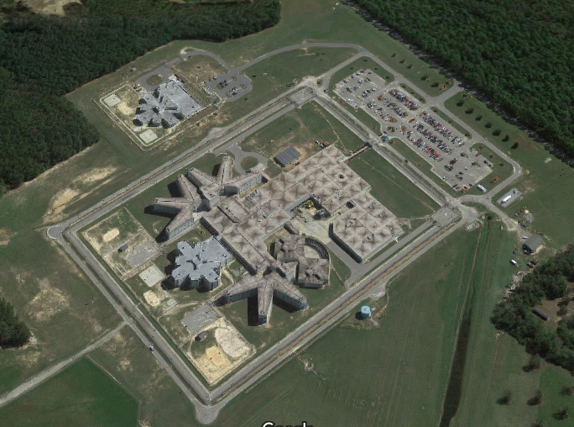
Paul Braese, PE
Energy Manager
North Carolina
Department of Public Safety
SCO Conference 2019

Slide 22

Summary
Opportunities
  Opt-Out Funds: EE & DSM
  LED Lighting
  Water Management Systems
  Building Management Systems
  High Performance Maintenance
Challenges
  Time
  Money

Slide 23



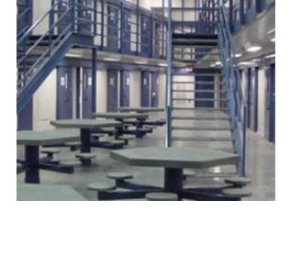
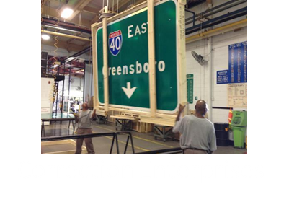



About NCDPS
$54M Utility Spend
305 Sites
3523 Buildings & Structures
103 Leased Spaces
2430 Utility Accounts

Slide 24
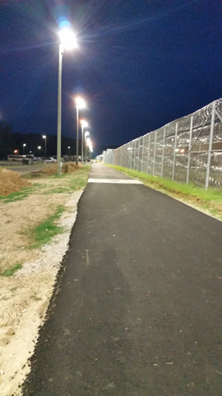
Opportunities
Opt-Out Funds:
  Approaching $ 1 Million
  Funds must be expended in same FY
LED Area Lighting
  Up to 80% energy savings
  Existing Fixtures at End of Life
  State Term Contracting
  “Smart” Fixtures
  +/- 18% ROI

Slide 25
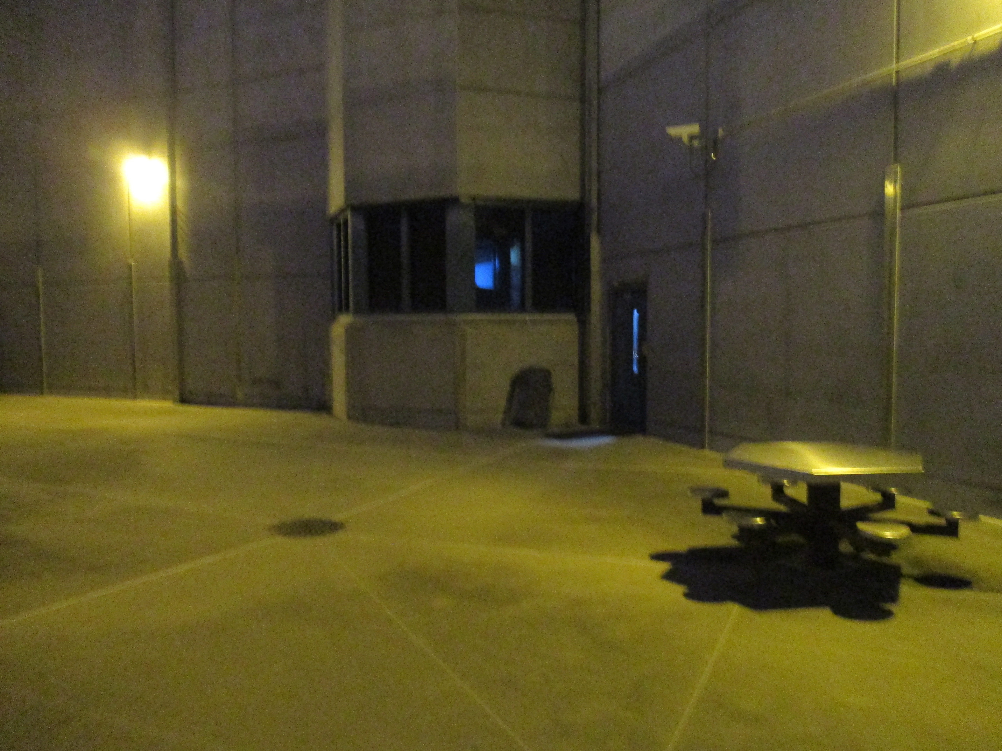
Opportunities: LED Area Lighting
Before

Slide 26
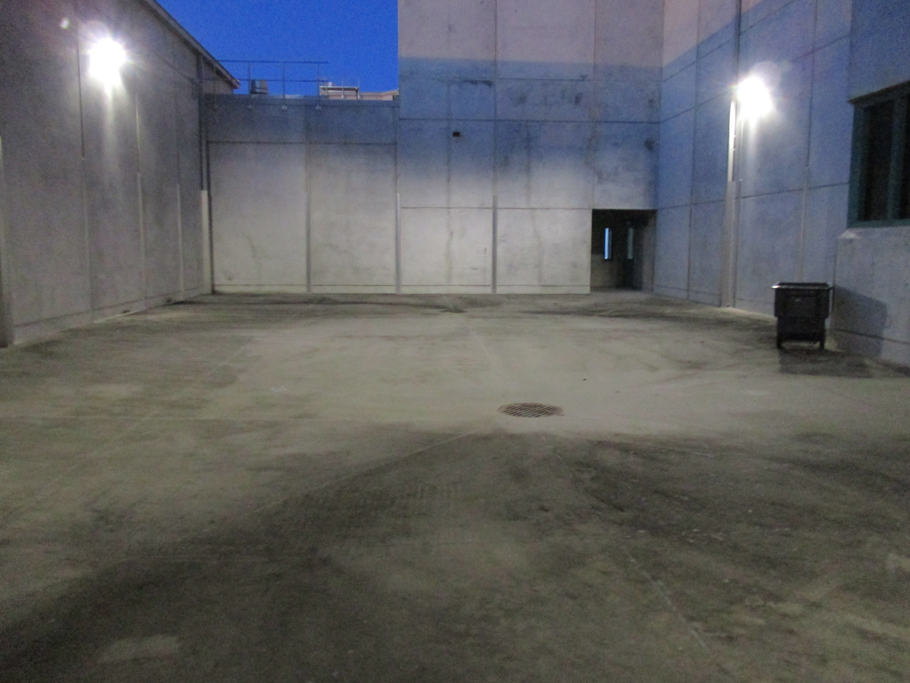
Opportunities: LED Area Lighting
After
Before
90% Reduction in power

Slide 27
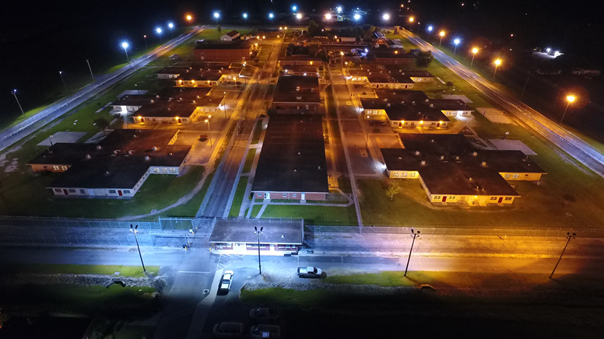
Opportunities: LED Area Lighting
Before

Slide 28
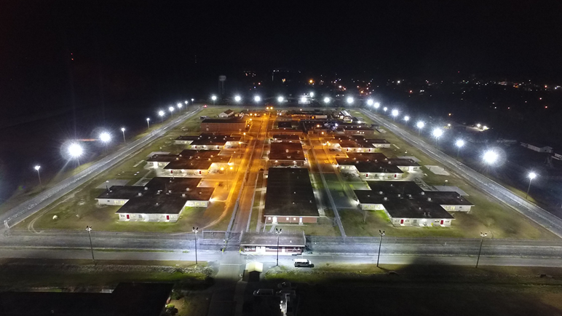
Opportunities: LED Area Lighting
Before
After
70% Reduction in power

Slide 29


Opportunities: LED Interior Lighting
30% +/- ROI

Slide 30

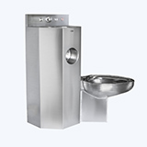
Opportunities:
Water Management Systems
Water/Sewer is ???? % of our Spend?
Electricity is ???? %
5-15% ROI
40-50% Reduction in Water Usage

Slide 31
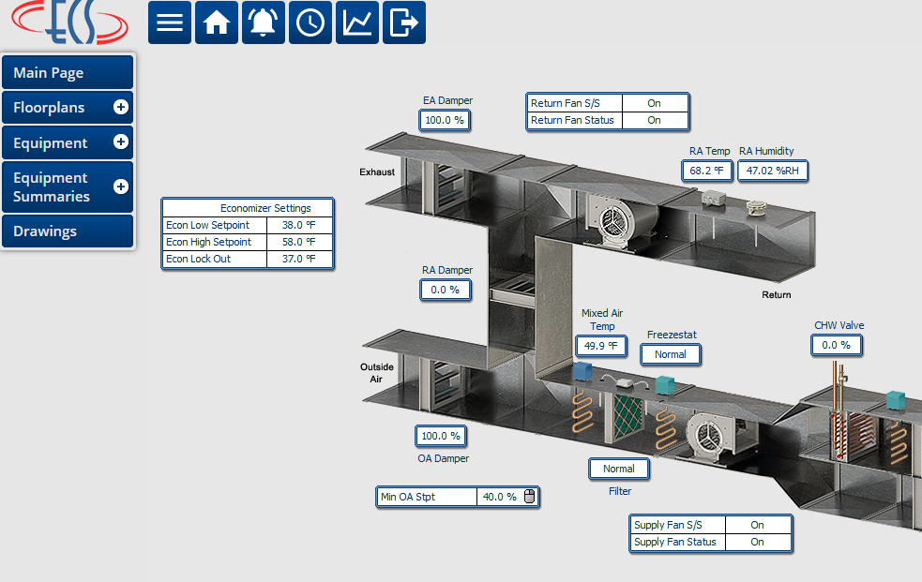
Opportunities: BMS
Standardization:
  Sequence of Operations
  Input/Outputs
  Data Analytics
  Graphics Look & Feel

Slide 32
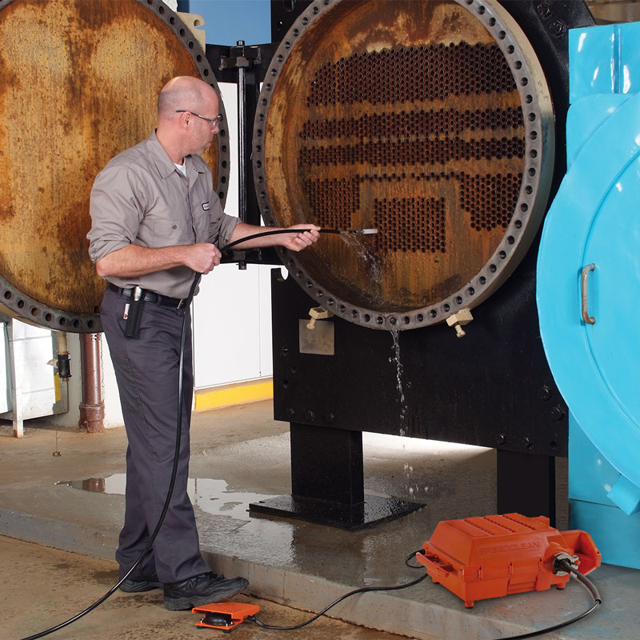


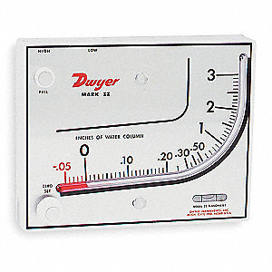
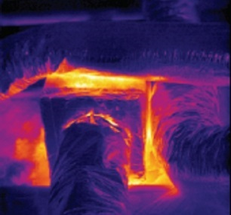
Opportunities: High Performance Maintenance
Chemical Treatment
Combustion Analyses
Chiller & Boiler Tube Rodding
Access Doors (everywhere!)
Belts & Sheaves
Fin combing
Duct Leakage
Basic T & B

Slide 33
Challenges
  Time
  Money

Slide 34
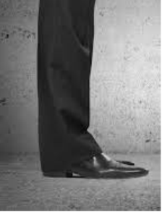
Challenges
  Time
Our Spend …..

Slide 35
Challenges
  Time
Our Spend …..
Our Bandwidth …..

Slide 36
Challenges
Time
  Bandwidth
  Data Collection, Management & Analyses
  Procurement
    SBES
    Term Contracts
    Performance Contracting?
  Operations/Maintenance
    Hiring Timeframe
    Salaries
Notes:
Maintenance vs. capital funding: can forgo maintenance – equipment fails – accelerate capital funding

Slide 37
Challenges
  Money
    ~ Funding: $120M (-40% usage intensity by 2025)
    Yearly Opt-Out Funds: ~ $1M
    R/R Funds:
      Energy Efficiency Projects Compete
      Should be complementary
    No HB1292
    Utility Costs Always Increase (Over Time)
Notes:
No compounding effect from $ Savings
Typical Water Management System: $1.5M-$2M
Typical Site Lighting $100K+
Opt out funds decrease over time as usage decreases
Complementary: replaces failing equipment, reduces maintenance costs.

Slide 38
Our Goal
Use Taxpayer’s $ Wisely
  Install the right lamp
  Turn the right wrench
To Do So…
  Streamline Data Collection & Analysis
  Create the Funding Stream
  Provide the bandwidth
  Prioritize Maintenance

Slide 39
THANK YOU
Paul Braese, PE
North Carolina Department of Public Safety
Central Engineering
Energy Manager
2020 Yonkers Road
4216 Mail Service Center
Raleigh, N.C. 27699-4216
919-324-1253
paul.braese@ncdps.gov
Notes:
THANK YOU, PAUL.
NEXT I’D LIKE TO ASK ROGER WOODS OF IBI GROUP TO GIVE US HIS THOUGHTS ON THE ROLE OF THE PRIVATE SECTOR IN MEETING THE GOALS OF EXECUTIVE ORDER 80.

Slide 40
PRIVATE SECTOR ROLE IN EXECUTIVE ORDER 80
Roger Woods, PE
Intelligent Building Systems Lead Engineer
IBI Group of North Carolina
801 Corporate Center Drive
Suite 202
Raleigh, N.C. 27607
919-851-4221
roger.woods@ibigroup.com
Notes:
THANK YOU, ROGER. I’D LIKE TO NOW PRESENT SOME SLIDES ON THE INFRASTRUCTURE OF OUR DOWNTOWN STATE BUILDINGS COMPLEX, AND ENERGY ACTIVITIES CURRENTLY BEING PURSUED TO MEET THE OBJECTIVES OF EXECUTIVE ORDER 80.

Slide 41
DEPARTMENT OF ADMINISTRATION
ENERGY PROGRAMS
JOSEPH BADEN, PE
BUILDING SYSTEMS ENGINEER
NORTH CAROLINA DEPARTMENT OF ADMINISTRATION

Slide 42
Department of administration MAJOR BUILDINGS overview
APPROXIMATELY 65 BUILDINGS
OVER 6,000,000 GROSS SQUARE FEET
CONCENTRATED IN THE DOWNTOWN RALEIGH STATE GOVERNMENT COMPLEX
MOST DOA BUILDINGS ARE SERVED BY THE CENTRAL BOILER PLANT AND BY TWO CENTRAL CHILLER PLANTS
FACILITIES ENGINEERING & MAINTENANCE SERVICES ARE PROVIDED BY THE STATE CONSTRUCTION OFFICE AND THE FACILITIES MANAGEMENT DIVISION OF THE DOA
SCO Conference 2019
Notes:
FACILITIES AND MAINTENANCE SERVICES ARE PROVIDED BY THE FACILITIES SERVICES GROUP WITHIN THE DEPARTMENT OF ADMINISTRATION.
TECHNICAL SUPPORT IS PROVIDED BY THE CONSULTING SERVICES GROUP WITHIN THE STATE CONSTRUCTION OFFICE, WHICH IS PART OF THE DOA.

Slide 43
TENANTS OF DOA BUILDINGS
ADMINISTRATIVE OFFICE OF THE COURTS
COMMUNITY COLLEGES
DEPARTMENT OF ADMINISTRATION
DEPARTMENT OF AGRICULTURE
DEPARTMENT OF COMMERCE
DEPARTMENT OF ENVIRONMENTAL QUALITY
DEPARTMENT OF HEALTH & HUMAN SERVICES
DEPARTMENT OF INFORMATION TECHNOLOGY
DEPARTMENT OF INSURANCE
DEPARTMENT OF JUSTICE
DEPARTMENT OF LABOR
DEPARTMENT OF MILITARY AND VETERAN’S AFFAIRS
DEPARTMENT OF NATURAL AND CULTURAL RESOURCES
DEPARTMENT OF PUBLIC INSTRUCTION
DEPARTMENT OF PUBLIC SAFETY
DEPARTMENT OF REVENUE
DEPARTMENT OF TRANSPORTATION
ETHICS COMMISSION
OFFICE OF THE GOVERNOR
OFFICE OF THE LIEUTENANT GOVERNOR
SECRETARY OF STATE
STATE AUDITOR
SCO Conference 2019

Slide 44
Notes:
THESE ARE THE TWO CHILLERS IN THE CHILLER PLANT BEHIND THE NATURAL SCIENCE MUSEUM. EACH CHILLER IS RATED AT 1,200 TONS CAPACITY.
BOTH OF THE CHILLERS IN THE DISTRICT LOOP ARE ALSO RATED AT 1,200 TONS EACH.
A THIRD CHILLER PLANT IS CURRENTLY UNDER CONSIDERATION.

Slide 45
DOWNTOWN BUILDINGS ON
THE CHILLED WATER LOOP
Building | In-Building Chiller
Administration | X
Agriculture
Agriculture Annex
Albemarle | X
Archdale
Court of Appeals (Ruffin) & DOT Raney Building
Dobbs
History Museum
Justice
Labor
Legislative Building
Legislative Office Building
Natural Science Museum | X
New Education
New Revenue | X
Old Education
Olivia Raney
State Capitol
SCO Conference 2019
Notes:
THE THERMAL STORAGE TANK, OFF SALISBURY STREET, HOLDS 2.68 MILLION GALLONS OF CHILLED WATER.
THE THERMAL STORAGE TANK IS PART OF THE DISTRICT (NORTHERN) CHILLED WATER LOOP.
THE DISTRICT LOOP HAS TWO CHILLERS AND TWO COOLING TOWERS.
THE CAPITAL (SOUTHERN) LOOP HAS TWO CHILLERS AND THREE COOLING TOWERS.
THE CAPITAL LOOP CHILLER PLANT IS IN A COURTYARD OFF SALISBURY STREET, BETWEEN THE LABOR BUILDING AND THE MUSEUM OF SCIENCE.
THE DISTRICT AND THE CAPITAL CHILLED WATER LOOPS CROSS CONNECT AT THE CAPITAL LOOP CHILLER HOUSE.
ALL FOUR CHILLERS ARE ABOUT 1,200 TONS EACH
WORK CONTINUES ON UPGRADING THE CHILLED WATER AND STEAM SYSTEMS IN THE DOWNTOWN COMPLEX.
EACH OF THE FOUR CHILLERS IN THE ABOVE CHART ARE 400 TON CHILLERS.

Slide 46
DOA BUILDINGS
CURRENT ENERGY PERFORMANCE
FISCAL YEAR | TOTAL ENERGY USAGE (BTU) | TOTAL BUILDING AREA (GROSS SQUARE FEET) | BTU/GROSS SQUARE FEET
2002 - 2003 | 696,827,809,264 | 4,659,040 | 149,565
2017 - 2018 | 746,199,520,986 | 6,140,901 | 121,513 (-19%)
SCO Conference 2019

Slide 47
Department of administration
ENERGY REPORTING CHALLENGES
ADDITION/REMOVAL OF BUILDINGS AND PARKING DECKS
CHANGES IN BUILDING USAGE & OCCUPANCY
WEATHER VARIABLES
VARIATIONS AND LIMITATIONS IN METERING ACCURACY AND CAPABILITIES
ALLOCATION OF CENTRAL STEAM AND CHILLED WATER BY BUILDING
UNIQUE ENERGY PERFORMANCE OF EACH BUILDING
SCO Conference 2019

Slide 48
Department of administration
SUPPLY SIDE ENERGY STRATEGIES
AS FUNDING BECOMES AVAILABLE:
INSTALL STEAM AND CHILLED WATER METERS AT ALL DOA BUILDINGS
CONTINUE DOWNTOWN COMPLEX CHILLED WATER ISOLATION PROJECT
UPGRADE THE STEAM TO HOT WATER CONVERSION SYSTEMS
RECOMMISSION ECONOMIZERS AND TEMPERATURE RESET SCHEDULES
RENOVATE FAILING HVAC SYSTEMS
INSTALL ENERGY EFFICIENT HVAC EQUIPMENT
IMPROVE ENERGY TRACKING AND REPORTING TOOLS
SCO Conference 2019

Slide 49
Department of administration
DEMAND SIDE ENERGY STRATEGIES
AS FUNDING BECOMES AVAILABLE:
EXPAND CENTRAL MONITORING & CONTROL OF BUILDING HVAC SYSTEMS
REPLACE REMAINING MAGNETIC BALLASTS AND T-12 LAMPS
REPLACE FAILING LIGHTING CONTACTORS
INVESTIGATE IMPROVED LIGHTING CONTROLS
REEVALUATE HVAC SETBACKS
ISOLATE SERVER ROOM AND BUILDING HVAC SYSTEMS
RECOMMISSION PARKING GARAGE 65 VENTILATION SYSTEM
REPLACE SINGLE PANE WINDOW SYSTEMS
SCO Conference 2019

Slide 50
Department of administration
ENERGY COMMUNICATION & TRAINING
INTEGRATE PREVENTATIVE MAINTENANCE AND ENERGY SAVINGS STRATEGIES
IMPROVE ENERGY SAVINGS VISIBILITY
IDENTIFY TRAINING OPPORTUNITIES
COORDINATE WITH TENANT AGENCIES ON ENERGY SAVINGS STRATEGIES
ENROLL ADDITIONAL STAFF IN ENERGY MANAGEMENT DIPLOMA PROGRAM
SCO Conference 2019

Slide 51
Department of administration
WATER CONSERVATION STRATEGIES
IDENTIFY WAYS TO OBTAIN COMPLETE AND ACCURATE WATER USAGE DATA
INVESTIGATE OPTIONS FOR ELECTRONIC REPORTING OF WATER USAGE DATA
INSTALL COOLING TOWER FEED WATER METERS TO REDUCE SEWER CHARGES
SCO Conference 2019

Slide 52
HOUSE BILL 330
ENERGY REDUCTION OBJECTIVES
APPLICABILITY | DEADLINE | ENERGY OBJECTIVE | BENCHMARK
ALL STATE BUILDINGS OVER 20,000 SQUARE FEET | 2025 | 40% REDUCTION | FY 2002-03
MAJOR NEW CONSTRUCTION | UPON RATIFICATION | CALCULATED 40% REDUCTION | ASHRAE 90.1-2004
MAJOR RENOVATION | UPON RATIFICATION | CALCULATED 30% REDUCTION | ASHRAE 90.1-2004
INDOOR POTABLE WATER USE | UPON RATIFICATION | CALCULATED 30% REDUCTION | 2006 NC BUILDING CODE
FEASIBILITY ANALYSIS & GUARANTEED ENERGY SAVINGS CONTRACTS
APPLICABILITY | DEADLINE | ENERGY OBJECTIVE | FUNDING METHOD
ALL STATE BUILDINGS OVER 20,000 SQUARE FEET, IN USE OVER 10 YEARS | FEASIBILITY: 10/1/2020 RFP: 4/1/2021 | ENERGY SAVINGS COVER COSTS WITHIN TEN YEARS | GUARANTEED ENERGY SAVINGS CONTRACT
ALL STATE BUILDINGS OVER 10,000 SQUARE FEET, IN USE OVER 10 YEARS | FEASIBILITY: 10/1/2025 RFP: 4/1/2026 | ENERGY SAVINGS COVER COSTS WITHIN TEN YEARS | GUARANTEED ENERGY SAVINGS CONTRACT
SCO Conference 2019
Notes:
IT’S IMPORTANT TO NOTE THAT EXECUTIVE ORDER 80 IS ALREADY ON THE BOOKS, WHEREAS HOUSE BILL 330 IS CURRENTLY UNDER CONSIDERATION BY THE GENERAL ASSEMBLY.

Slide 53
EXECUTIVE ORDER 80 - HOUSE BILL 330 COMPARISON
ENERGY REDUCTION OBJECTIVES
STATUS |  | APPLICABILITY |  | DEADLINE |  | ENERGY OBJECTIVE |  | BENCHMARK
EXECUTIVE ORDER 80 | HB 330 | EXECUTIVE ORDER 80 | HB 330 | EXECUTIVE ORDER 80 | HB330 | EXECUTIVE ORDER 80 | HB 330 | EXECUTIVE ORDER 80 | HB 330
ISSUED | UNDER LEGISLATIVE REVIEW | CABINET AGENCY BUILDINGS (NOTE 1) | ALL STATE BUILDINGS IN TOTAL | 2025 | 2025 | 40% REDUCTION | 40% REDUCTION | FY 2002-03 | FY 2002-03
 |  |  | MAJOR NEW CONSTRUCTION |  | DESIGN & CONSTRUCTION |  | CALCULATED 40% REDUCTION |  | ASHRAE 90.1-2004
 |  |  | MAJOR RENOVATION |  | DESIGN & CONSTRUCTION |  | CALCULATED 30% REDUCTION |  | ASHRAE 90.1-2004
 |  |  | INDOOR POTABLE WATER USE |  | DESIGN & CONSTRUCTION |  | CALCULATED 30% REDUCTION |  | 2006 NC BUILDING CODE
 |  | FEASIBILITY ANALYSIS & GUARANTEED ENERGY SAVINGS CONTRACTS
 |  | APPLICABILITY |  | DEADLINE |  | ENERGY OBJECTIVE |  | FUNDING METHOD
 |  | NA | ALL STATE BUILDINGS OVER 20,000 SQUARE FEET, IN USE OVER 10 YEARS | NA | FEASIBILITY: 10/1/2020 RFP: 4/1/2021 | NA | ENERGY SAVINGS TO COVER COSTS WITHIN TEN YEARS | NA | GUARANTEED ENERGY SAVINGS CONTRACT
 |  | NA | ALL STATE BUILDINGS OVER 10,000 SQUARE FEET, IN USE OVER 10 YEARS | NA | FEASIBILITY: 10/1/2025 RFP: 4/1/2026 | NA | ENERGY SAVINGS TO COVER COSTS WITHIN TEN YEARS | NA | GUARANTEED ENERGY SAVINGS CONTRACT
NOTE 1: CABINET AGENCIES ARE THE DEPARTMENTS OF ADMINISTRATION, CORRECTIONS, ENVIRONMENTAL QUALITY, INFORMATION TECHNOLOGY, HEALTH & HUMAN SERVICES, MILITARY AND VETERAN'S AFFAIRS, NATURAL & CULTURAL RESOURCES, PUBLIC SAFETY, REVENUE, AND TRANSPORTATION.

Slide 54
QUESTIONS AND DISCUSSION
EXECUTIVE ORDER 80
DPS ENERGY PROGRAMS
PRIVATE SECTOR INVOLVEMENT
DOA ENERGY PROGRAMS

Slide 55
THANK YOU
Joseph Baden, PE
Building Systems Engineer
State Construction Office
301 North Wilmington Street
Suite 450
Raleigh, N.C. 27601
919-807-4096
joe.baden@doa.nc.gov

