Slide 1


STATE BUILDING COMMISSION
MERIT AWARDS
SCO Conference 2019

Slide 2

FRANK B. TURNER AWARD NOMINATION
THE 38TH ANNUAL
STATE CONSTRUCTION
CONFERENCE
SCO Conference 2019

Slide 3
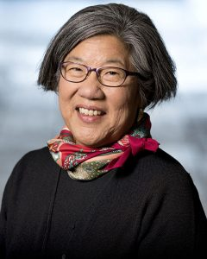

2019 FRANK B. TURNER
AWARD RECIPIENT
Anna Wu, FAIA
Associate Vice Chancellor
SCO Conference 2019

