Slide 1


Interscope+ and Bluebeam Update
March 28, 2019
SCO Conference 2019

Slide 2
Capstat
HUBSCO
P6
I+
SCO Conference 2019
Notes:
Good morning. I though it might be helpful to give a little background on Interscope: it is an acronym
Internet, State, Construction, Office, Project, Environment
Interscope was originally created in 1999 for the State Construction Office to internally track Capital Projects
In 2012, the decision was made to create a state-wide Capital Project System that would be used by the Community College System, the University System, and all State Agencies.
Interscope today is a culmination of the university’s CapStat system, HUBSCo, Premavera 6 and most recently the integration of the Bluebeam.
Segway into what does Interscope do

Slide 3
Track the life cycle of Capital Projects from
Authorization
Until closed out
Tracks funding sources
Tracks HUB data
Uploads Drawings to Bluebeam
SCO Conference 2019
Notes:
We know why we have Interscope, but what can Interscope DO?

Slide 4
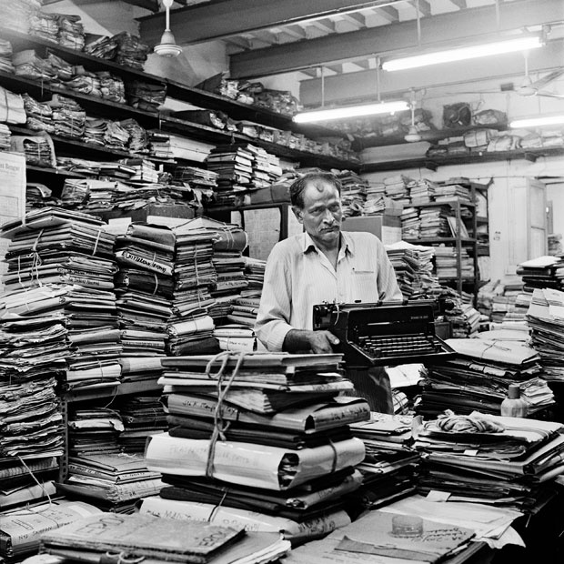

SCO Conference 2019
Notes:
Interscope is taking the State Construction Office from a manual paper process to an interactive internet based project system that can be accessed from anywhere that has an internet connection.
Since our last conference: We have installed 6 major system releases to keep Interscope and SCO in compliance with General Statutes and relevant to newer technologies.
NEXT SLIDE

Slide 5
Bluebeam Integration
Design Build Delivery Method
Inspections Module
HUB Reporting
SCO Conference 2019
Notes:
The most challenging of these system changes has been Bluebeam
I m happy to say has been fully implemented
--Designers-you can now upload any size plans into Interscope for Design Review
-no more emailed plans, CD’s or flashdrive’s are needed You can have your plans uploaded for review in just a few clicks.
All you need is an Interscope logon and access to the project
Design Build, Design Building w/ Bridging and Public Private Partnership delivery methods are now available in Interscope.
In keeping with Statute changes of 2018, our inspections module now has the ability to accommodate electrical, mechanical and plumbing inspections
-HUB reporting has been enhanced to now allow us to see contractor participation at the prime and subcontractors levels. The HUB office can now view submission and participation reports and export HUB data.

Slide 6
$6,000,000
in SAVINGS to date for the State of North Carolina
Reduced Cost
=
SAVINGS
Notes:
With change, innovation & technology, the question always comes up: What is your ROI
Electronic CHANGE ORDERS alone have saved the state of NC $6M
Average of 125 change orders per month
With an Average cost of $500 each to process a manual change order
Electronic Change Orders have been in production nearly 8 years
in a few years we can look for add’l cost savings associated with the Bluebeam Implementation.
Transition
The cost savings we realize is because by CHANGE
NEXT slide

Slide 7
Change is…
Difficult
Scary
Unknown
Frustrating
SCO Conference 2019
Notes:
Transition to next slide
But change is not impossible if we approach it as
Next Slide

Slide 8
A Process
Not an Event
Notes:
The SCO’s Design Review team has embraced this process of change with grace, skill, and professionalism
Proving the process of change requires people and their buy in

Slide 9
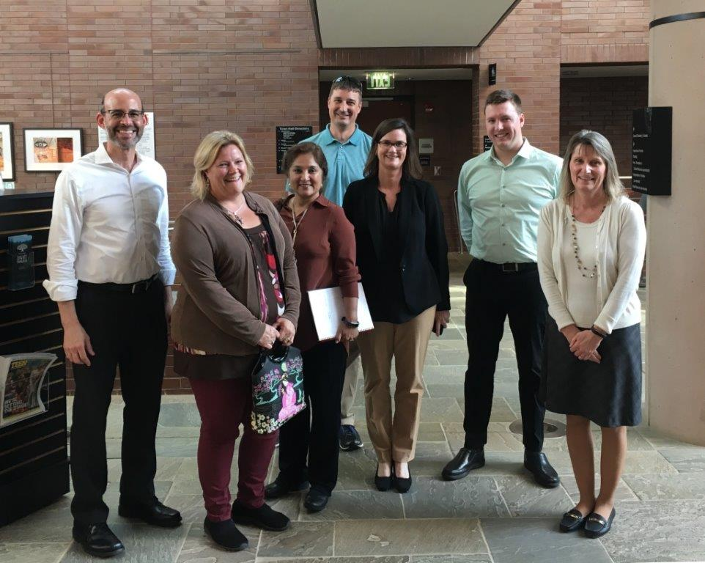
We Organized a Committee
We Collaborated for Best Practices
SME’s for each discipline on this committee
We created JIT’s
SCO Conference 2019
Notes:
our process of change consisted of:
1- organizing a SCO Bluebeam Committee with representation from each discipline within Design Review
2-We collaborated with other government agencies and designers currently using BB for best practices.
This is a photo of most of the BB committee and the Town of Cary’s review section. They were gracious in meeting with our group to share how they use BB. We found their knowledge and experience to be invaluable.
3-Our committee has SME’s in each discipline or super users. I might even call them EXTREME users! They know everything!
4-We developed a JIT training approach. We started with an initial overview training for all BB users and then followed up with JIT trainings covering topics and tools we were beginning to use or that we needed based on the reviews currently in the house.

Slide 10

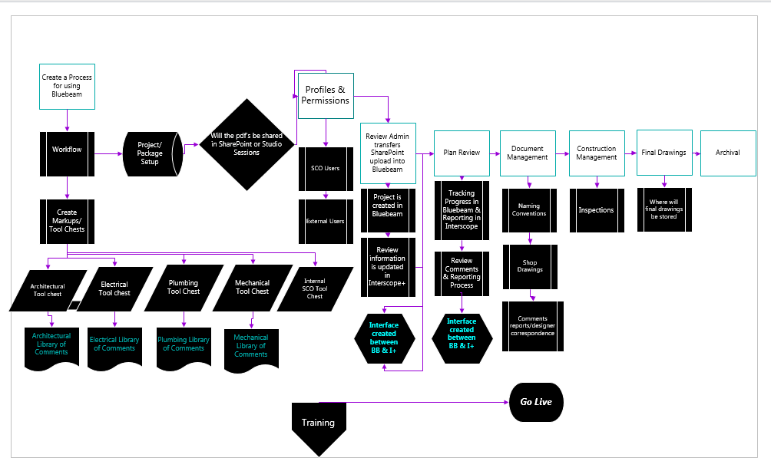
SCO Conference 2019
Notes:
This is a flow chart of our project implementation journey
Highlights of Chart
We identified our manual workflow and adapted them to an electronic platform.
We accomplished this by creating tool chests within BB for each discipline, created permissions with BB so the user would not be overwhelmed by features they may not use daily,
The Biggest hurdle was creating a technology bridge between Interscope & BB the cavoite a solution that was acceptable to the State’s IT dept.
We also identified our need for electronic document management. We have the whole paper document management process figured out….the digital platform is a bit different.
The red arrow indicates where we are in the process and the beginning of phase 2, which is construction management.
What does all of this mean for SCO productivity?

Slide 11
39 % Increase in Productivity
SCO Conference 2019
This Photo by Unknown Author is licensed under CC BY-NC-ND
Notes:
At last year’s conference we projected the implementation of Bluebeam would create a savings of $3.9 m over 5 years. I think it is to early to speak to any cost avoidance but we can speak to productivity
based on 3 months of data:
We are realizing a 39% increase in productivity which has increased the workload capacity
Removing the need to hire additional staff to accommodate the increased workload.
That is pretty impressive when you throw in a learning curve. This really demonstrates our Design Review team’s commitment to excellence. Applause!

Slide 12
Uploading Plans In Interscope
Bluebeam Invitations
Responding to Comments
SCO Conference 2019
Notes:
What does this implementation look like for designers:
We want you all to send us your plans electronically, if possible. And If it is a larger project, please submit electronically and send one paper set.
No more CD’s, flash drives needed. Just a user logon for Interscope and you are a few clicks away from electronically uploading your plans. BTW, Bluebeam does NOT have files size limits
A few things to consider before uploading your documents:
A-All files must be electronically created and be a PDF
B-CAD and/or Rivet files will need to be converted to PDF prior to upload
C-Be sure all of your pages are electronically numbered if not electronically numbered, The page numbers turn to “Jiberish” Apparently this is a technical term coined by the BB Committee
D-Please follow the naming conventions outlined in the State Construction Manual in Section 512
Special NOTE: Signatures that prevent markups are prohibited on drawings being submitted for review. in other words, no need to lock your drawings at this stage
BUT signatures are required on BID Sets
You can find step by step training on designer submittals under the Help Tab in Interscope
NEXT Block
State Construction has received your plans, what happens now: The magic behind the scenes begins
1-We use techinology behind the scenes to create a session in Bluebeam and you will receive an invitation to that session from Bluebeam via email.
NEXT Block
Once Plans have been submitted electronically, you will get your comments back electronically.
Allowing you to respond to comments electronically in BB by finding the comment, right click and “Reply”
Transition to the next slide
How do we learn how to do this?

Slide 13
TRAINING
CPC Training
June 12, 2019
October 9, 2019
Interscope + Training
April 9, 2019
May 2, 2019
Sept 10, 2019
October 8, 2019
October 22, 2019
November 5, 2019
Designer and Contractor Training by Request
Contact LeaAnne Hahnel
Oct 9 WebEX
June 12 WebEx
Notes:
You can contact me directly for Bluebeam training or other training needs for designers and contractors
This year our CPC trainings will also be available via webinar. Be sure when registering you are selecting live/onsite training or webinar.
All Interscope trainings will be live classroom trainings, except by special request for web training. Usually held for an individual campus or agency
You can register for All classes the Help tab within Interscope
You will also find some training vignettes under the HELP Tab for any task within I+ and several for BB. BB trainings are being developed and will be added under the help tab.
In the mist of all this training, we are moving into phase 2 of Bluebeam implementation

Slide 14
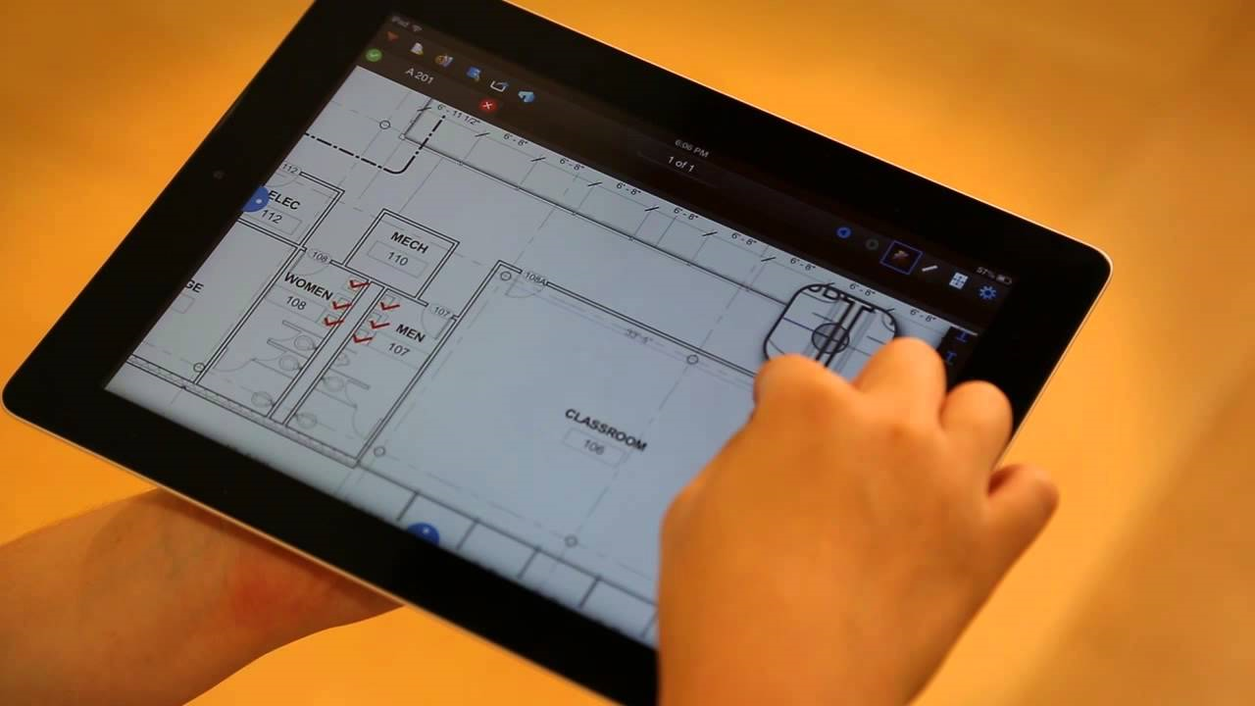
Notes:
Our construction management team will be onboarding to Bluebeam giving the ability to monitor, inspect and collaborate with designers and contractors all while on the jobsite.
This phase begins mid 2019 with completion in late 2020.

Slide 15

https://blog.dronedeploy.com/
Notes:
Beyond ipads and cell phones. Could we have drones on our jobsites delivering information directly back to State Construction via Bluebeam?

Slide 16
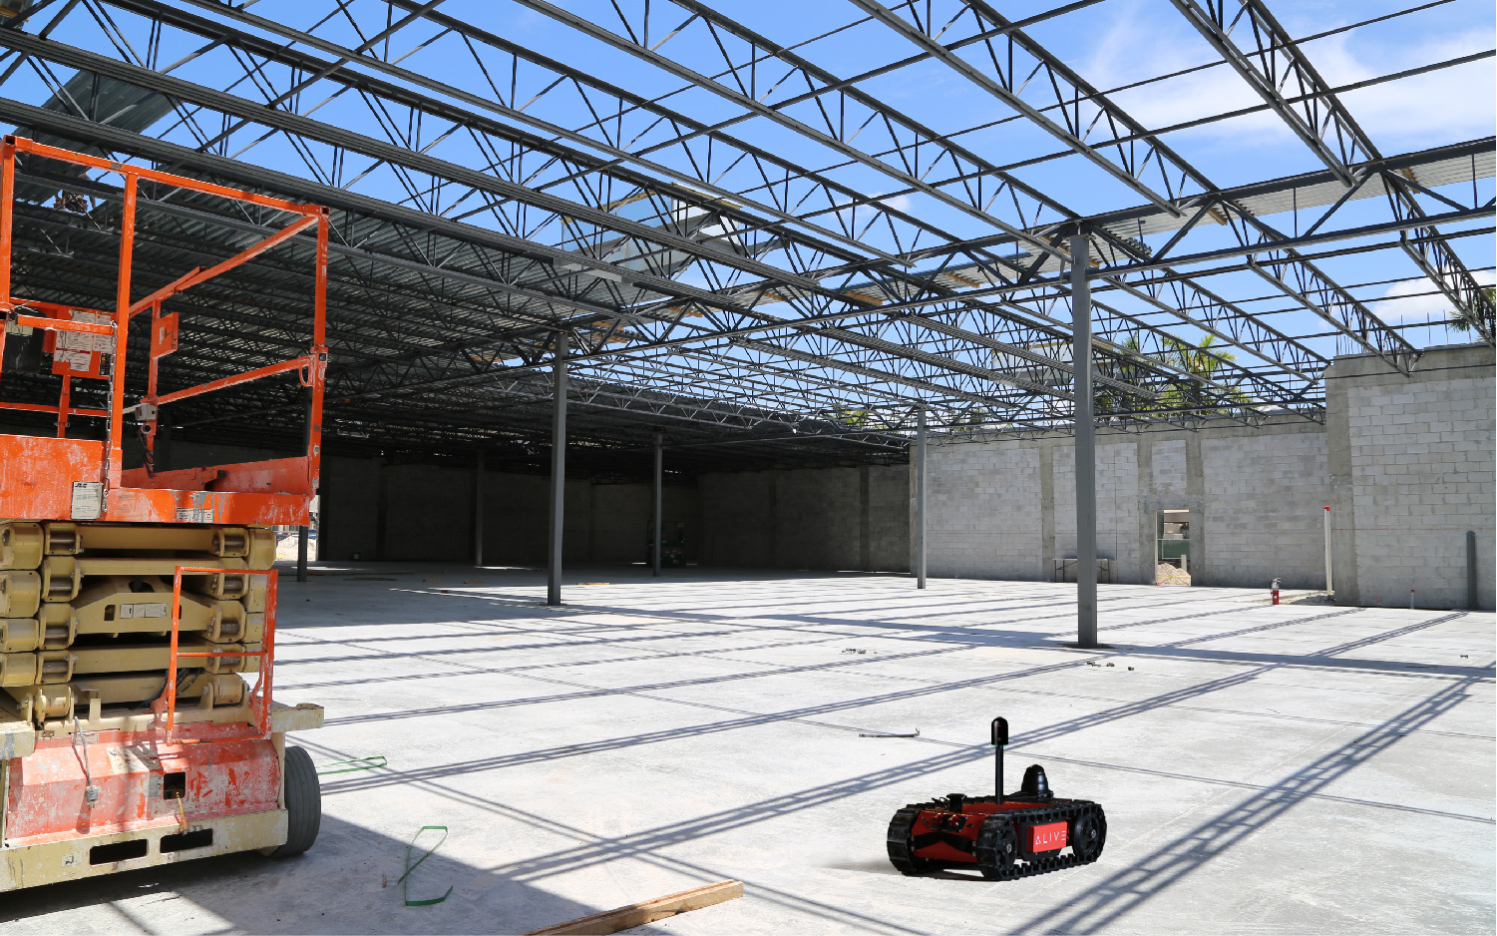
Alive.ai/construction.com
Notes:
Or Rovers to inspect those hard to reach places?
I am not sure if state government can handling these cutting edge trends….yet
But I am certain that Interscope and Bluebeam can!
With your power of innovation and technology in the construction industry, we will certainly be the driving force to see us all into the future with cost savings, improved resource management and superior project implementation at the state level.
Thank you and enjoy the rest of your conference!

Slide 17
Interscope+ and Bluebeam Update
March 28, 2019
SCO Conference 2019

