Slide 1


STATE BUILDING COMMISSION
MERIT AWARDS
SCO Conference 2019

Slide 2

EXCELLENCE
IN
CONSTRUCTION
THE 38TH ANNUAL
STATE CONSTRUCTION
CONFERENCE
SCO Conference 2019

Slide 3



STATE BUILDING COMMISSION
MERIT AWARDS
Excellence in construction
East Carolina University
Main Campus Student Union & Parking Deck
SCO Conference 2019

Slide 4
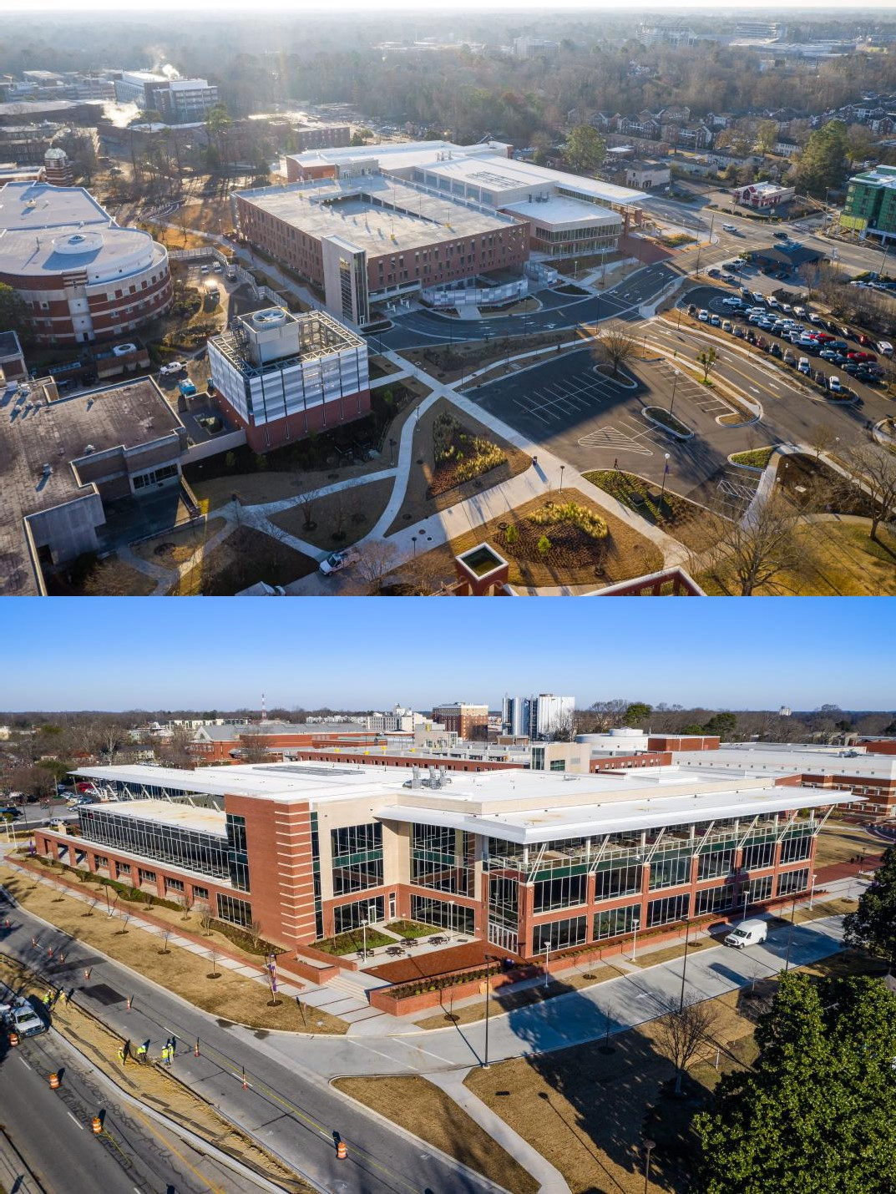
SCO Conference 2019

Slide 5
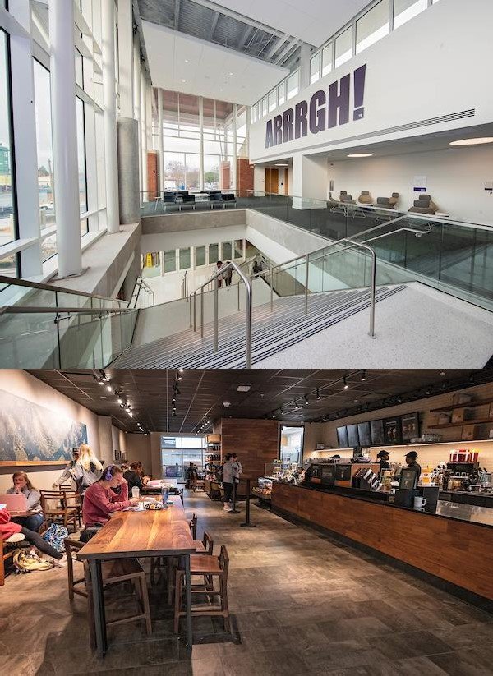
SCO Conference 2019

Slide 6
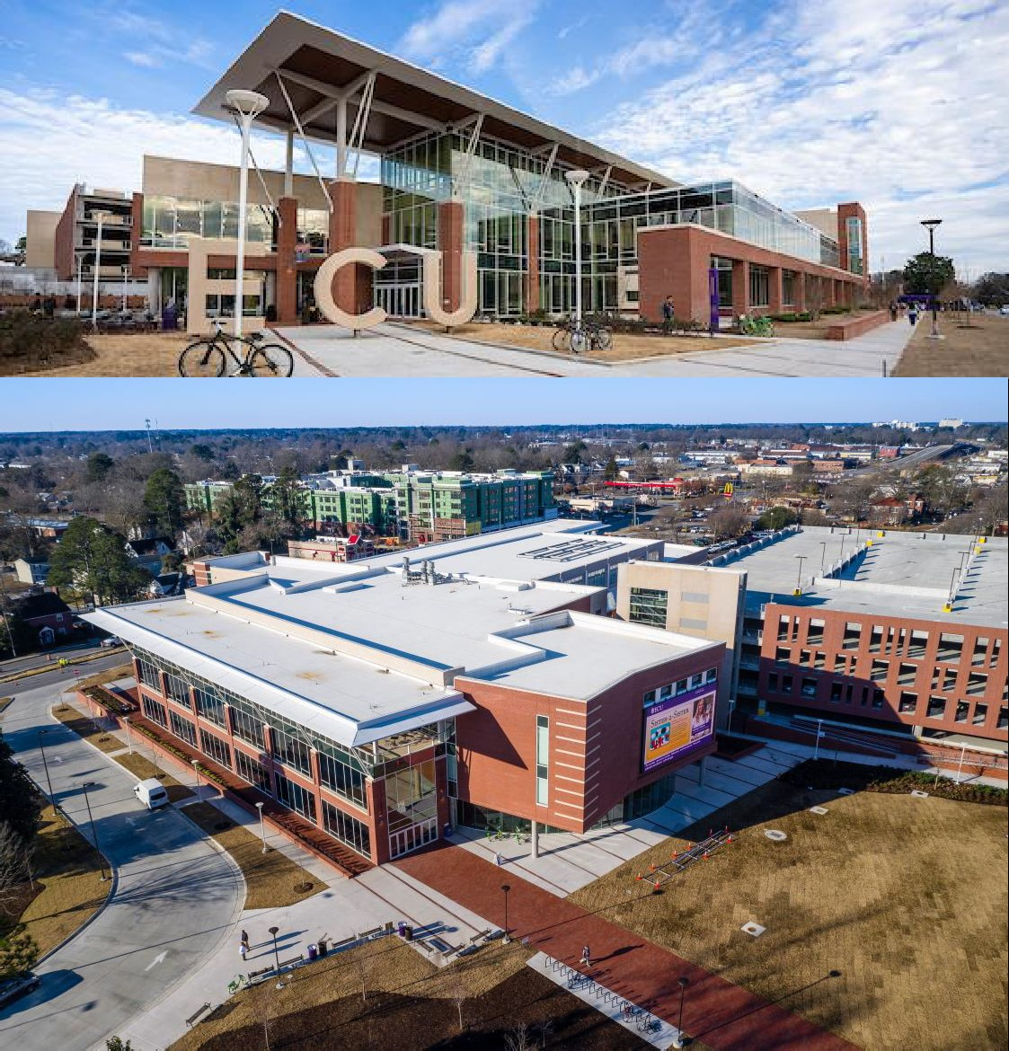
SCO Conference 2019

Slide 7
SCO Conference 2019

Slide 8
EXCELLENCE
IN
PROJECT IMPLEMENTATION
THE 38TH ANNUAL
STATE CONSTRUCTION
CONFERENCE
SCO Conference 2019

Slide 9



STATE BUILDING COMMISSION
MERIT AWARDS
EXCELLENCE IN PROJECT IMPLEMENTATION
North Carolina A & T State University
New Student Center
SCO Conference 2019

Slide 10
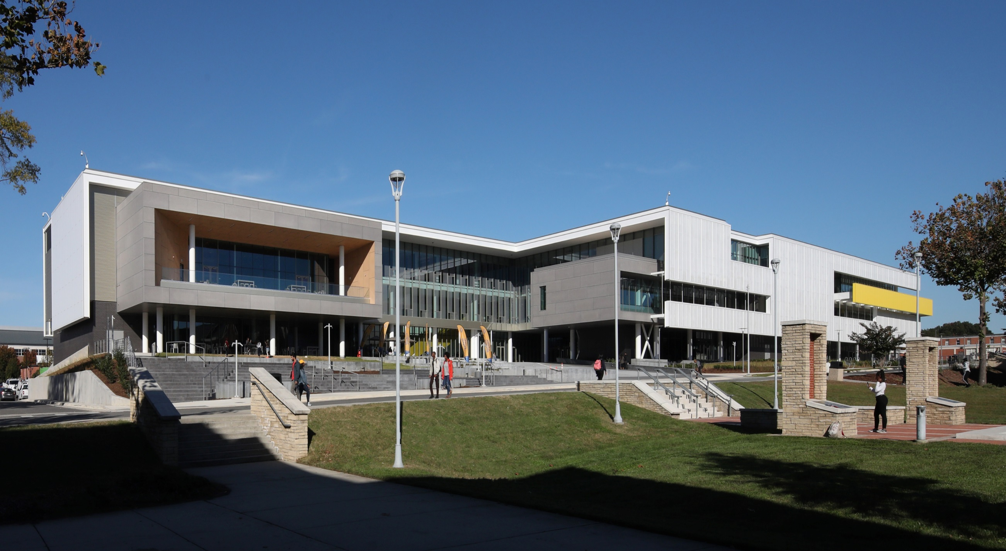
SCO Conference 2019

Slide 11
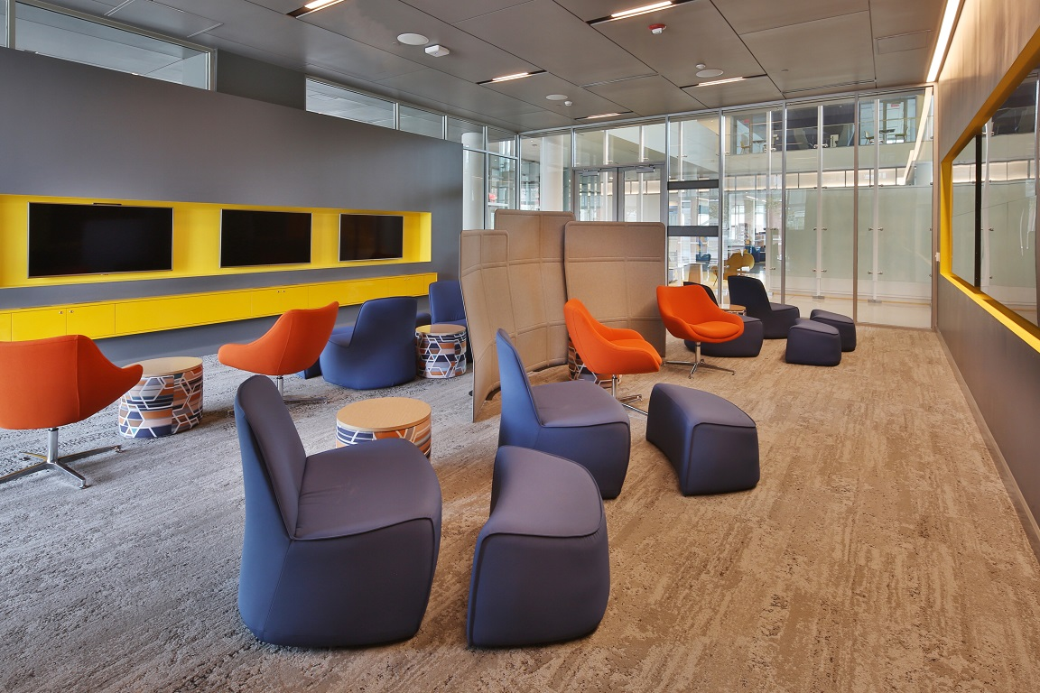
SCO Conference 2019

Slide 12
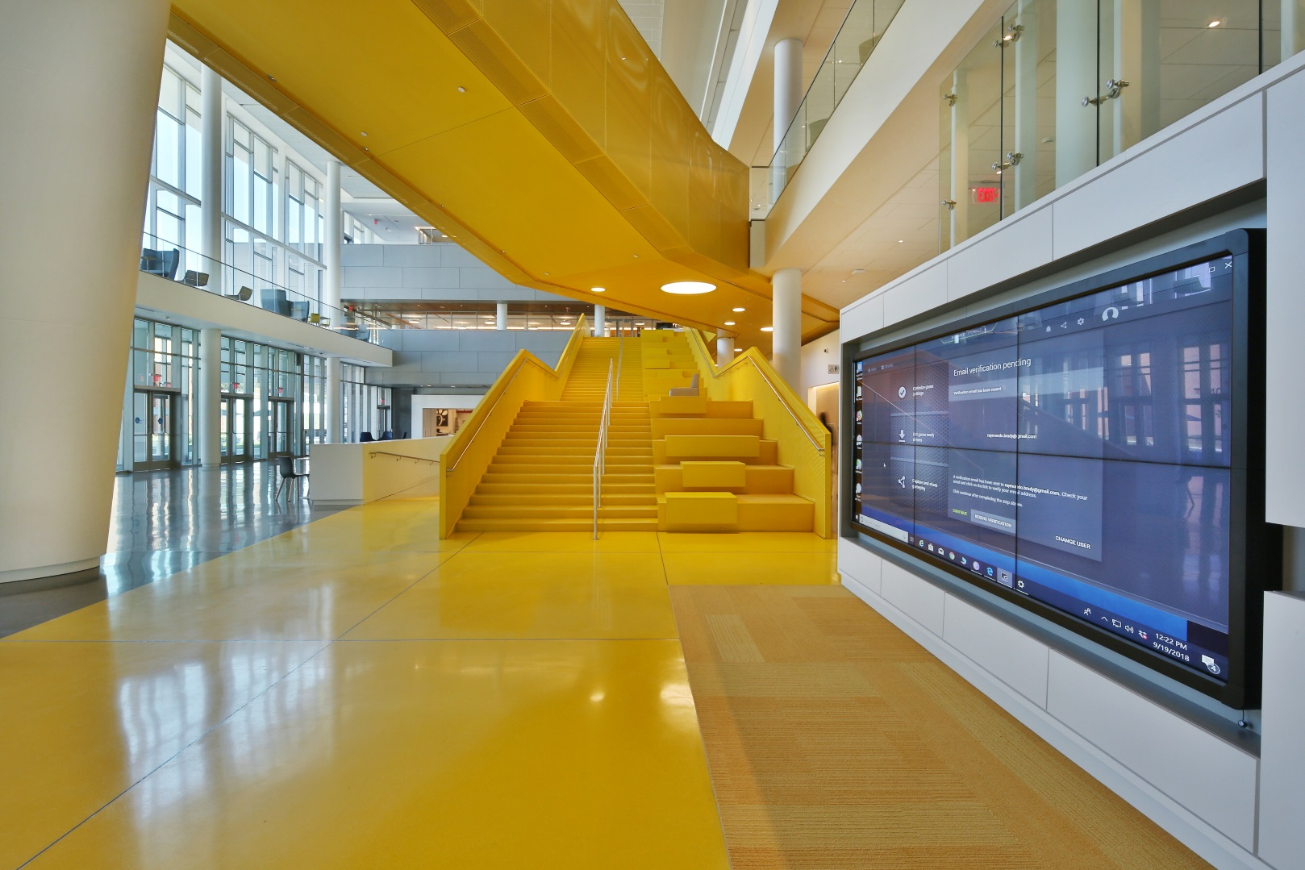
SCO Conference 2019

Slide 13
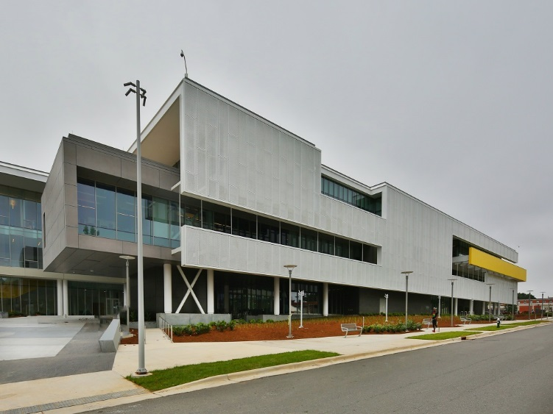
SCO Conference 2019

Slide 14
EXCELLENCE
IN
PROJECT IMPLEMENTATION
THE 38TH ANNUAL
STATE CONSTRUCTION
CONFERENCE
SCO Conference 2019

Slide 15


STATE BUILDING COMMISSION
MERIT AWARDS
EXCELLENCE IN PROJECT IMPLEMENTATION
Western Carolina University
Brown Building Renovation & Addition
Watson Tate Savory, Inc.
SCO Conference 2019

Slide 16
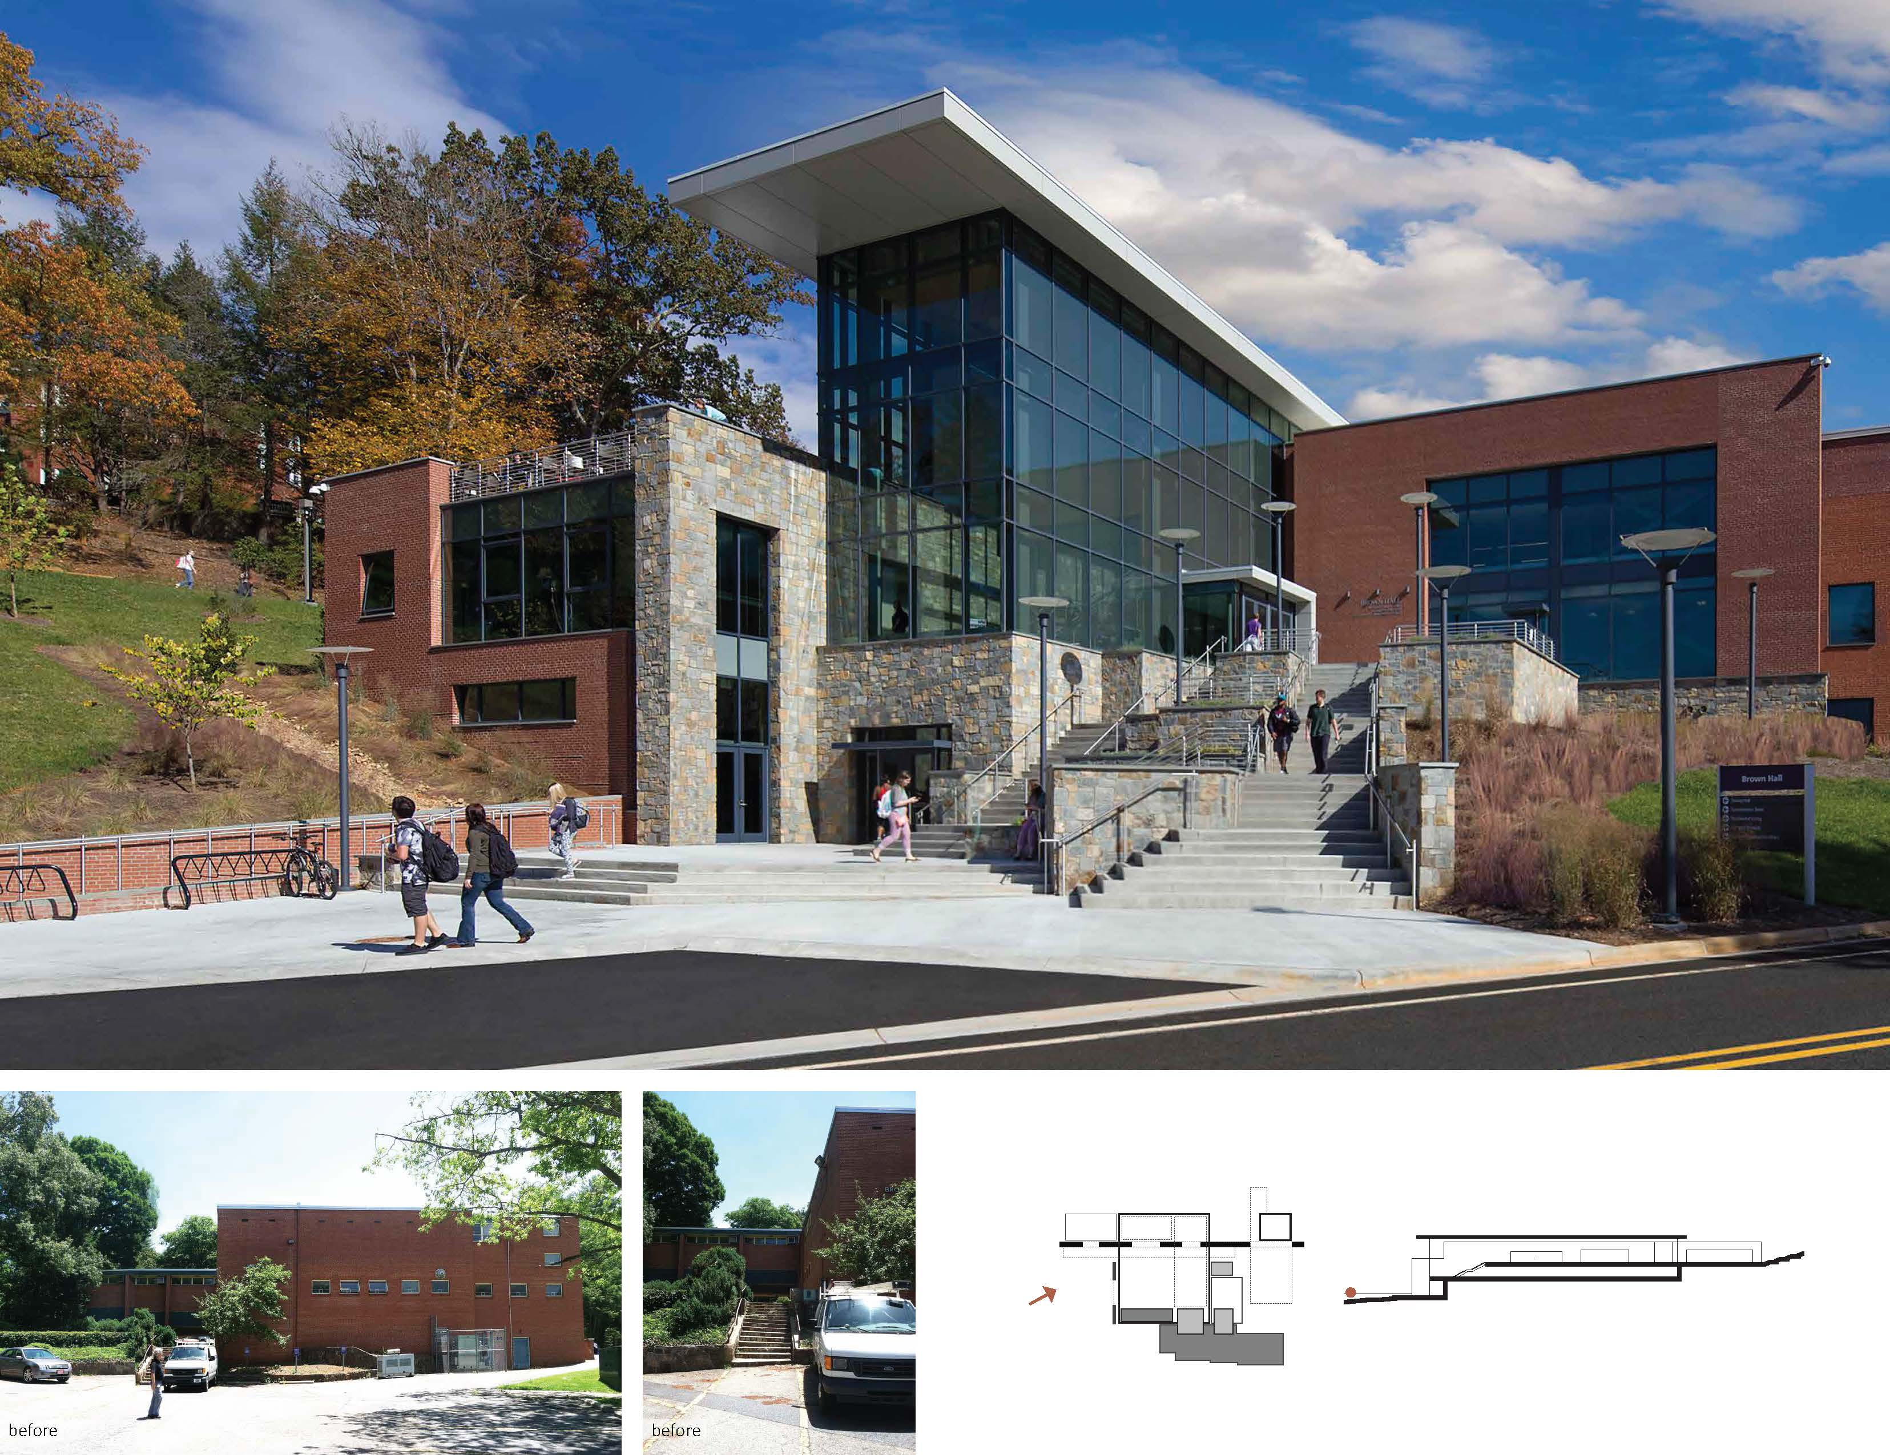
SCO Conference 2019

Slide 17
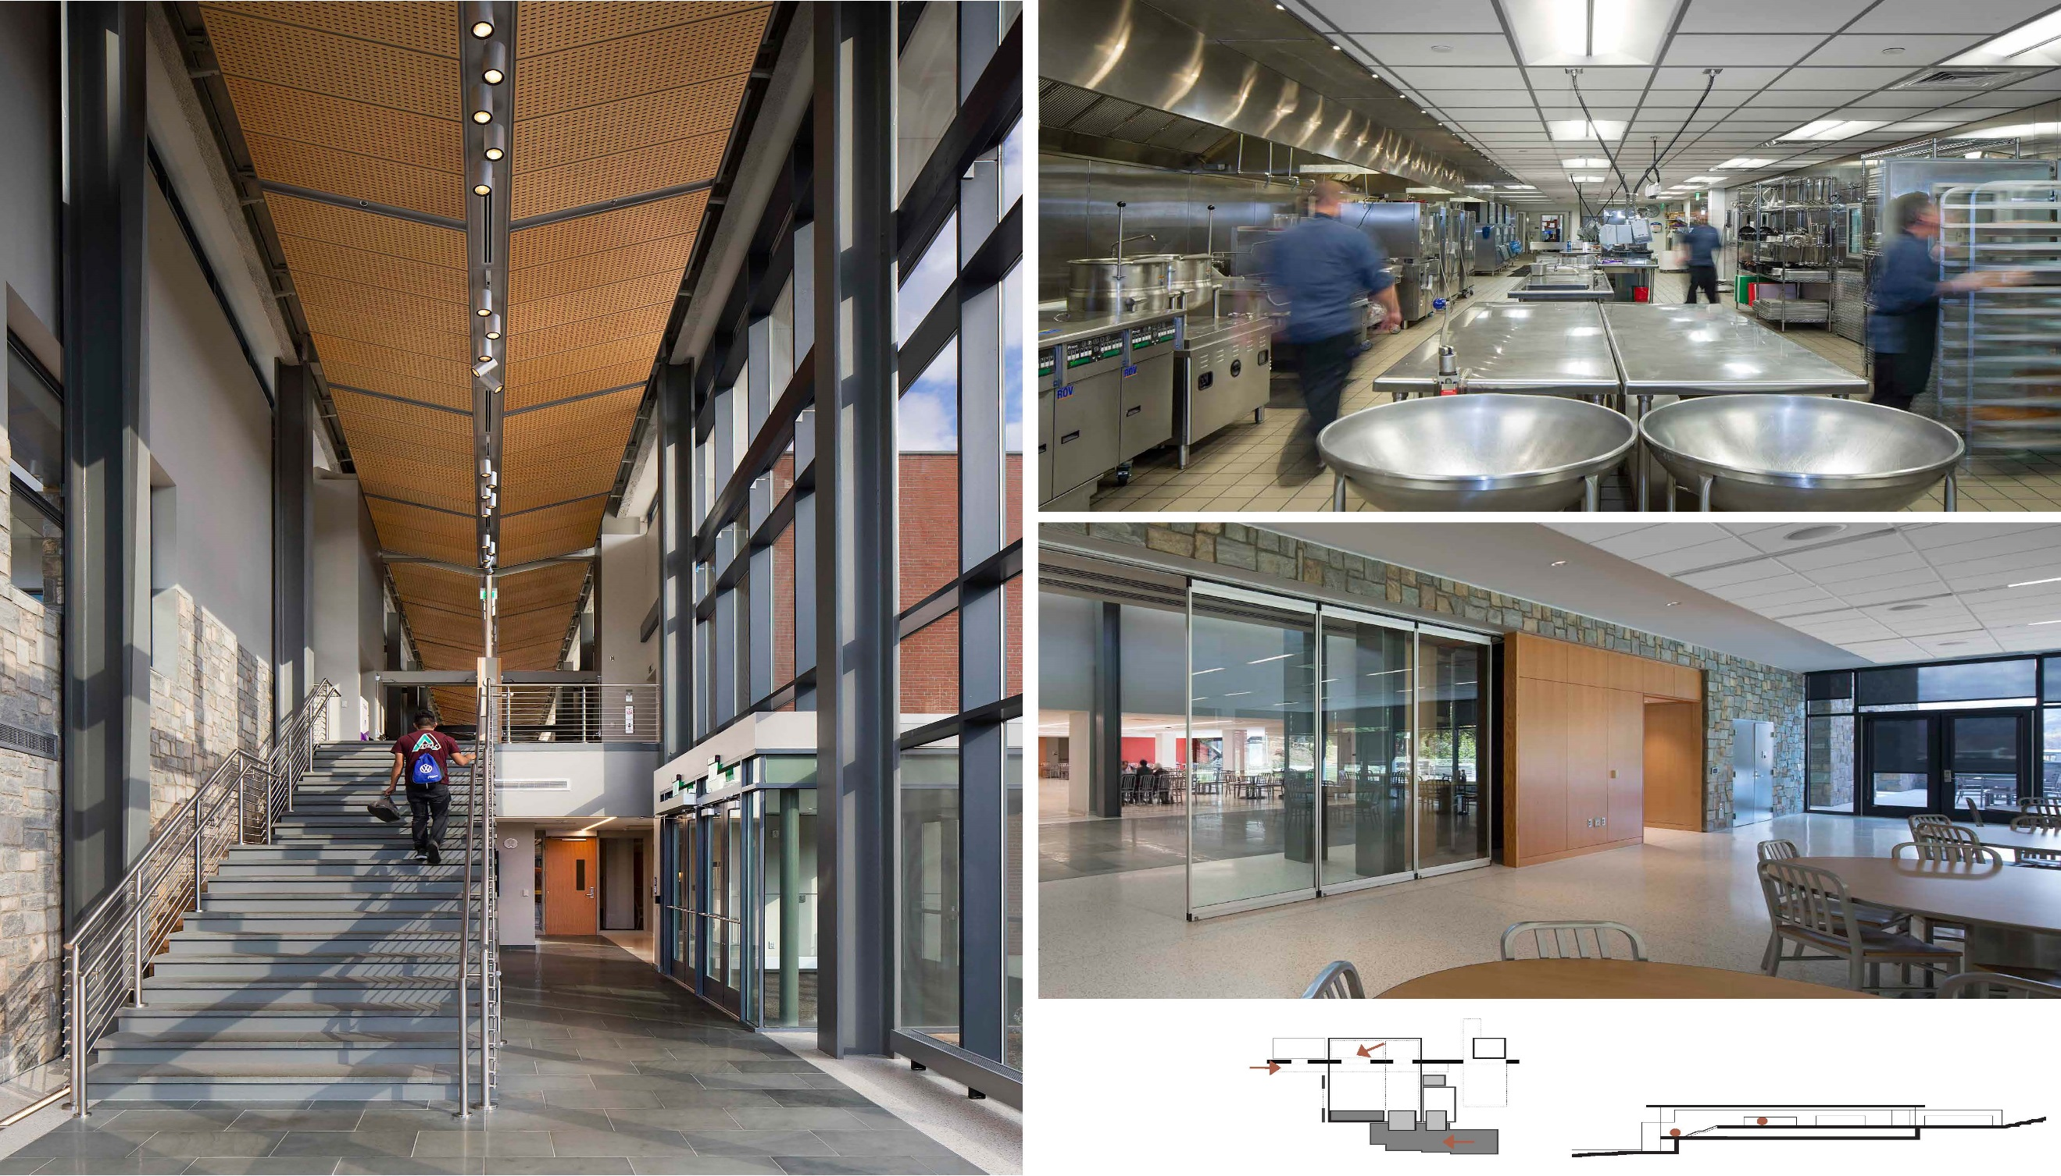
SCO Conference 2019

Slide 18
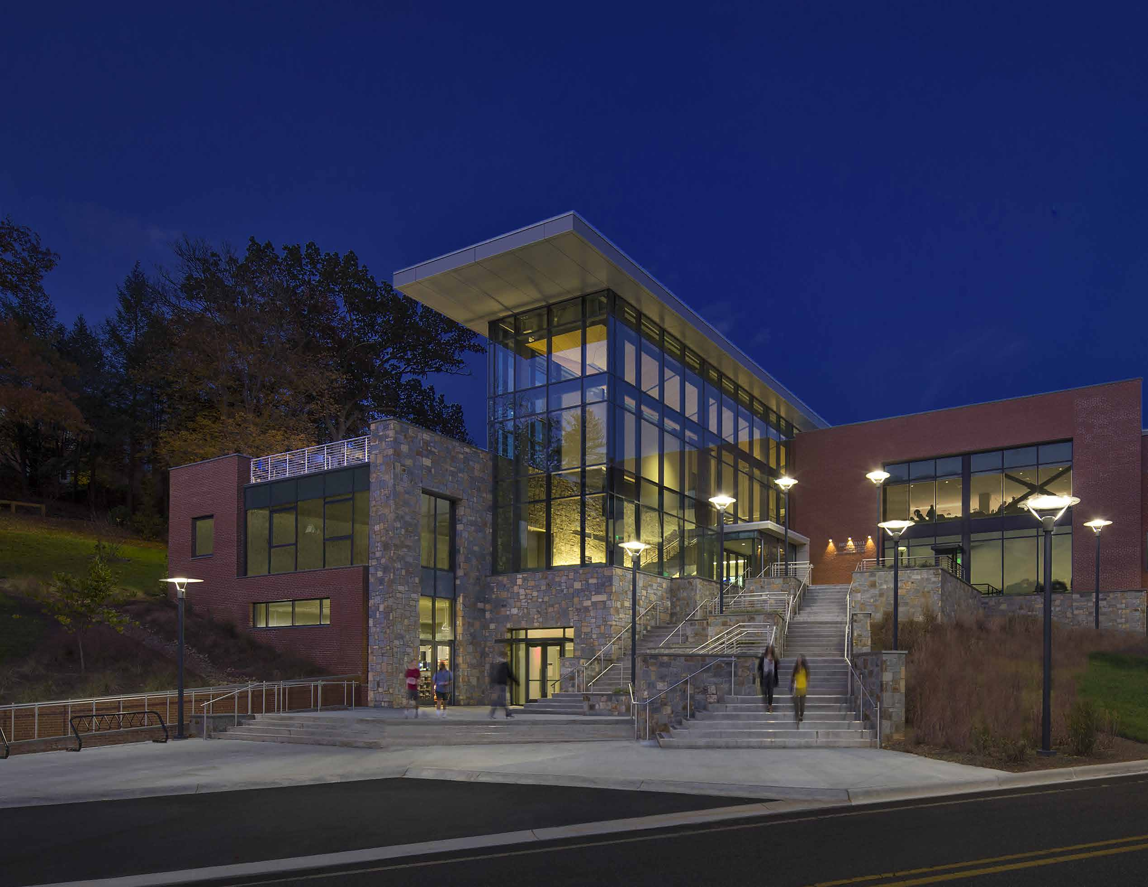
SCO Conference 2019

Slide 19
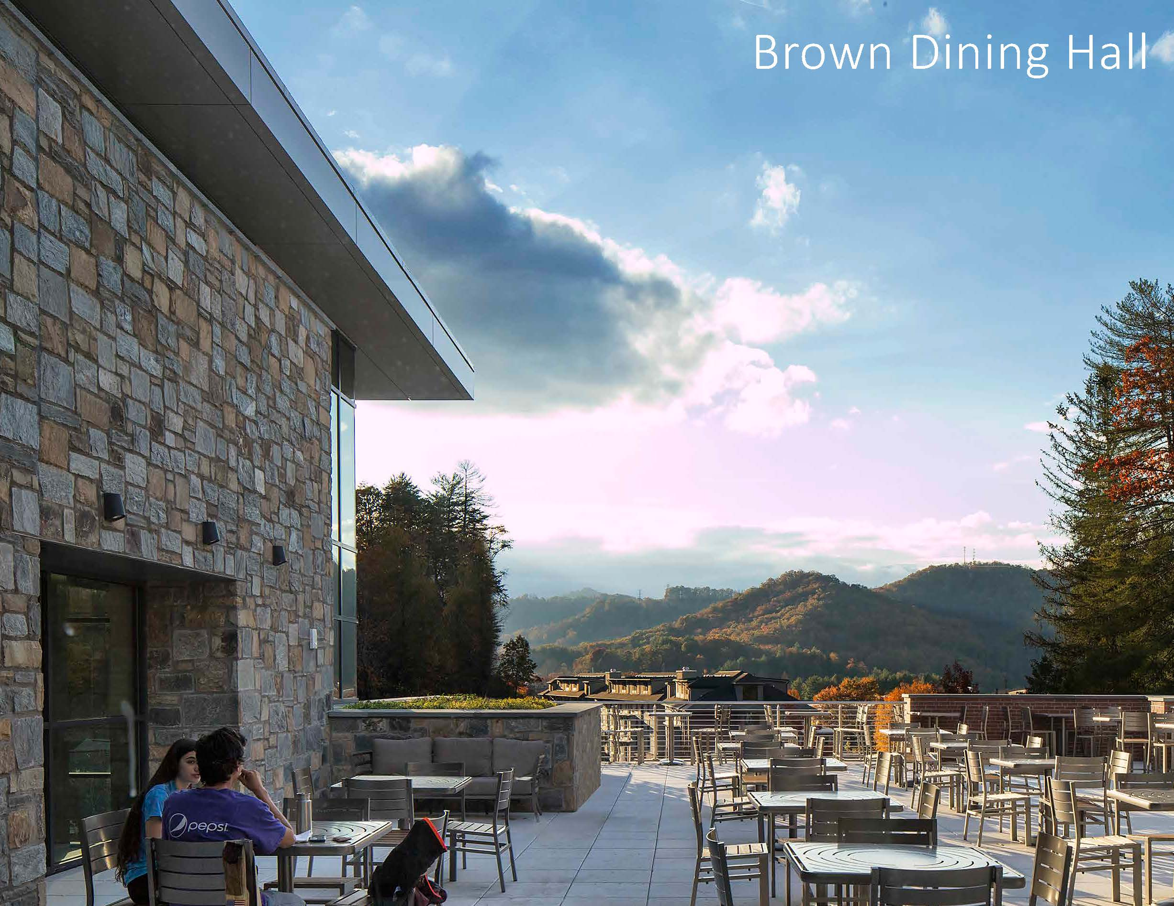
SCO Conference 2019

Slide 20
FRANK B. TURNER AWARD NOMINATION
THE 38TH ANNUAL
STATE CONSTRUCTION
CONFERENCE
SCO Conference 2019

Slide 21
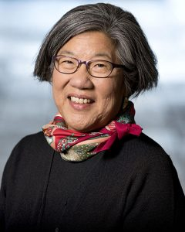

2019 FRANK B. TURNER
AWARD RECIPIENT
Anna Wu, FAIA
Associate Vice Chancellor
SCO Conference 2019

Slide 22

STATE BUILDING COMMISSION
MERIT AWARDS
SCO Conference 2019

