Slide 1

US & NC Construction Spending, Labor & Materials Outlook
NC State Construction Conference
Raleigh, March 28, 2019
Ken Simonson
Chief Economist, AGC of America
simonsonk@agc.org

Slide 2
Headline Forecast
The US economy is still expanding but more slowly:
- consumer, business confidence are generally high; ‘19 recession probability is low
- but latest data are weak for jobs, retail sales, single-family housing, manufacturing
- trade & fiscal policy concerns continue
Contractors remain busy and confident; construction employment is growing in most states and spending is up in most project categories
Three concerns:
- impact of trade policies on materials costs and on demand for construction
- widening labor shortage, worsened by hostile immigration policy
- if interest rates rise, may cut demand for income-producing projects, new homes
Source: Author

Slide 3
AGC members’ expectations for 2019—US & NC
3
US/NC Net % who expect dollar volume of projects to be higher
17%/10% | Public building | 14%/-5% | Water/Sewer
16%/24% | Highway | 13%/30% | Private Office
16%/8% | K-12 school | 12%/33% | Manufacturing
16%/17% | Hospital | 11%/11% | Higher Education
15%/23% | Retail, Warehouse, Lodging | 10%/16% | Power
15%/0% | Federal (e.g., VA, GSA, USACE, NAVFAC) | 5%/-5% | Multifamily Residential
14%/-5% | Transportation (e.g., transit, rail, airport)
Source: AGC 2019 Outlook Survey, Jan. 2019

Slide 4
Construction spending & employment, 2006–2019
Spending put in place, Feb. ‘06 (prior peak)–Jan. ‘19
trillion $, seasonally adjusted annual rate
Employment, April ’06 (peak)–Jan. ‘19
millions, seasonally adjusted
12/18 Total: $1.28 trillion
(6.2% above ‘06 peak)
1/18 Total: 7.5 million
(3% below peak)
Nonresidential
(0.6% above ‘18 peak)
Private residential
(25% below ‘06 peak)
Private nonresidential
(1% below ‘18 peak)
Residential (16% below ‘06 peak)
Public
(4% below ‘09 peak)
Source: spending--U.S. Census Bureau; employment--Bureau of Labor Statistics

Slide 5
Nonresidential spending by segment: 2017-2018 change and 2019 forecast
 |  | 2017 vs. 2016 |  | 2018 vs. 2017 |  |  | 2019 forecast
Nonresidential total (public+private) |  |  | -0.5% | 4.7% |  |  |  | 2-5%
 | Power (incl. oil & gas field structures, pipelines) |  | -5 | 4 |  |  |  | 2-7%
 | Educational | 1 |  | 3 |  |  |  | 0-5%
 | Highway and street |  | -4 | 4 |  |  |  | 3-8%
 | Commercial (retail, warehouse, farm) | 12 |  | 2 |  |  |  | 0-5%
 | Office |  | -1 | 9 |  |  |  | 0-5%
 | Manufacturing |  | -13 |  | -2 |  |  | near 0
 | Transportation | 4 |  | 15 |  |  |  | 5-10%
 | Health care | 4 |  | 0 |  |  |  | near 0
 | Lodging | 6 |  | 11 |  |  |  | 0-5%
 | Sewage & waste disposal |  | -12 | 8
 | Other--amusement; communication; religious; public safety; conservation; water: 11% of ‘17 total | 3 |  | 6
Source: U.S. Census Bureau construction spending report; Author’s forecast

Slide 6
Construction spending: education, health care annual total, 2008–16; monthly (seasonally adjusted annual rate), 1/17–1/19; billion $
Education: (state/local K-12, S/L higher; private)
Health care: (private hospital, S/L hospital, other)
total (78% private)
total (78% public)
state/local preK-12
private hospital
state/local higher ed
Other
private
state/local hospital
Jan. ‘18–Jan. ‘19: 7% (state/local preK-12 14%; state/local higher ed -2%; private 4%)
Jan. ‘18–Jan. ‘19: -3% [private hospital -2%; S/L hospital
-11%; other (special care, medical office, federal) -2%]
Source: U.S. Census Bureau construction spending report

Slide 7
Key points: education & health care
Rising house & commercial property values are supporting school district tax receipts & bond issues for preK-12 projects
Higher-ed enrollment is shrinking and some small colleges are closing; decrease in full-tuition foreign students will hurt budgets
Rising stock prices help private school & college capital campaigns
Health care spending is shifting from hospitals to standalone special-care facilities (urgent care, surgery, rehab, hospices)
Source: Author

Slide 8
Construction spending: public works annual total, 2008–16; monthly (seasonally adjusted annual rate), 1/17–1/19; billion $
Highways (99.7% public in 2018)
Transportation facilities
(air, transit, rail, water)
total
other
air
Jan. ‘17–Jan. '18: 13%
Jan. ‘17–Jan. '18: 9% (air 16%; other 5%)
Sewage/waste & water
(sewage 98% public in 2018; water 99% public in 2018)
Conservation and development
(99.8% public in 2018)
sewage/
waste
water
Jan. ‘17–Jan. '18: Sewage/waste 2%, water 5%
Jan. ‘17–Jan. '18: 14%
Source: U.S. Census Bureau construction spending report

Slide 9
Key points: roads, transportation, sewer/water
Federal infrastructure bill is unlikely in 2019; spending wouldn’t occur until later, but state highway funding and P3s are increasing
Many new and ongoing public & private airport projects; revival of freight rail construction; but no net increase likely in public funding for port, passenger rail or transit construction
Water & sewer/wastewater spending returning to 2011-15 levels after large drop in 2016-17; little long-term new funding likely
Conservation will grow if Corps of Engineers can award enough $
Source: Author

Slide 10
Construction spending: industrial, heavy annual total, 2008–16; monthly (seasonally adjusted annual rate), 1/17–1/19; billion $
Power (94% private in 2018)
Manufacturing (99.4% private in 2018)
total
electric
total
oil & gas
other
chemical
Jan. ‘18–Jan. ‘19: 2% (oil & gas 13%; electric -1%)
Jan. ‘18–Jan. ‘19: 3% (chemical -3%; other 8%)
Amusement & recreation (55% private in 2018)
Communication (99.3% private in 2018)
total
private
public
Jan. ‘18–Jan. ‘19: 9% (private 6%; public 14%)
Jan. ‘18–Jan. ‘19: -8%
Source: U.S. Census Bureau construction spending report

Slide 11
Key points: power & energy, mfg, amusement, communication
Solar, wind power are growing again; expect more oil & natural gas pipelines in ’19 but timing is subject to court & regulatory delays
Manufacturing construction should recover further in ‘19 based on energy projects, U.S. economic growth; but tariffs, foreign retaliation, rising construction costs are major concerns
Amusement & recreation spending is very “lumpy”—a few big stadiums at irregular intervals; but funding for local, state, federal parks keeps eroding
Communication may revive as wireless firms build out 5G networks
Source: Author

Slide 12
Construction spending: developer-financed annual total, 2008–16; monthly (seasonally adjusted annual rate), 1/17–1/19; billion $
Retail (private)
Office (87% private in 2018)
Total
Private
Public
Jan. ‘18–Jan. ‘19: -14%
Jan. ‘18–Jan. ‘19 : 8% (private 8%; public 10%)
Warehouse (private)
Lodging (private)
Jan. ‘18–Jan. ‘19: 6%
Jan. ‘18–Jan. ‘19: 11%
Source: U.S. Census Bureau construction spending report

Slide 13
Key points: retail, warehouse, office, hotel, data centers
Retail now tied to mixed-use buildings & renovations, not standalone structures; ongoing store closings imply downturn continuing in ‘19
Warehouse growth is still benefiting from e-commerce; more local than huge regional distribution centers likely in future; self-storage is booming
Office employment still rising but space per worker is shrinking; more urban & renovation work than suburban office parks
Hotel pipeline is still growing but sector is very interest-rate sensitive
Data centers remain a strong niche but no data available on how strong
Source: Author

Slide 14
Private residential spending: slower single-family growth, pickup in multifamily annual total, 2006–16; monthly (seasonally adjusted annual rate), 1/17–1/19; billion $
Spending put in place (billion $)
12-month % change
Private residential total
(25% below Feb ‘06 peak)
1/18–1/19:
Single-family
(44% below Feb ‘06 peak)
Multifamily: 13%
Improvements
(16% below Apr ‘18 peak)
Private total: -6%
Multifamily
(1% above Dec ‘18 peak)
Single-family: -7%
Improvements:
-9%
Source: U.S. Census Bureau construction spending report

Slide 15
Residential spending forecast--2019: 5-9% (3% in 2018; 12% in 2017)
SF--2019: 6-10% (5% in 2018; 11% in 2017); rising interest rates, building costs, student debt will limit number of potential buyers
MF--2019: 2-5% (1% in 2018; -2% in 2017)
  occupancy rates, rents have leveled off; but permits are rising, implying rebound in 2019
  millennials are staying longer in cities and denser suburbs where MF construction is bigger share of market than in outer suburbs
  nearly all MF construction is rental, not condo; more high-rises
Improvements--2019: 5-10% (0% in 2018; 19% in 2017); rising number of seniors prefer remodeling to moving but interest cost, labor scarcity may be barriers
Source: Author

Slide 16
Population change by state, July 2017–July 2018 (U.S.: 0.62%)
decrease
0-0.49%
0.5-0.99%
1.0-1.49%
1.5%+
1.5%
2.1%
0.9%
0.3%
1.1%
0.6%
0.8%
NH
0.5%
0.4%
0.2%
-0.3%
VT
0.3%
-0.2%
1.0%
0.4%
2.1%
0.4%
0.1%
MA
0.6%
1.9%
0.6%
-0.4%
0.2%
1.4%
0.5%
-0.6%
0.0%
0.3%
0.6%
CT
-0.03%
RI
0.1%
0.3%
1.7%
0.1%
1.1%
DE
1.0%
NJ
0.2%
0.3%
0.9%
1.3%
0.4%
1.3%
-0.1%
0.3%
1.0%
MD
0.3%
DC
1.0%
AK
-0.3%
-0.2%
1.5%
HI
-0.3%
Source: U.S. Census Bureau

Slide 17
State construction employment change (U.S.: 4.6%)
1/18 to 1/19: 44 states up, 6 states and DC down
Top 5
WV | 51.6%
NV | 12.9%
CT | 11.0%
AZ | 10.3%
WY | 9.5%
Over -10%
-5.1% to -10%
-0.1% to -5%
0%
0.1% to 5%
5.1% to 10%
Over 10%
7%
7%
-1%
-4%
NH
4%
4%
2%
7%
4%
7%
4%
VT
-5%
9%
4%
3%
13%
1%
3%
MA
1%
2%
3%
3%
3%
3%
7%
52%
Bottom 5
VT | -4.6%
ME | -4.5%
SC | -3.8%
MS | -2.1%
DC | -1.3%
4%
2%
1%
CT
11%
RI
5%
3%
10%
2%
4%
DE
8%
NJ
4%
7%
5%
3%
2%
-4%
-2%
6%
7%
MD
1%
DC
-1%
5%
-1%
5%
Shading based on unrounded numbers
HI
1%
Source: BLS state and regional employment report

Slide 18
North Carolina construction employment
1/90–2/19 (seasonally adjusted; shading = recessions)
Peak: Mar ‘07
256,400
2/18–2/19
North Carolina
2.8%
223,000
13% below peak
Source: BLS

Slide 19
Construction Employment Change from Year Ago
1/08–2/19 (not seasonally adjusted)
2/18–2/19:
U.S. 3.2%
North Carolina 3.2%
Charlotte-Concord-Gastonia, NC-SC*
-1.3%
*The Bureau of Labor Statistics reports employment for construction, mining and logging combined for metro areas in which mining and logging have few employers.
Source: BLS

Slide 20
Change in construction employment, 2/18–2/19 (NSA)
Metro area or division | 12-mo. empl. change | Rank (out of 358)
North Carolina (Construction) | 3%
North Carolina (Mining, logging, and construction)* | 3%
Asheville* | 11% | 14
Burlington* | 0% | 233
Charlotte-Concord-Gastonia, NC-SC* | -1% | 290
Durham-Chapel Hill* | 4% | 121
Fayetteville* | 8% | 40
Greensboro-High Point* | 2% | 187
Greenville* | 9% | 27
Hickory-Lenoir-Morganton* | 2% | 187
Raleigh* | 4% | 121
Rocky Mount* | 0% | 233
Wilmington* | -3% | 309
Winston-Salem* | 7% | 58
Myrtle Beach-Conway-North Myrtle Beach, SC-NC* | 6% | 79
Virginia Beach-Norfolk-Newport News, VA-NC* | 1% | 215
*The Bureau of Labor Statistics reports employment for construction, mining and logging combined for metro areas in which mining and logging have few employers. To allow comparisons between states and their metros, the table shows combined employment change for these metros. Not seasonally adjusted statewide data is shown for both construction-only and combined employment change.
Source: AGC rankings, calculated from BLS state and area employment reports

Slide 21
Construction employment change by metro, 2/18–2/19
21
Over 10%
5.1% to 10%
0.1% to 5%
0%
-0.1% to -5%
-5.1% to -10%
Over -10%
Shading based on unrounded numbers
Source: BLS state and regional employment report

Slide 22
Construction workforce indicators (not seasonally adjusted)
Construction openings: all-time high; hires steady
(Jan. data, 2009-19)
Construction job openings rate has been growing as pay accelerates (Jan. data, 2009-19)
Source: Bureau of Labor Statistics

Slide 23
Outlook 2019: Firms plan to add workers but expect continued difficulty finding them
Source: AGC 2019 Outlook Survey, Jan. 2019

Slide 24
Outlook 2019: Firms with staffing challenges face higher costs and delays
Source: AGC 2019 Outlook Survey, Jan. 2019

Slide 25
12-month change in producer price index for key inputs
Source: Bureau of Labor Statistics

Slide 26
Cumulative changes in materials & labor costs vs. bid prices​
Cumulative % change, not seasonally adjusted
1/16–2/19
PPI for inputs to construction
Average hourly earnings for all construction employees
PPI for nonresidential building
Source: Bureau of Labor Statistics

Slide 27
2017-2018 summary and 2019 forecast
 |  | 2017 actual | 2018 actual | 2019 forecast
Total spending |  | 4% | 4% | 4-7%
 | Private – residential | 12% | 3% | 5-9%
 | – nonresidential | 1% | 3% | 3-6%
 | Public | -3% | 7% | 2-5%
Goods & services inputs PPI |  | 4.4% | 3.8% | 4-6%
Wages & salaries (avg. hourly earnings) |  | 3.1% | 3.6% | 3.5-4.5%

Slide 28
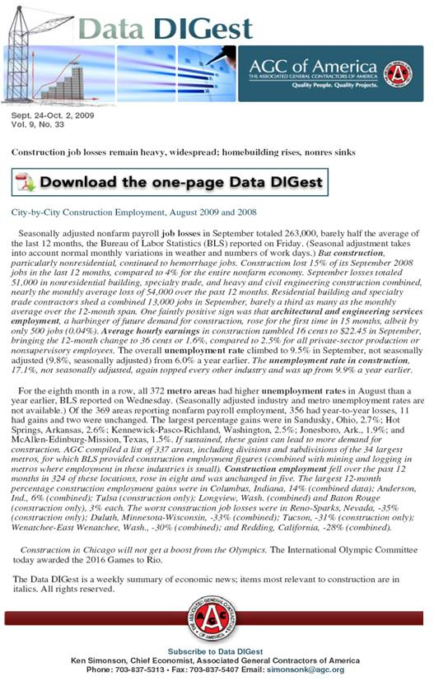
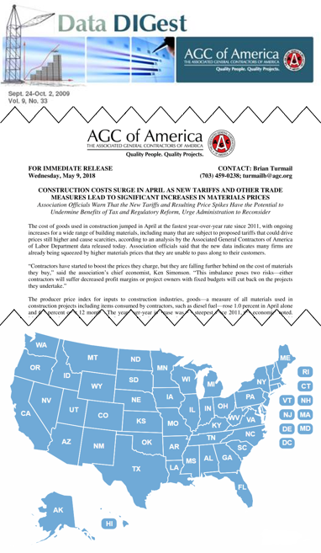
AGC economic resources
(email simonsonk@agc.org)
The Data DIGest: weekly 1-page email (subscribe at http://store.agc.org)
monthly press releases: spending; producer price indexes; national, state, metro employment with rankings
yearly employment & outlook surveys, state and metro data, fact sheets: www.agc.org/learn/construction-data
webinar May 16 11-12:30 PDT w/ Kermit Baker, AIA, & Alex Carrick, ConstructConnect

