Slide 1
FORGOT YOUR PASSWORD
If you need assistance please call, 919-814-5600
The Web Address is:
https://www.surplus.nc.gov/

Slide 2
The Web Address is: https://www.surplus.nc.gov/
Scroll Down

Slide 3
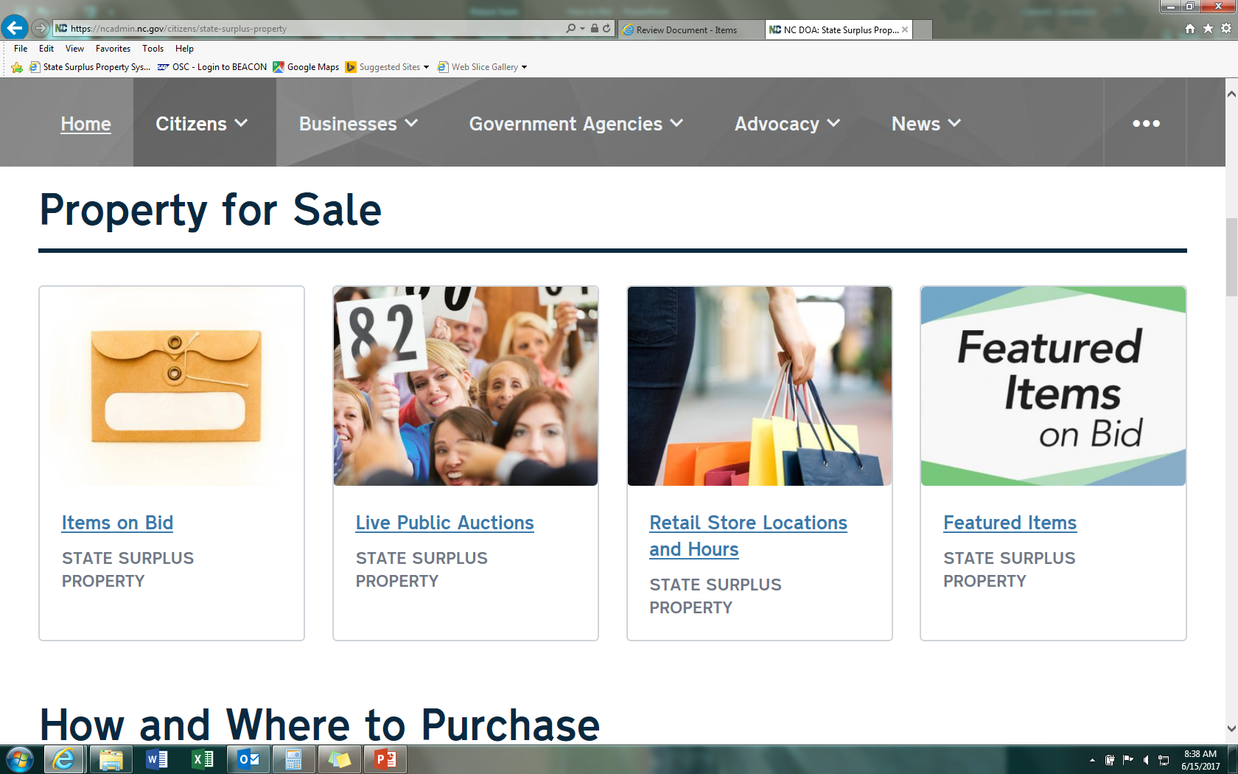
Click on Items on Bid

Slide 4
The Web Address is: https://www.surplus.nc.gov/
Click on Sign In

Slide 5
Click on Forgot You Password?

Slide 6
Type in email associated with account and press Submit.

Slide 7
username
Click hyperlink in email to reset your password. The reset code should be automatically inserted on page.

Slide 8
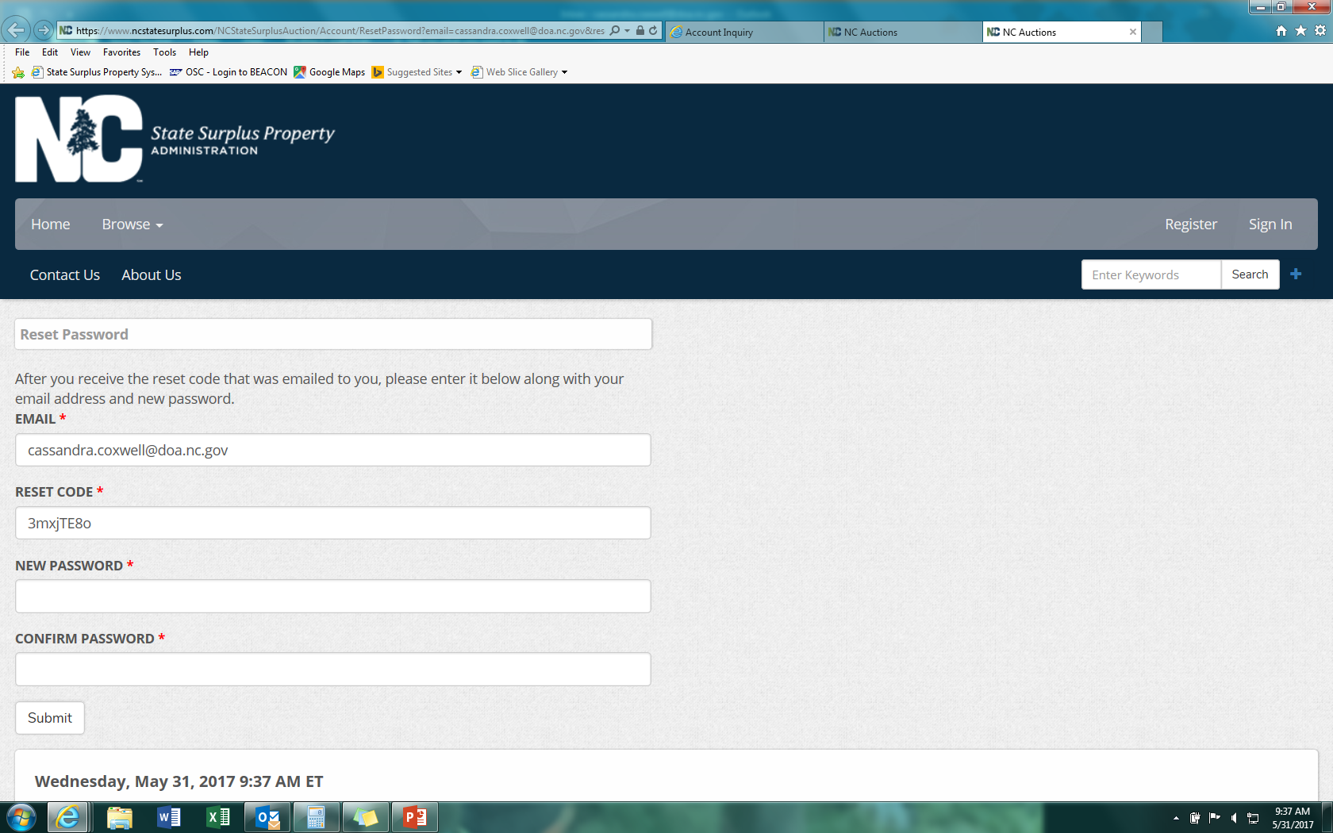
Type in new password. Password must be a minimum of 6 characters.

Slide 9
Type in username and new password.

