Slide 1
Forming 2020 State Census Complete Count Committees
Atlanta Regional Office
Managing Census Operations in
AL, FL, GA, LA, MS, NC, SC
The goal of the 2020 Census is to count everyone once, only once and in the right place.
Notes:
Purpose: To provide information on why and how to prepare for the 2020 Census, especially how local government and community groups can get involved in improving the accuracy of the results.
Note: For small groups (about 10 or less), start with brief introductions of everyone in the room.

Slide 2
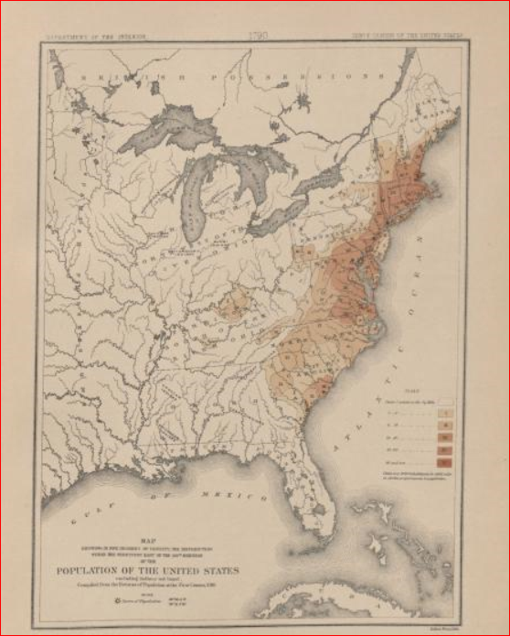
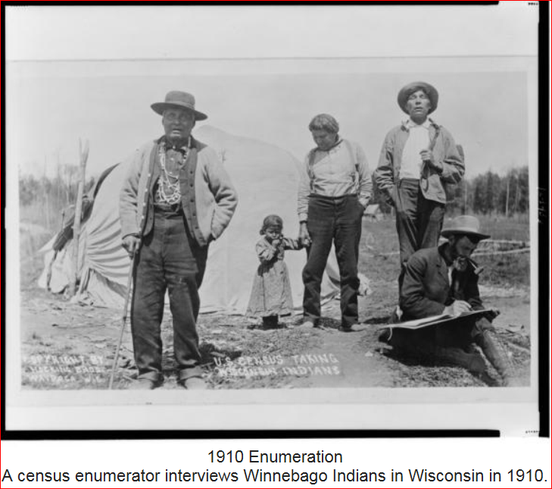
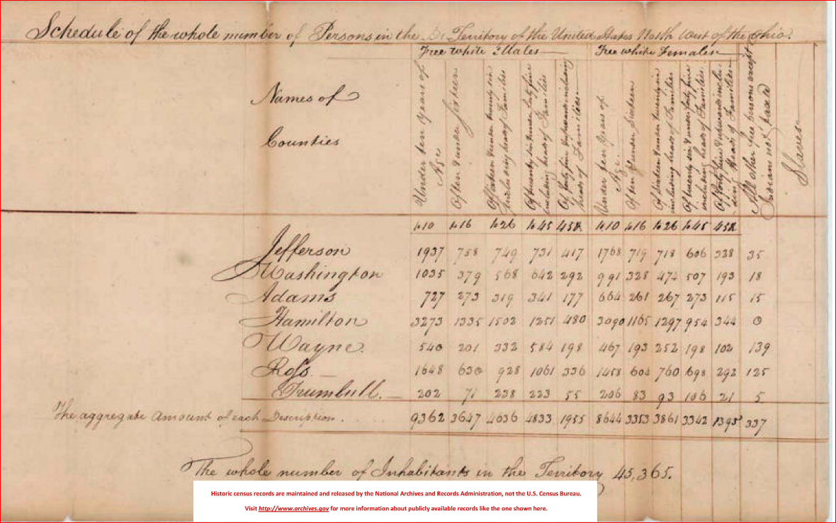
The U.S. Constitution and Decennial Census
Conducted every 10 years since 1790, as required by the U.S. Constitution. Article I, Section 2. "Representatives and direct Taxes shall be apportioned among the several States which may be included within this Union, according to their respective Numbers . . .
The 1790 counted 3.9 million inhabitants.
U.S. marshals conducted the enumerations between 1790 and 1870.
Specially trained enumerators carried out the census beginning in 1880.
Notes:
We always like to explain why we conduct a population count. A population count is required every 10 years by the U.S. Constitution. Article 1, Section 2 states that "Representatives and direct Taxes shall be apportioned among the several States which may be included within this Union, according to their respective Numbers . . .
Note: The decennial census steadily expanded throughout the nineteenth century. And by the turn of the century, the demographic, agricultural, and economic segments of the decennial census collected information on hundreds of topics. Some households would get a long form along with the short form in order to collect that expanded demographic data. However, for the 2010 Census it was simplified back to a basic headcount with 10 questions and the other demographic topics had been removed. That demographic data is now collected in the monthly survey called the American Community Survey. The 2010 Form can be found at https://www.census.gov/2010census/about/interactive-form.php

Slide 3
Why We Ask You to Allocate Resources to the 2020 Census
Political Power
Census is constitutionally mandated for re-apportionment of Congress
Census results are used for Redistricting at national, state, and local levels.
Money/Economic Impact
Over $675 Billion/year is distributed to state and local governments using Census numbers (Over $4 Trillion over the decade).
Notes:
We are and have been meeting with governors, local governments, and community organizations to ask leaders to allocate resources like time and funding because the data has an economic and political impact. The reasons we asked are -Number 1, Census data is used in Congressional Apportionment every decade. The numbers are used to determine how many congressional seats are allocated to each state. I’m sure many of you have read stories or heard about certain states losing or gaining congressional seats; the decennial Census numbers determine that.
Note: If a question arises about that process, presenter may opt to “go live” or point the audience to the apportionment site at http://www.census.gov/population/apportionment/.
Number 2, decennial figures are used by states and local officials in Redistricting. The drawing of voting districts and congressional districts are heavily dictated by census data.
Note: If a question arises about that process, presenter may opt to “go live” or point the audience to the redistricting site at http://www.census.gov/rdo)
Number 3, the data is used to allocate billions of dollars in federal funds to state and local governments through federal programs and grants.

Slide 4
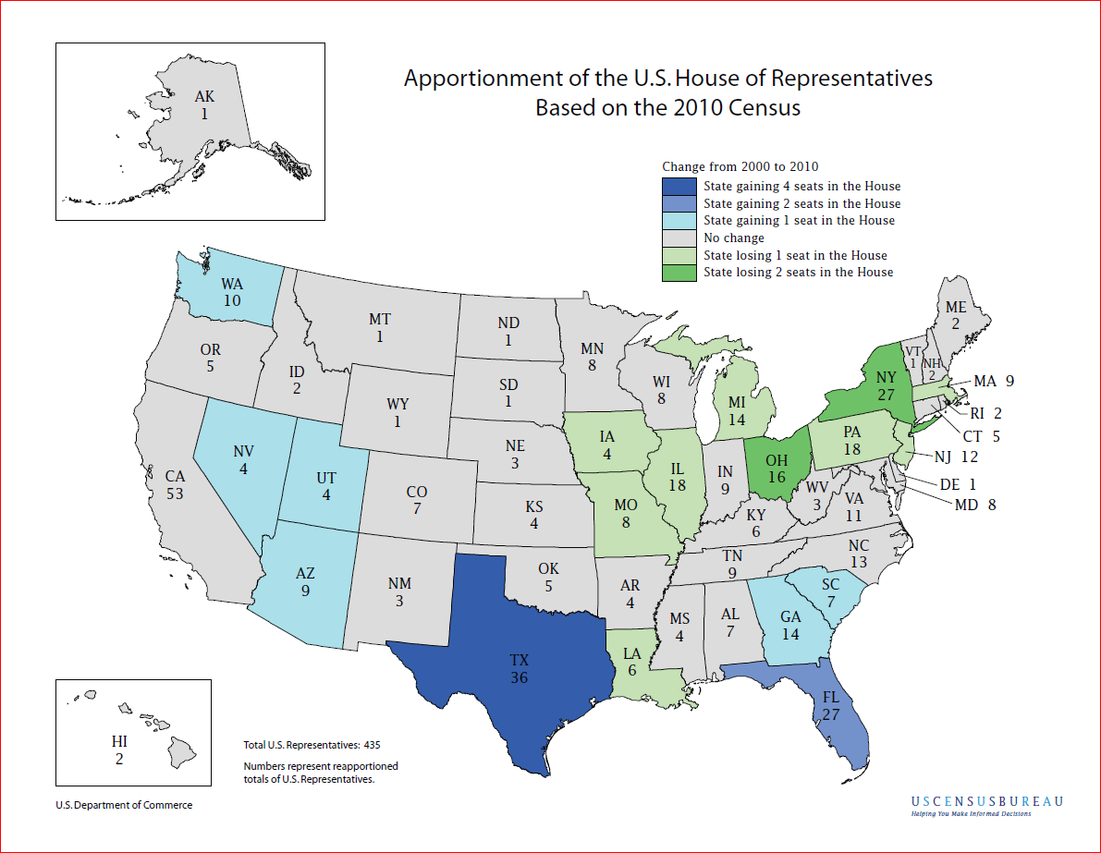
Notes:
As result of the population Count in 2010, 4 states in our region experience apportionment changes. GA and SC gained 1 Congressional seat, Florida gained 2 congressional seats, AL, NC, and MS stayed the same, while Louisiana lost one congressional.

Slide 5
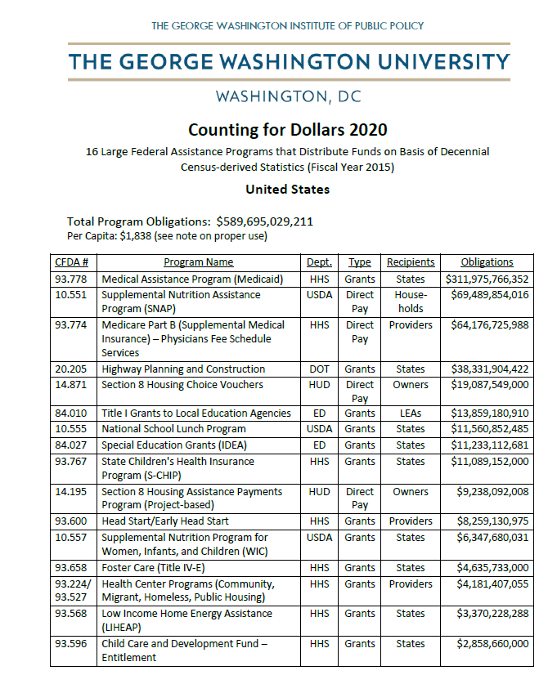
Counting For Dollars Project 2020 Initial Analysis: 16 Large Census-guided Financial Assistance Programs
In Fiscal Year (FY) 2015, the 50 states plus the District of Columbia received $589.7 billion from 16 large Census-guided programs, such as Medicaid, Highway Planning and Construction, the National School Lunch Program, and Head Start.
For 15 of the 16 programs, the amount of funds a state received was guided by its 2010 Census count. The more accurate the state’s count, the more fair and equitable is its share of federal funds.
Notes:
Let’s take a look the money aspect.
“Some federal dollars are allotted to the states based on the number of people counted in the census; Medicaid is an example. In other cases, census numbers determine if a community is eligible for critical federal program dollars. Examples include city and county population thresholds (50,000 or 200,000) for Community Development Block Grants, and rural area designations for Rural Electrification loans. Therefore, each person counted may directly determine funding levels for a few programs, and will influence funding levels for many others.” We have provided the Counting for dollars analysis for your state, which shows that largest federal assistance programs that are distributed based on census data. See the per capita amount for your state, which shows how much federal funding a state could lose per person.
Note: Other programs allocate funds based on certain household characteristics, such as average or median income levels. Still, each person counted may directly determine funding levels for a few programs, and will influence funding levels for many others.” For every program but the National School Lunch Program, the equitable distribution of funds to a state depends on the accurate measurement of its population count and characteristics. NSLP also depends on small area poverty estimates. i.e. school district levels. Retrieved from http://civilrightsdocs.info/pdf/census/CountingForDollars-Intro.pdf

Slide 6
Census Data Are Used In Many Ways
Forecasting of future transportation needs
Determining areas eligible for housing assistance and rehabilitation loans
Assisting tribal, federal, state and local governments in planning, and implementing programs and services in:
Education
Healthcare
Transportation
Social Services
Emergency response
Designing facilities for people with disabilities, the elderly and children
Notes:
Census data are used in many ways. Some ways include:
Review each bullet on the slide.
Note: The Census data includes the population data from the count and some of the more detailed socioeconomic information that is being collected monthly from a sample of the population through the American Community Survey (ACS). The ACS has been used to collect this more detailed household data nationwide since 2005. During the 2020 Census cycle, some households will receive both the ACS and the census questionnaires. Households should complete both.

Slide 7
Privacy and Confidentiality
Under Title 13, U.S. Code, all Census Bureau employees swear a lifetime oath to protect respondent data. It is a felony for any Census Bureau employee to disclose any confidential census information during or after employment, and the penalty for wrongful disclosure is up to 5 years imprisonment and/or a fine of $250,000.
We protect information by taking precautions in how we collect, analyze and disseminate information. The Census Bureau has strong program to protect information as they collect, process and store it in secure IT systems.
The Census Bureau encrypts information, limits access, and actively monitors systems to make sure information stays secure.
Notes:
As a data collection agency, we must protect that information. We protect information by taking precautions in how we collect, analyze and disseminate information. The Census Bureau has a strong program to protect information as they collect, process and store it in secure IT systems.
We will never share a respondents information with others.
Read the first two (2) bullets then say the following:
In simple terms, this means
NOT IMMIGRATION, (ICE)
NOT Law Enforcement Agencies like FBI
NOT EVEN POLICE
Or allow it to be used to determine their eligibility for government benefits.

Slide 8
It is important to note that the Census Bureau:
never asks for your full Social Security number;
never asks for money or a donation;
never sends requests on behalf of a political party;
never requests PIN codes, passwords or similar access information for credit cards, banks or other financial accounts.
Notes:
It is important to note that we never ask for SS numbers, money for donations, never send requests on behalf of a political party, and we never request pin codes, passwords, or similar access information. We conduct hundreds of survey per year and in the past, some one-time surveys provided gift cards to participants for participating. In those cases, we asked for the last 4 digits of the SS number.
Note: The Interactive version of the 2010 form can be found at https://www.census.gov/2010census/about/interactive-form.php

Slide 9
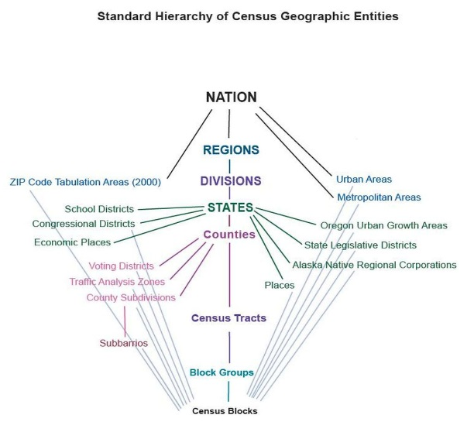
Did Do You know that the Census Bureau Collects a
Wide Variety of Data Every Month?
Demographics:
Age
Sex
Marital
Education
Housing
Health Ins and more
Business and Industry Data
Import/Exports
Employment
Government Data
Data at a variety of Geographic Levels:
National, State, County
City/Place
Tract
Block
Congressional Districts
Notes:
This slide shows some of the wide variety of data captured through a variety of other surveys, which you can find on the website. You can also find Census data at a variety of geographic levels and request data or a data workshop on accessing Census data if you need assistance.

Slide 10
The goal of the 2020 Census is to count everyone once,
only once
and in the right place.

Slide 11
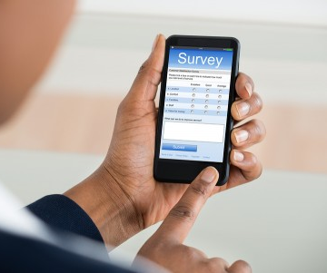
New Initiatives for Census 2020 to help us reach our goal.
Allowing people to respond anytime, anywhere, via phone or internet. Tests have shown internet self-response is the most cost effective and accurate way. Those that request a form can complete the Census using the form.
The Census Bureau is eliminating paper and incorporating the use of handheld data collection devices.
The goal of the 2020 Census is to count everyone once,
only once and in the right place.
Notes:
In order to meet our goal to count everyone once, and only, and in the right place, the Census Bureau has implemented a couple of new initiatives for the 2020 Census. One we are Optimizing Self Response: Allowing people to respond anytime, anywhere, via phone or internet, and maximizing internet self response (testing has shown internet response is the most cost effective and the most accurate).
We are also Reengineering Field Operations:
We are eliminating paper and incorporating the use of handheld data collection devices as part of our re-engineering our field operations. In some areas, like areas with rural route addresses the Census will either send paper forms or send Census takers to those addresses.

Slide 12
State Complete Count Committees
Ultimately, the success of the 2020 Census depends on everyone’s participation. One way to ensure success is by forming a Complete Count Committee.
State and local governments, businesses and community leaders form Complete Count Committees to encourage participation in their community. They develop an outreach plan tailored to the unique characteristics of their community. Then they work together to implement the plan.
Notes:
Ultimately, the success of the 2020 Census depends on everyone’s participation. One way to ensure success is by forming a Complete Count Committee. Complete Count Committees encourage participation in their communities. They develop outreach plans tailored to the unique characteristics of their communities Then they work together to implement their plans.

Slide 13
State Complete Count Committees
State Complete Count Committees conduct a wide range of possible activities. For example, they host promotional events, display census information in government buildings, include census messages on customer billing statements or other correspondence, and they network with community leaders to ensure everyone is involved.
Opportunity to “tailor” the Census outreach and messaging to most effectively influence for the state.
Involve all constituent groups, and use “trusted voices” of community leaders to encourage self-response.
Notes:
Complete Count Committees conduct a wide range of possible activities. For example, they host promotional events, display census information in government buildings, include census messages on customer billing statements or other correspondence, and they network with community leaders to ensure everyone is involved. Complete Count Committees can have a greater influence on the community because they know their communities better than we do. They also know the value of one trusted person telling another person that the census is easy, safe and important. It is important for the CCC to include members from all constituent groups in the community to develop a comprehensive outreach plan.

Slide 14
Get Organized Right NOW!
Households will begin to experience, by the end of 2018, some type of census operation such as address listing. These necessary operations verify the accuracy and location of each address.
The immediate formulation of a SCCC will ensure that local households are kept abreast of the various census operations before the information is nationally circulated.
The more informed households are about the 2020 Census operations, the better their understanding of the census process becomes, thus increasing their willingness to be a part of the successful enumeration in 2020.
Notes:
We are asking you to get organized now. Households will begin to experience, by the end of 2018 and in early 2019, some type of census operation such as address canvassing. These necessary operations verify the accuracy and location of each address. The immediate formulation of a CCC will ensure that local households are kept abreast of the various census operations and recruiting activities before the information is nationally circulated.
The more informed households are about the 2020 Census operations, the better their understanding of the census process becomes, thus increasing their willingness to be a part of the successful enumeration in 2020.

Slide 15
What is the Structure of a SCCC?
The Governor appoints a chairperson-Secretary Sanders
The Chairperson and the Liaison Bob Coats are main source of contact between the SCCC and the Census Bureau
The Chairperson and Liaison collaborate with the highest elected official or community leader to select subcommittees and chairs of the subcommittees
Notes:
The basic structure of the SCCC is displayed in this slide. Highest elected officials or community leaders appoint chairpersons or liaisons, who will be our main source of contact. Then, the chairperson collaborates with the highest elected official or community leader to select subcommittees and chairs of the subcommittees
Note: The U.S. Census Bureau does not manage the Complete Count Committees. We support the activities of the CCC track their work, and help spread the word about their activities.

Slide 16
SCCC Chair and Subcommittee Chairs
Govern appoints SCCC committee chairperson who is committed, knowledgeable, and active in the community
Select subcommittee chairpersons who are purpose-driven, result oriented, and get results
Customize and design the committee to reflect a true snapshot of the community
Include diverse perspectives to achieve objectives. Assess which groups—locally and nationally—are able to provide support and assistance
Include Trusted Voices
Notes:
The Census Bureau has learned from previous censuses and made recommendations for success in 2020. These recommendations are based on information gathered from the committees, focus group sessions, and summary reports submitted by Partnership Specialists. The recommendations are- • Customize and design the committee to reflect a true snapshot of the community. • Use technology effectively. Communicate with committee members through electronic mediums. • Include diverse perspectives to achieve objectives. Assess which groups—locally and nationally—are
able to provide support and assistance. • Choose a committee chairman who is committed, knowledgeable, and active in the community.• Select Subcommittee Chairpersons who are purpose-driven, result oriented, and gets results.• Review CCC activities in your area from the 2010 Census. Repeat what worked well. Eliminate what did not work well. Modify activities and incorporate new innovative activities in your plan, as needed. • Incorporate a census awareness in all existing community festivals and activities scheduled. • Recruit experienced members to motivate and support new members.• Keep detailed records of SCCCs/CCCs’ strategies and activities so that the program can be better assessed and best practices be replicated.

Slide 17
Local Government CCC’s
Local government CCC’s should include members with experience in the following areas:
Government
Education
Media
Minority Organizations
Community organizations
Workforce developments
Faith-based institutions
Businesses
Notes:
The U.S. Census Bureau’s recommended structure for Complete Count Committees (CCC) maximizes the effectiveness of committee outreach strategies in their communities. However, the committees are encouraged to adopt their own structure based on the determination of their unique community needs in order to maximize the effectiveness of the outreach. Once these needs are determined, a committee may choose to create subcommittees dedicated to these needs. Regardless of the structure, government committees should include members with experience in the following areas: government, workforce development, faith-based community, education, media, minority organizations, community organizations, and businesses

Slide 18
Community-based CCC’s
The Census Bureau encourages community leaders in hard-to-count areas to form CCC’s and include trusted voices from the community.
Hard-to-count areas may, for example, have:
• Hidden or overcrowded housing
• Populations that speak little or no English
• Off-campus apartments
• New immigrant populations
• High poverty areas
• People displaced by natural disasters such as
floods, fires, and hurricanes
Notes:
The Census Bureau encourages community leaders in hard-to-count areas to form CCCs. Hard-to-count areas may,
for example, have: • Hidden or overcrowded housing. • Populations that speak little or no English. • Off-campus apartments. • New immigrant populations. • People displaced by natural disasters such as floods, fires, and hurricanes • Housing with restricted access, like gated communities or areas where migrant and/or seasonal workers live.
Note: Apartments, areas with off-campus student housing, gated communities present challenges for the census as well. Both local government and community-based CCC’s can address those as well as all the other hard-to-count areas.

Slide 19
Subcommittee Examples
Government
Education
Faith-based
Media
Business
Community-based organizations
Recruiting
Housing
Senior Citizens
Philanthropic
Service Providers
Notes:
The decision to form subcommittees is based on community need and the opportunities and challenges in reaching areas or populations that may not respond or may potentially be undercounted. This slides show the common examples of subcommittees. It is important to note that in the past, committees have also created subcommittees devoted to data and maps, youth, homeless, LGBTQ, veterans, special housing, recruiting, immigrants, and home owners associations. These subcommittees can help reach the most challenging areas to count. Different subcommittee structures and sizes are appropriate for different types of committees. The subcommittee structure is determined by the size and needs of the community it serves.

Slide 20
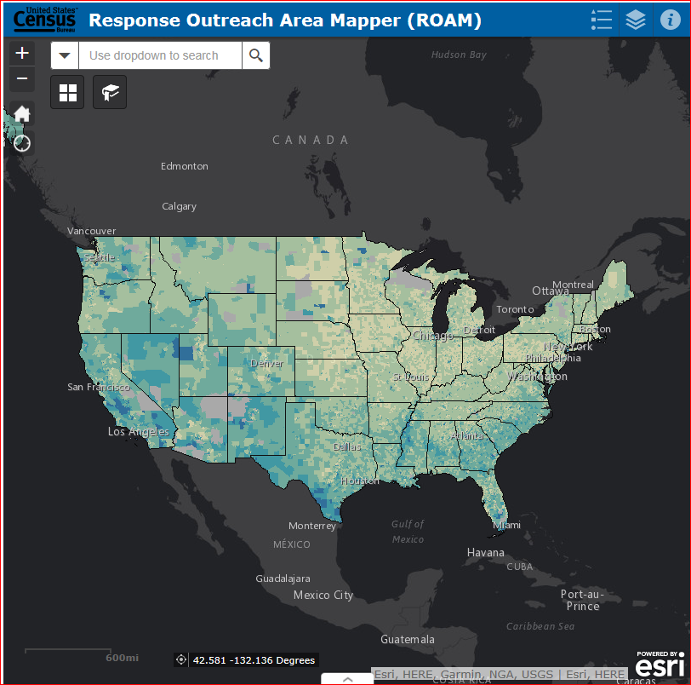
Explore the Response Outreach Area Mapper Web Application
The U.S. Census Bureau has released the Response Outreach Area Mapper (ROAM) web application.
An interactive map to identify areas that typically have low response rates for censuses and surveys.
Community planners and local officials can use the ROAM to plan, focus and allocate resources for the 2020 Census.
Provides tract-level data.
Notes:
CCC’s can now start to look at specific areas that may be hard to count to identify committees needed and members needed using the Response Outreach Area Mapper (ROAM) application or ROAM. The ROAM was developed to make it easier to identify hard-to-survey areas and to provide a socioeconomic and demographic characteristic profile of these areas using American Community Survey (ACS) estimates available in the Census’s Planning Database. It provides a Low Response Score (LRS) for each tract along with demographic and population data for each tract. When viewing the map in the ROAM, you will see areas color coded by their LRS. The darker the area, the higher the LRS and the more likely the tract will be hard to count. Learning about each hard-to-survey area allows the U.S. Census Bureau to create a tailored communication and partnership campaigns, and to plan for field resources including hiring staff with language skills. These and other efforts can improve response rates.
Note: You can show the ROAM by going to the website at https://www.census.gov/roam. The site can be easily found by searching Census ROAM. Handouts on each LRS for each tract in each county/parish in the state may have been provided. When looking at the range of scores for our region, the highest LRS scores include scores at 25 and higher. Those are the highest priority areas and reaching out to trusted voices, business, and schools in those tracts is important.

Slide 21
How the Census Bureau Will Support You
We will provide staff from our regional offices to work directly with each Complete Count Committee.
We will provide information, assist you in forming committees and subcommittees, and participate in local events and activities.
We provide a guide for 2020 Census Complete Count Committees on our website at https://census.gov/programs-surveys/decennial-census/2020-census/complete_count.html
As the 2020 Census gets closer, the Census Bureau will also launch a robust communications campaign. We’ll use advertisements, conduct outreach. You can leverage our efforts in your own community through your Complete Count Committee.
Notes:
The Census Bureau will provide staff from our regional offices to work directly with each Complete Count Committee. As the 2020 Census gets closer, the Census Bureau will also launch a robust communications campaign. We know how important it is for you to have materials that help spread the word in your community. We plan to provide a variety of digital resources. If budget allows, we may also provide a limited quantity of printed materials and promotional items.
Note: We are currently researching the best messages to use, the best types of materials and the best campaign design.
We plan to provide an array of digital assets like logos, taglines, drop-in articles and template fact sheets and posters for you to customize and share with your community.
If you have any feedback about what worked well last time or what improvements you suggest for the 2020 Census., please share that information.

Slide 22
Prepare for 2020 Census, Now!
Create or join a Complete Count Committee and partner with other trusted voices and influential leaders in your area who are committed to increasing census participation. Encourage your peers to get involved too. Call the Atlanta Regional Office to schedule a CCC Workshop.
Raise awareness by including census information in newsletters, social media posts, podcasts, mailings, and on Web sites.
Help recruit census workers when jobs become available.
Notes:
The actual count is in 2020, but the census is here.
By forming CCC’s now, you can begin developing your plan, allocating your resources and informing your community.
o A good first step is identifying your community’s unique characteristics. Consider any barriers or concerns that may prevent your community members from participating in the census. Then you can explore ways to address or overcome those barriers.
o You can begin allocating funds for conducting outreach activities through 2020.
o In 2019, residents may begin to see census workers verifying our address list in your community. The more informed your residents are about the 2020 Census, the better they will understand the process and the more willing they will be to participate.
We will support you.
Local staff will also be available to work with Complete Count Committees at the county and municipal levels.
• We will provide information, assist you in forming committees and subcommittees, and participate in local events and activities.

Slide 23
Recruiting/Hiring Challenges
Now an online application and assessment is required for 2020 Census hourly positions (paid weekly). 2020census.gov/jobs
Expected challenges from the online process
Applicants who do not have computer or smart phone access
Applicants who do not have internet access or easy internet access
Applicants who are not tech-savvy and possibly intimidated by the process
Applicants who do not have email addresses
Notes:
We have already noticed that we have some recruiting challenges while hiring for the 2018 Census Test. As you can see, 2020 applicants will have to fill out an online application and complete an online assessment starting September 7th of this year. Applicants must have a valid email address, have a valid SS card, be 18 years of age by the hire date, be a U.S. citizen. They must also pass a background check with fingerprints, if selected. So there are various challenges caused by the process. Challenges include everything from people not having computers to people not having email addresses. We pay a competitive wage and mileage to field staff.
Note: Selections will be based more on the census tracts we need to hire in and the language, if there are many people in the area speak a language other than English.

Slide 24
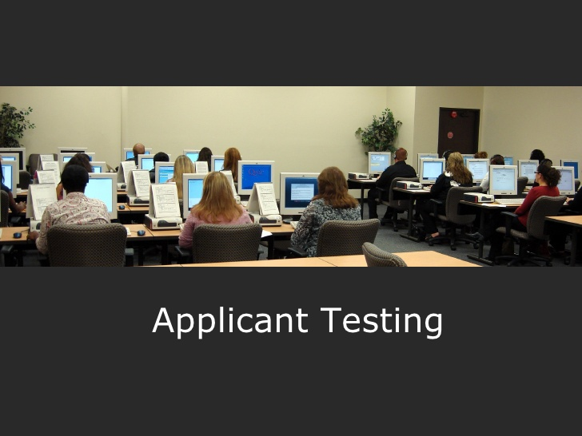
Census Recruiting Help Needed
Free space with computers
Free space with good internet access
Preferably, ADA accessible space
Spread the word about jobs
Notes:
We need your help to help us identify free spaces for people to use computers, access the internet, and are preferably ADA accessible, public and free.

Slide 25
Where to Direct Interested Applicants for 2020 Census Positions
www.usajobs.gov
or
Census.gov/fieldjobs
or
Toll Free Jobs Line
1-855-JOB-2020
(1-855-562-2020) or (1-855-889-8932)
2020census.gov/jobs for hourly jobs (paid weekly)
Notes:
We have started hiring for 2020 Positions. Some positions will be in the Atlanta Regional Census Centers, but soon, the local Census offices will open in various areas across the region. We will be asking our partners to spread the word about more Census positions as they come available. The salaried positions have to be completed on the usajobs.gov website. However, applicants now must first create a login.gov account and then link your usajobs account to login.gov. Login.gov is a service that offers secure and private online access to government programs, such as federal benefits, services and applications. With a login.gov account, you can sign into multiple government websites with the same username and password.

Slide 26
Next Steps
Continue to finalize your list of SCCC members
Inform the Census Bureau Partnership staff of the selected Chairperson, Committee members, Subcommittee chairpersons and members
Schedule a Census workshop on SCCC Workplans and Strategies.

Slide 27
Contact Information:
Atlanta Partnership Staff 470-889-6530
atlanta.rcc.partnership@census.gov
Atlanta Recruiting 1-855-889-8932
atlanta.rcc.recruiting@census.gov
Atlanta Geography 470-889-6550
atlanta.geography@census.gov
Notes:
You can reach 2020 Census staff by calling or email Census staff in the appropriate department. We look forward to hearing from you and working with you. Thank you.

