Slide 1
Disaster Recovery and Environmental Justice
Rachel Posey, DR Project Staff Attorney
Elizabeth Savage, DR Project Staff Attorney

Slide 2
LANC Disaster Relief Project: What We Do
Provide legal assistance and education to low-income survivors of natural disasters in NC
This includes:
Helping clients apply to and navigate legal issues involved with recovery programs like FEMA and ReBuild North Carolina
Removing barriers to recovery like ownership issues (we will talk more on this later)
We also help clients appeal unfavorable determinations
Litigating contractor fraud and negligence
Litigating and negotiating insurance matters
Representing clients in consumer protection matters
Landlord-tenant and other housing related issues
Social work assistance

Slide 3
Environmental Injustice & Disaster Recovery
Environmental Injustice
-The benefits of environmental statutes, government programs, and aid disproportionately helps white, affluent communities
-Disproportionate burden of the disaster
-Disparate recovery stats
-“Poverty trap” barriers to recovery
Relief program requirements like proof of being up to date on property taxes, mortgage, and restrictions on use of recovery funds (duplication of benefits restrictions)
-Compounding public health inequities
-The burdens of environmental hazards are borne disproportionately by communities of color
Disaster Recovery

Slide 4
Poverty & Disaster: Public Health Considerations
Disastrous events (natural disasters and infectious disease disasters) can cause stress, loss of property, physical injury, and death. Disasters can also cause and/or exacerbate pre-existing mental health conditions (which can linger far after the event has subsided; for example, PTSD).
Factors that affect "resiliency" and can increase the risk of adverse health consequences after a disaster include age (geriatric populations), location (environment is prone to repeated disaster), socioeconomic status (poverty), race (particularly BIPOC), disability, and underlying health conditions (both physical & mental).
For individuals and households suffering from the cycle of poverty, any change in circumstance is likely to be disruptive, especially one such as a serious disastrous event.

Slide 5
The Cycle of Poverty & Disaster
DISASTER STRIKES
Low individual/household income & low generational wealth
Limited access to basic needs resources (nutrition, sanitary drinking water, safe/sanitary housing, healthcare, education, employment opportunities)
Increased risk of disease, malnutrition, hazardous employment, etc...
Built environment
considerations
Access to legal resources and estate/financial planning
Presence of risk factors

Slide 6
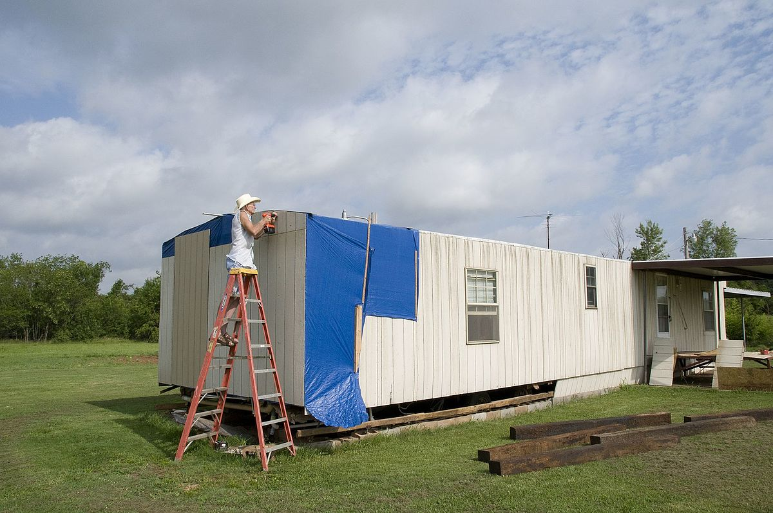
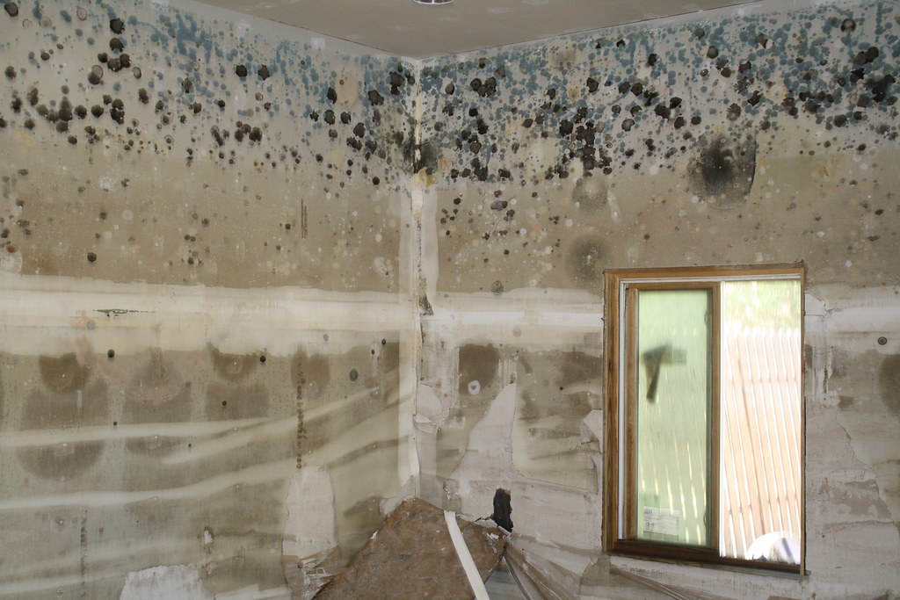
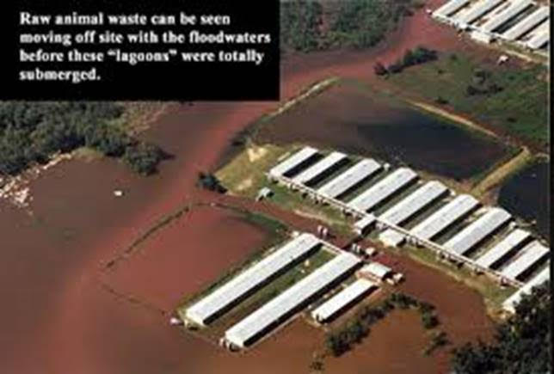
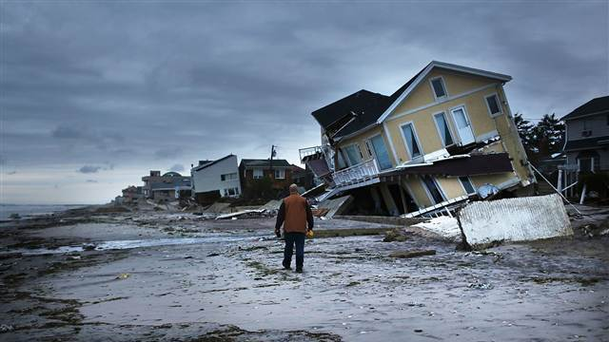
Post-Disaster Human Health & Environmental Health Issues
Physical & Mental Injury
Foodborne & Waterborne Infectious Disease
Vector-borne Disease
Air & Water Pollution
Electrical Hazards & Carbon Monoxide Poisoning
Water & Food Supply
Well Water Testing & Decontamination
Structure Damage
Mold
Septic and Wastewater System Issues
This Photo by Unknown author is licensed under CC BY-SA.
This Photo by Unknown author is licensed under CC BY.
This Photo by Unknown author is licensed under CC BY-NC-ND.
This Photo by Unknown author is licensed under CC BY-NC.

Slide 7
Burdens of the Disasters
In general, most of our project's clients are from low-lying communities of color in the east that have been around for generations and are particularly susceptible to flooding
Vulnerable Housing
A lot of our clients live in mobile homes
As of January 2018, there were nearly 479,000 mobile homes in NC-about 12.7% of the housing in the state
In eastern counties it can be upwards of 30% of the housing
Manufactured or mobile homes are much more accessible to low-income populations-can be over $100,000 cheaper to purchase a mobile home as opposed to a small "stick built" home. Also, they are easier to buy outright with no need for a mortgage that may require higher credit to obtain
Many of these homes are old-passed down by other family members, very little upkeep, wear from repeated storm events

Slide 8
Burdens of the Disasters Cont.
z
Compounding EJ risk factors
Proximity to hazards such as hog farms and coal ash impounds makes the impact of flooding events much more dangerous
Many of our rural clients rely on well water-contamination from storm events is a big issue
Inability to relocate even temporarily after the storm
Because of a lack of personal and family resources
Most of our clients live in their damaged homes-dealing with pervasive mold, exposure to the elements, lack of heat and water etc.

Slide 9
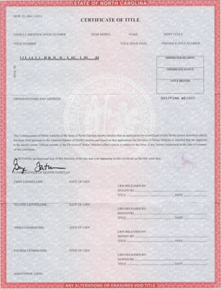
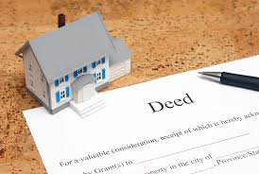
EJ Barriers to Recovery: Ownership
Most, if not all, federally funded disaster recovery programs have home ownership as a requirement to receive assistance-which most people think of as meaning you have the deed to your stick-built home or the title to your mobile home
Seems simple? Nope-Heirs' property makes this a huge barrier
Heirs' property is what is created when land passes through several generations by intestate succession-without a will
This is a unique issue faced by the black community, particularly in the south
Lack of access to the legal system combined with a distrust of southern white courts led to a huge disparity in the number of black southerners who engage in estate planning
Upwards of 75% of black Americans do not have a will, more than twice the percentage of white Americans that do not have a will
This fragmented way of passing down land can mean one parcel of property could technically have dozens of owners with fractional shares
Around a third of all black owned land in the south is heirs' property-this translates to 3.5 million acres

Slide 10
EJ Barriers to Recovery: Ownership Cont.
Heirs' Property cont.
Some programs, like ReBuild NC, require you to try and track down all the heirs to a piece of property
Can be burdensome and time consuming
Some programs, like Office of State Budget and Management, won't assist clients who don’t own their land and are unable to get life estates (not probable if you have 80 people with partial interests)
In addition to making it difficult to prove ownership to get access to recovery funds, the fragmented nature heirs' property makes black owned land incredibly susceptible to loss
Black land ownership peaked in 1910 at 15 million acres and has fallen steadily ever since
It also makes getting a mortgage or accessing a line of credit through financing difficult due to lack of clear title, affecting the ability of these owners to create intergenerational wealth

Slide 11
EJ Barriers to Recovery: Property Taxes
Disaster recovery programs, especially ones that have a replacement element, require that applicants show that they are up to date on their property taxes or that they have a payment plan in place with the county tax office
The main reason for this is that most counties will not issue construction or demolition permits until the property taxes are paid
Also, the programs do not want to replace a home that is just going to go into tax foreclosure
We find that a lot of our clients have unpaid property taxes going back several years
We have also run into tax offices that refuse to set up payment plans, some of which have been transparent about their dislike for our clients
Most charitable organizations we work with for client support won't provide money for property tax payments (some will, but only for the year of the hurricane)
So, a lot of our clients are stuck with property tax bills upwards of $1,000 (in some cases much more) that they must pay before they can get help with home repair

Slide 12
EJ Barriers to Recovery: Property Taxes Cont.
Everyone has to pay property taxes, right? So why are property taxes an environmental justice issue?
Black-owned homes are assessed at a higher value relative to their sales price than similarly-situated white owned homes
Higher value=higher property taxes
A recent study showed that nationally, on average, black families pay 13% more in property taxes than white families in the same situation; a so-called "black tax"
This also cannot be explained purely by poverty levels-the higher rates of property taxes for black families cuts across the wealth spectrum
Black families are also much more likely to be denied if they appeal their property appraisals to the county tax office, or, if granted, the reduction in value is typically less than a similarly-situated white family sees
Larger yearly property tax payments, and accumulation of years of back taxes, prevent black families from creating intergenerational wealth. It also makes black families more likely to go into tax foreclosure
Because the property tax burden is disproportionately born by black Americans, they are the group most likely to face barriers to accessing disaster recovery funds that require paid-off property taxes or payment plans

Slide 13
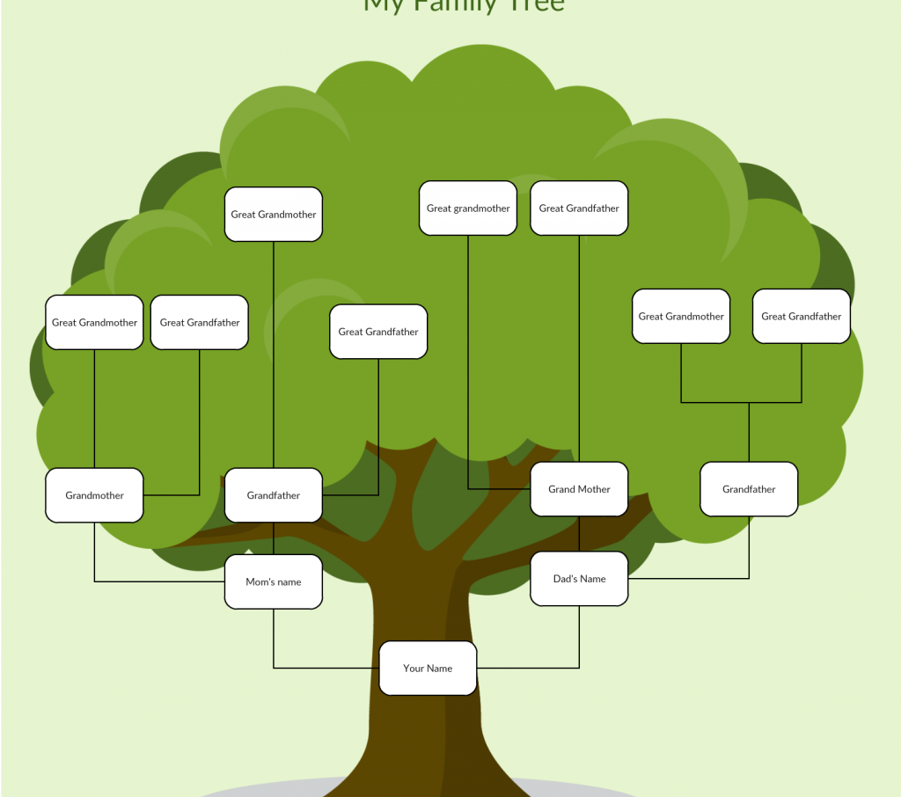
Ways That Our Project Helps Overcome These Barriers
Ownership
Most of the disaster recovery programs will accept life estate deeds granted post-disaster to applicants who were living on the property at the time of the storm. If ownership is less complicated (ex: client living in house owned by their sibling), we can help them negotiate and execute these deeds
For heir property, we advise clients on heir property issues and help clients create family trees from the point of the last deed on record to determine who has an interest in the property.
Explaining property law to these programs-most of the individuals managing and doing intake have zero understanding of property law and intestate succession, so in some cases what is needed is to just advocate and explain to them why our client is a valid owner even though they aren't on a deed

Slide 14
Ways That Our Project Helps Overcome These Barriers Cont.
z
Property Taxes
Sometimes all we can do for past-due bills is negotiate with the tax offices to try and get them to agree to a payment plan
Track down organizations that will pay back taxes
Request re-evaluations
Some of our attorneys have been successful in getting back taxes lowered by having the tax office re-assess the property-many of our client's homes are being taxes based on their value pre-storm (which is usually significantly higher than its current value)
Apply for exemptions going forward
Homestead Exemption

Slide 15
Questions?

Slide 16
Resources
https://features.propublica.org/black-land-loss/heirs-property-rights-why-black-families-lose-land-south/
https://cwfnc.org/wp-content/uploads/2020/01/8.14-Water-Justice-Report.pdf
https://www.fema.gov/sites/default/files/2020-03/stafford-act_2019.pdf
https://context-cdn.washingtonpost.com/notes/prod/default/documents/19fd7c55-911a-448f-a089-d299c773b5fb/note/84507c99-e0be-42bc-8c01-bd105496bebb.#page=1

