Slide 1
Disaster Preparedness

Slide 2
All areas of the state – from coastal and sound counties to the mountains – have been impacted by hurricanes in the past 23 years. Heavy winds, tornadoes, strong thunderstorms, flooding, storm surge and landslides can all be caused by hurricanes, causing tragic damage.
Hurricanes | Ready NC

Slide 3
Matthew
Florence
Dorian
Isaias
Eta
Fred
Ian
Since 2016, North Carolina has experienced several major storms:

Slide 4
Pre-Hurricane tips
Make
Make a plan with your family
Keep
Keep emergency supplies (batteries, flash light, bottled water)
Purchase
Purchase flood insurance
Pack
Pack a bag of essential items
Keep
Keep receipts of major purchases
Remember your medicine
Documents

Slide 5
Hurricanes and Land Ownership
Do you own your home?
Do you own your home with one or more other people?

Slide 6
Heir property
Some people have inherited property without a will, and/or the property is shared by many relatives. Lawyers often call this “heir property.” You may also know this as “family land.”
Notes:
Explain how heir property can be a barrier to receiving disaster assistance.

Slide 7
Heir property
There are two ways to eliminate heir property:
All heirs may agree to give ownership to one person. One heir may buy the others’ shares, or the others may voluntarily give their share to a single family member. In some cases, the heirs may agree to form a corporation or other entity to hold and
manage the property.
Any owner of the property may file for partition. This is a court case in which the owner asks a judge to divide up the property. Typically, this results in the judge ordering the property sold at auction. Anyone, including investors from outside the family, may buy the property at a sale. The property will be sold to the highest bidder. The proceeds will be divided among the owners according to their ownership share.

Slide 8
the Basics: Last Wills & Testaments and advance directives
DISASTER RECOVERY PROJECT PROVIDING:
Basic information for drafting and executing last wills and testaments, living wills, health care powers of attorneys, and powers of attorneys (durable and springing)
Notes:
Briefly explain how estate planning documents are an important aspect of disaster preparedness.

Slide 9
last will & testament
A legal document that expresses a person’s wishes as to how their property is to be distributed after their death.

Slide 10
May I revoke or change my will prior to my death?
You may revoke or change your will at any time prior to your death so long as you are of sound mind.

Slide 11
Advance directives
This Photo by Unknown Author is licensed under CC BY

Slide 12
WHAT ARE ADVANCE DIRECTIVES?
Legal documents that allow the signer to make decisions and appointments as to the persons that will make financial and healthcare decisions for them when the signer is unable to make those decisions for themselves.
Advance directives include the following:
Living Will
Health Care Power of Attorney
Power of Attorney (Durable and Springing)

Slide 13
What is a Living will
A document detailing a person’s desires regarding their medical treatment in circumstances in which they are no longer able to express informed consent.
The Living Will becomes effective when either of the following conditions exist:
Incurable or irreversible condition;
Unconscious and to a high degree of medical certainty you will not regain consciousness; or
Advance dementia or another condition which results in a substantial loss of cognitive ability, and to a high degree of medical certainty the loss is not reversible.

Slide 14
Health Care Power of Attorney (HCPOA)
A legal document in which you give someone the power to make medical decisions for you if you are not competent or if you are not able to communicate your wishes.

Slide 15
What authority does my health care agent have?
The ability to make and carry out all health care decisions and mental health decisions, unless limitations are implemented by the signer.

Slide 16
WHY SHOULD I HAVE ONE?
Ensure that the person you want to make medical decisions for you is the one making them if you are unable to do so.
Ensure that there is someone with authority to act if your next of kin cannot agree.
Prevent the possible need for a guardian of the person.

Slide 17
POWER OF ATTORNEY
A Power of Attorney is a legal document in which you give someone (known as your agent) the legal authority to take certain actions for you regarding financial decisions.
You decide how much or how little authority to give your agent

Slide 18
DURABLE AND SPRINGING POWERS OF ATTORNEYS
Durable POA
Effective immediately; remains in effect during incapacity or incompetence
Springing POA
Effective ONLY once person becomes incapacitated or incompetent

Slide 19
Why do I need a power of attorney?
Ensure that the person you want to conduct your business affairs has the proper legal authority to do so.
Prevent the possibility of the need for a legal guardian

Slide 20
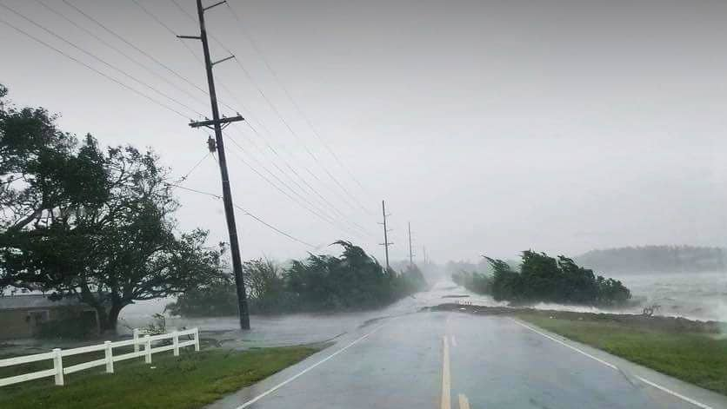
Post-hurricane Tips and Resources
This Photo by Unknown Author is licensed under CC BY-ND

Slide 21
Post-disaster resources
Disaster Supplemental Nutrition Assistance Program
If you are already receiving Supplemental Nutrition Assistance Program (SNAP) benefits, you can apply for additional benefits
If you receive less than the monthly maximum for your household size and you have losses due to the disaster.
Apply for food assistance by calling 211 or contacting your county’s Department of Social Services (DSS) office

Slide 22
Disaster Supplemental Nutrition Assistance Program
Children who are homeless or displaced due to the disaster may be eligible for free meals at school, regardless of income.
This Photo by Unknown Author is licensed under CC BY-ND

Slide 23
Disaster Supplemental Nutrition Assistance Program
You may qualify for D-SNAP if you have at least one of the following types of
disaster-related expenses:
• Home or business repair expenses
• Temporary shelter expenses
• Evacuation or relocation expenses
• Home or business protection
expenses
• Disaster-related personal injury
expenses, including funeral expenses
• Lost income due to the disaster,
including delayed income
• Lost food due to the disaster

Slide 24
Utility Services
If your home has lost water, gas, electricity, or cable due to a recent storm, you should report the loss of service directly to the utility company.

Slide 25
Utility Services
If your home is unlivable and you expect
to be out of your home for a significant
amount of time, you can ask your utility
providers to suspend your services to
save you money. You can also request a
waiver of any reconnection fees

Slide 26
Utility Services
If you cannot afford to pay the existing utility bills from your damaged home due to a loss of income, you may be able to receive financial assistance by contacting your local Department of Social Services office, American Red Cross, Salvation Army, or United Way.

Slide 27
Utility Services
If you are having problems with your utility company, you may be able to get assistance through the Public Staff of the
North Carolina Utility Commission:
Toll-free number: 866-380-9816 or 919-733-9277
• Website: https://publicstaff.nc.gov

Slide 28
Replacing benefits and documents
If you have lost your SNAP/
EBT card, you must report it immediately by calling
888-622-7328.
Request a replacement Medicare card by calling 800-633-4227.
For a lost Medicaid card,
you should contact your DSS caseworker.
If you have lost your VHIC,
contact the VA medical center where your
photo was taken to request a replacement. If you no longer visit that location, you can contact the new location where you seek
care or call 877-222-8387.
You can order a
duplicate NC driver’s license or a state-issued
ID card online at www.NCDOT.gov. You can also replace it by visiting a DMV office.

Slide 29
Replacing benefits and documents
Birth certificates, Marriage licenses, Divorce Decrees:
You can order copies of these document through the Register of
Deeds office in the NC county in which the birth, marriage, or divorce took place. If the event took place in another state, contact that state’s Vital Records Division or the county’s record division.

Slide 30
Avoiding scams and frauds
• Ask for an official ID from anyone claiming to be from the government, power company or insurance company
.
• Contact your insurance company first if your property has been damaged by a disaster. Some insurance companies
require the adjuster’s approval before work can be done.
• Shop around and compare estimates for any major repairs. Legitimate contractors will also provide written estimates for home repairs.
• Avoid sharing personal information, such as social security numbers or bank account numbers, with anyone who contacts you first. If someone contacts you claiming to be from a government agency or organization, look up the number for that
organization online and call to verify that the person is really an employee.
• Remember that you should not be asked to pay to file any disaster assistance applications.
This Photo by Unknown Author is licensed under CC BY-SA

Slide 31
Tenant’s Rights Post-disaster: Eviction and Repair
If your rental home is destroyed or so badly damaged by a natural disaster that it is not sanitary or safe for you to live in,
North Carolina law gives you the right to cancel your lease within 10 days of the date of the damage. You must give the
owner or manager written notice of your intent to cancel the lease. You will be required to pay any rent currently due.

Slide 32
Tenant’s Rights Post-disaster: Eviction and Repair
Your landlord may also end your lease if
the damage is too severe for the landlord
to repair. If this happens, your landlord
must give you notice as required by your
lease. If your lease does not state how
much notice is required to end the lease,
the amount of time is set by law. For
example, on a month-to-month lease, the
landlord must provide at least one week’s
notice before the end of your lease.
This Photo by Unknown Author is licensed under CC BY-SA

Slide 33
Tenant’s Rights Post-disaster: Eviction and Repair
If you continue to live in the home, the
landlord is required to make repairs
to make the home safe, decent and
sanitary. The landlord must do this within
a reasonable time. However, the repairs
are only legally required if the landlord
is aware of the damage. Make sure you
inform the landlord about needed repairs
right away, and that you keep a record of
the date and your conversation. It is best
to make your repair requests in writing,
which may include handwritten, email, text
message, or social media message
This Photo by Unknown Author is licensed under CC BY-SA-NC
Notes:
Reiterate informing the landlord in writing.

Slide 34
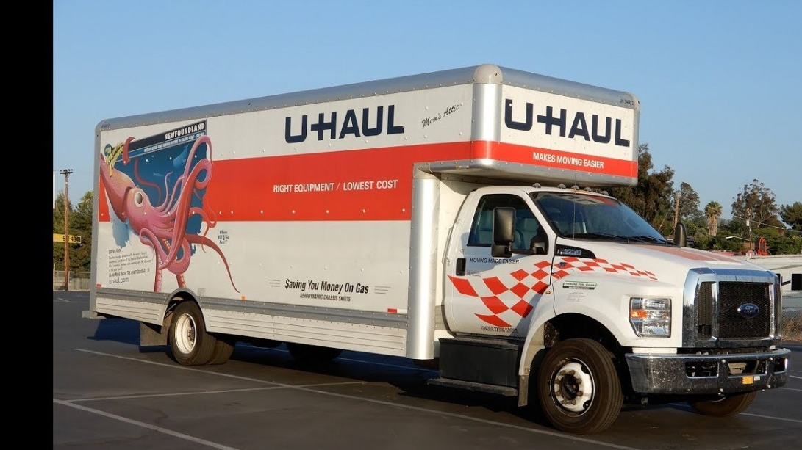
Tenant’s Rights Post-disaster: Eviction and Repair
If you have to move out while repairs are
being made, you are not required to pay
rent for the time that you are not living in
the home. You will typically be responsible
for your living expenses, including rent
elsewhere, while repairs are being made.
FEMA may be able to assist you with rental
costs while you are displaced
This Photo by Unknown Author is licensed under CC BY-NC

Slide 35
Tenant’s Rights Post-disaster: Eviction and Repair
Your landlord can evict you for failing to
pay rent that is due, even if you have been
affected by a disaster. If you are unable
to stay in the home or unable to pay your
rent, you should stay in contact with your
landlord to explain your situation and try
to reach an agreement
Notes:
Keep track of you communication. If possible, communicate via email and text in order to have evidence of the communication.

Slide 36
Tenant’s Rights Post-disaster: Eviction and Repair
In general, your landlord is not responsible
for damage to your belongings caused by
the natural disaster. If you have renter’s
insurance for your property, you should
file a claim. You should also take pictures
of all damaged property

Slide 37
Tenant’s Rights Post-disaster: Eviction and Repair
If you want to move due to damage to your home, or if your landlord continues to charge you rent without completing repairs, we recommend that you contact an attorney to ensure that your rights are protected. You can call the Legal Aid NC helpline to learn if you can get free assistance
1-866-219-5262

Slide 38
Fema
If you have been affected by a federally declared disaster, you may qualify for disaster assistance through FEMA’s Individuals and Households Program. You should apply to
FEMA as soon after the disaster as possible, and generally, you must apply within 60 days of the disaster.

Slide 39
Fema
FEMA can provide money for home repairs; temporary rental assistance; medical, dental
and funeral expenses; vehicle repair or replacement; repair or replacement of essential
household items; and other essential expenses related to the disaster

Slide 40
Fema
To apply for FEMA assistance, you can:
• Go to www.DisasterAssistance.gov
• Call 1-800-621-3362 or TTY 1-800-462-7585
• Apply in person at a FEMA Disaster Recovery Center

Slide 41
Fema
You should save receipts showing how you spent the money for at least three years after you receive it. FEMA may ask you for proof that the money was spent as intended. If you receive money for home repair, but it is not enough to complete all repairs on your home, you should keep your receipts until all repairs are completed so that you can show proof of how you spent the FEMA money to any other organizations assisting you

Slide 42
QUESTIONS?
Thank You!

