Slide 1
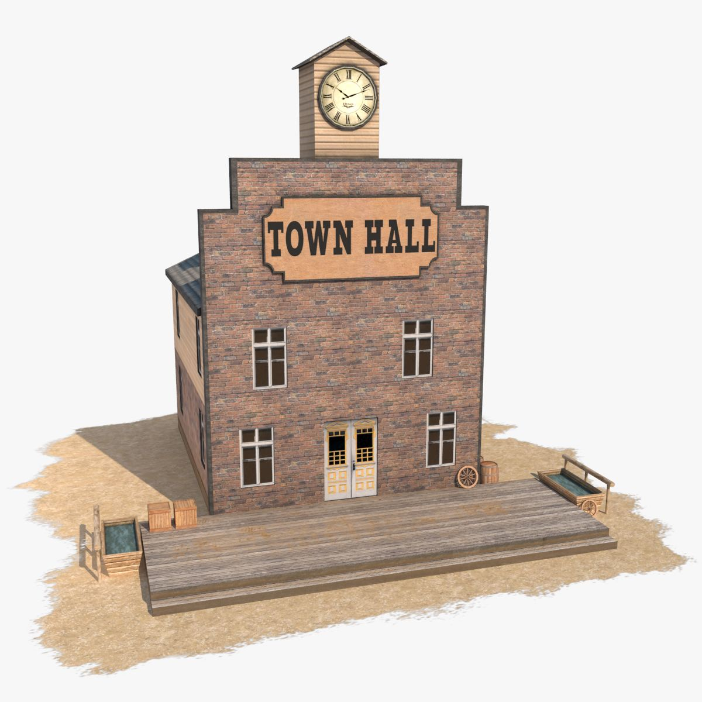
Title
Division of Purchase and Contract Town Hall
August 11

Slide 2
Objective
The objective of these meetings is to inform State Agencies and Entities about Statewide Term Contract (STC) Awards, Updates or Changes. Additionally, these meeting will provide opportunities for you to present questions to the P&C Contract Management Team.

Slide 3


Purchase & Contract
Contract Management Team
Jack Alspaugh,
Contract Manager
Ian Fox,
Contract Manager
Pamela Case-Gustafson, Contract Manager
Melissa Pressley,
DSPO Contract Management
Carter Biggs,
Contract Manager
Deidra Jones, Agency Legal Consultant

Slide 4

Month 2026 Awarded Contracts
STC 8014B Promotional Items
STC3121A Interior, Exterior & Epoxy Paint and Supplies

Slide 5
STC8014B Overview
This is a mandatory Statewide Term Contract for state agencies, departments, institutions, universities, and community colleges – unless exempted by the North Carolina General Statute. Non-mandatory entities, including schools and local government, may use this contract if allowed by general statute.
The term of the contract is July 1, 2026 to June 30, 2029.​
Commodity Codes for eProcurement: 80141605 + 80140000
Categories: Apparel, Bags & Totes, Drinkware, Writing Instruments, Award & Recognition Gifts, Misc Promotional Merchandise

Slide 6

Meet the Vendor…
Covered Categories
Apparel
Bags & Totes
Drinkware
Writing Instruments
Award & Recognition Gifts
Misc Promotional Merchandise
“You’ll shine. We’ll make certain.”
Scale & Speed
360° Guarantee
Dedicated Team
Explore a wide selection of promo products, perfectly printed and guaranteed to arrive on time – visit 4imprint.com
Certain delivery
Certain value
Certain happiness
Every order backed by our promise — if something isn't right, we make it right. No questions asked.
Led by Karla Kohlmann (35yrs) and Jen Groskreutz (27yrs) — government & institutional experience.
specialmarkets@4imprint.com (888) 234-5797
State of North Carlina Statewide Contract Introduction

Slide 7

Meet the Vendor…
Small business in Black Mountain, NC (NCSBE application processing)
Dedicated Account Manager
Our team has over 100 years combined industry experience
Rapid response time
No charge for product research, basic design layout or proofs.
Access to millions of products, including some brands not available to the entire industry.
Apparel – Bags & Totes – Drinkware – Writing Instruments – Awards- Misc Promotional Merch (including print)
Sales@barefootswag.com
Rhonda@barefootswag.com
Britni@barefootswag.com
828-357-8345
www.barefootswag.com

Slide 8

Meet the Vendor…
Covered Categories
Apparel
Bags & Totes
Drinkware
Writing Instruments
Award & Recognition Gifts
Misc Promotional Merchandise
“You think it, we ink it.”

Slide 9

Meet the Vendor…
Covered Categories
Bags & Totes
Drinkware
Writing Instruments
Misc. Promotional Merchandise
Used for events, outreach, recognition, recruiting, schools, departments, and campaigns.
North Carolina-Based Support and Account Management
Product & Branding Guidance
More Than Promo – Office Supplies (4412A) and Office Paper (1412A)
Simple Ordering Process:
Browse or Ask for Help → Request a Quote → Approve & Order → Review Digital Proof

Slide 10


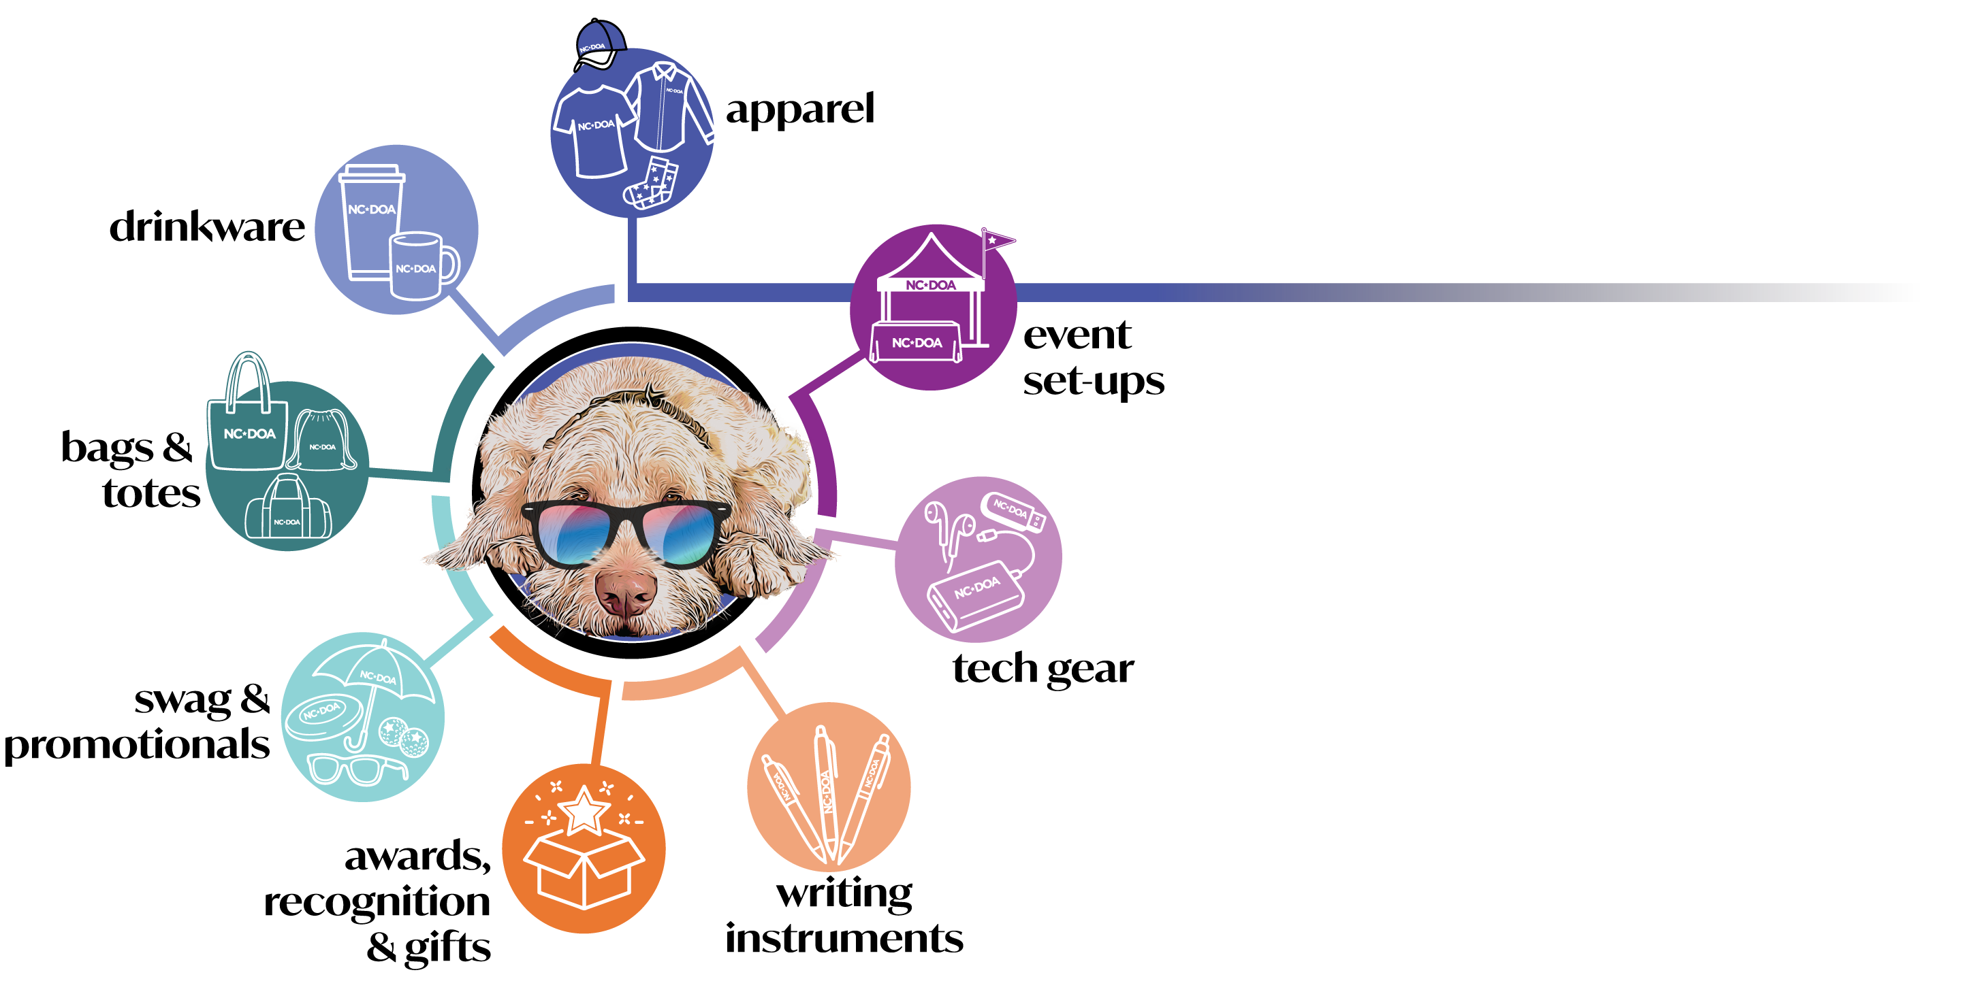

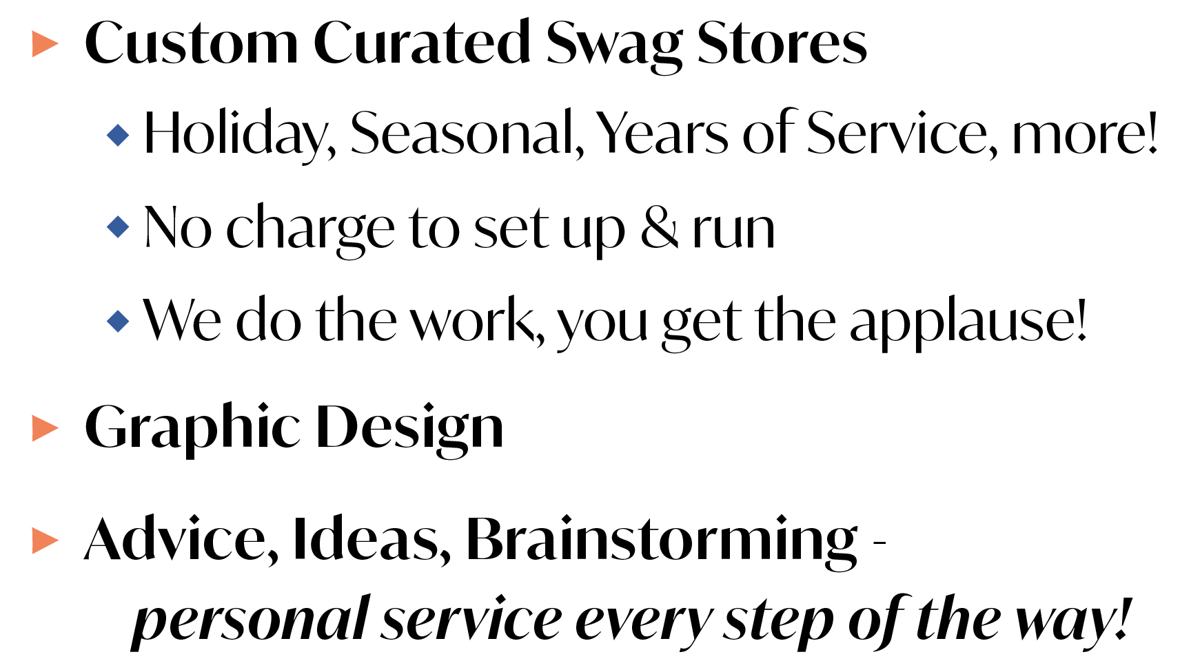

Slide 11

Meet the Vendor…
Covered Categories
Apparel
Bags & Totes
Drinkware
Writing Instruments
Award & Recognition Gifts
Misc Promotional Merchandise
“Business Solutions That Simplify How You Work”

Slide 12

Mission Statement
To provide the highest quality experience possible to our clients through the research, production, and on-time delivery of any logoed item they desire.
Value Added Services
High-touch, single point of contact throughout the order process
Same-day or next-day quote turnaround
Rush order capability
Same attention given to small order requests as to large order requests
Domestic and direct-import production
Full-service provider, starting from art creation through fulfillment
Well-financed, capable of handling multi-million dollar orders
Print-on-demand capabilities
Every category of promotional product, wearables, and award products provided, including custom-designed products
47 years in business — Progressive Marketing has established long-term relationships with industry suppliers that greatly improve and support our ability to perform and resolve any issues

Slide 13

Meet Tiffany Saur from Soar Promo
Helping North Carolina agencies SOAR.
Common Challenges
Why Soar Promo?
$
LIMITED BUDGET
01
DIRECT FACTORY SOURCING
SAVE 30%+
◷
TIGHT TIMELINE
02
GOVERNMENT EXPERIENCE
?
WHAT TO ORDER?
03
OWNER-LEVEL SERVICE
YOUR NEXT PROJECT. LET’S SOAR.

Slide 14

Meet the Vendor…
Covered Categories
Apparel (Decorated)
Bags & Totes
Drinkware
Writing Instruments & Stationary
Award, Trophies, & Recognition Gifts
Custom Created Merchandise
Other (Tech, Office/Desk, Home, Health & Wellness)
Services (Kitting, Warehousing & Fulfillment)
Pop-up Stores (aggregate group orders)

Slide 15

Meet the Vendor…
Covered Categories
Apparel
Bags & Totes
Drinkware
Writing Instruments
Award & Recognition Gifts
Misc Promotional Merchandise
“Promotional Products | Marketing Solutions”

Slide 16

More than promotional products.
We manage the program.
Three things to remember about Uniforms Today:
1
2
3
LOCAL
ACCESS
IN-HOUSE APPAREL
MANAGED PROGRAMS
EMPLOYEE-LEVEL FULFILLMENT
Sales leader
in South
Carolina
Decoration + customization.
Not just one-off orders.
We handle the operational headache.
Embroidery, screen printing, custom apparel and on-site seamstresses — with greater control over quality, fit and production.
Recurring needs across the year — uniforms, back-to-school, recruiting, new-hire kits, recognition, outreach and department programs.
Packed by individual employee, department, location or program — ready to distribute or ship.
Virginia
fulfillment
TWO PLATFORMS. SAME
MANAGED PROCESS.
Uniforms Today
ePromosToday.com
Pens & drinkware → bags & awards →
event merchandise
Uniforms + branded/custom apparel
programs
Promo apparel + merchandise
Product + decoration + customization + packing + fulfillment — from start to finish.
Dan Berkowitz | dan.berkowitz@uniformstoday.com
Notes:
Good afternoon, everyone.
Since we're the last company presenting, I'll keep this simple. You've already heard a lot about promotional products, so instead of another product list, I want to leave you with three things that make Uniforms Today different.
First, apparel is a major part of our business, and we handle decoration and customization in-house - including embroidery, screen printing, custom apparel, and on-site seamstresses. That gives us greater control over quality, consistency, fit, and production.
Second, we specialize in managed programs, not just one-off orders. We can help with a single event, but we really add value when needs continue throughout the year - uniforms, back-to-school apparel, recruiting merchandise, new-hire kits, employee recognition, public outreach, and appreciation programs.
Third, we handle the fulfillment. For larger employee orders, we can sort and pack by individual employee, department, location, or program, so your staff does not have to receive boxes and sort everything internally.
We support this through two dedicated platforms using the same managed process. Uniforms Today supports uniforms, branded and custom apparel, and ongoing apparel programs. ePromosToday.com supports promotional apparel and merchandise - from writing instruments and drinkware to bags, awards, event products, and everything in between.
For larger programs, we provide dedicated account-management support. Much of our fulfillment is handled through our Virginia warehouse, and we have a sales leader based in South Carolina when face-to-face support is helpful.
So whether you need 50 embroidered polos, custom apparel, or a statewide employee program, we can handle the product, decoration, customization, packing, and fulfillment from start to finish.
That's where Uniforms Today is different. Thank you.

Slide 17
STC3121A Overview
This is a mandatory Statewide Term Contract for state agencies, departments, institutions, universities, and community colleges – unless exempted by the North Carolina General Statute. Non-mandatory entities, including schools and local government, may use this contract if allowed by general statute.
The term of the contract is July 1, 2026 to June 30, 2031​
Categories: Interior, Exterior, Epoxy Paint and Supplies
Transportation is FOB Destination, no separate freight line charges allowed.

Slide 18

Meet the Vendor…
Covered Categories
Interior Paint
Exterior Paint
Epoxy Paint
Paint Supplies

Slide 19

Meet the Vendor…
Covered Categories
Interior Paint
Exterior Paint
Epoxy Paint
Paint Supplies
Pittsburgh Paints Company

Slide 20


Q&A

